Slide 1

SURVEY
TIME!

Slide 2
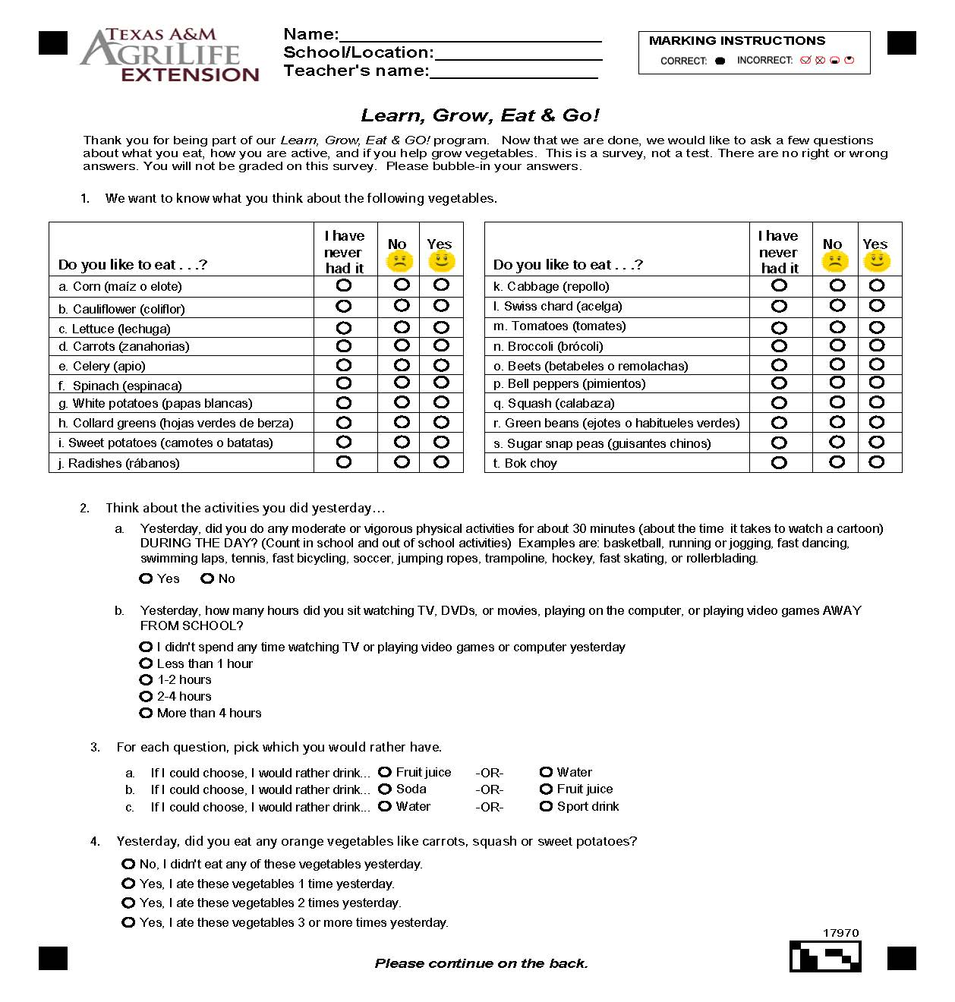

Do you like CORN?

Slide 3
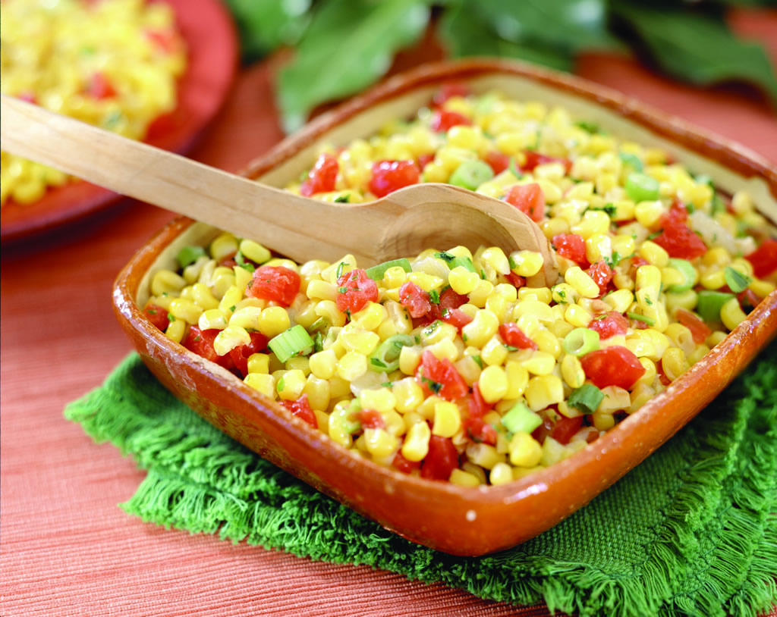
Corn

Slide 4
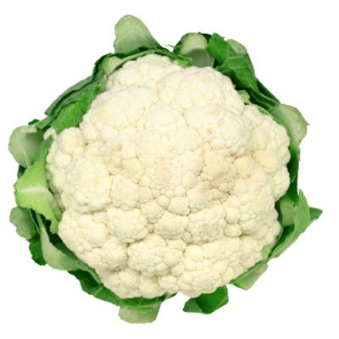
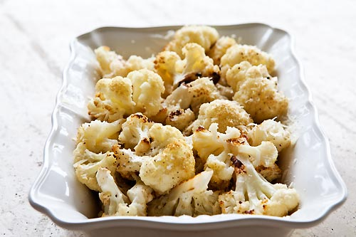
Cauliflower

Slide 5
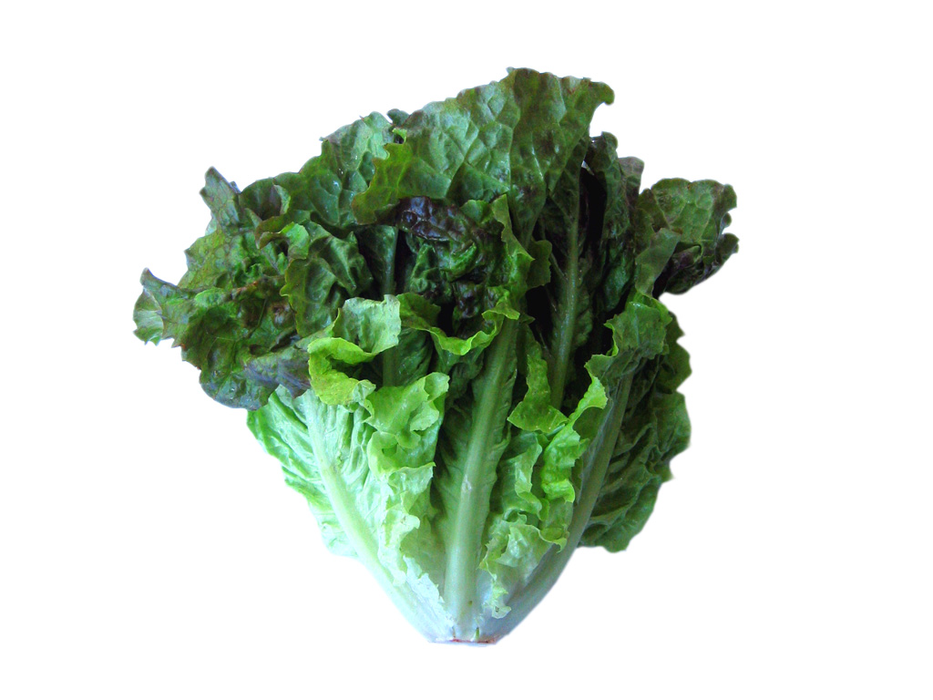
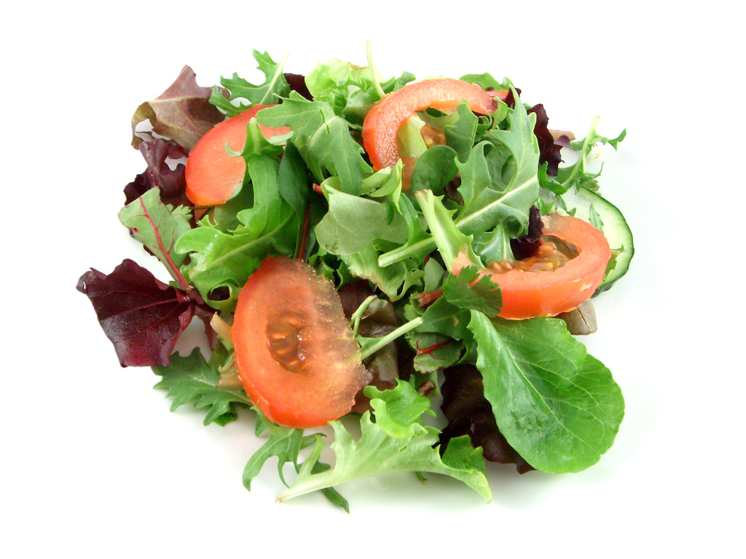
Lettuce

Slide 6
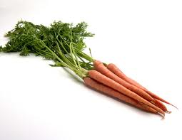
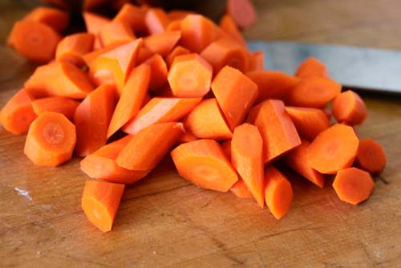

Carrots

Slide 7
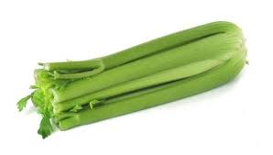
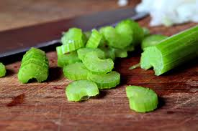
Celery

Slide 8
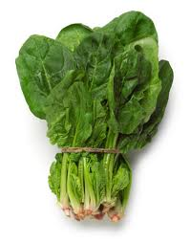
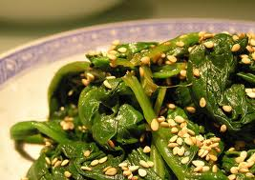
Spinach

Slide 9
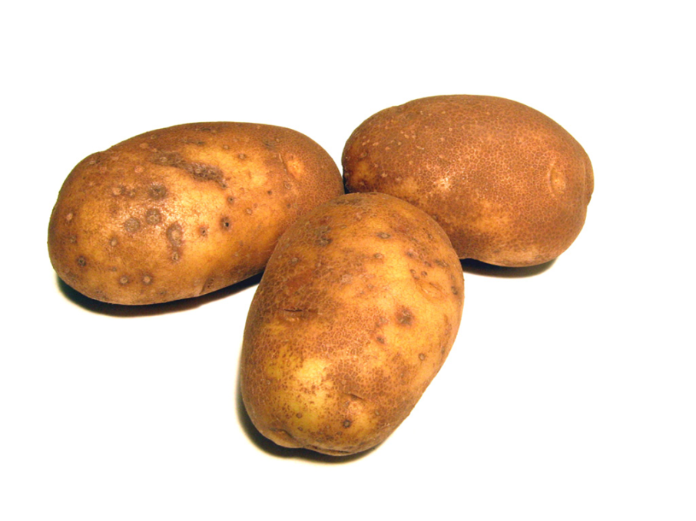
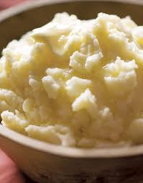
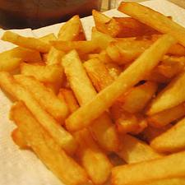
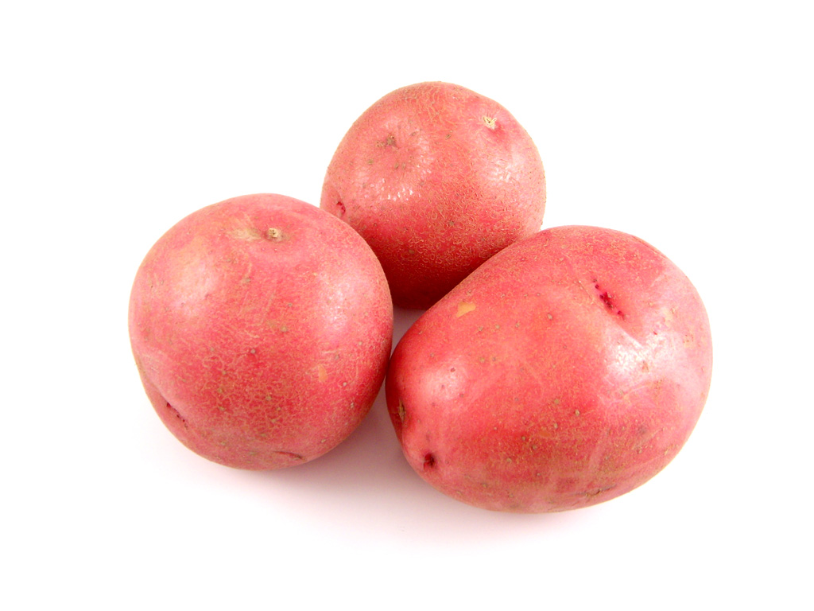
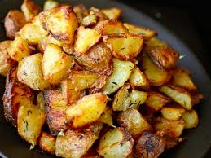
White Potatoes

Slide 10
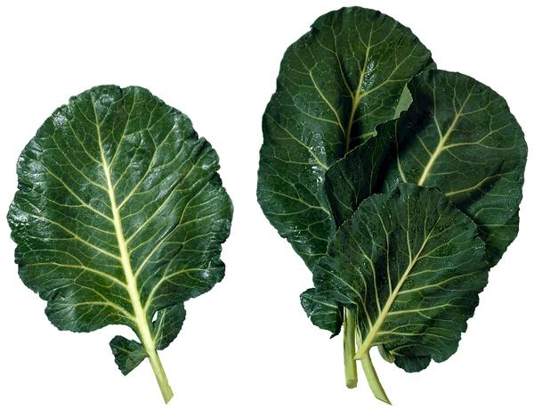
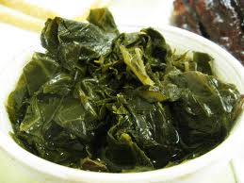
Collard Greens

Slide 11
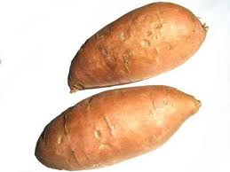
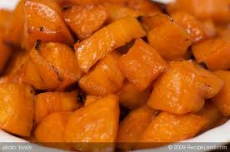
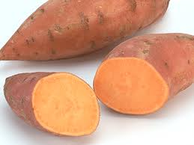
Sweet Potatoes

Slide 12
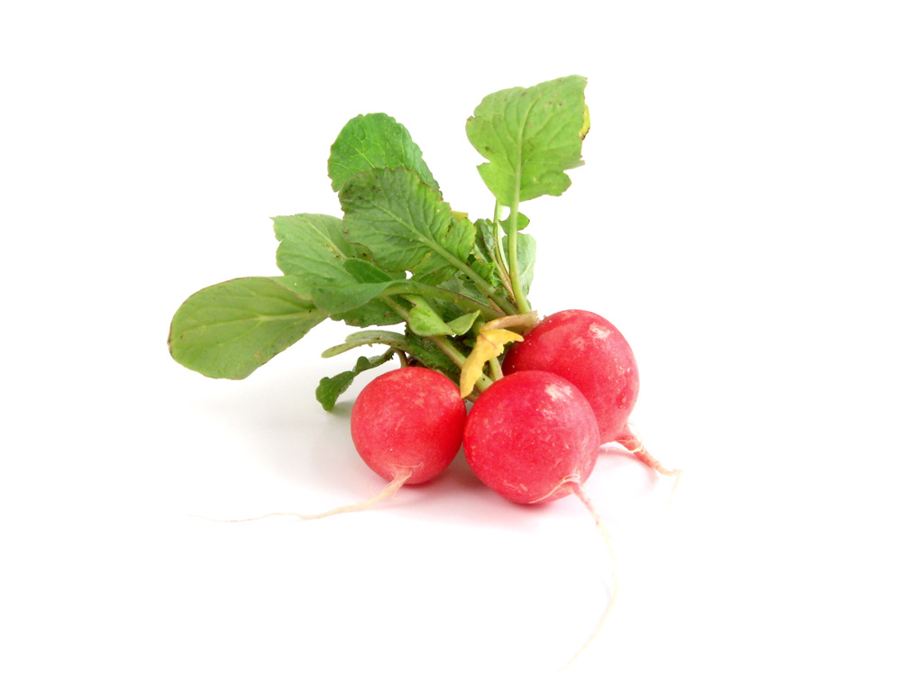
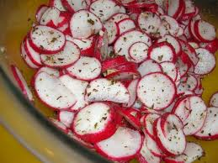
Radishes

Slide 13
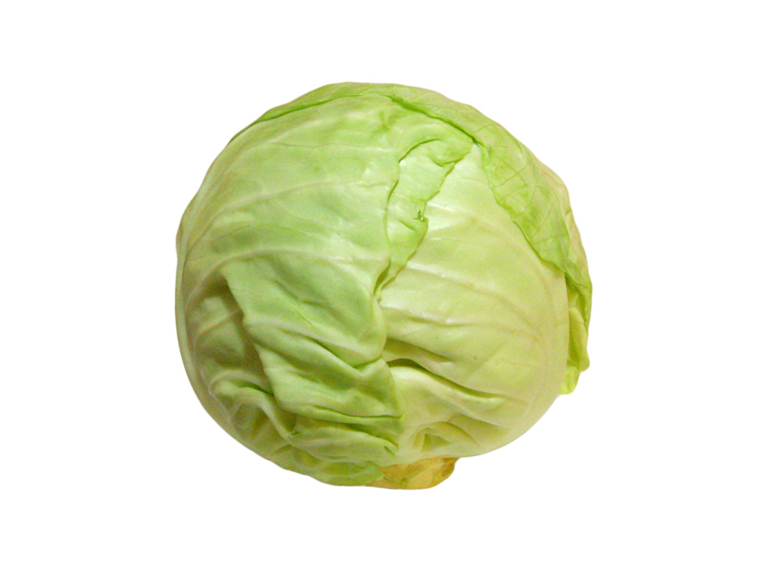
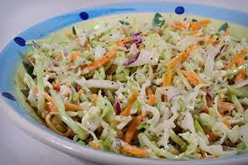
Cabbage

Slide 14
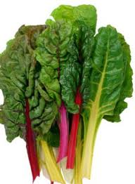
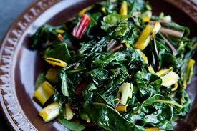
Swiss Chard

Slide 15
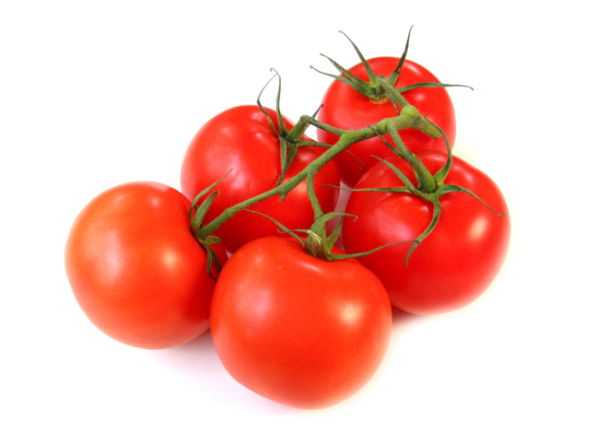
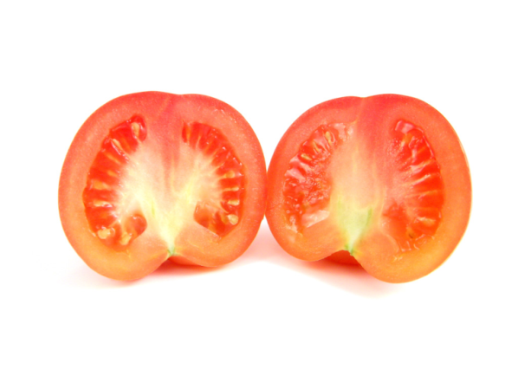
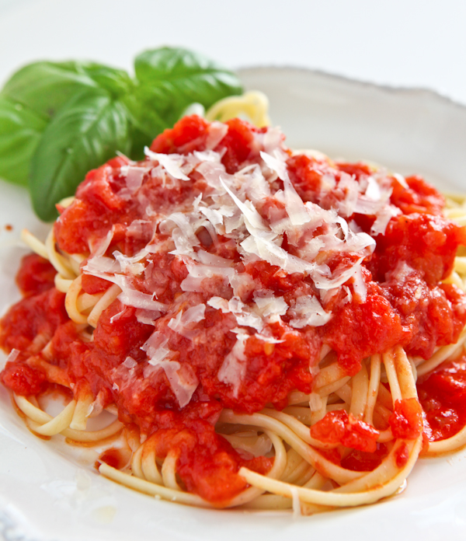
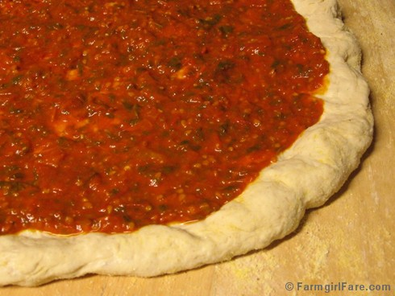
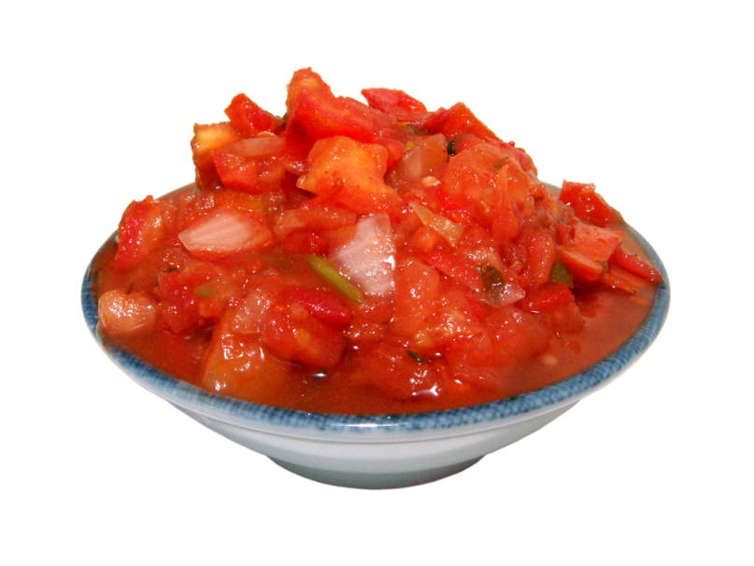
Tomatoes

Slide 16
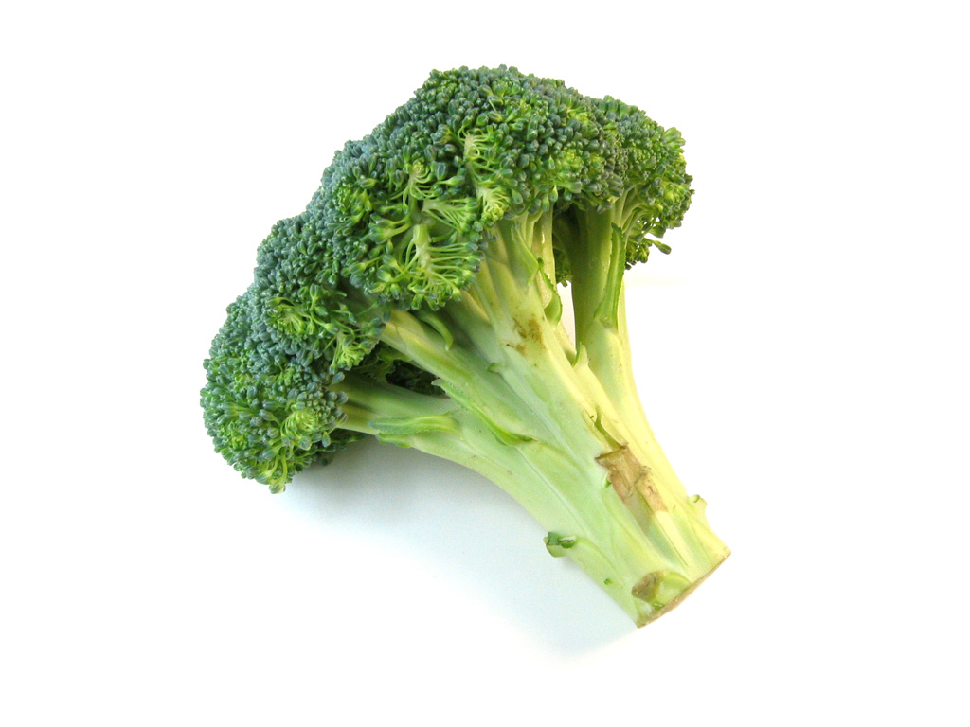
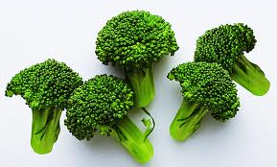
Broccoli

Slide 17
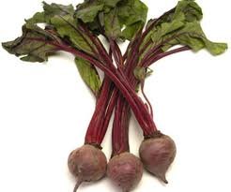
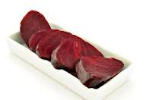
Beets

Slide 18
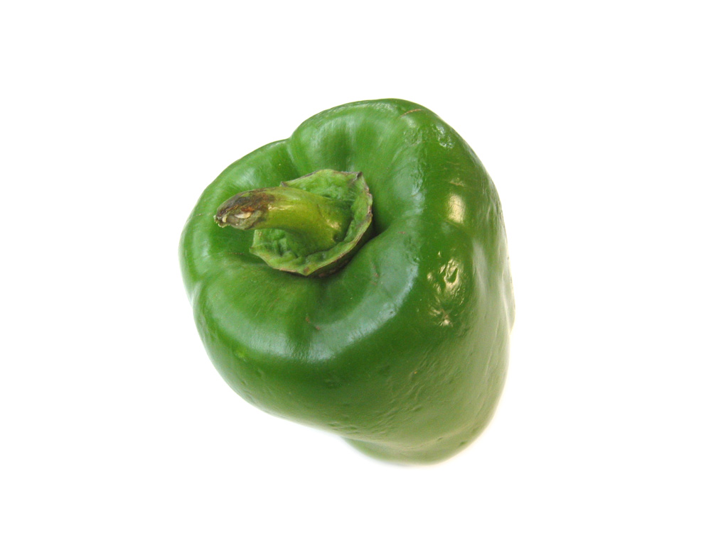
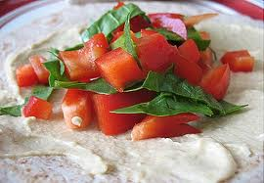
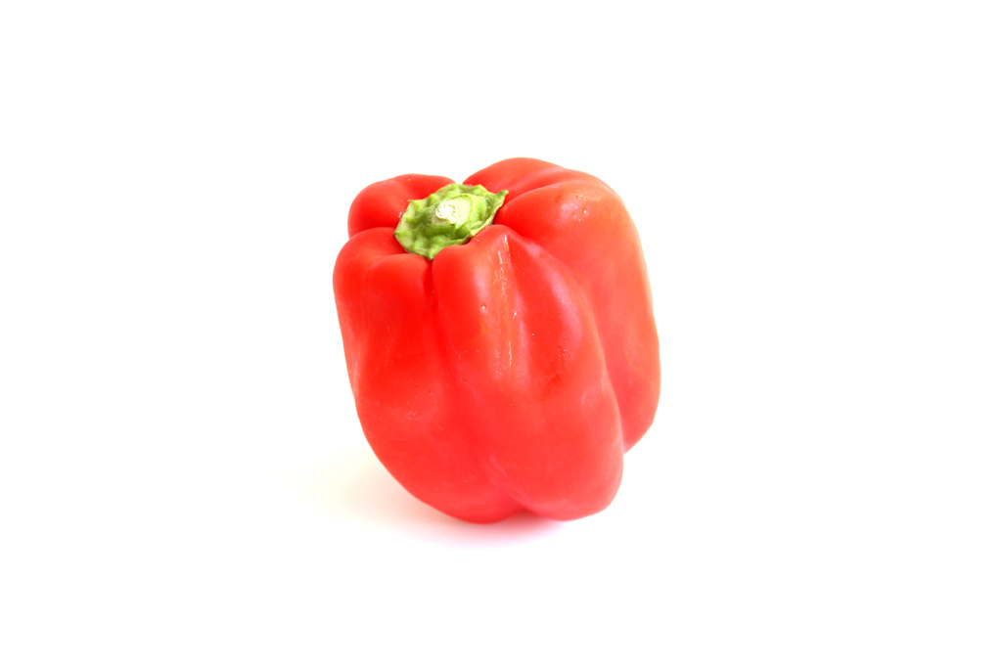
Green or Red Bell Peppers

Slide 19
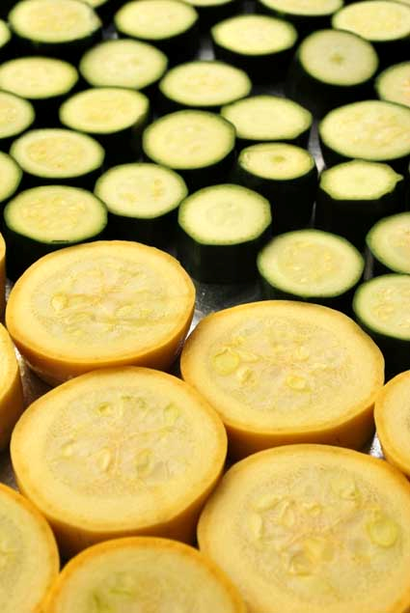
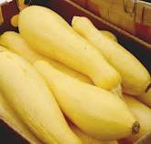
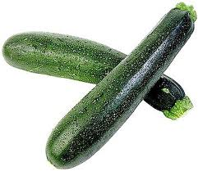
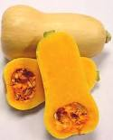
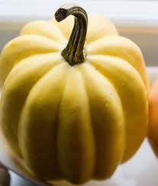
Squash

Slide 20
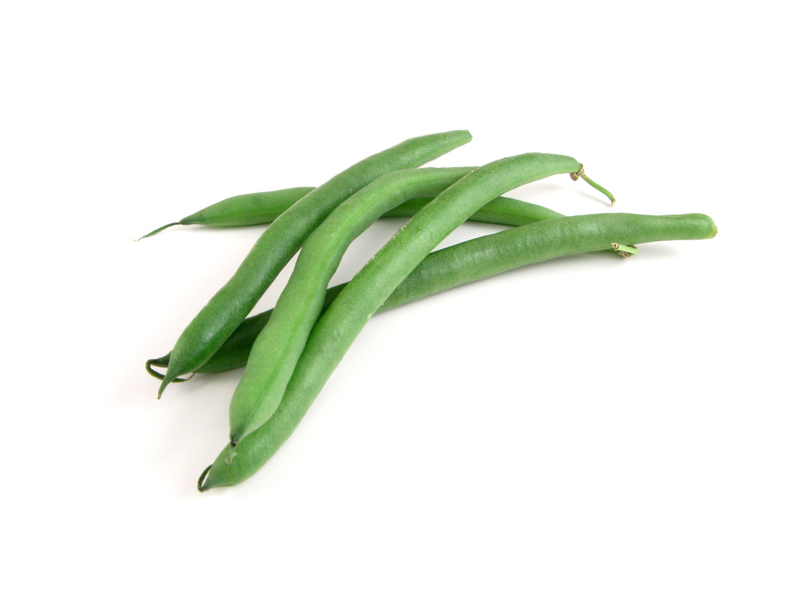
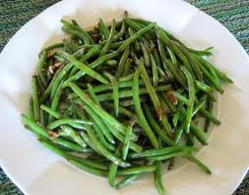
Green Beans

Slide 21
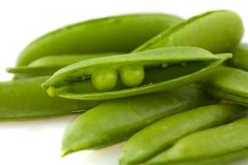
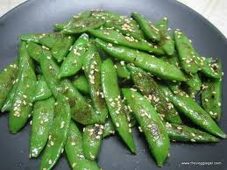
Sugar Snap Peas

Slide 22
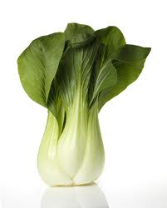

Bok Choy

Slide 23













Moderate or Vigorous Activities
YESTERDAY
Hiking
Playing tag
Dancing
Playing basketball
Jumping Rope
Running
Skateboarding
Bicycling
Shoveling dirt
Soccer
Swimming
Pushing wheelbarrow

Slide 24


YESTERDAY

Slide 25


Would you rather have…
OR

Slide 26

Would you rather have…
OR

Slide 27

Would you rather have…
OR

Slide 28
YESTERDAY
Did you eat any orange vegetables like carrots, squash, or sweet potatoes?

Slide 29
YESTERDAY
Did you eat a salad made from lettuce, or any green vegetables like spinach, collard greens, Swiss chard, green beans, sugar snap peas, broccoli, or other greens?

Slide 30

YESTERDAY
Did you eat any beans like pinto, garbanzo or kidney beans?

Slide 31


YESTERDAY
Did you eat any other vegetables like tomatoes, asparagus, red cabbage, cauliflower, cucumbers, mushrooms, green and red bell peppers, eggplant, or celery?

Slide 32





YESTERDAY
Did you eat fruit? Fruits are all fresh, frozen, canned or dried fruits. DO NOT COUNT fruit juice.

Slide 33


In the last year…

Slide 34
Question 11

Slide 35

You’re done!
GREAT JOB!
THANK YOU!!!

