Slide 1


Notes:
There is a significant body of research showing the relationship between improving school performance, attendance, attachment and commitment, and the development of pro-social skills and leadership capacity related to increased physical activity and improved opportunities for project-based, hands-on or real life learning. LGEG is focused on getting children to participate in school activities where they can learn important science, math and language arts concepts and at the same time be more physically active, improve healthy eating habits and have fun. LGEG activities promote leadership and responsibility in children and, according to teacher surveys, have improved classroom participation.

Slide 2
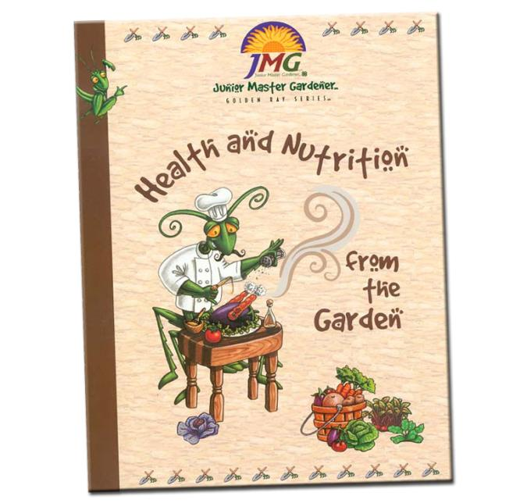
*early research substantiating real benefits to students/schools

Slide 3
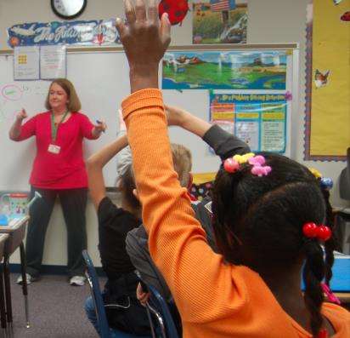


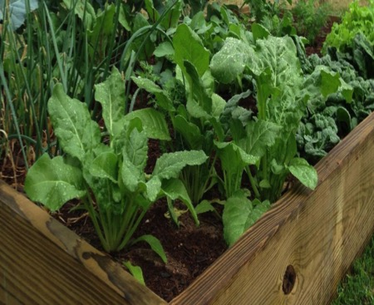

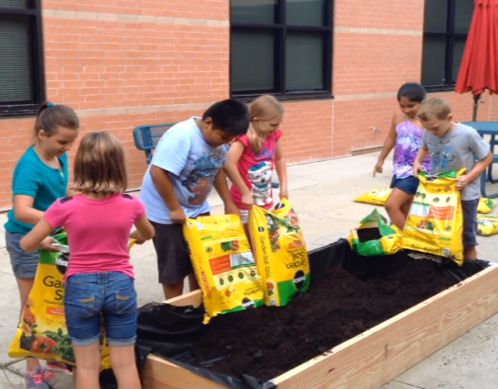


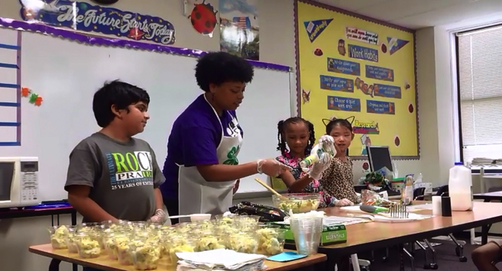
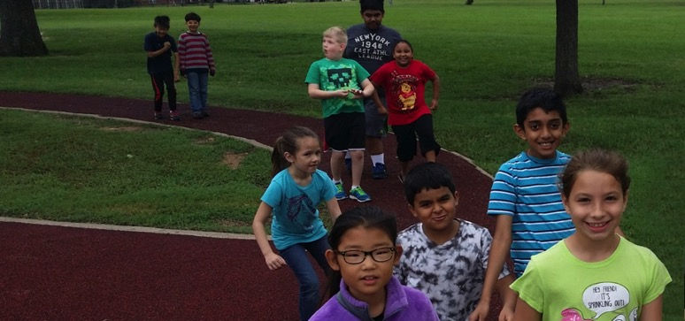



Slide 4

CURRICULUM DESIGN
10 weeks,
2 lessons/week
Sequence, integration,
pace, & flexibility

Slide 5
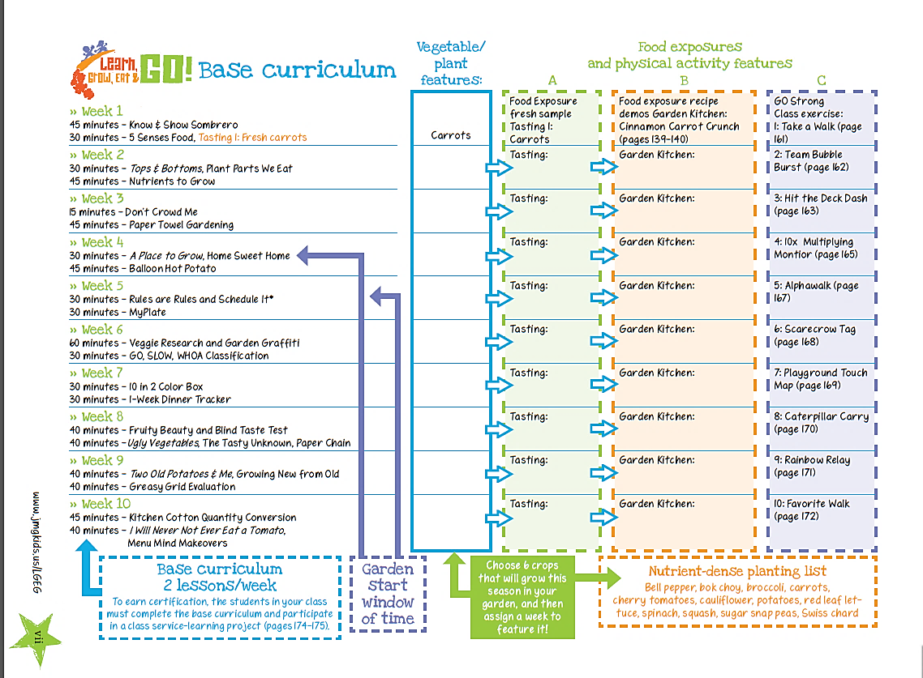

Slide 6
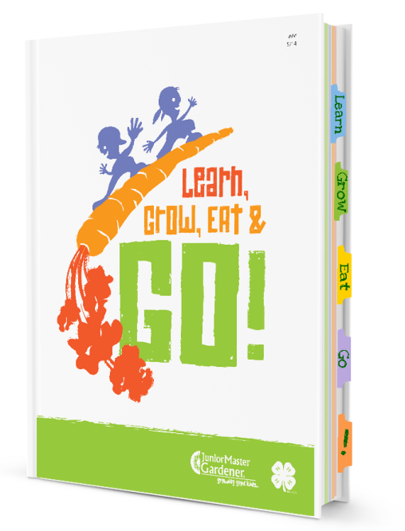

Slide 7
Activity Session
Know and Show Sombrero
WHERE TO FIND ME?
LGEG Manual
Week 1, page 2

Slide 8
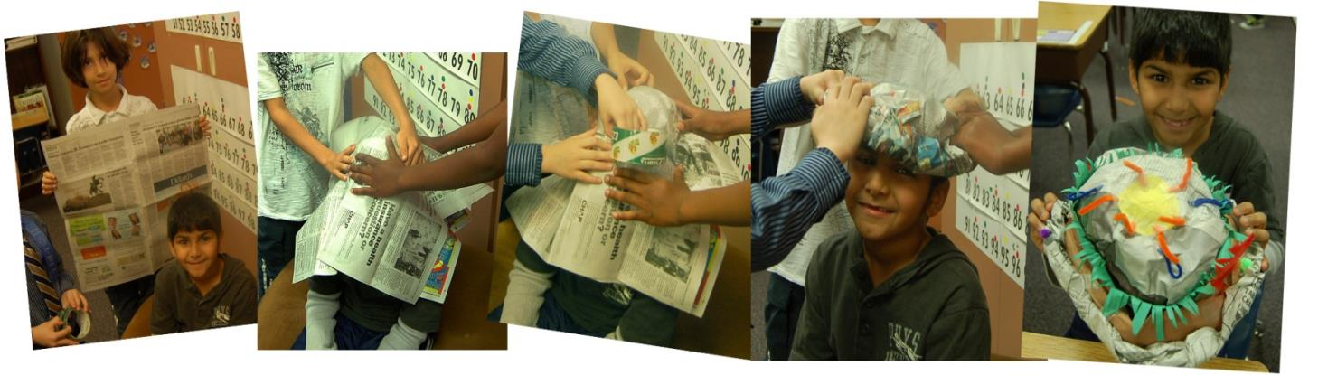
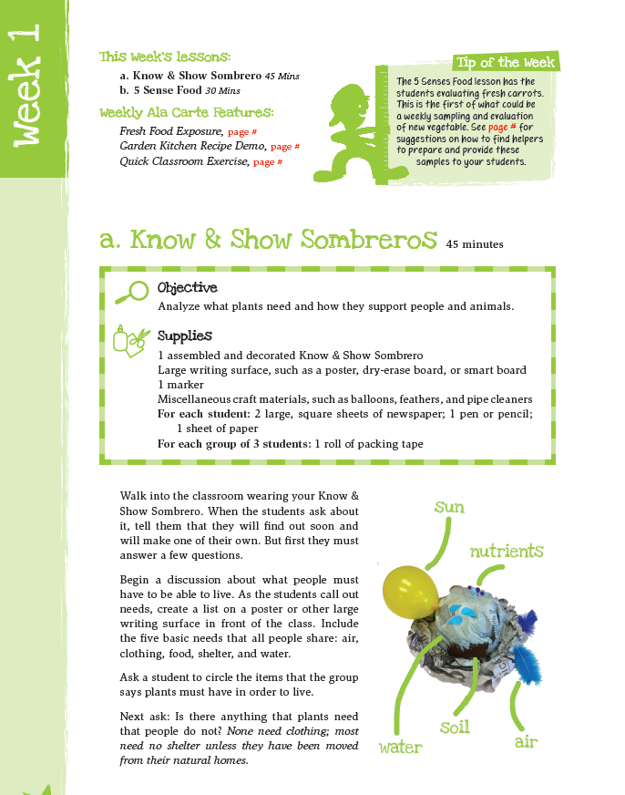
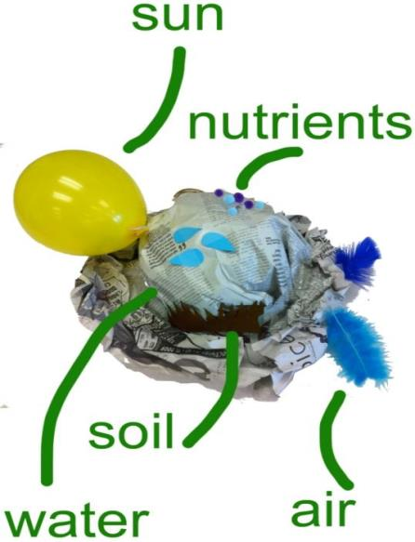
Plants need P.L.A.N.T.S.
P
L
A
N
T
S
lace
ight
ir
utrients
hirsty
oil
Notes:
Do know and show sombrero with participants

Slide 9
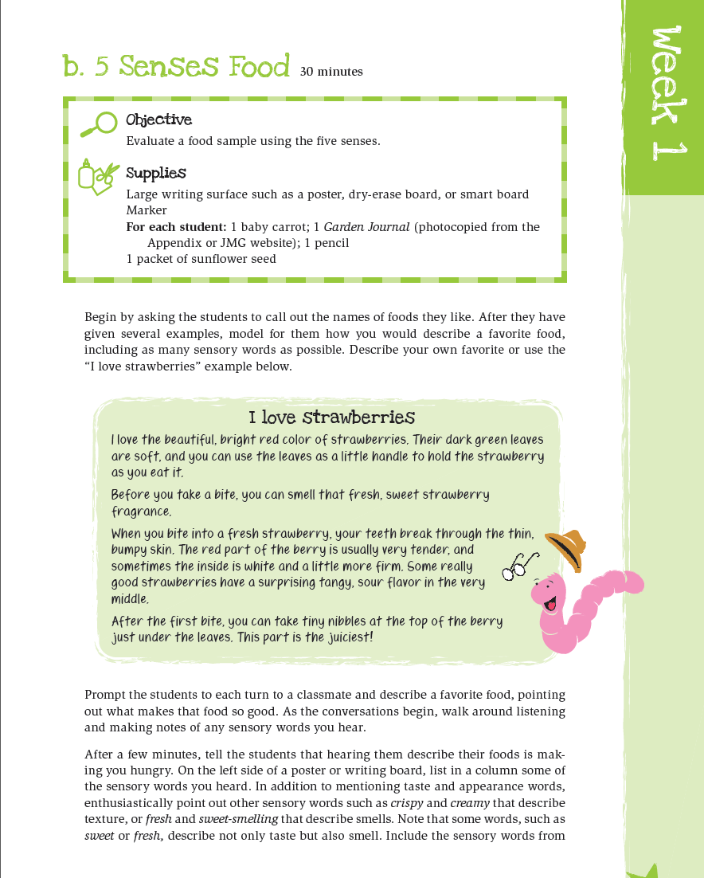




Slide 10

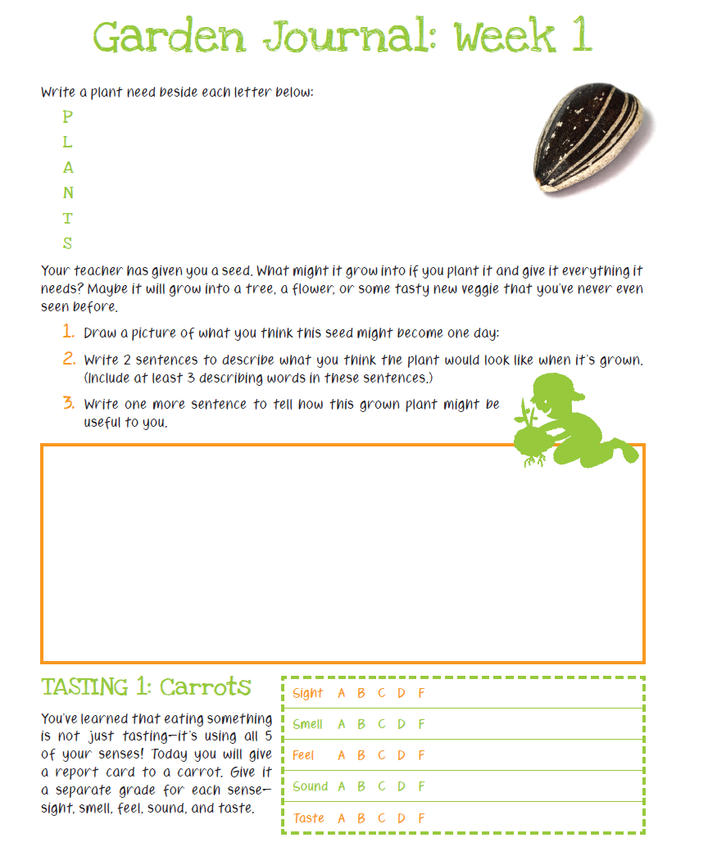


Slide 11

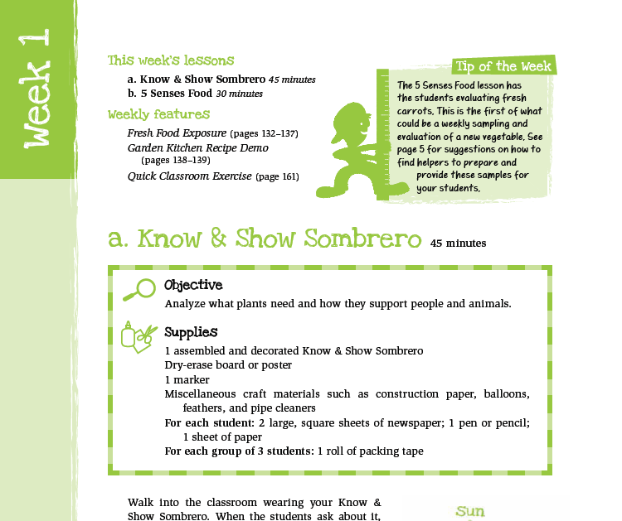

Know & Show Sombrero 45 mins
5 Senses Food 30 mins

Slide 12

first food exposures
- one bite fresh,
raw samples

Slide 13
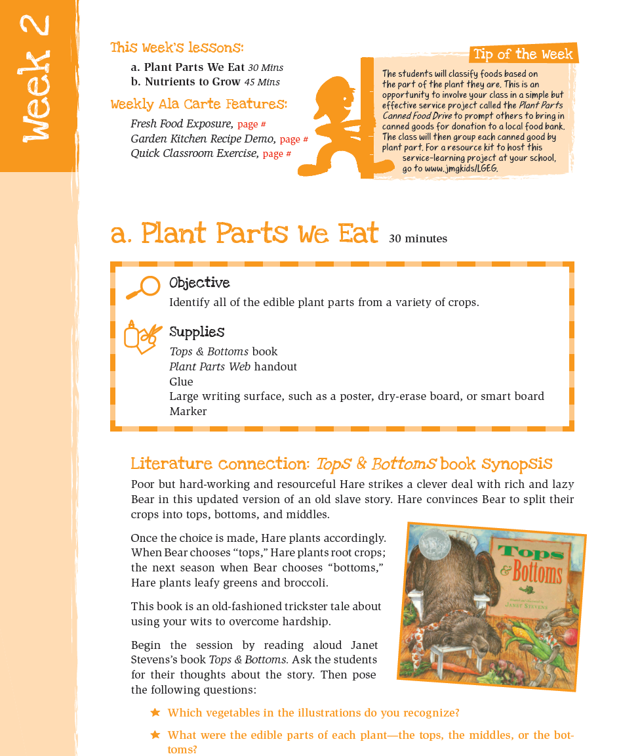




Slide 14


Slide 15
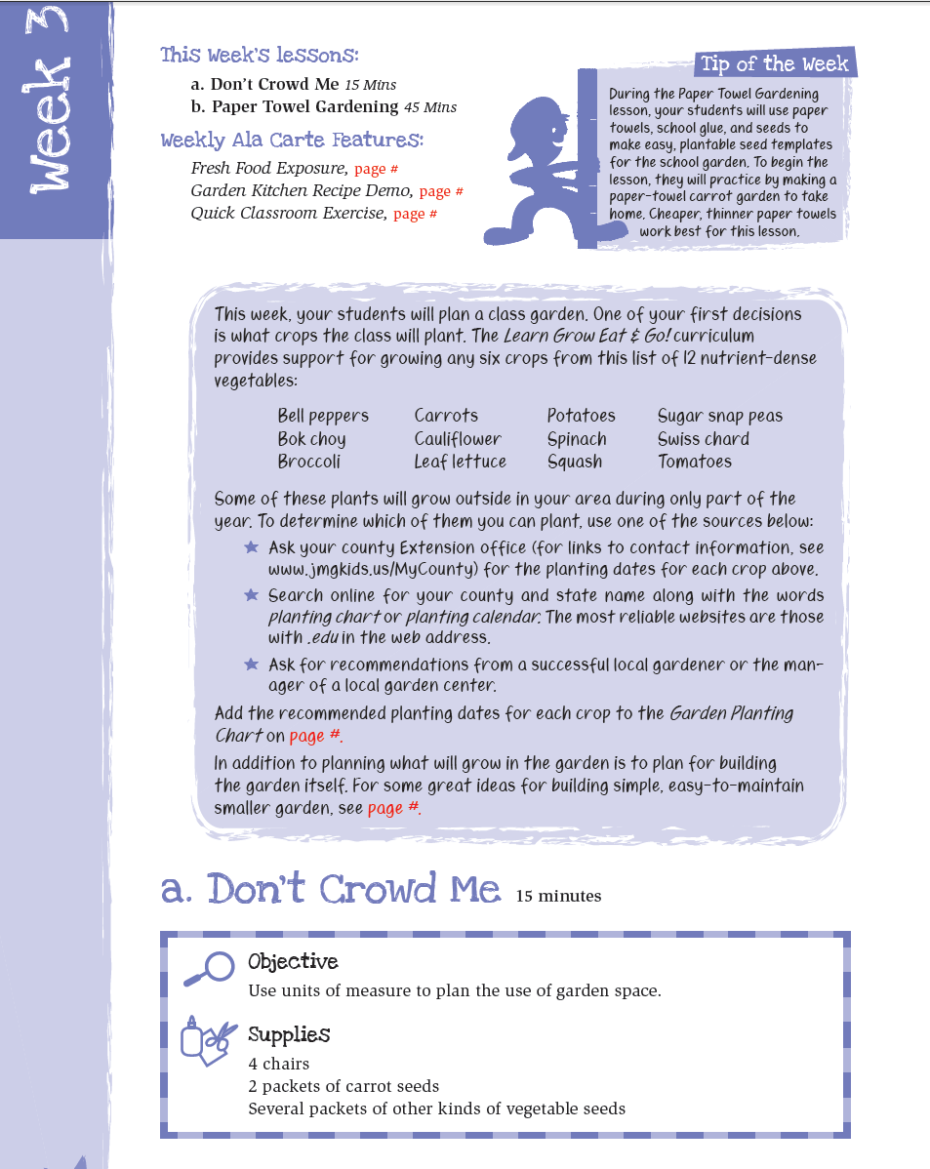



Slide 16
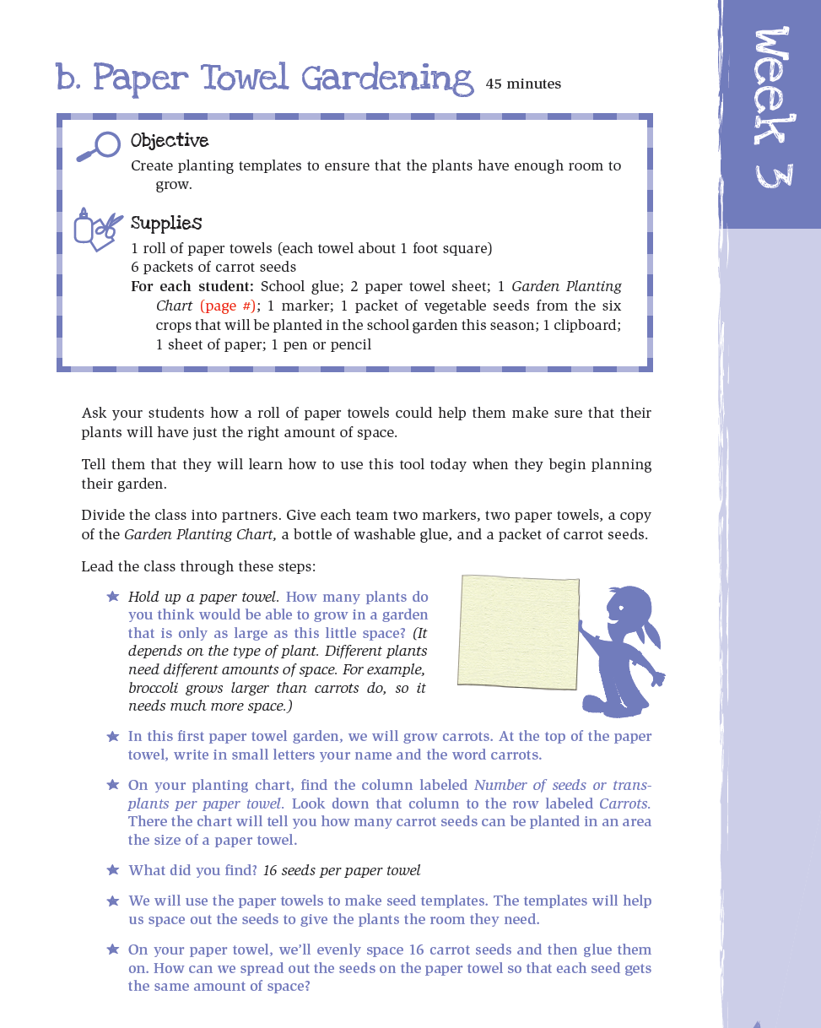
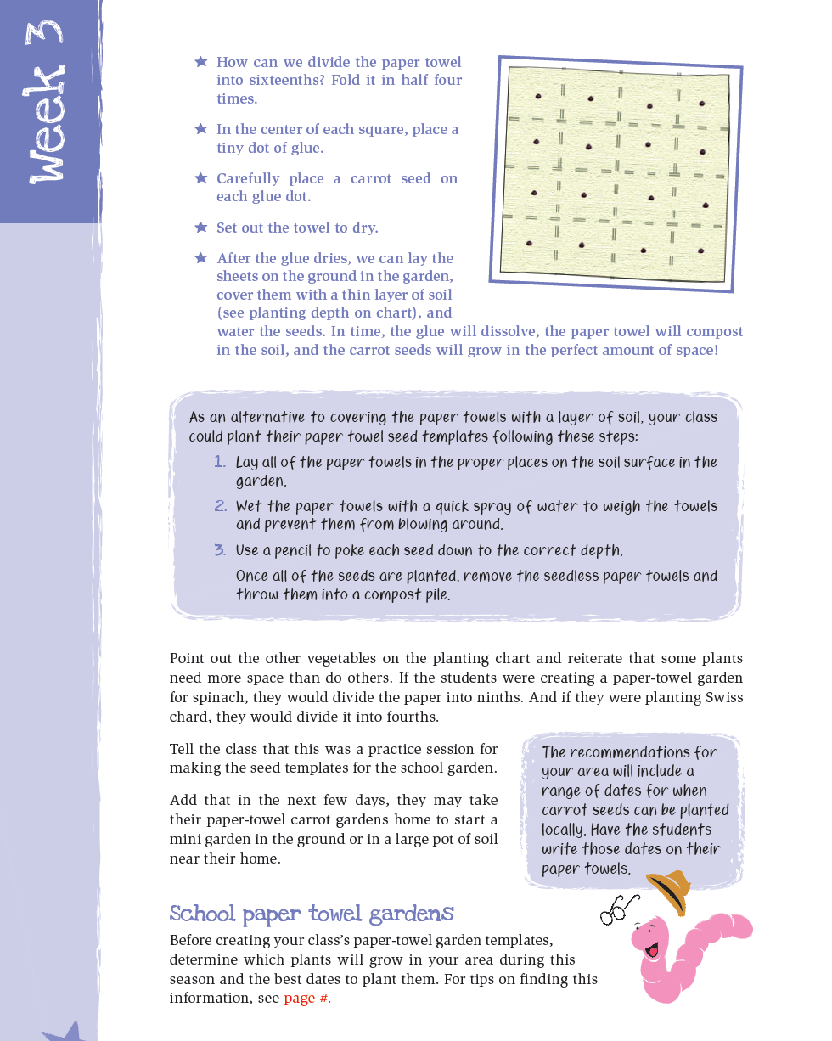

Slide 17

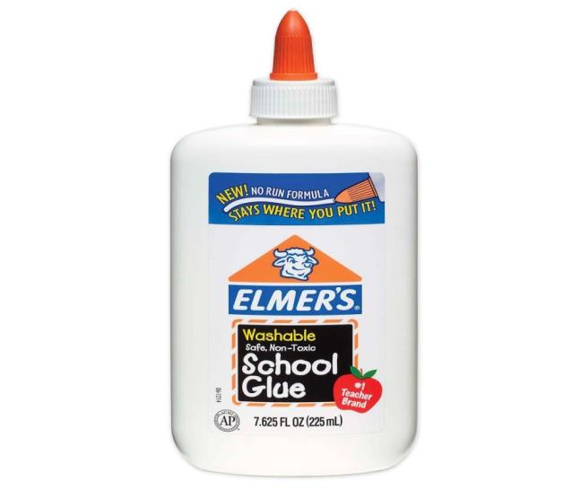
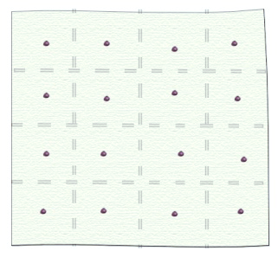

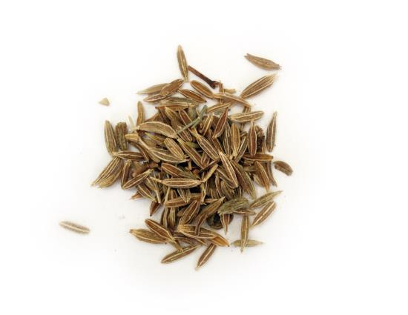

Slide 18







What don’t we just put 16
seeds & plants in every square?

Slide 19
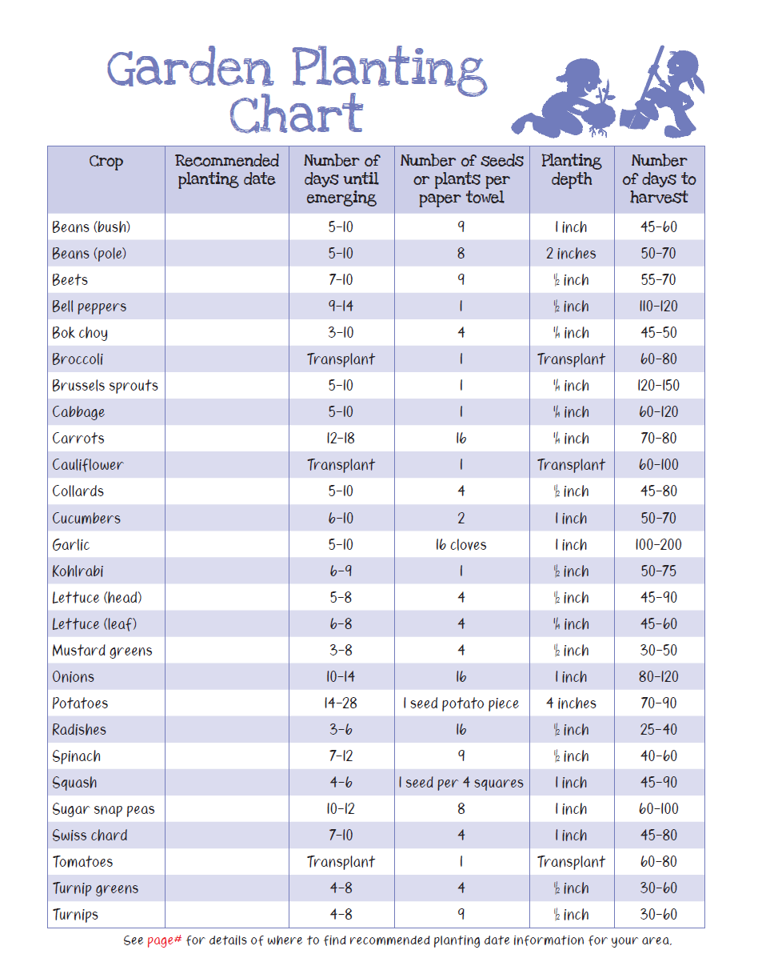

Local
Extension
support
provide
info on
your local
planting
dates

Slide 20
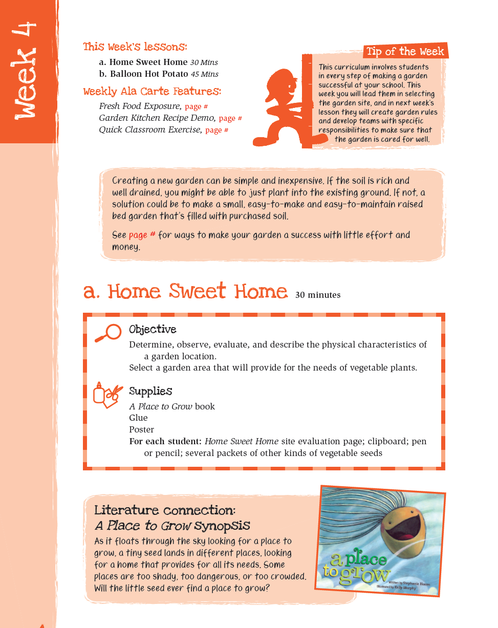


Slide 21
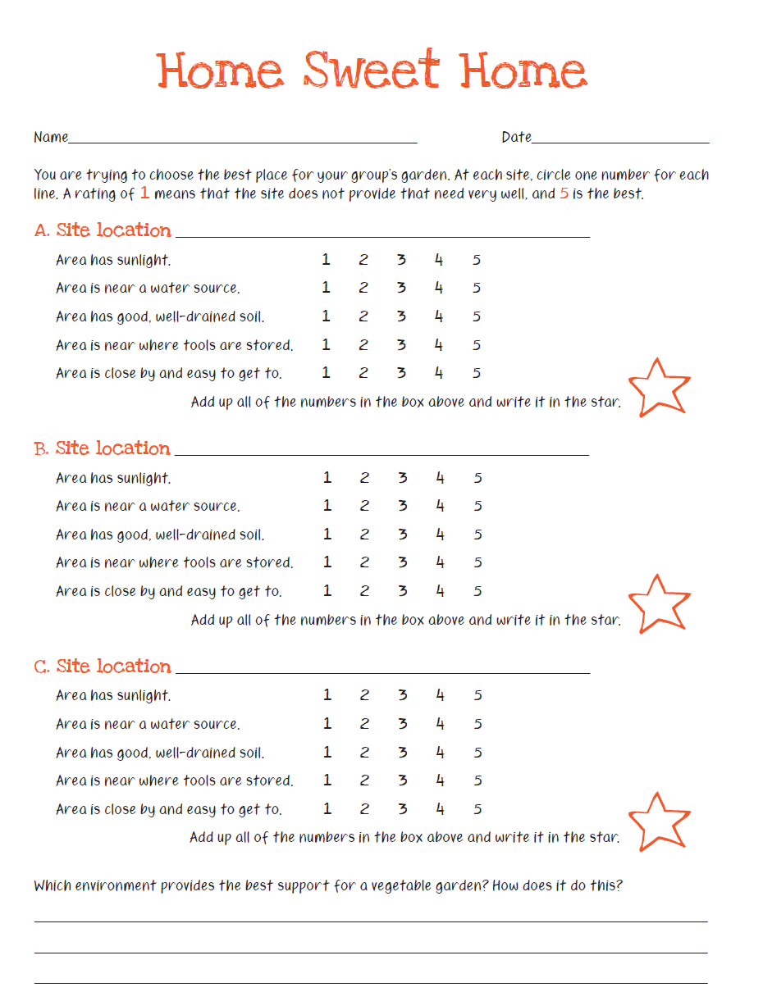


Slide 22
Activity Session
Home Sweet Home
WHERE TO FIND ME?
LGEG Manual
Week 4, page 28

Slide 23
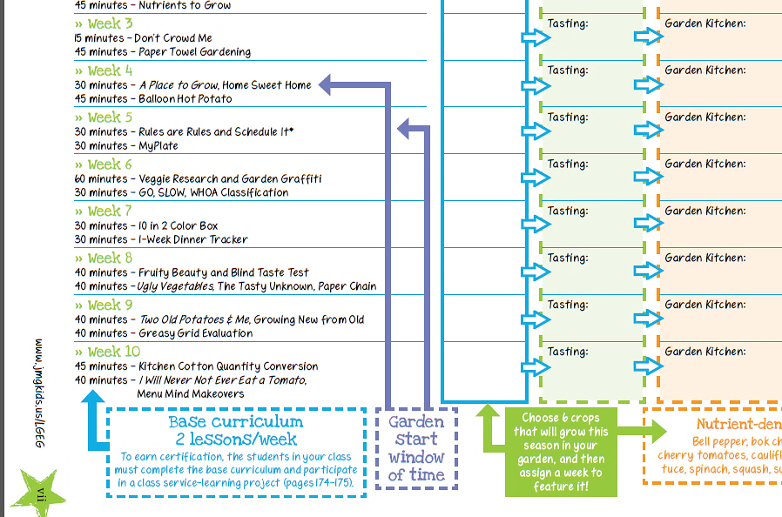
Soon after students evaluate & select the location in the Home Sweet Home lesson, the garden can be built.

Slide 24
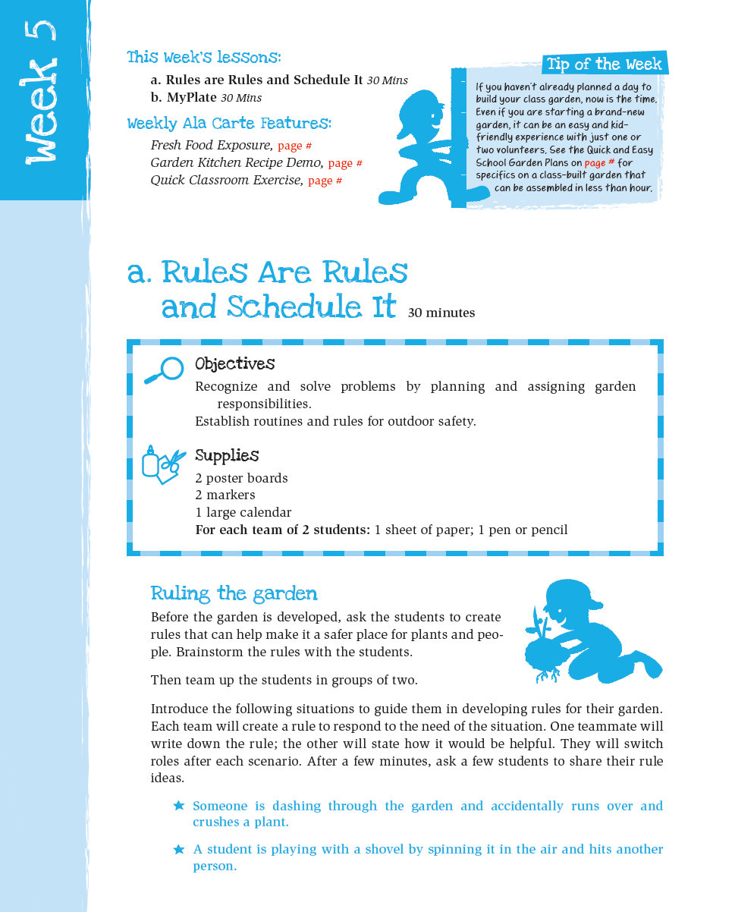
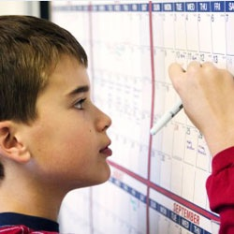

Slide 25

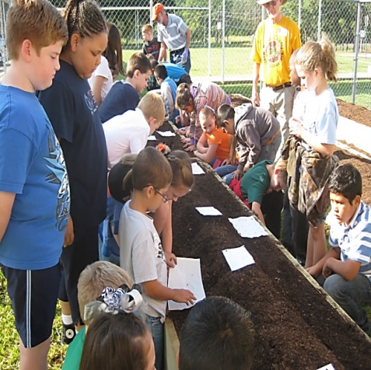
Starting
School Gardens

Slide 26
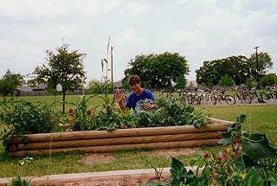
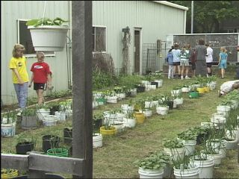
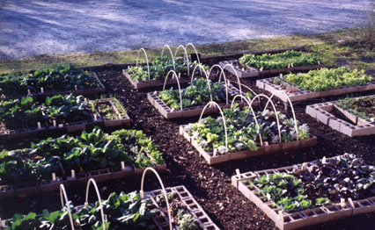
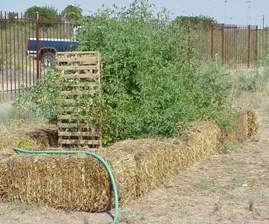
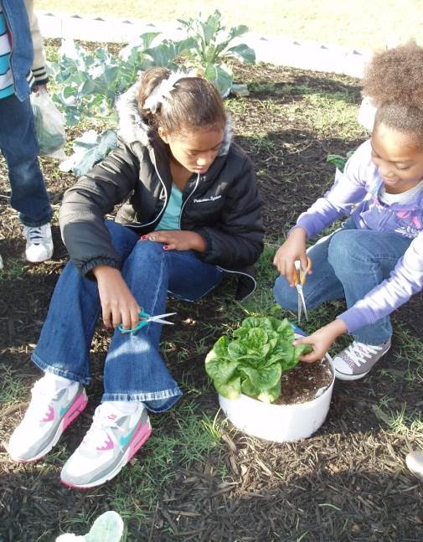
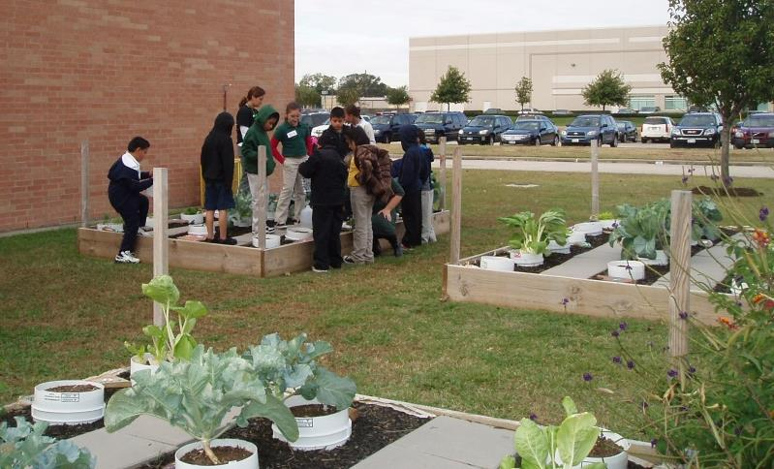
Lots of Options!

Slide 27
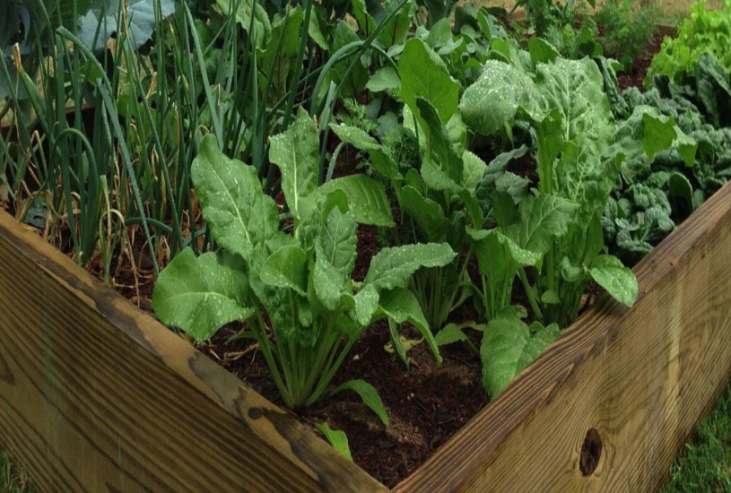

The LGEG school garden project specifically designed to be:
Simple
Easy
Quick
Inexpensive

Slide 28
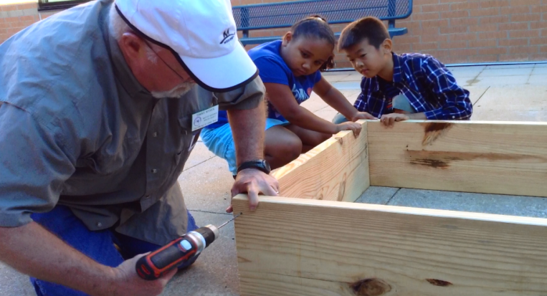
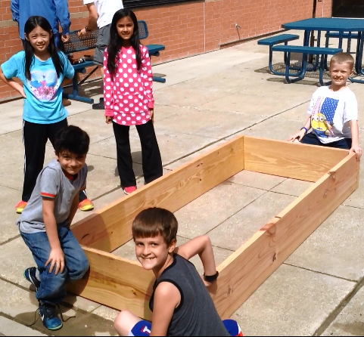
Quick & Easy
Garden Kit
Getting Materials
Building the Garden
Planting It
Provides
teachers
with
steps on:
with the help of one volunteer with a drill!

Slide 29
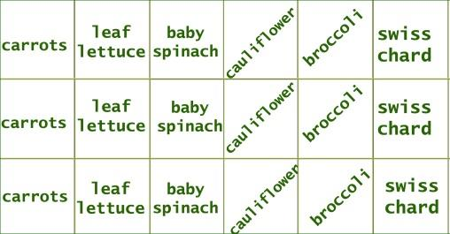
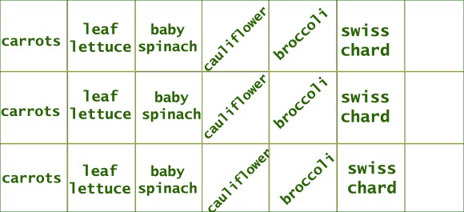
Quick & Easy Garden Kit
Getting Materials: What are we growing?
- growing 6 seasonal crops
- 3 square ft. plantings of each
- extra space for kids to choice plantings
- simplicity of steps/supplies
Sample cool season 3x7 raised bed:
kids’
choice
kids’
choice
kids’
choice

Slide 30
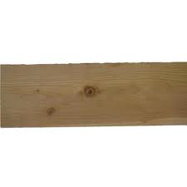
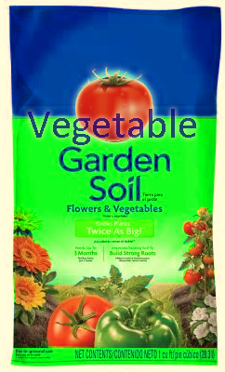
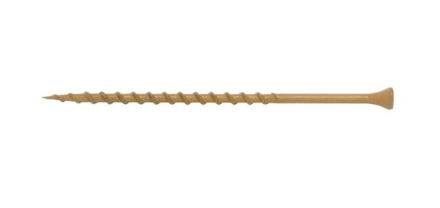
Quick & Easy Garden Kit
- simplicity of steps/supplies
2
10’ boards
21
cubic
feet soil
Boards can be cut at building store
12
4” Screws

Slide 31
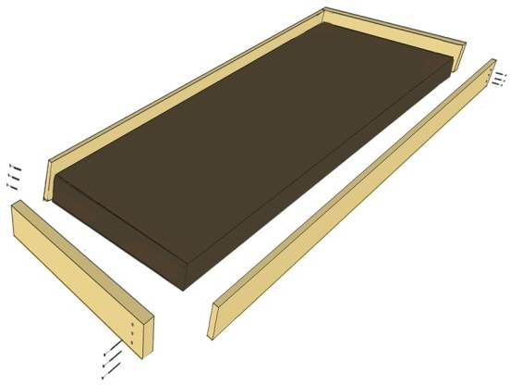
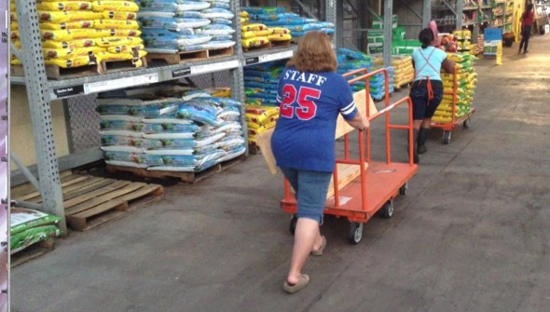
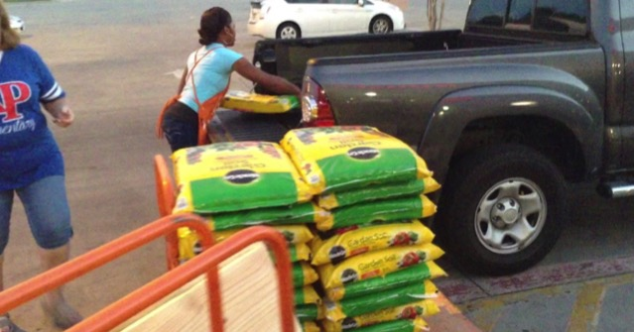
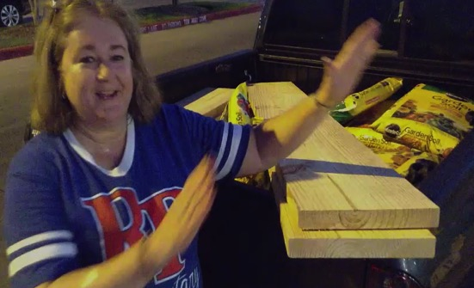
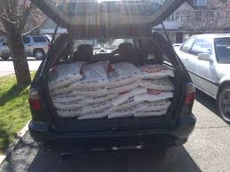
Quick & Easy Garden Kit
How to get materials to school?
- can be loaded for you at building store
- whole garden fits in back of van or small truck
(borrowed vehicle, potential volunteer task?)

Slide 32
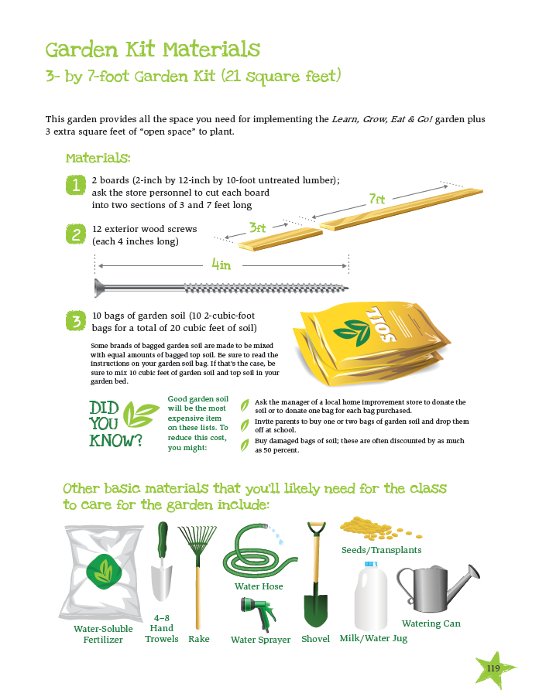
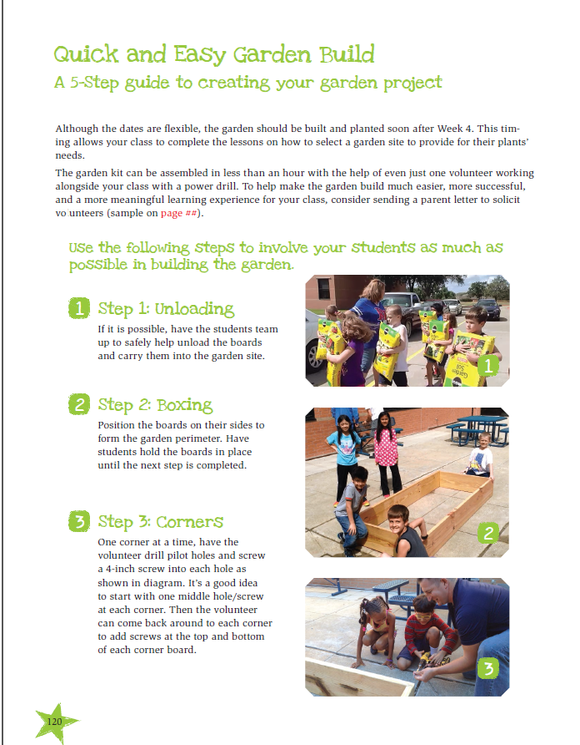
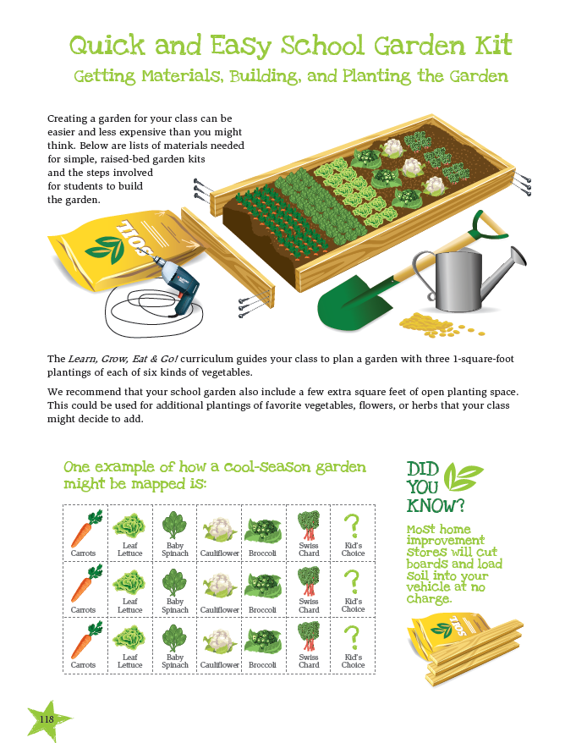
Grow:
Quick & Easy Garden Kit Pages include in curriculum

Slide 33

Food Exposure

Slide 34


Garden
Kitchen
recipe
demos
http://jmgkids.us/garden-kitchen-recipe-demos/
Notes:
Show video

Slide 35




Slide 36


Research shows physical activity breaks can improve academic performance.

Slide 37


Weekly featured
brain &
body boosting
activities
Notes:
Have groups participate in an activity

Slide 38

Weekly featured
brain &
body boosting
activities
Notes:
Have groups participate in an activity

Slide 39






Intro letter to parents
weekly update letters
appendix:

Slide 40

If you have access to volunteers, this page lays out specific tasks you can assign them to help:
Intro letter to parents
weekly update letters
appendix:

Slide 41


Notes:
Pre-test

Slide 42


www.JMGkids.us/LGEG
teacher support:
  Make your job easier:
  Curriculum resources
  Resource links
  Free PDFs Copies
  parent letters
  student worksheets
  garden kitchen recipes
  garden journals

Slide 43
JMG Moodle Course
2 Purposes
As a teacher training course:
Approx. 2.5 hrs of teacher CEUs per module
Continually accessible
As multimedia/web-based curriculum:
Multimedia, more comprehensive
Includes printables from hard copy
Allows for certifications
Updateable

Slide 44

AgriLifeBookstore.org

Slide 45



Teacher
Training
& Online
Curriculum
self-directed &
engaging training
course
for teachers,
volunteers &
Extension
dynamic
professional
development &
new, multimedia
curricular option for the Learn, Grow, Eat & Go! curriculum

Slide 46



4 professional hours
1 full year access
Printable lessons
Easy-to-follow, 10 weekly modules
Sharpening Science components to provide the teacher/leader helpful garden science & food science info
See lessons modeled by teacher in a public school classroom

Slide 48


Slide 49



Slide 50


Slide 51


Slide 52



Slide 53




Slide 54


campus.extension.org

