Slide 1
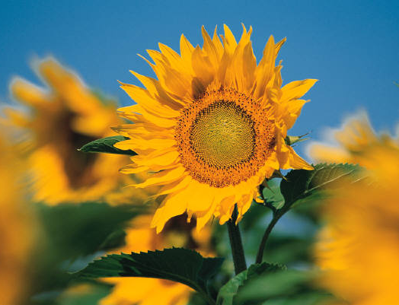

Texas A&M University, Feb29-Mar2. 2017
2017 National JMG® Leader Training

Slide 2
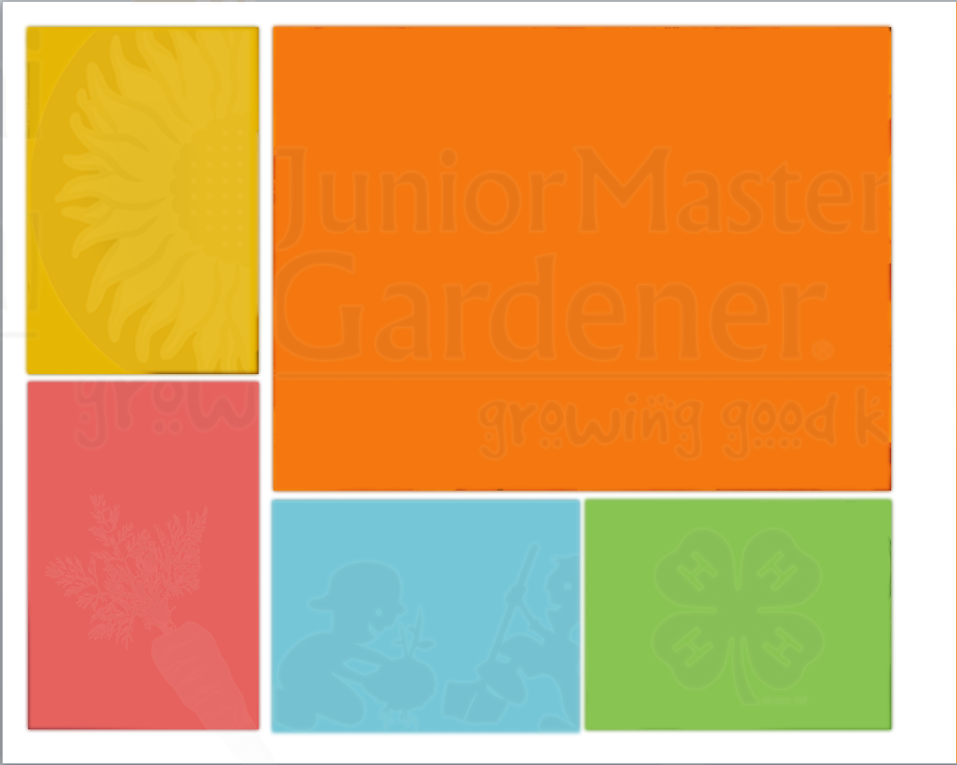

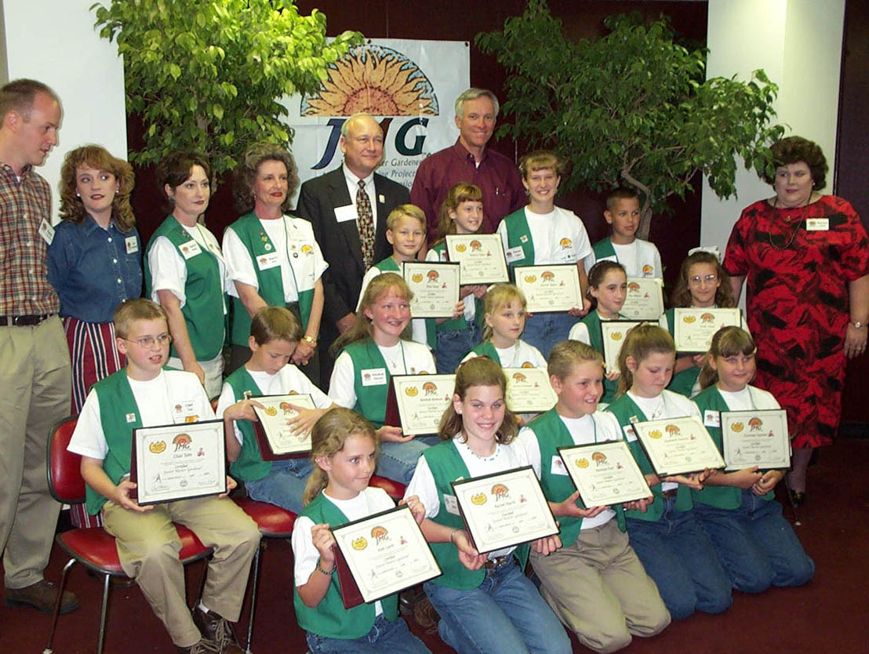
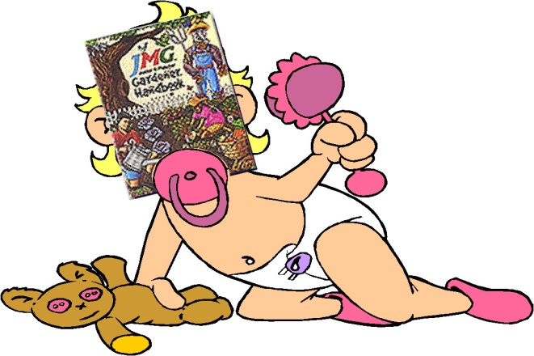
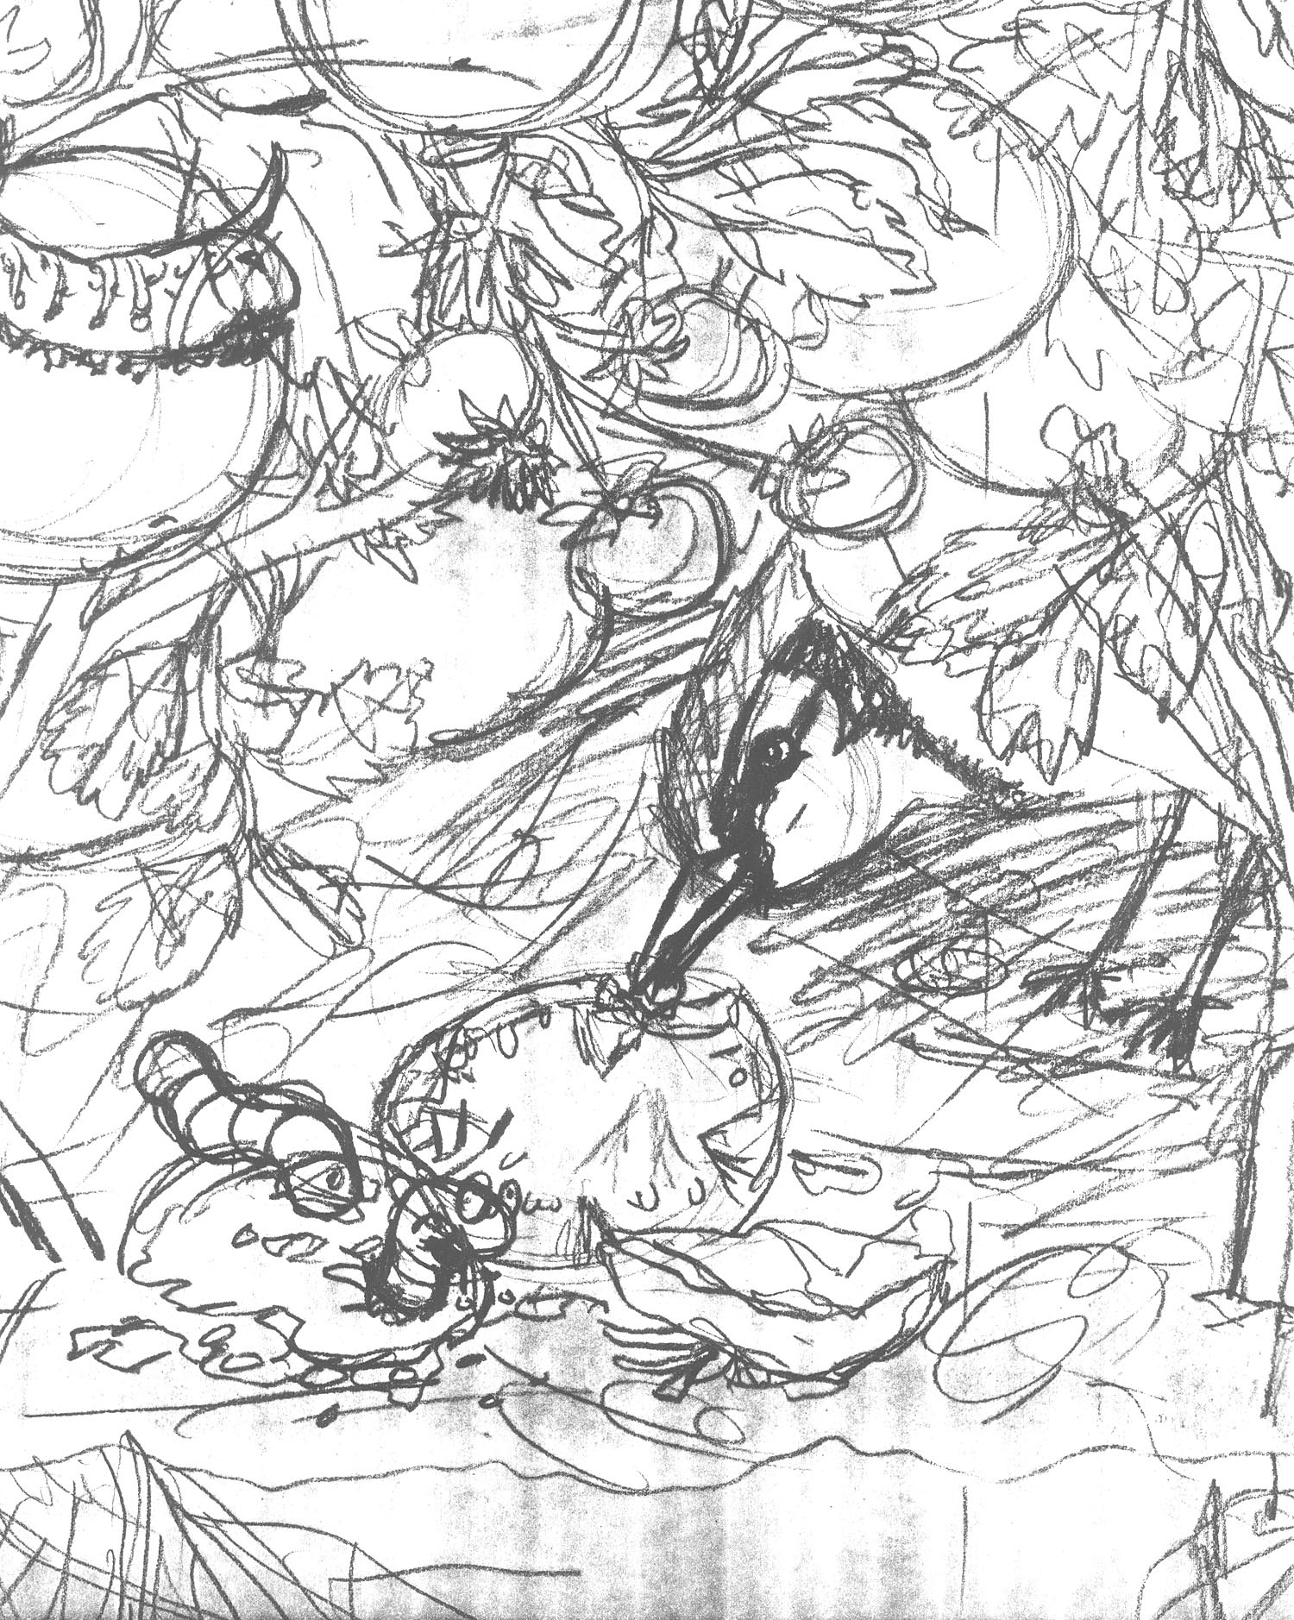
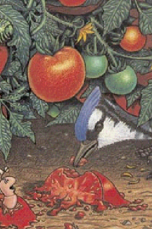
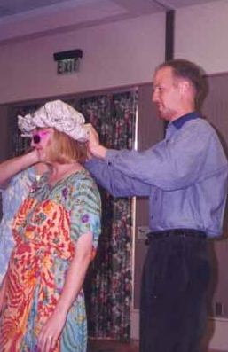
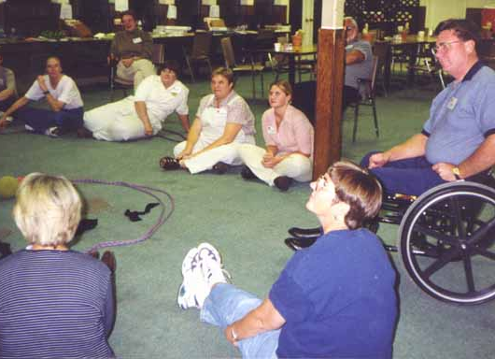
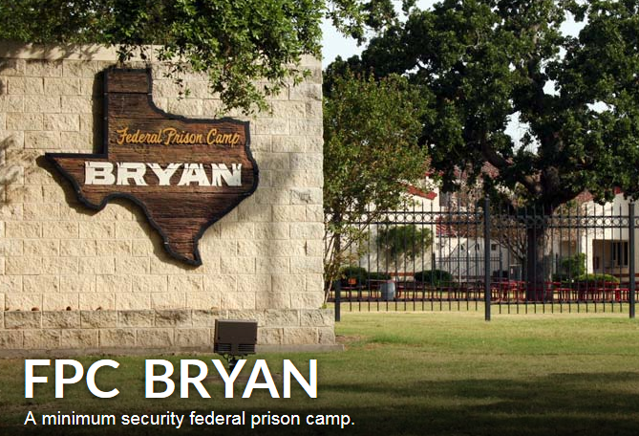

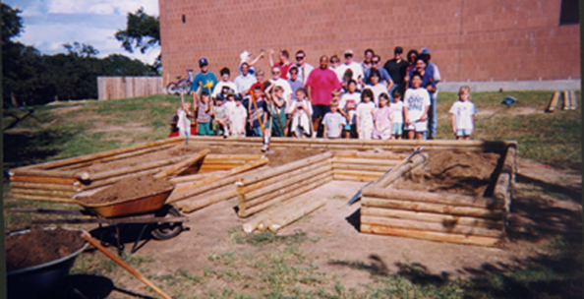
Congratulations!
You have given birth to a brand new baby program!
Date of Birth: August 1999
Weight: 0ver 400 activities thick
Proud Parents:
Texas A&M AgriLife
Extension Service

Slide 3



2016 JMG:
An international youth garden program
of the cooperative Extension network.
JMG in all 50 States,
10 countries
38 State Partners
4 International
Partners

Slide 4
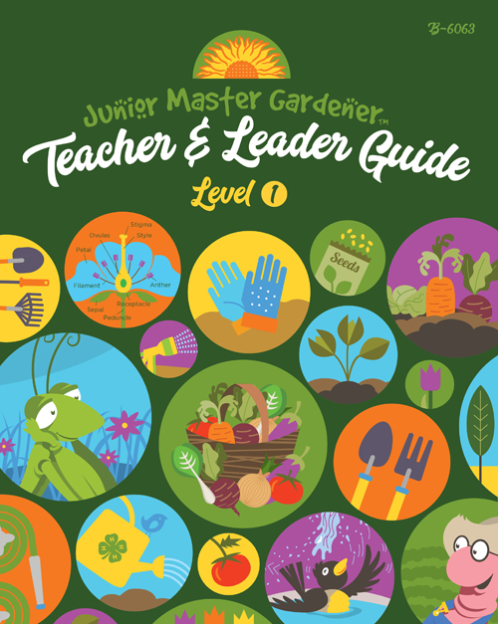
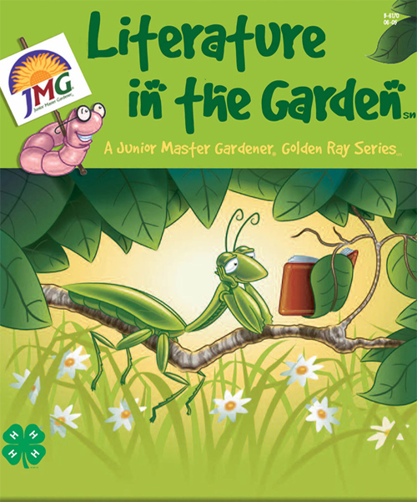


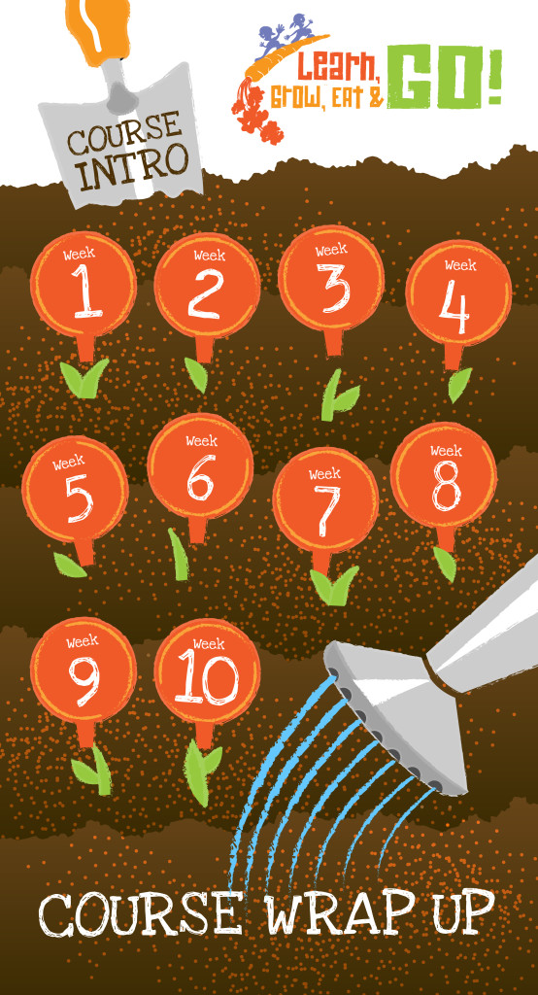
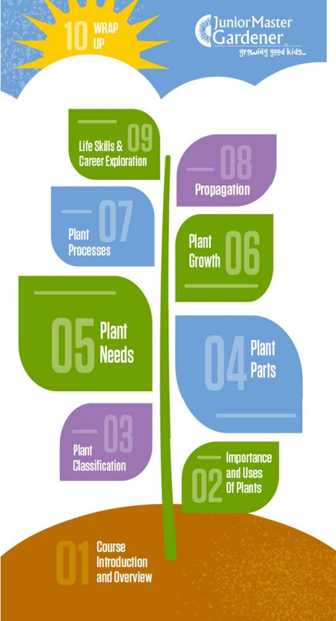
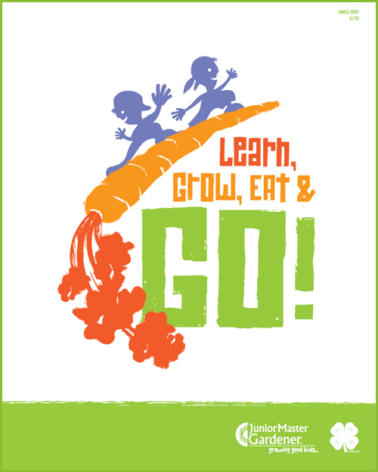
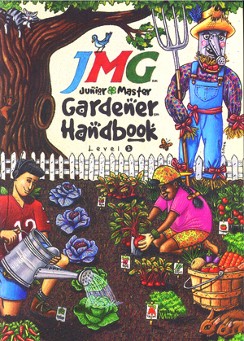
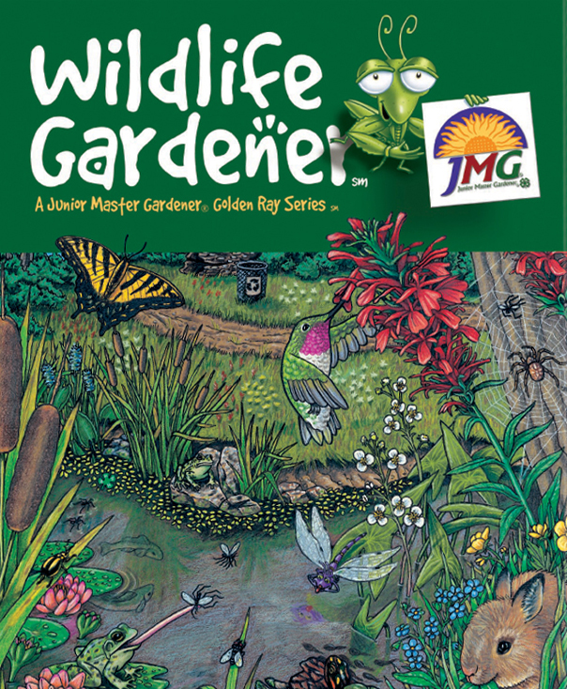

An international youth garden program
of the cooperative Extension network.

Slide 5
JMG Updates!
Partnerships:
Borlaug Institute Intl. Agriculture
American Horticultural Society
Nursery/Landscape Associations
Keep America Beautiful
State Departments of Agriculture
State Master Gardener Programs
USDA

Slide 6
Research Projects
Texas A&M University
University of Texas
Purdue University
Louisiana State University
Kansas State University

Slide 7

Our Mission: Growing good kids by igniting a passion for learning, success, and service through a unique gardening education.

Slide 8
Igniting a passion for learning
“The response from students, as well as parents was overwhelming…
I have enjoyed the program more than anything I have ever taught.
Kary Thigpen - Teacher
Bath & Birdy Works JMG Group

Slide 9
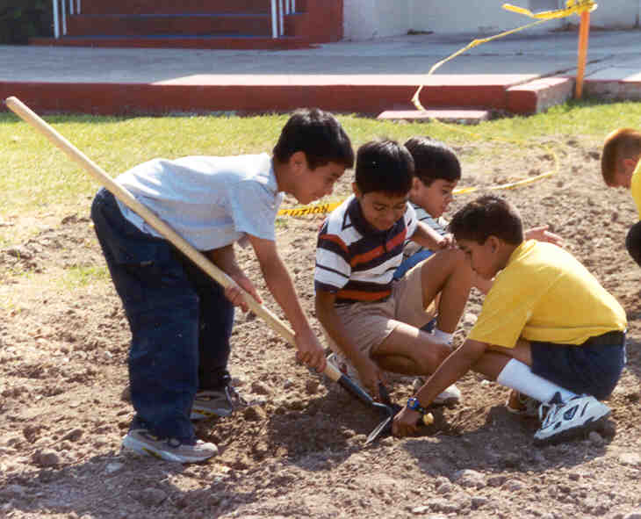
Igniting a passion for learning
“It enhances the student and teacher learning process…serves as a
catalyst for student
interest in science.”
JMG Group leader response
National JMG Leader Survey

Slide 10
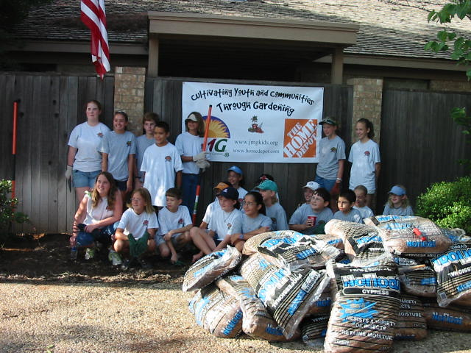
Igniting a passion for service
“The children were thrilled to be working on something that will last … they were excited that they were able to do this for the community.”
Alice Phillips
JMG Coordinator
Midland and Ector Counties

Slide 11
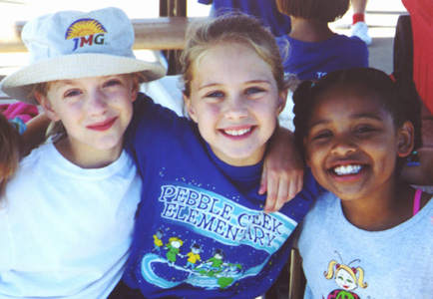
Igniting a passion for service
“The children are learning far more than what the ground can produce… they are learning to be active participants in
their community
to help their
fellow man.
Gonzalo Salazar – Principal
Los Fresnos Consolidated ISD

Slide 12
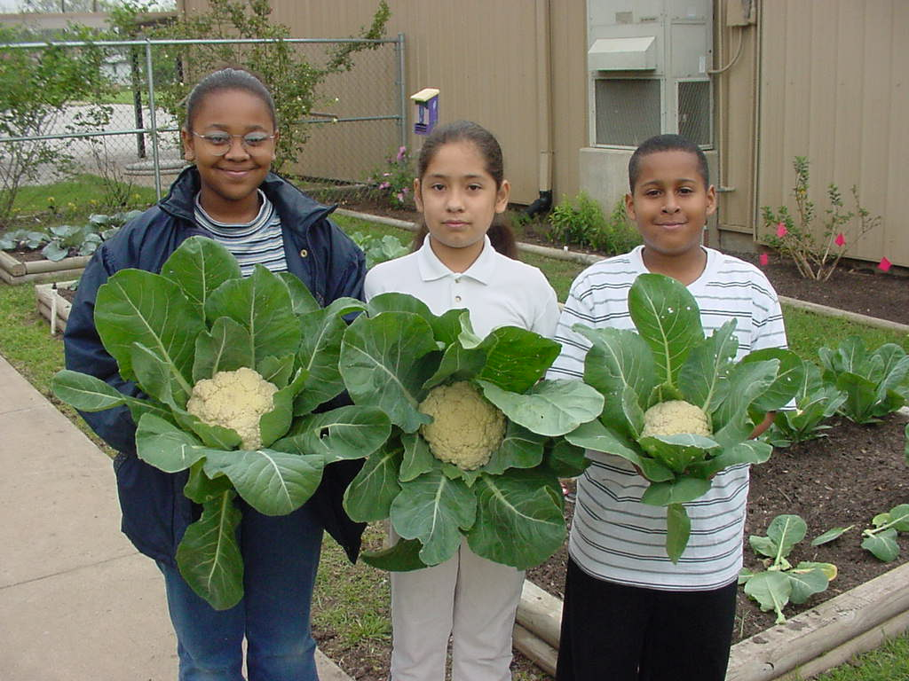
Igniting a passion for success
For all students
  The JMG program currently serves students in school settings
  with over 51% ethnic minorities.

Slide 13
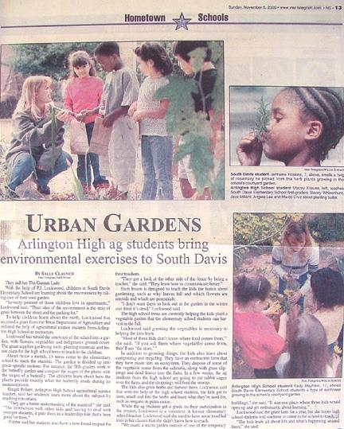
Igniting a passion for success
      “The high school students gain a better understanding of the concept being taught…they enjoy teaching horticulture and environmental science and have learned a greater respect for the teaching profession.”
      High School Teacher

Slide 14
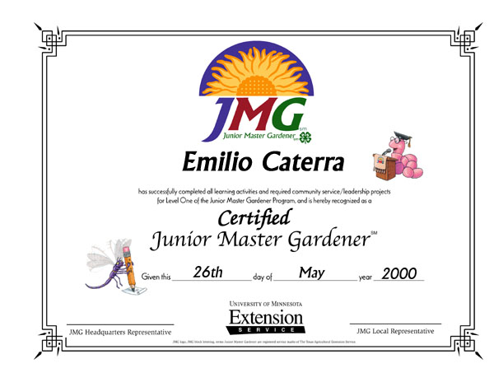
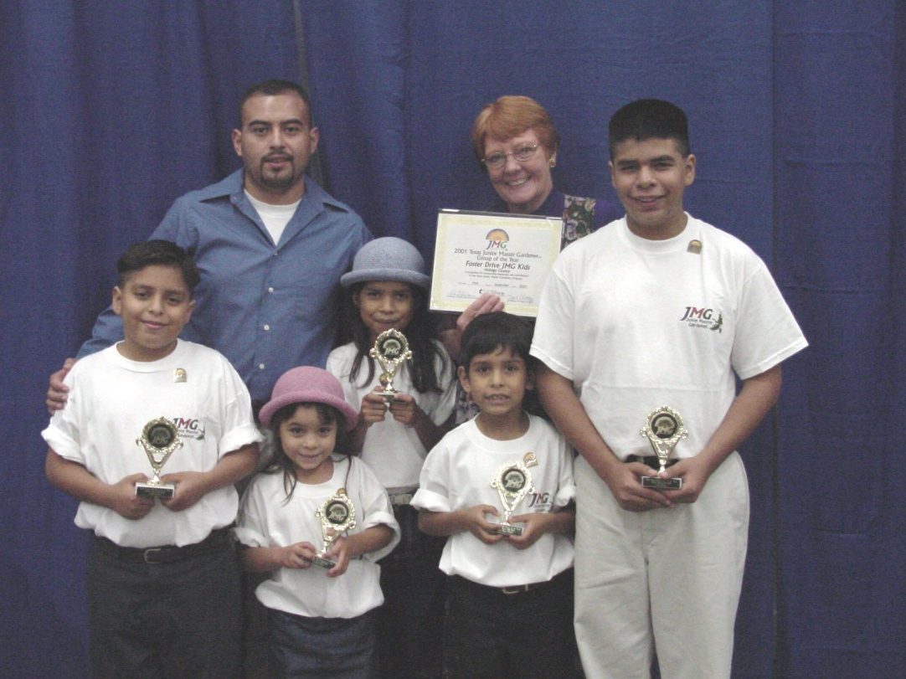
Igniting a passion for success
Recognition certifications for kids

Slide 15
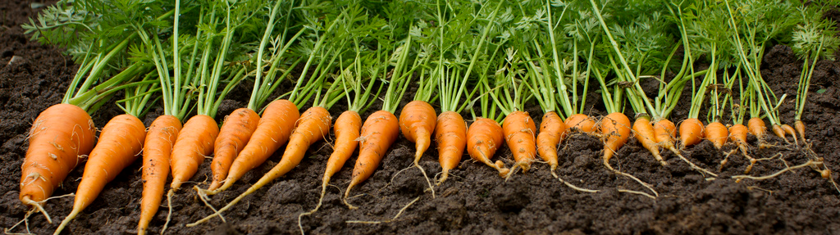
This training conference will equip you to:
effectively lead proven, research-based JMG lessons
prepare JMG teacher/leader training events for their local communities
enroll & register children in the JMG program
organize and engage youth in career exploration and service learning activities
involve local schools, county Extension office, volunteers and parents with JMG programs

Slide 16
National JMG Office:
  Assist states in starting JMG program
  Assist or conduct leader trainings
  Assist in pursuing financial support for programs through sponsorships and grants
  Maintain national JMG database and web site
  Publish and distribute curriculum
  Protect trademarks and program quality

Slide 17
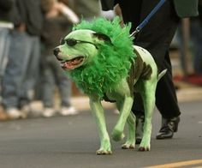
Dream Big!
If you are not the lead
dog, the scenery never changes!
Together, we can all make the commitment and leave a legacy growing good kids!

Slide 18
2017 National JMG® Leader Training
JMG Class/Group Registration

Slide 19
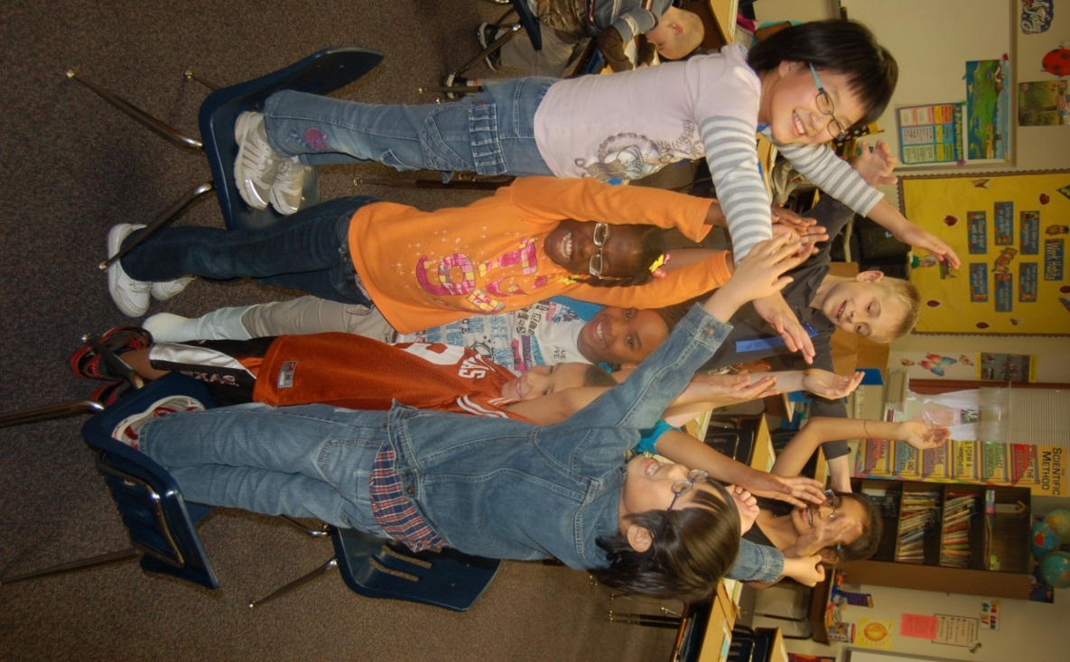
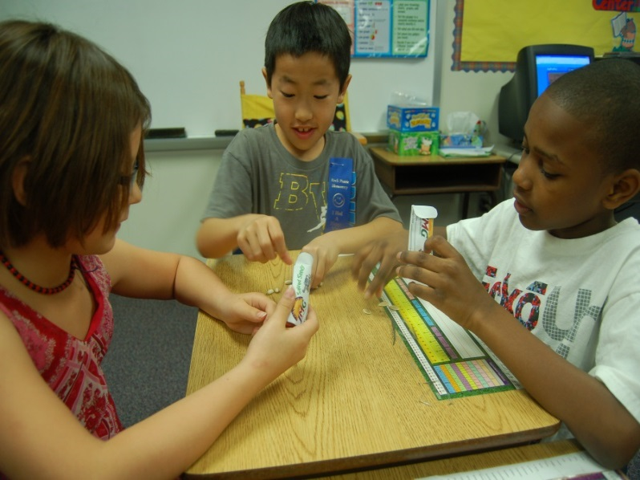
The JMG group/class:
Public school
Private/charter schools/home schools
4-H Clubs, Boy/Girl Scouts
after school programs, YMCA
Public and botanical gardens
Notes:
Ask for additional examples

Slide 20

JMG Registration:
  Minimum of 5 youths
  One or more adult teacher/leader(s)
  Suitable meeting facilities
  An official group name
Register
even if…
Notes:
Ask them to give examples by naming the groups that they have led
Even if… they are only doing a few activities, a summer camp, not working towards certification, etc

Slide 21
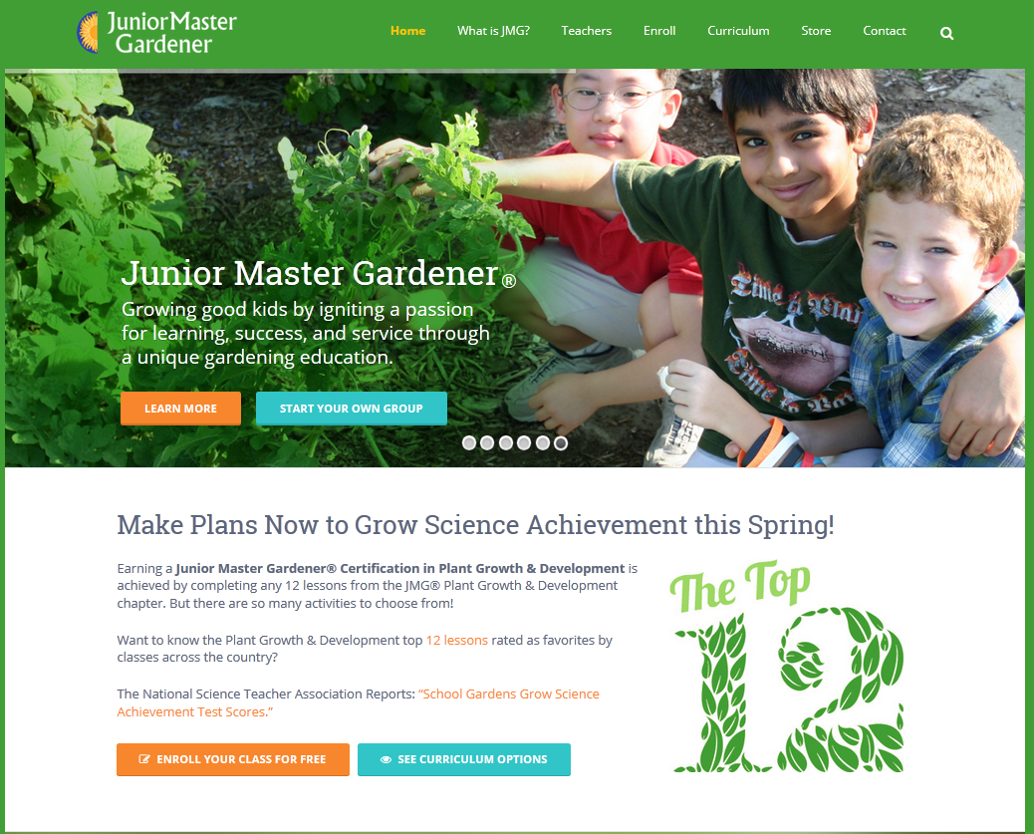

Slide 22
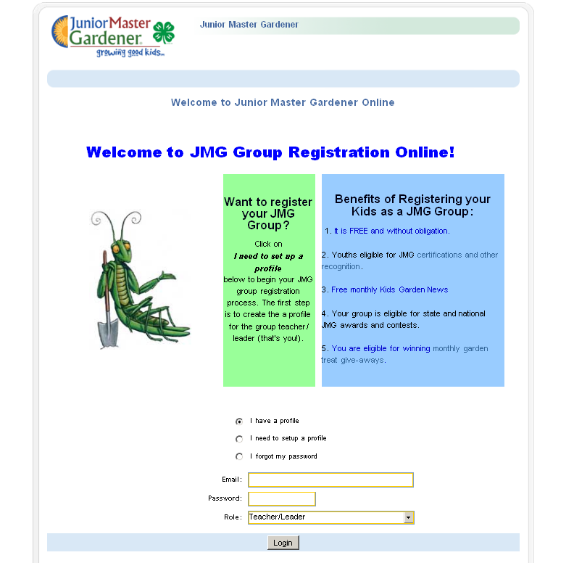

Slide 23
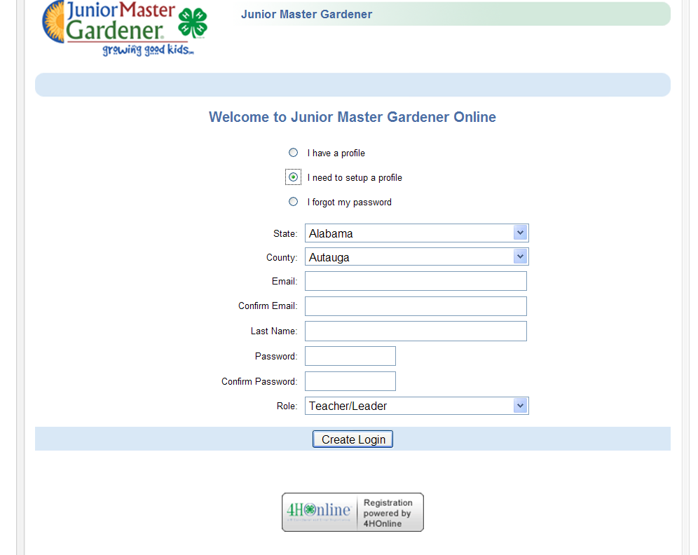
Notes:
Walk through the registration packet

Slide 24

Notes:
Walk through the registration packet

Slide 25
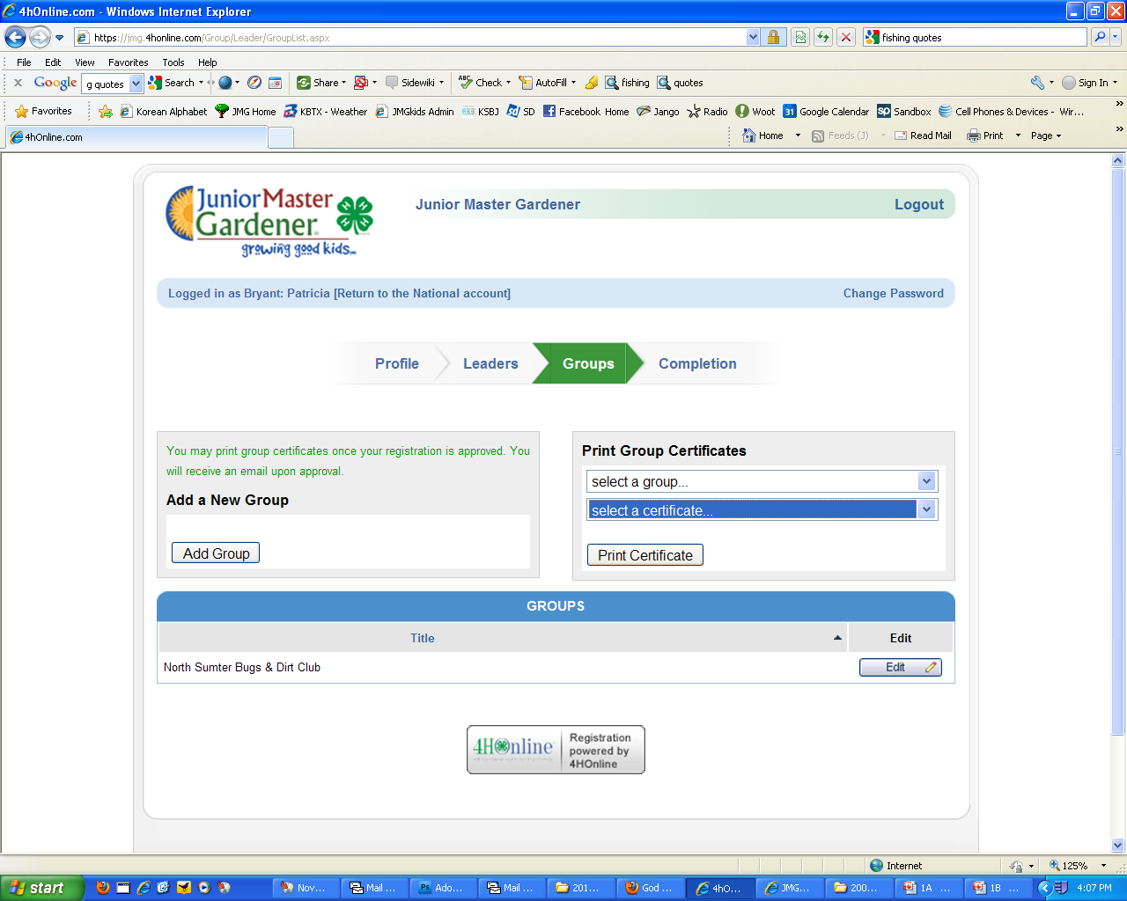
Add your group & print
group registration
certificate
Notes:
Walk through the registration packet

Slide 26
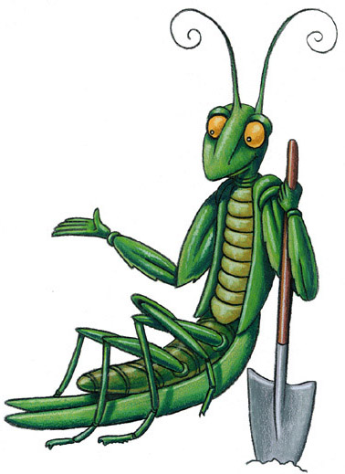
Why Should Groups Register?
Get a cool registration certificate.
Get updates on upcoming JMG news and events.
It’s free, doesn’t obligate youth to complete program.
Allows youths in your group to earn recognition certifications.

Slide 27
2017 National JMG® Leader Training
JMG & the Core Curriculum

Slide 28
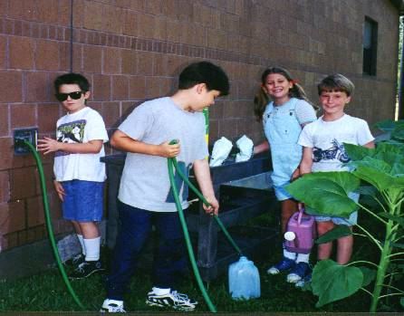
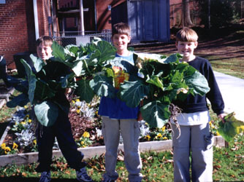
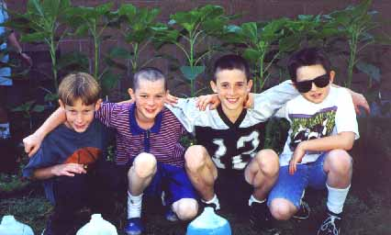
Junior Master Gardener® Program
Program Purpose:
Develop leadership skills
Identify community needs/volunteer opportunities
Peer and cross generation mentoring
Foster personal pride and responsibility
Increase knowledge in environmental &
horticulture education

Slide 29
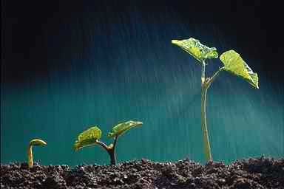
Junior Master Gardener® Program
Levels of Instruction
  Currently available
  Level 1 - Grades 3-5
  Level 2 - Grades 6-8

Slide 30
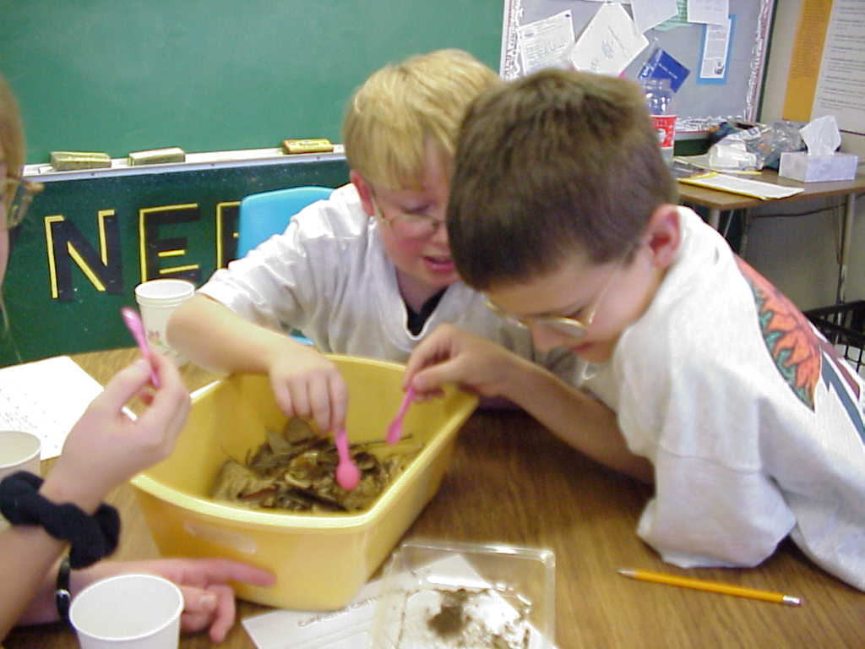
Curriculum Design
  Hands-On and Project Based
  Integrated across all subject areas
  Flexibility of use
  Choices available in group and individual activities
  Community service and leadership incorporated in all units

Slide 31
Junior Master Gardener®
Level One Core Curriculum
JMG
Teacher
Guide
JMG
Youth
Handbook

Slide 32
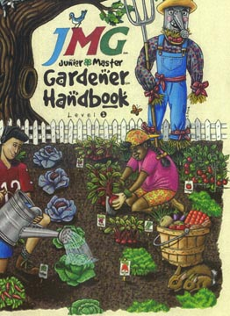
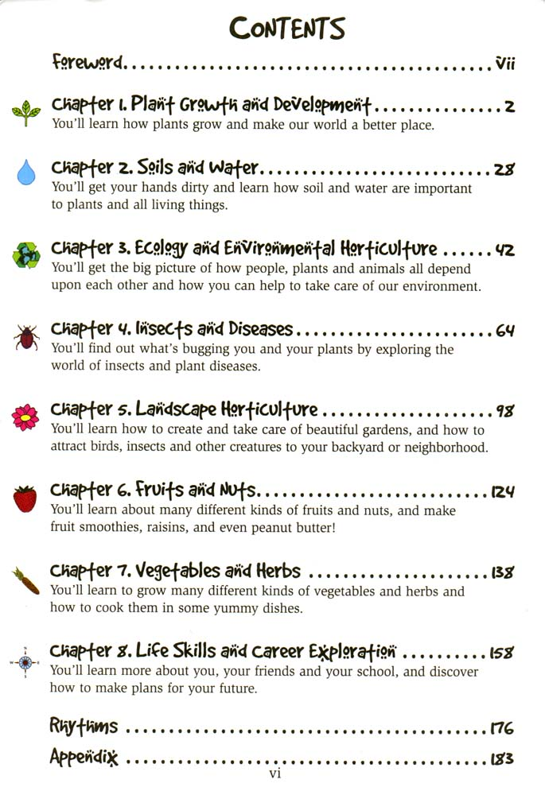

Slide 33
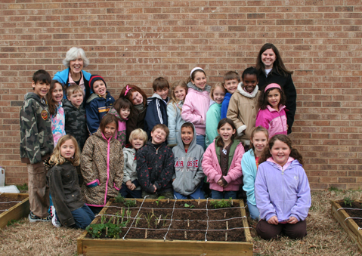
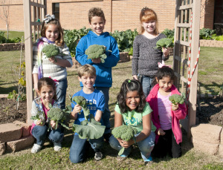
JMG Teacher/Leader Guide

Slide 34
The JMG® Teacher/Leader’s Guide
    Introduction and management guide
    Chapter group activities
    Community Service
    Projects/Leadership
    Helpful appendices

Slide 35
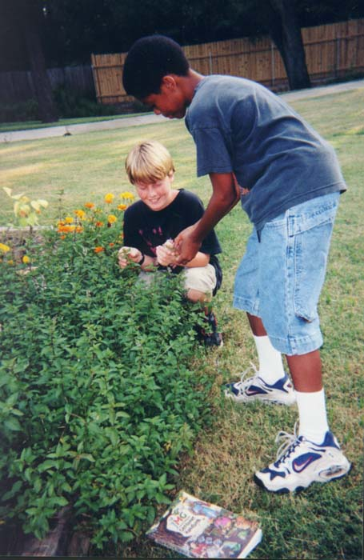
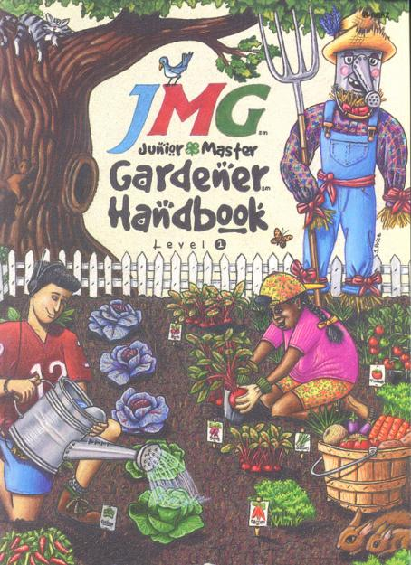
Go and Do It ! ! !

Slide 36
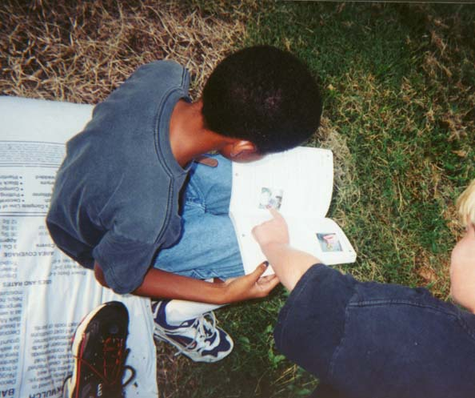
JMG® Youth Handbook
Making
your decision

Slide 37
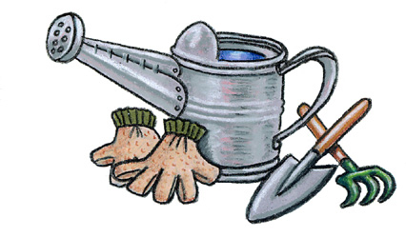
Activity Session A
Secret Smells (pg. 79, Teacher/Leader Guide)
Know and Show (pg. 4)
Plant Parts Rap (pg. 8)
Grow Cards (pg. 63)
Chew on This (pg. 94)

Slide 38
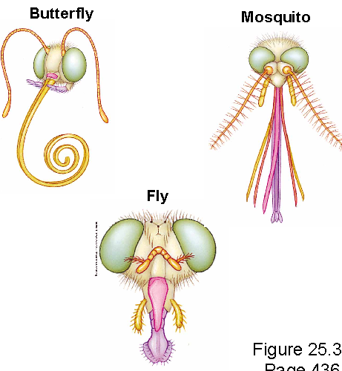
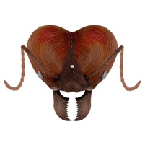
Chew on This (pg. 94, Teacher/Leader Guide)
  Insects have 4 different types
  of mouth parts.
    Chewing
    Piercing/Sucking
    Siphoning
    Sponging

Slide 39
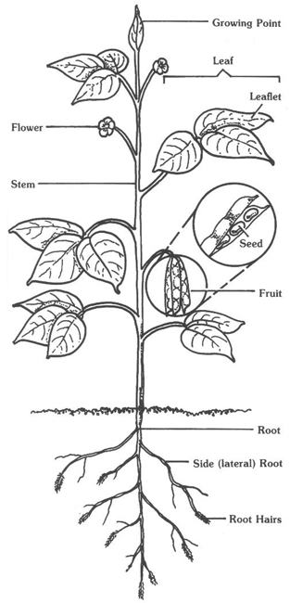
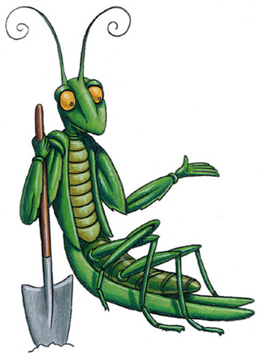
Plant Parts Rap (pg. 8, Teacher/Leader Guide)
roots,
stems,
leaves,
flowers,
fruit,
seeds

Slide 40

Grow Cards (pg. 63, Teacher/Leader Guide)
Fund raiser
Mothers day cards
Thank you notes

Slide 41













How is the Program Used?
Pick and choose some JMG activities for your youth to try
JMG Recognition Opportunities:
Recognition Medals
JMG Certifications

Slide 42

JMG® Certification for Youths
Certified Junior Master Gardener®
Golden Ray Seriessm Certification
Learn, Grow, Eat & Go! Certification
JMG Level 2 Certifications

Slide 43

  JMG Core Curricula

Slide 44

    Complete 1 group activity per
    teaching concept in each chapter
    v
    Complete 1 individual activity per
    teaching concept in each chapter
    Complete 1 service learning/leadership project per chapter

Slide 45

Service Learning & Leadership Development

Slide 46

Recognizing your kids…
Notes:
Walk through the registration packet

Slide 47

Notes:
Walk through the registration packet

Slide 48


Certified Junior Master Gardeners®

Slide 49
Activity Session B
Suck a Bug (pg. 4, Teacher/Leader Guide)
Insect Riddles (pg. 76)
Metamorphosis Bracelets (pg. 83)
Plant People (pg. 165)
How Tall is that Tree? (pg. 165)

Slide 50

Teaching Children
About Insects
Kids Love Bugs!
3 Body Regions
3 Pair of Legs
Eyes
Antennae
Wings or no wings

Slide 51

Teaching Children
About Insects
Kids Love Bugs!

Slide 52
2017 National JMG® Leader Training
Lesson features:
JMG Teacher & Leader Guide

Slide 53


JMG Level One - Teacher/Leader Guide
Hamburger Plant, p.1

Slide 54







Seed Science, p.10
1.
2.
4.
3.
5.

Slide 55

Oxygen Factory, p. 17

Slide 56


Leaf & Seed Sort Chart, p.10
Leaf and Seed Sort Information Chart, p.7

Slide 57



Cylinder Gardening (p. 164)

Slide 58
2017 National JMG® Leader Training
Research & Evaluation

Slide 59

School Gardening and
Plant-based Education
Uses plants, gardens and the environment as a context for engaging students in the learning experience.
  Gardens of every conceivable variety
  Non-gardening experiences with plants

Slide 60
Is there a network to support?
Examples of networks that support JMG programs in the
United States:
Network of educators/volunteers in place – EFNEP, SNAP-Ed, and adult Master Gardener volunteer programs
Local farmers market and farm to school programs
State and local health organizations and agencies
State and local education organizations
Chef Associations
Community volunteer organizations
Notes:
60

Slide 61

National Interest
USDA – People’s Garden Project
USDA – Farm to Cafeteria
White House Kitchen Garden
Increase in sales of vegetable transplants through nurseries
Concept of “local-vores”
Organically grown
Food labeling
Notes:
61

Slide 62

Does gardening
work?
What does the research say?

Slide 63

Why Garden-based Learning?
High retention rate: researchers document that there is a 75% retention rate for learning by doing and a 90% retention rate when students teach other students
Empowerment: connection to Earth gives sense of achievement, increases motivation and self-confidence
Academic enhancement: more relevant, and therefore meaningful, learning experience
Teamwork: facilitates cooperation and communication
Priscilla Logan, educational consultant, Santa Fe, NM as quoted by Sealy, 2001.

Slide 64



“JMG is a hands-on program aligned to academic standards… It is so refreshing for our students to be able to cover the TEKS in other than a test format. The children enjoy the activities.”
Kathleen Coburn, Ph.D., Director of Math, Science, Gifted Education, Temple ISD

Slide 65

Program Evaluation
National Online Survey for Leaders
Over 85% of respondents stated that
JMG has increased youth interest in science
Over 83% of respondents stated JMG has
contributed to higher academic standards
Over 85% of respondents said JMG youths were
more enthusiastic about learning

Slide 66

2007 issue of Hort Technology
Studies specifically examining the benefits of students participating in JMG Curricula :
“…results show once weekly use of gardening activities and hands-on classroom activities help improve science achievement test scores.”
Impact of Hands-on Science through School
Gardening in Louisiana Public Elementary Schools
“Students in the experimental group
scored significantly higher on the
science achievement test compared to
the students in the control group .”
Growing Minds: The Effect of a School Gardening
Program on the Science Achievement of
Elementary Students

Slide 67
2007 issue of Hort Technology
Studies specifically examining the benefits of students participating in JMG Curricula :
“Qualitative data also indicated that the students enjoyed the program, shared what they
learned with others, and wanted to
participate in more JMG and gardening
type activities .”
An Evaluation of the Junior Master Gardener
Program in Third Grade Classrooms
“… students in the experimental group
did significantly increase their overall
life skills scores .”
Growing Minds: The Effects of a One-year School
Garden Program on Six Constructs of Life Skills
of Elementary School Children

Slide 68

Health & Nutrition:
  School gardens used to teach children about nutrition and healthier food choices.
  Morris, Briggs, and Zidenberg-Sherr, 2000
  Children who plant and harvest their own vegetables are more willing to taste and like them. Morris, Briggs, and Zidenberg-Sherr, 2000
  Children more likely to choose fruits or vegetables as snacks after participating
  in a garden program. Lineberger and Zajicek, 2000

Slide 69

Nutritional Knowledge
& Increased consumption
After completing the JMG
curriculum students regardless of
age, ethnicity or county of residence,
had increased knowledge about the
benefits of eating fruits and vegetables
and fruit and vegetable consumption
increased from pre to posttest with student reporting eating healthier snacks at the end of the study.
Koch, 2001

Slide 70

Parental Involvement
Study of parental involvement in schools with JMG programs found that school gardening may be an effective tool for involving parents
The greatest increase in parental involvement was seen in white and Hispanic parents with lower income levels. Boyer, 2002

Slide 71

Environmental Literacy
Researchers found that “students who engaged in more outdoor related activities reported more positive environmental attitudes.”
Skelly, S.M . And Zajicek, J.M. (1998). The effect of an interdisciplinary garden program in the environmental attitudes of elementary school students. Hortechnology, 9(4), 579-583.

Slide 72

Gardening and Experiential
Nutrition Education in Schools
A Promising Approach:
  Students studying nutrition in classroom while growing vegetables outdoors increased nutrition knowledge and preference for vegetables.
  (Morris, Neustadter, Zidenberg-Cherr; 2001 and Morris, Zidenberg-Cherr, 2002)
  Children who plant and harvest their own vegetables are more likely to eat them.
  (Morris, 2002; Foerster, et.al, 1998; Morris, et. al, 2001, Morris and Zidenberg-Sherr, 2002)
Notes:
72

Slide 73
Gardening and Experiential
Nutrition Education in Schools
A Promising Approach:
  Nutrition Education plus gardening was found as an effective strategy for improving in school consumption of fruit and vegetables during school lunch times.
  (Parmer et.al., 2009)
  Evidence of promising gains in fruit and vegetables interest and knowledge, but limited evidence-based, peer-reviewed research evaluating gardening programs on nutritional outcomes.
  (Robinson-O’Brian, 2009)
Notes:
73

Slide 74

Components of Indiana State-wide Eat Your Way to Better Health program
Nutritional educational materials targeting famers market consumers
School salad bars – funds supported equipment in 3 elementary schools
School Gardening with the Junior Master Gardener – Health and Nutrition from the Garden
Recipes for kids/parents on how to use produce
http://www.cfs.purdue.edu/extension/food_health/nutrition/better_health.html

Slide 75

Found to have a positive impact on third-grade classrooms across participating counties and success.
Creating school gardens, providing nutrition education, and encouraging interaction between students, teachers, parents, and the community:
contributed to increased fruit and vegetable intake among students.
provided students with a sense of locally grown produce
student desire to sample produce new to their taste buds.
http://www.cfs.purdue.edu/extension/food_health/nutrition/better_health.html

Slide 76

500 children identified by BMI
as overweight or obese
Children and parents participate in Salud y Bienestar (10 week program)
Junior Master Gardener program – catalyst to teach nutrition, understand where food comes from, helps encourage healthy choices, parents and kids working together
Garden Café – introduced to allow children to pay nominal price to sample foods prepared by chef using fresh, locally grown produce
http://www.sbsdk12.org/news/2010/06/22eastsidewellness.shtml

Slide 77
Pilot Results:
Overall decreases in prevalence of obesity and overweight, with more marked decrease with an increasing length of time in program
Prevalence of obesity decreased from 30% to 25% in one year
Prevalence of overweight and obesity combined decreased from 55% to 42% in time period
Results for girls- decrease in prevalence of obesity from 26 to 19%, and decrease of prevalence of obesity and overweight from 48 to 38%
http://www.sbsdk12.org/news/2010/06/22eastsidewellness.shtml

Slide 78










Research Project: Texas Grow! Eat! Go!
Expansion/Implementation/Research
Study Project

Slide 79

Resources for
Research
www.jmgkids.us/research

Slide 80







www.twitter.com/jmgkids
www.facebook.com/juniormastergardener
www.pintrest.com/jmgkids
www.instagram.com/jmgkids
www.JMGkids.us

Slide 81
Tomorrow:
Start at 8:30
Focus in Learn, Grow, Eat & Go! curriculum
Panel lunch discussion

