Slide 1

2017 National JMG® Leader Training
Golden Ray Series

Slide 2



Junior Master Gardener®
Golden Ray Series
^{thematic Level One Curricula}
*

Slide 3
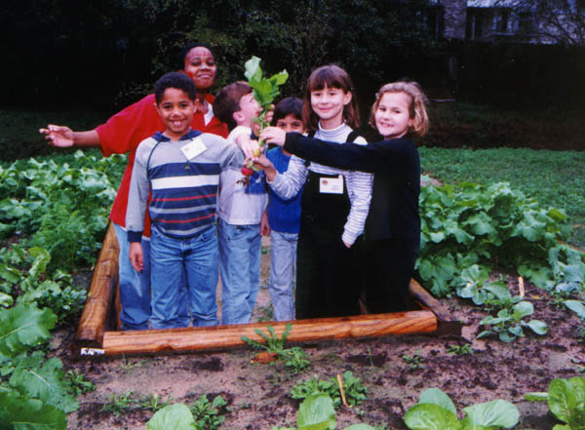
JMG® Certification for Youths
Certified Junior Master Gardener®
Golden Ray Seriessm Certification

Slide 4
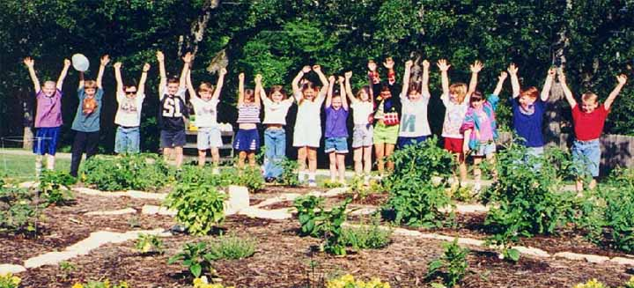
Golden Ray Series Certification
Junior Master Gardener®
Golden Ray Series
^{thematic Level One Curricula}
  A. any combination of 12 activities
  B. completing 1 Life Skills/Career Exploration activity
  C. participating in 1 service project

Slide 5
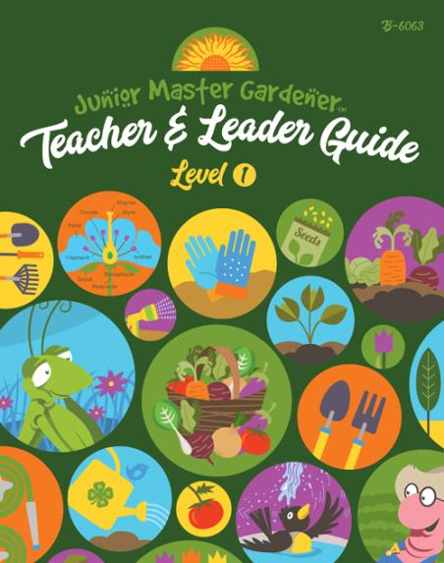
Junior Master Gardener®
Golden Ray Series
^{thematic Level One Curricula}
*
teaching concepts:
Basic Gardening
Growing Techniques
Thrifty Gardens
Food Safety
ABCs of Healthful Eating
Healthful Snacks

Slide 6
Junior Master Gardener®
Golden Ray Series
^{thematic Level One Curricula}
*
“Parents are excited that their kids are in the program. Their children have stopped going to the candy aisle first and are going to the fruits and vegetables.”
Sandy Farber, JMG Coordinator,
District of Columbia

Slide 7






Junior Master Gardener®
Golden Ray Series
^{thematic Level One Curricula}
teaching concepts:
Gardening Basics

Slide 8

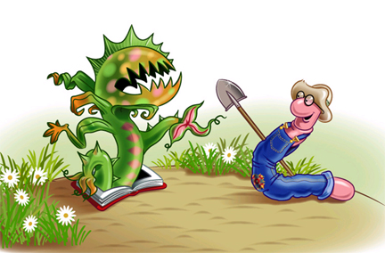
Brings children’s literature to life
Integrates gardening across all subjects
recognizes youths with certification

Slide 9



GROWING GOOD KIDSSM
Excellence in Children’s Literature
Book Awards Program
Recognize those children’s books that are uniquely successful in promoting an understanding of and appreciation for plants, gardening and the environment.

Slide 10

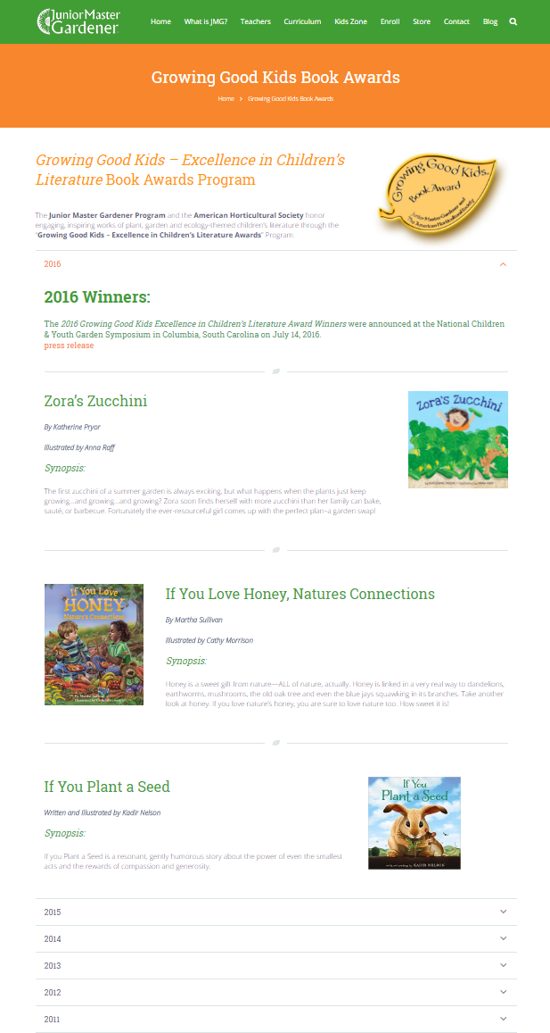
GROWING GOOD KIDSSM
Excellence in Children’s Literature
Book Awards Program

Slide 11

Junior Master Gardener®
Golden Ray Series
^{thematic Level One Curricula}
Dig into to gardening for wildlife!
Identify local birds, mammals,
insects, reptiles and amphibians.
Investigate life cycles and
interrelatedness of wildlife/plants.
Discover how to attract desirable
wildlife to your garden.
Establish a NWF® Certified
Schoolyard Habitat®!

Slide 12
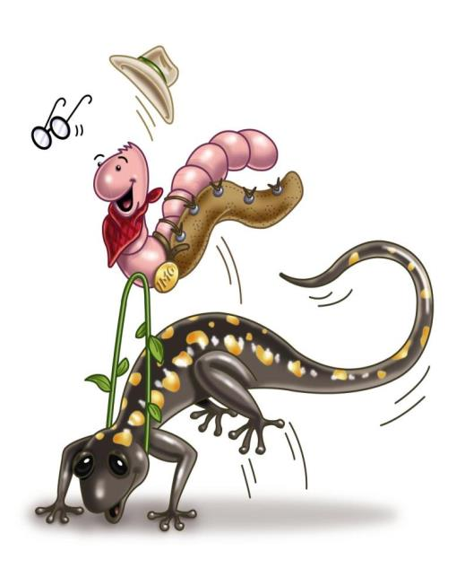
Junior Master Gardener®
Golden Ray Series
^{thematic Level One Curricula}
teaching concepts:
Habitat Gardening Basics
Essential Elements
Birds
Mammals
Insects
Reptiles and Amphibians
Wildlife Habitat Sites

Slide 13
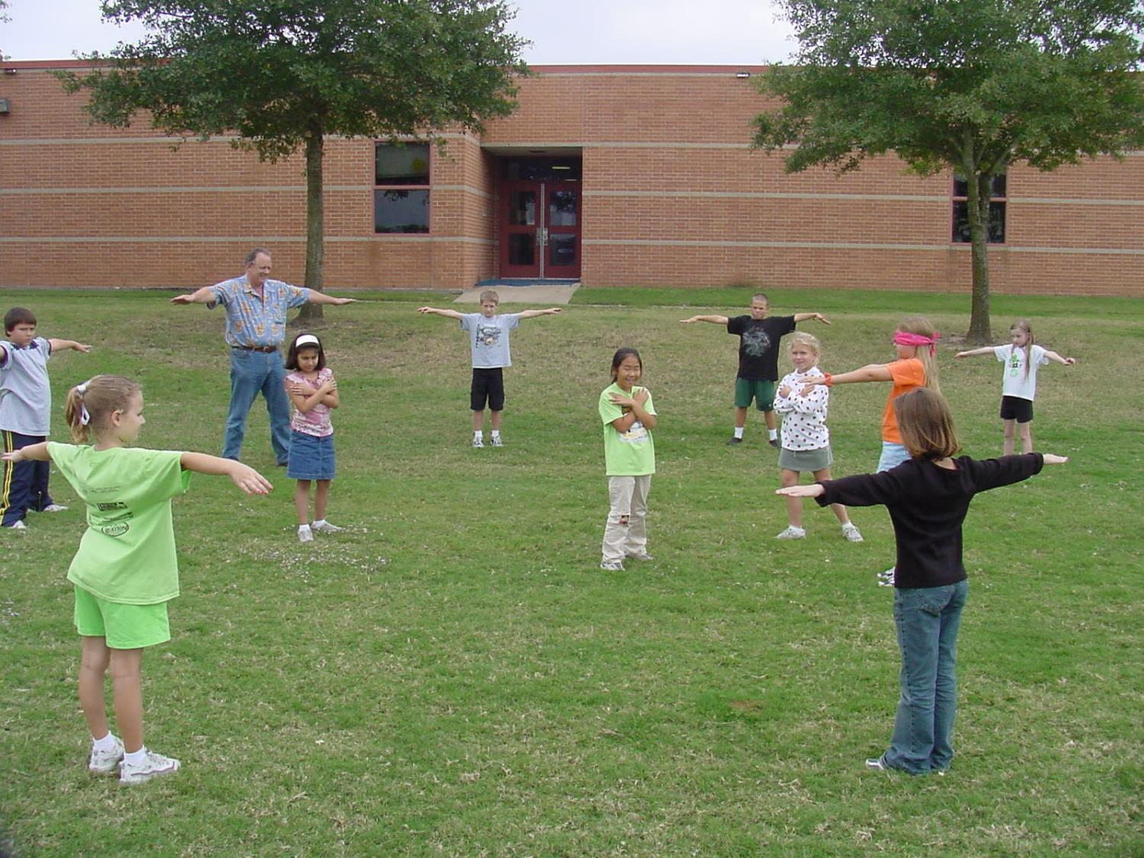

How do my kids become
Certified Wildlife Gardenerssm?
  Youths can earn certification as a
  Wildlife Gardenersm by completing:
  A. at least 12 activities
  B.1 Life Skills/Career Exploration activity
  C. establish a Certified Schoolyard Habitat®
  or other service-learning project

Slide 14

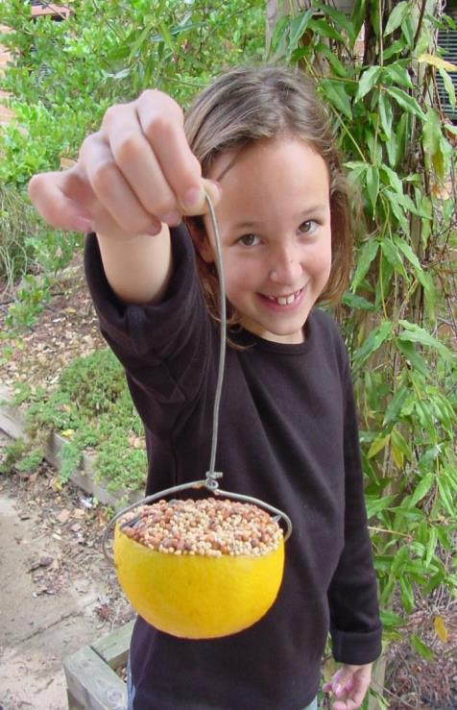

How do my kids become
Certified Wildlife Gardenerssm?

Slide 15




Junior Master Gardener®
Golden Ray Series
^{thematic Level One Curricula}

Slide 16

Junior Master Gardener®
Golden Ray Series
^{thematic Level One Curricula}
in one chapter/theme
Plant Growth & Development
Soils & Water
Insects & Plant Diseases
Ecology & Environmental Hort
Landscape Horticulture
Fruit & Nutrition
Vegetables & Herbs
Life Skills & Career Exploration
multi: Growing a
Vegetable Garden

Slide 17
Activity Session C
Monster Flowers, Lit in the Garden (pg. 23)
Overhead Roots, Lit in the Garden (pg. 113)
Far Out Feeder, Wildlife Gardener (pg. 55)
The Great Cover Up, Wildlife Gardener (pg. 88)

Slide 18
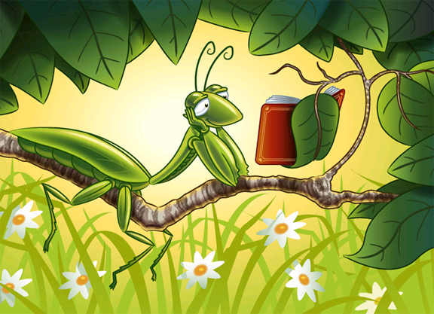
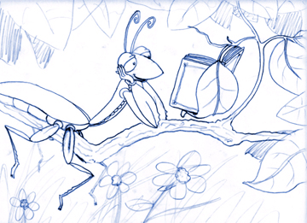
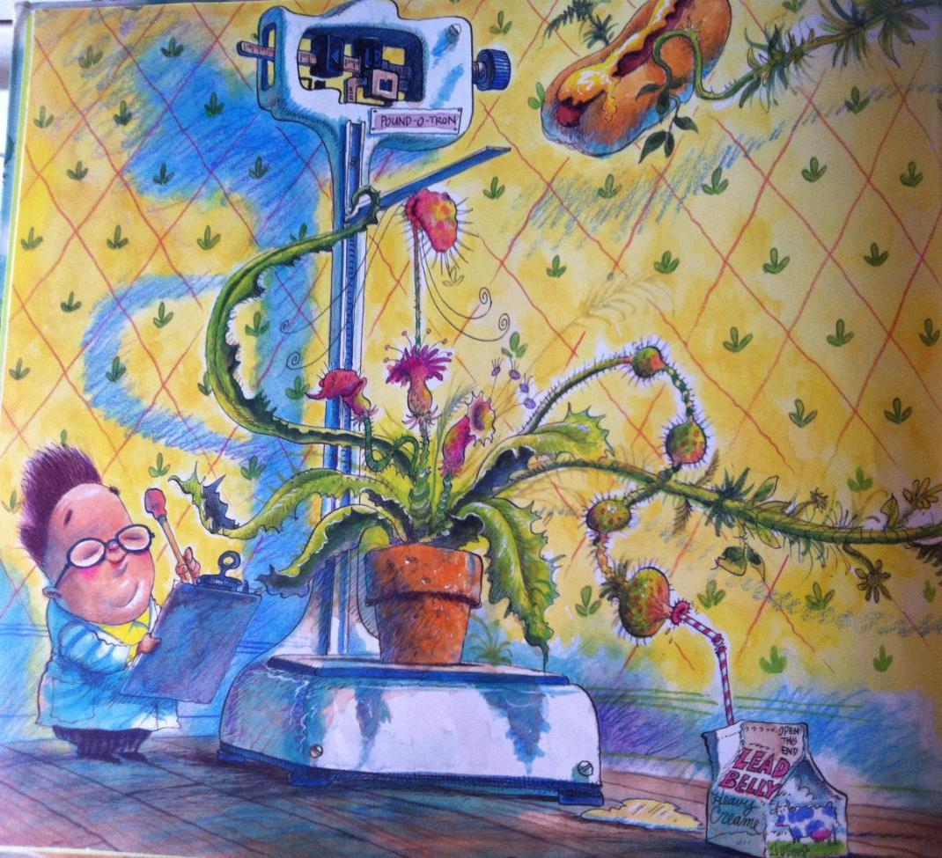


Slide 19


Slide 20
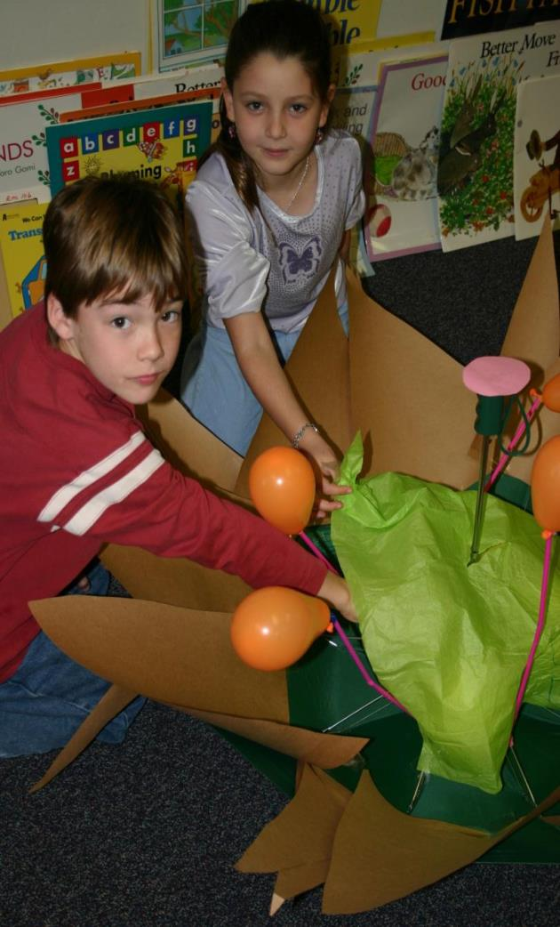
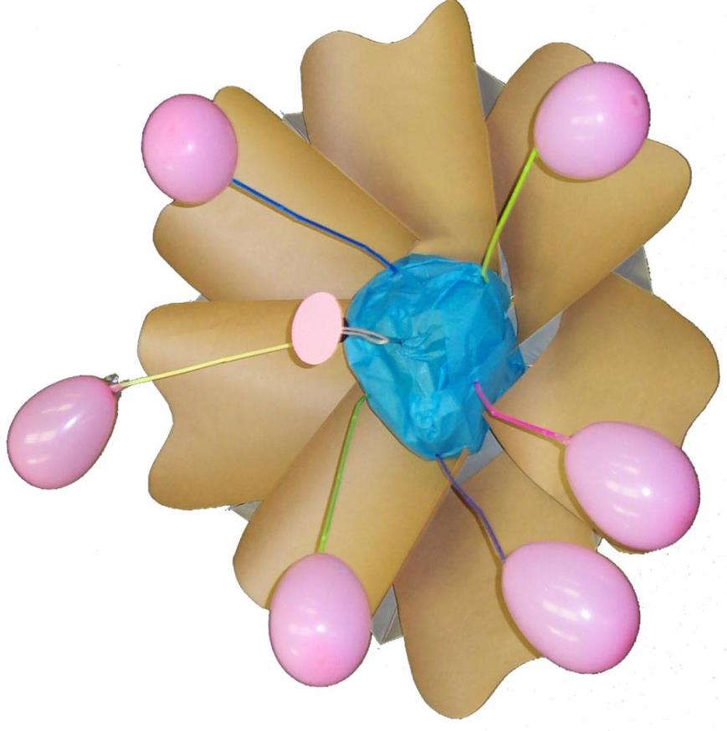
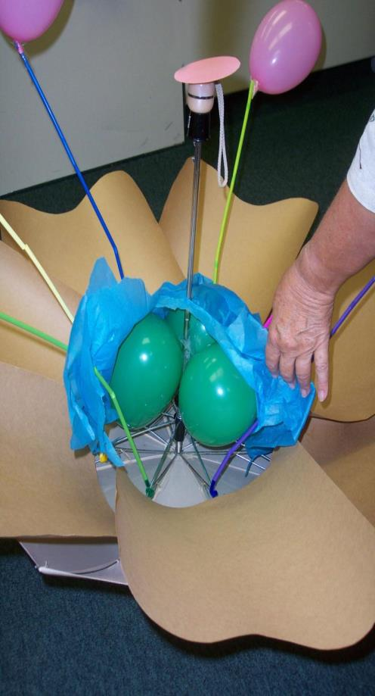
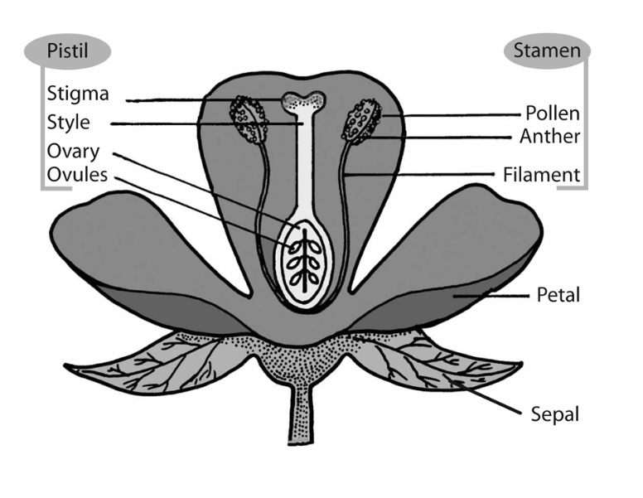
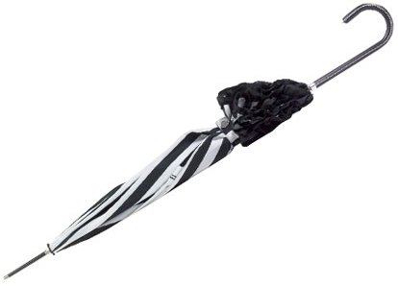

Monster Flowers, p23
Monster Flower p27

Slide 21


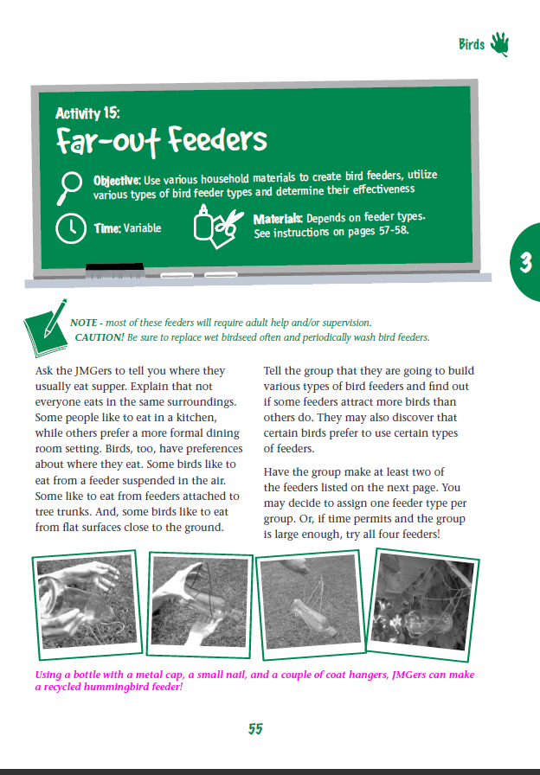
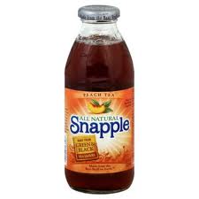
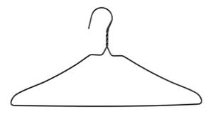
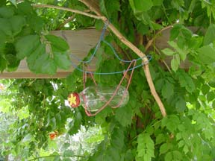
Far Out Feeder, p55

Slide 22
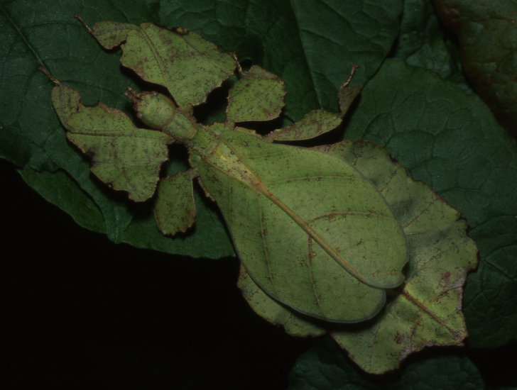
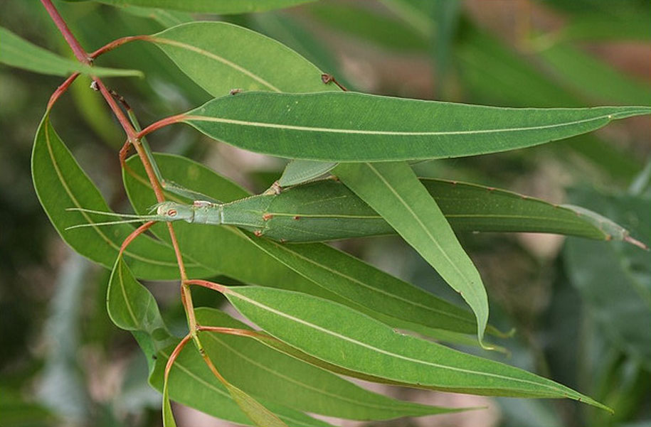
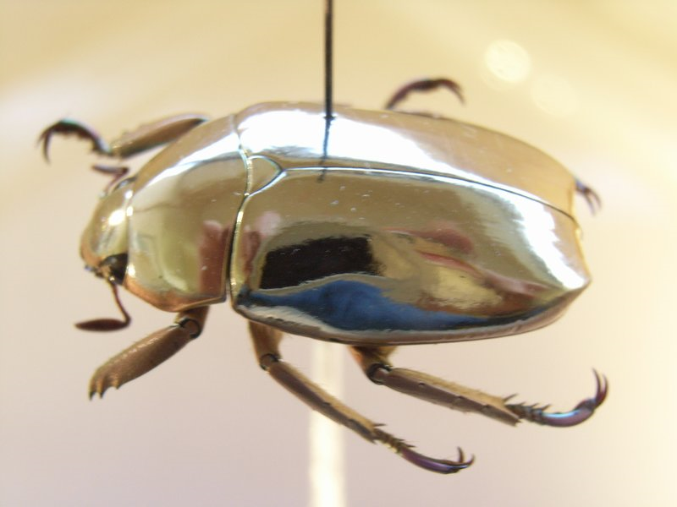
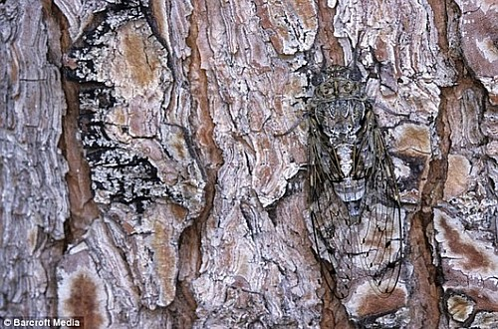
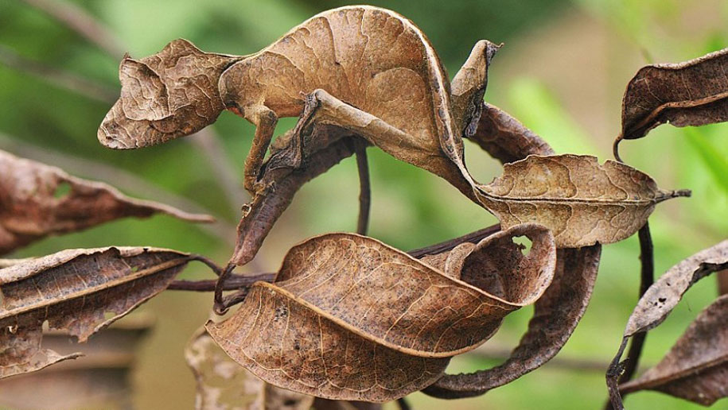

Slide 23
2017 National JMG® Leader Training
Lesson features:
Literature in the Garden &
Wildlife Gardener

Slide 24
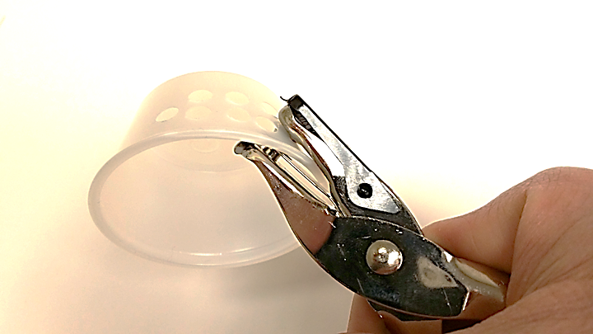
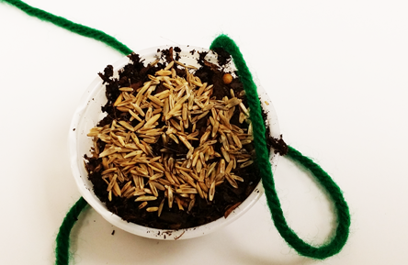
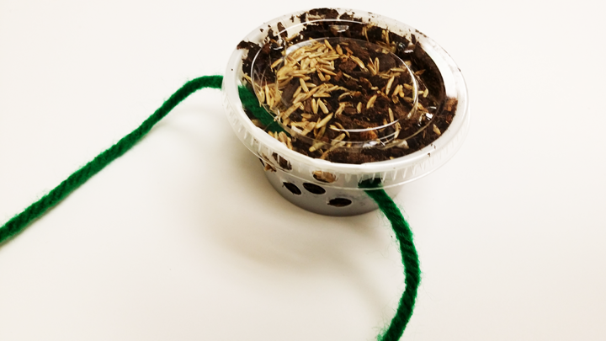
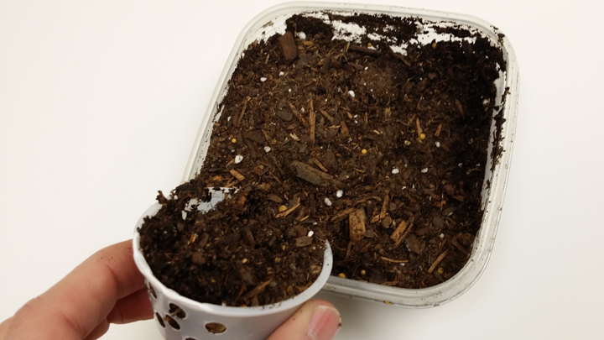
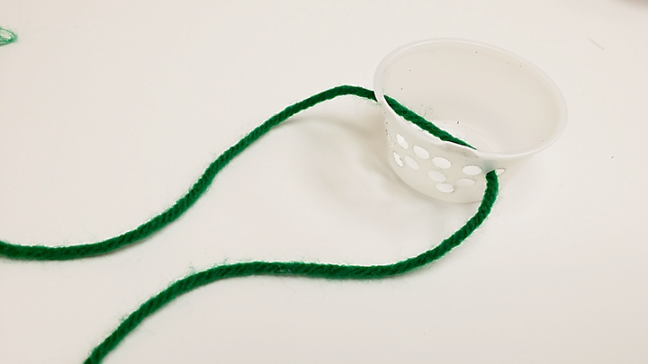
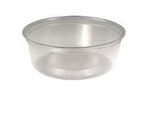
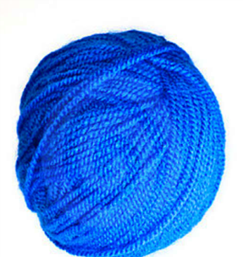
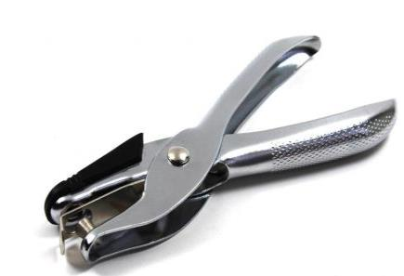
Growing Clean Air Neck Pet, p40

Slide 25
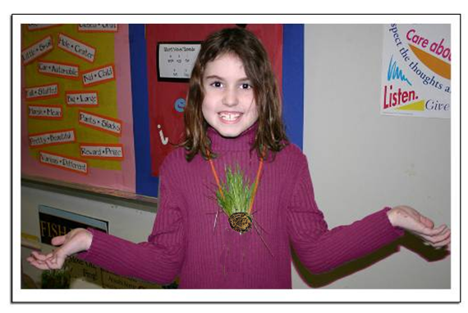
Growing Clean Air Neck Pet, p40

Slide 26
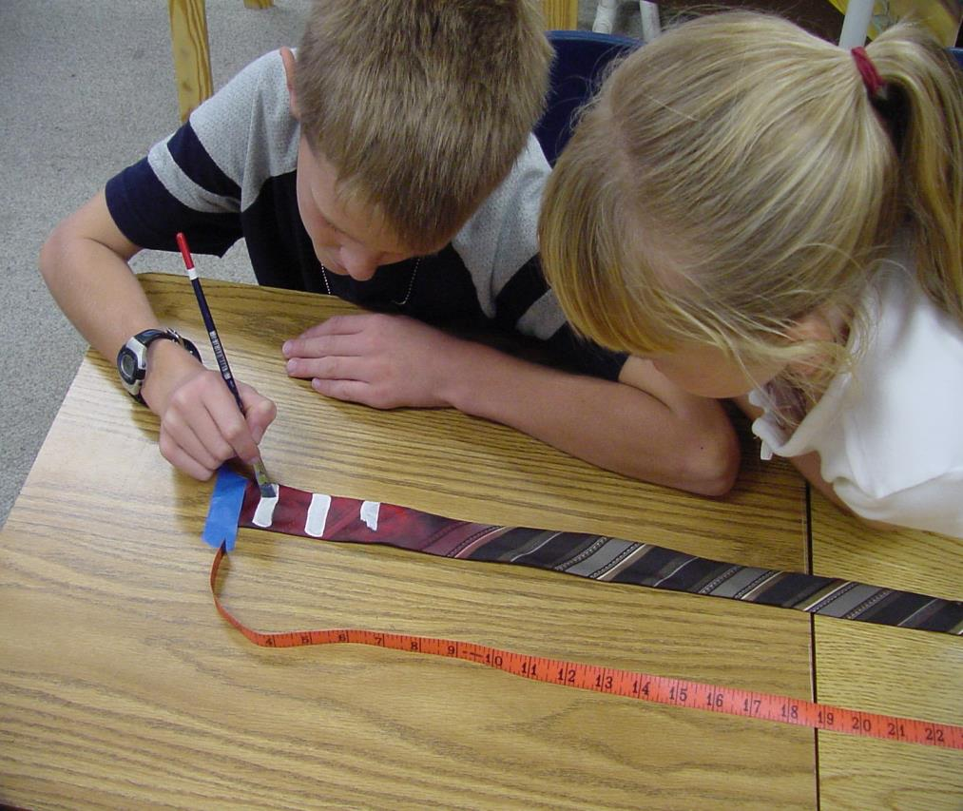
Ties that Coil, pg. 106

Slide 27

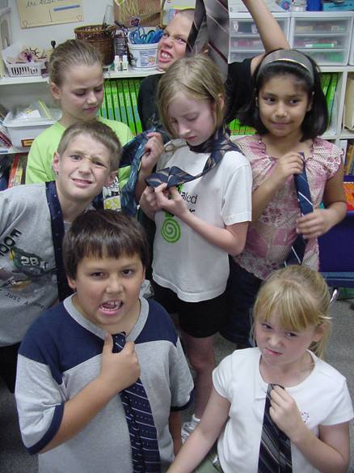
Ties that Coil, pg. 106
So, where do you get the ties ?!
Host an Ugly Tie Day!

Slide 28
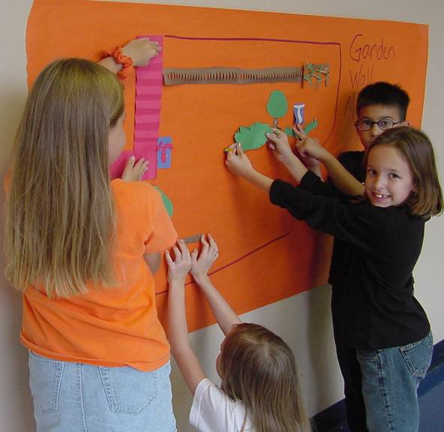
A la Carte Garden, pg. 137

Slide 29




Junior Master Gardener®
Golden Ray Series
^{thematic Level One Curricula}
chapters/themes:
Plant Growth & Development
Soils & Water
Insects & Plant Diseases
Ecology & Environmental Hort
Landscape Horticulture
Fruit & Nutrition
Vegetables & Herbs
Life Skills & Career Exploration
multi: Growing a
Vegetable Garden
^{stand-alone}
^{curriculum:}

Slide 30
2017 National JMG® Leader Training
Learn, Grow, Eat & Go!

Slide 31


2017 National JMG® Leader Training
Overview & Research

Slide 32
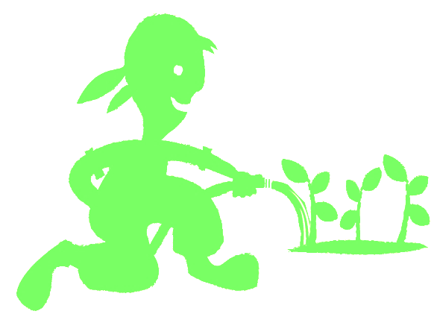
Benefits of JMG to children?
Increased leadership and personal responsibility
Improved academic achievement – particularly science
Increased parent and mentor involvement with youth in schools with JMG
Exposure to career exploration paths
Engagement in community service/service learning projects
Youth certification as Junior Master Gardeners
www.jmgkids.us/research
Notes:
32

Slide 33
Can Gardening Positively impact?
Child Health
Childhood Obesity Rates
Family health
Family mealtimes
Reach into the home
Notes:
33

Slide 34
Why Health Matters
Healthy kids are in school & in class.
Healthy kids are ready to learn.
Healthy teachers are at school with energy.
Healthy administrators and staff are engaged.
Healthy parents are at work or home –involved.
Healthy people have a higher quality of life.
Healthy people need fewer health resources.
Healthy communities are desirable places to live and work.
Notes:
34

Slide 35
Biggest Health Challenges
2017 National JMG® Leader Training

Slide 36
Relevance
High prevalence of childhood obesity is cause for concern because it is linked to negative health consequences for children and their families.
Vegetable exposure plus school gardening has been shown to improve consumption of fruits and vegetables.
Adding more frequent and more vigorous physical activities during school has been shown to improve student fitness and weight.
The greater the frequency of vegetable consumption and physical activity by parents, the greater the consumption of these foods and exercise by their children.
With child obesity rates among low-income children in Texas ranging from 10% to over 20%, engaging schools and families in prevention efforts is critical.
Notes:
36

Slide 37
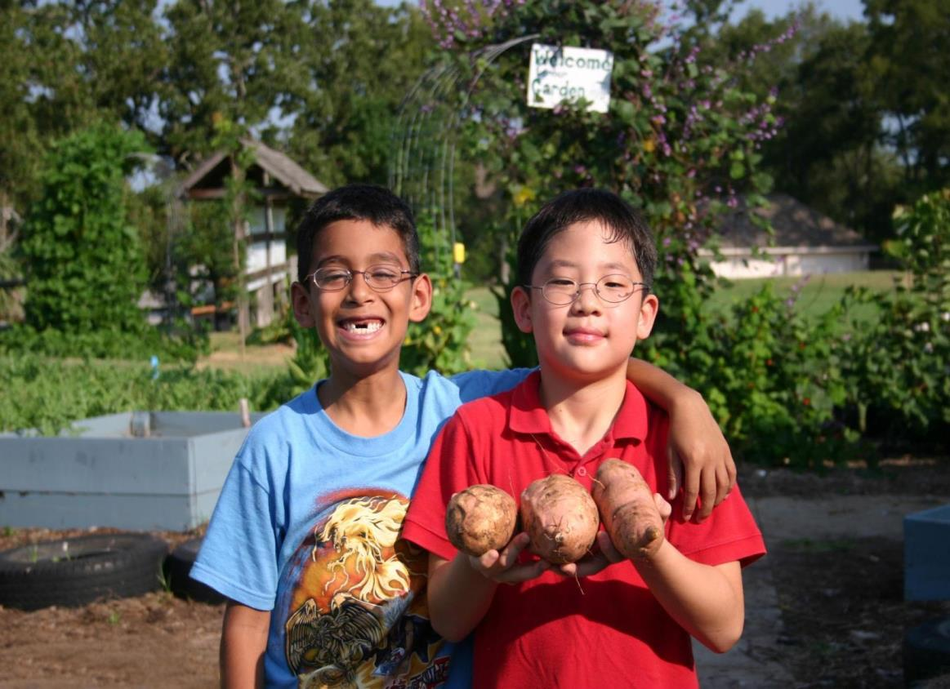









Research Project: Texas Grow! Eat! Go!
Expansion/Implementation/Research
Study Project

Slide 38
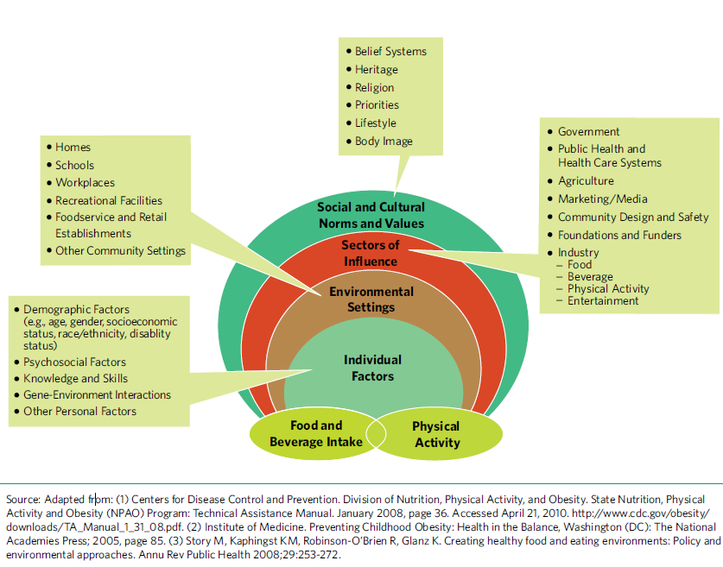
Social Ecological Model
2017 National JMG® Leader Training

Slide 39

Who participated in research study
32 Title 1 schools, 5 Texas school districts/5 Texas counties
  Corpus Christi ISD/Nueces County
  Dallas ISD/Dallas County
  Huntsville ISD/Walker County
  Klein ISD/Harris County
  Willis ISD/Montgomery County
8 schools per district (3 to 5 - 3rd grade classes)
3rd and 4th grade students & their families
School personnel at each school
County extension staff and county volunteers
(Master Gardeners; Master Wellness; interns)
Largest research and evaluation study ever done on the
Junior Master Gardener program

Slide 40
Methods
Methods:
Instrumentation:
Pre-post test study with control group
Sample:
  28 schools across 5 cities in Texas
  ~ 1,600 student-parent pairs (C1 + C2 = 1326)
Schools randomized in each school district to receive varying combination of intervention components:
  CATCH only (control)
  CATCH + WAT
  CATCH + JMG
  CATCH + WAT+ JMG
Intervention implemented in 3rd grade classes
  Students measured pre-post intervention in 3rd grade and at the beginning and end of 4th grade
Student Surveys (read by research staff)
Parent Survey
Child BMI (height & weight)
Teacher Surveys and interviews
Extension Project Specialist Interviews
Interviews with school administrative staff
Teacher Program Activity Time Log (SNAP-Ed Match Form)

Slide 41
Parent Demographics: Race/Ethnicity
Language Spoken at Home
English | 72%
Spanish | 27%
Other | 1%
Notes:
This is a nice visual of the ethnic distribution:
Over 25% of the participating parents spoke Spanish as their main language

Slide 42

Parent Demographics:
Percent of Parents Reported to Receive:
48.6%
reported receiving
NO benefits
12.0%
42.3%
6.2%
WIC
SNAP
Other
2017 National JMG® Leader Training

Slide 43
Behavioral Targets
Twelve Core Behaviors
Child Behaviors | Parent/Adult Behaviors | Child & Parent/Adult Interaction Behaviors
Increasing fruit and vegetable consumption (F&V) | Increasing access and availability of F&V in the home | Gardening together
Decreasing sugar sweetened beverage (SSB) consumption | Limiting availability of SSB | Preparing snacks and meals together
Increasing physical activity (PA) | Providing PA opportunities for children | Engaging in PA together
Decreasing sedentary activity | Limiting children’s sedentary activity | Eating snacks and meals together

Slide 44
Summary of Significant Outcomes by Treatment
 | CATCH | CATCH+ JMG | CATCH+ WAT | CATCH+ JMG+WAT
Student
Vegetables preference | * | * |  | *
Vegetable consumption at school |  | * |  | *
Knowledge | * | * | * | *
Engagement in moderate PA | * |  | * | *
Sedentary Behavior (decrease) |  |  | *
Vegetable consumption at home
SSB consumption (decrease) |  |  |  | *
Parent
Home availability Vegetables
Home availability SSB |  |  | * | *
Parental support for child PA |  | * | *
Parental support for decreasing sedentary behavior
Student/Parent Interaction
Gardening together |  | * | * | *
Preparing food together |  | * |  | *
Eating meals together |  |  |  | *
PA together |  | * | *

Slide 45
Cohort 1 Parent Preliminary Results
Parent Participation in TGEG Activities by Treatment Group (Percent responding Yes)
Question | WAT (n=106) | JMG (n=118) | WAT + JMG (n=110)
Have you received TGEG materials from your child's school? | 38% | 49% | 56%
Have you attended TGEG events at your child's school? | 15% | 8% | 12%
Has your child talked about CATCH lessons at school? | 9% | 25% | 30%
Have you received any CATCH materials from your child's school? | 10% | 19% | 19%
Has your child talked about Go, Slow, Whoa foods? | 27% | 36% | 41%
Has your child talked you about their school garden? | 35% | 76% | 81%
Did you help build the garden at your child's school? | 12% | 9% | 14%
Did you read any TGEG vegetable recipes that your child brought from school? | 21% | 50% | 60%
Have you made any TGEG vegetable recipes for your family? | 9% | 26% | 30%
Have you watched any 'Dinner Tonight' videos? | 8% | 8% | 5%
Have you watched any of the 'Kids & Veggies' videos? | 15% | 8% | 5%
Have you and your child read any TGEG family stories together? | 11% | 13% | 16%
Did you walk with your child for Bonus Miles for class? | 26% | 16% | 27%
Have you played WAT Bingo with your child? | 8% | 6% | 5%
Did you volunteer to walk with your child's class at school? | 8% | 8% | 12%

Slide 46
LGEG Evidence Based Outcomes
Significant Improvements in:
MVPA
Total Physical Activity
Vegetables Consumption
Vegetable Preferences
Healthy Beverage Preferences
Self-Efficacy & Knowledge
Parent/child cooking, physical activity and gardening
Reaches into the home to support positive family health practices
BMI Significantly Reduced for use of LGEG
BMI Significantly Reduced for use of LGEG
Preliminary Conclusion: Family-focused garden, nutrition and physical activity
programs significantly improve health behaviors in children.
Notes:
Through the course of this research, we saw
child vegetable preference, and nutrition and plant science knowledge increased significantly
child physical activity with parents increased, while screen time decreased.
Parents encouraged eating vegetables and increased gardening with their children.
Teachers reported that students were more attentive and had high participation in LGEG learning activities.
41% of Parents learned about “Go, slow and whoa” foods
81% of parents learned about the school gardens
60% of parents read the recipes sent home and 30% tried the recipes
27% of parents walked with their child to earn “Bonus Miles” for their child’s class.

Slide 47
2017 National JMG® Leader Training
Lessons: Weeks 1-4

Slide 48



Slide 49
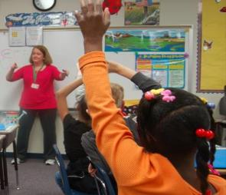


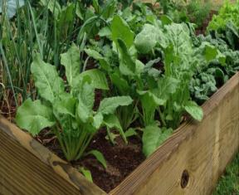

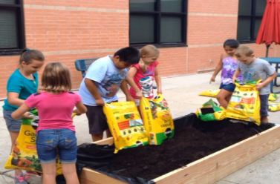

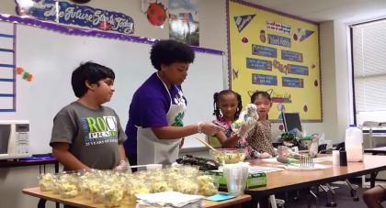

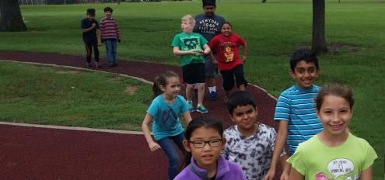


Slide 50
Primary constraints &
stressors of our teachers
Time & testing
Many others… funding, societal/family
issues, training, etc.

Slide 51


CURRICULUM DESIGN
10 weeks,
2 lessons/week
Sequence, integration,
pace, & flexibility

Slide 52
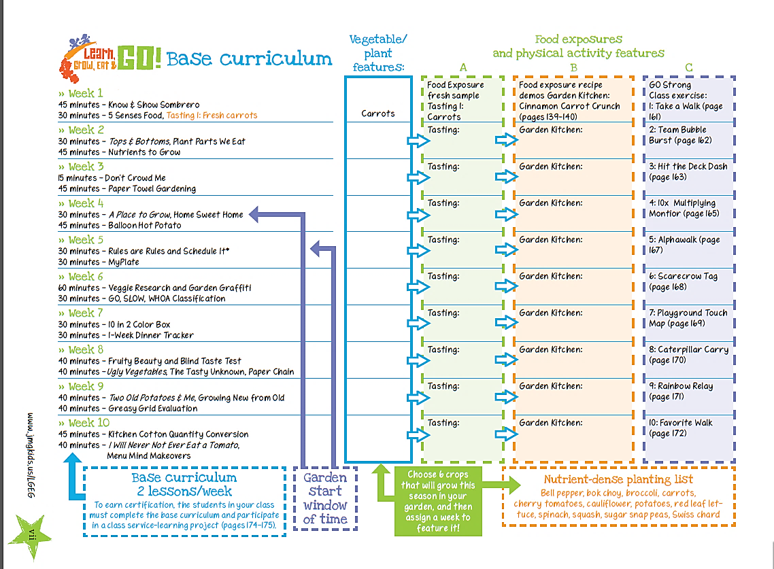

Slide 53


Lesson
Overview

Slide 54
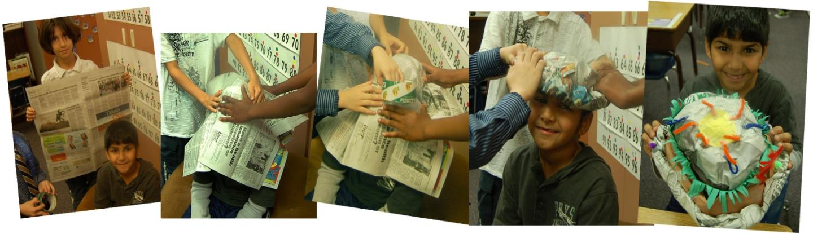
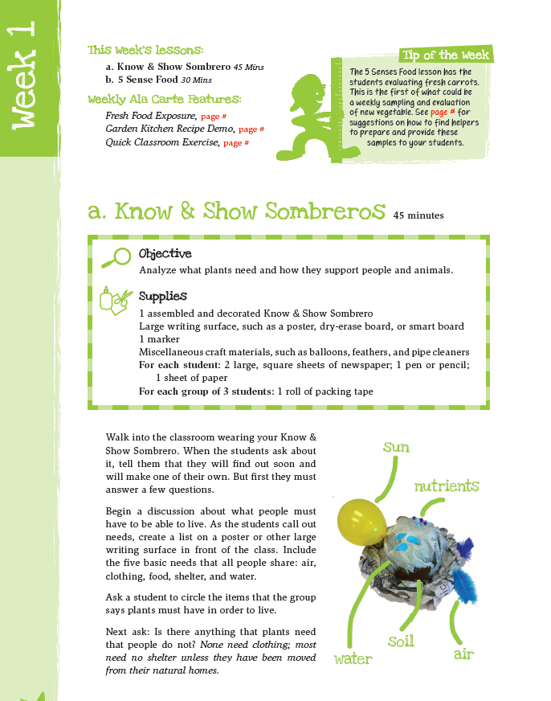

Plants need P.L.A.N.T.S.
P
L
A
N
T
S
lace
ight
ir
utrients
hirsty
oil
Notes:
Do know and show sombrero with participants

Slide 55
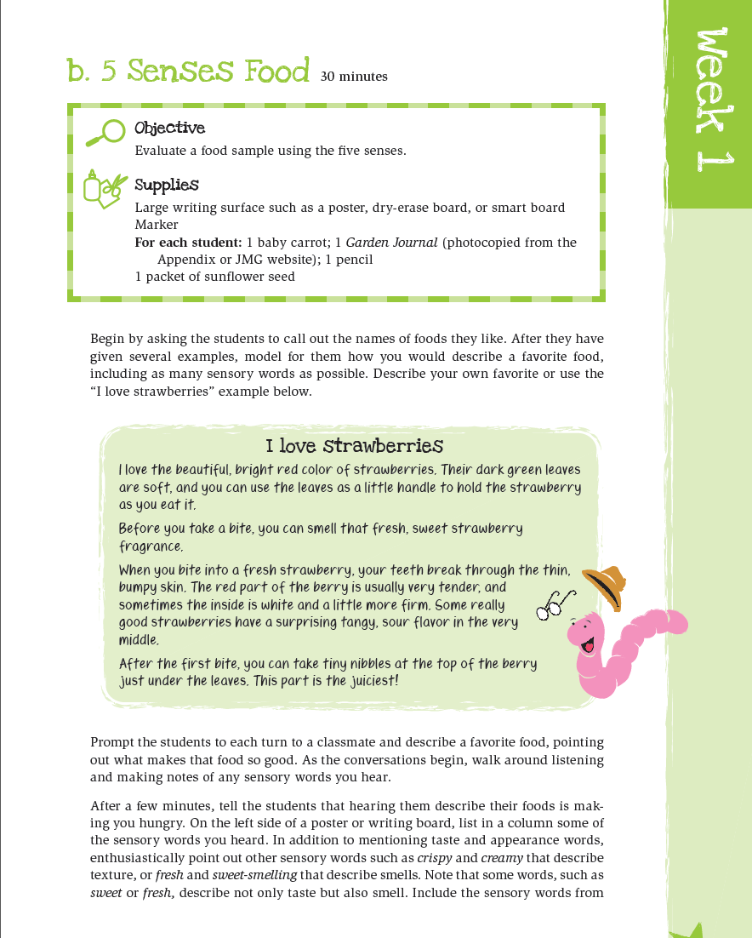




Slide 56

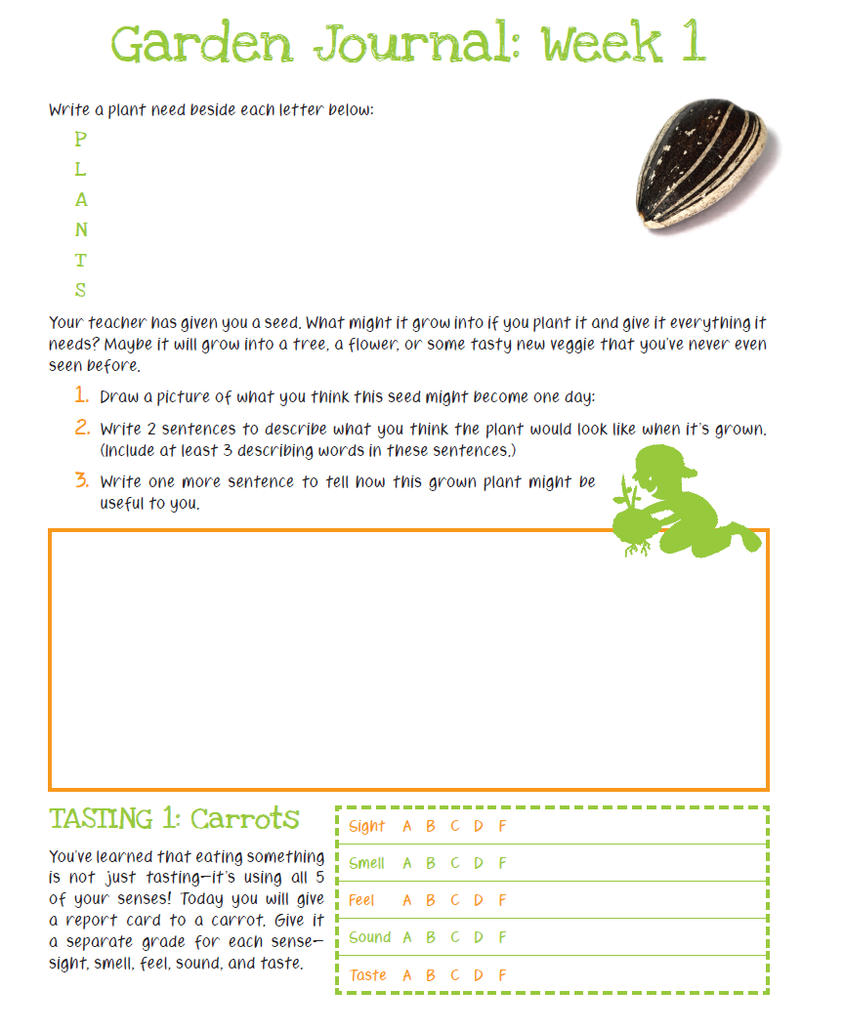


Slide 57



Know & Show Sombrero 45 mins
5 Senses Food 30 mins

Slide 58

first food exposures
- one bite fresh,
raw samples

Slide 59

2nd food exposures
Garden
Kitchen
recipe
demos

Slide 60


Slide 61




Slide 62


Slide 63



Slide 64




Slide 65






Slide 66








Slide 67

Local
Extension
support
provide
info on
your local
planting
dates

Slide 68


Slide 69


Slide 70


Slide 71


Slide 72



Slide 73

C.
B.
A.

Slide 74


Slide 75

Soon after students evaluate & select the location in the Home Sweet Home lesson, the garden can be built.

Slide 76








Slide 77
2017 National JMG® Leader Training
Overview: GROW Section

Slide 78






Lots of Options!

Slide 79


The LGEG school garden project specifically designed to be:
Simple
Easy
Quick
Inexpensive

Slide 80



Quick & Easy Garden Kit
Getting Materials
Building the Garden
Planting It
Provides
teachers
with
steps on:
with the help of one volunteer with a drill!

Slide 81


Quick & Easy Garden Kit
Getting Materials: What are we growing?
- growing 6 seasonal crops
- 3 square ft. plantings of each
- extra space for kids to choice plantings
- simplicity of steps/supplies
Sample cool season 3x7 raised bed:
kids’
choice
kids’
choice
kids’
choice

Slide 82





Quick & Easy Garden Kit
How to get materials to school?
- can be loaded for you at building store
- whole garden fits in back of van or small truck
(borrowed vehicle, potential volunteer task?)

Slide 83






/LGEG
www.JMGkids.us

Slide 84



Grow:
Quick & Easy Garden Kit Pages include in curriculum

Slide 85
2017 National JMG® Leader Training
Lessons: Weeks 5-6

Slide 86



Slide 87





Food Guide Pyramid

Slide 88


Slide 89



Slide 90



nutrient stone:
Class makes 3 different stones for each crop growing:
label stone:
benefit stone:

Slide 91

nutrient stone:
Class makes 3 different stones for each crop growing:
label stone:
benefit stone:

Slide 92
nutrient stone:
a Quick & Easy
option to stones/paint:
Use stir sticks and
permanent markers
Class makes 3 different stones for each crop growing:
label stone:
benefit stone:

Slide 93

Teaching students to be critical of advertisements
Evaluate foods and classify based on amounts of:
unhealthy fats, added sugars, and salt
Whoa foods – contain the most
Go foods – contain the least

Slide 94


Be critical of advertising:
Are all 5 food groups really represented?
Students come to consensus
To classify each food as Go
Slow
or Whoa

Slide 95

Classification charts included to illustrate
how foods are classified

Slide 96
2017 National JMG® Leader Training
Overview: EAT Section

Slide 97


Food Exposure

Slide 98


nutrient-dense planting list
carrots
leaf lettuce
broccoli
potatoes
swiss chard
bell pepper
Cauliflower
spinach
bok choy
cherry tomatoes
sugar snap peas
squash
(choose 6 to plant in your
school garden)

Slide 99



  Exposure to new foods:
    evaluation of ray, fresh samples
    Garden Kitchen recipe demos
    engage kids & encourage willingness to include new foods.
  Research shows children share those food experiences at home.
  Classroom & kid-friendly recipes
    Limited set-up space, cooking
    equipment, and time
    Cooking skills
    Model healthful food choices
    & safe kitchen practices

Slide 100

first food exposures
- raw sample
during Journal
time

Slide 101
Garden
Kitchen
recipe
demos
http://jmgkids.us/garden-kitchen-recipe-demos/
Notes:
Show video

Slide 103



Fresh sample prep & Garden
Kitchen Recipe Demos
have been led by many different partners including:
Cafeteria staff
Room moms
PTO Parent Committee
Volunteer organizations
(like Junior League, Lions Club)
Coaching by local Extension agents/volunteers.
Under supervision of
certified food handler.

Slide 104




Slide 105





Slide 106
2017 National JMG® Leader Training
Marketing to Schools/Youth Groups

Slide 107








Marketing to Schools, After School Programs and Community Based Clubs

Slide 108
“School Speak”
Top Ten Things To Know When Working With Schools…..
10. Schools, holistically, don’t know of Extension & if they do, aren’t aware of all that we do.
    education by Extension staff and volunteers is key
9. Relationship building and sustainable partnerships are imperative.
    seek out the district/school “cheerleader(s)” to get started & maintain these partnerships
8. Daily school schedules are everything – schools live and die by them.
    be flexible and have plan as to how to communicate when changes occur

Slide 109
School Speak
Top Ten Things To Know When Working With Schools
7. School program planning is like retail marketing…..working 6 months to 1 year out.
    reach out no later than Jan-March to secure spot on training calendars for late spring; summer; early fall
6. School security is a hot button.
    Ask for protocols & follow them
5. The Principal/Building Leader makes on average 225 one to two minute
decisions in a day.
    they care about your inquiry, but you may be #215 on their decision timeline
    **see #9…..remember it’s about relationship building
4. Hugs & High Fives are freely given by the “little” people!
    hug & high five the “little” people back

Slide 110
School Speak
Top Ten Things To Know When Working With Schools
3. Schools can be defined by the state’s assessment numbers. Texas example:
    understand that the state’s assessment test is called the STAAR;
    understand that the state’s standards for teaching are called the TEKS;
    remind schools that LGEG has vetted curriculum standards/correlations & is a school and community building program
2. Curriculum is a living, breathing document & changes to meet the needs of students.
    reinforce the interdisciplinary strategies of LGEG & the fun in project based learning
1. Your new job title may consist of : The Garden Lady/Man; Best Friend; The Recipe Lady; The Grow, Eat, Go, Person!
    Make new business cards & name badges ☺
Schools are one of the best places to experience the talents of our future leaders in our communities, our state & our nation!

Slide 111
Extension/County Staff Coordination
FCS & BLT
4-H
EFNEP
Horticulture or Ag

Slide 112
School District & Community Based Clubs
Organization & Coordination?
District Nutrition Dir.
& School Cafeteria Staff & City or ISD After School Programs
Who Are Our Targets?
Administration Curriculum Dir.
& District Health and Wellness Dir.
& PE Department/PE Teachers
School & District Facilities/Maintenance Department Personnel
Campus Principal/Assistant Principal &
Classroom Teachers
& Parent Liaison Coordinator

Slide 113
Volunteer Coordination
Who Are Our Targets?
Master Gardeners
&
Master Wellness
Community
Groups
ie: Non-profits;
University program interns;
involved community participants
School PTO Parents
&
Parents
Targeted Programs
ie: ESL Parent Volunteers

Slide 114
Interacting with the Schools, After School Programs & 4-H Spin Clubs
Find your “Cheerleaders” - Campus/District Reps, 4-H Spin Club Leader, Community Youth Organizer
  Classroom Teacher; PE Teacher; Cafeteria Manager; Administrator; Parent Liaison Coordinator; Club Leader; Youth Organizer
  Utilize Marketing Tools
Work with key individuals to set date for training of key personnel and staff
  Utilize Marketing Tools
Collaborate and assign roles
  Classroom, After School Teachers/Youth Leaders = LGEG weekly classroom concept/lesson delivery
  PE Teachers; Classroom teachers = GO Strong Exercise Activities/WAT extensions
  Cafeteria Manager; Parent Volunteers; Master Volunteers = Assist with food prep for tastings and demos
  Facilities/Maintenance; Teachers; Parent Volunteers = Assist with garden prep & install

Slide 115
Key Components of Program Interactions
Determine the best method of communication by visiting with key individuals
Once the LGEG program is approved and partnership has begun think about:
  Should each Teacher/Leader directly contact the agent in charge of program area or should they go through the Lead Teacher?
  Email, text, or phone calls?
  Regularly scheduled meetings?

Slide 116

The LGEG Curriculum:
Teachers and Youth Leaders
Empower implementers to make the LGEG curriculum their own
  Remember….. 10 overarching teaching Concepts
  2 hands-on lessons per Concept
  GO Strong class exercise activities per Concept
  Concepts are implemented in sequence
  Some may prefer to spread lessons over a week or even a
  month (if its used in a Club setting), others may choose to
  do them all at once
  There is no right or wrong way to implement

Slide 117

LGEG and the Utilization of Volunteers
Review Volunteer Descriptions in CEA Toolkit (found on LGEG website) for tasks related to gardening, nutrition and physical activities
Recruitment of volunteers to work with LGEG
Utilize existing volunteer base within Extension
  Master Gardener (MGs)
  Master Wellness (MWs)
Work with schools and clubs to engage parent
volunteers.
Involve and Engage ALL in program planning!

Slide 118









Marketing
Tools
LGEG Marketing Folders
LGEG Banner
TEKS/ STAAR Correlations
TGEG Infographic
LGEG
Website

Slide 119
How to Jump Start LGEG and Build Excitement with Students, Parents and the Community?
A STRONG KICK OFF EVENT!
Kick-off is the opportunity to recruit additional parent and community volunteers to participate in LGEG program to assist the county staff and teachers
Coordinate with an existing school or community event, if possible
  Open House; Health and Wellness Night; etc.
Utilize booths and exhibits you already have…make it fun and interactive
Have a designated location set up to recruit volunteers and ask them what area of volunteering they are interested in
Kick Off Event helps to excite the school about LGEG!
  Great time to use your LGEG display Banners

Slide 120

Role of Volunteers
Volunteers should assist with specific tasks
  Provide volunteers with tasks that need to be done through CEA Toolkit job descriptions and training (found on the LGEG website)
Use your currently trained volunteers (MGs and MWs) to train new LGEG volunteers
Encourage your trained volunteers to
think about how project can continue
without their involvement and
encourage them to train school
volunteers in this way.
BUILD……. Sustainability!

Slide 121

Role of Volunteers
Volunteers should help Teachers, After School Teachers, 4-H Spin Club Leaders, Parents, Students climb the mountain
  Our role is NOT to have them ride piggyback on us (CEAs/Master Volunteers) up the mountain
Sustainability is the goal
  We want LGEG participants able
  to climb the mountain and
  help others reach the top!

Slide 122
Sustainability of LGEG Program
SWEAT EQUITY
  Pride comes from clientele being a part of the process
    Ex: kids tying their shoes
  The LGEG garden should be viewed as the students’ garden, the school’s garden, the youth club’s garden not something that was built for them under the cover of darkness. Model the process so that it can be replicated by the teachers/students/parent volunteers in future
  This is not always the easiest process for Extension and Extension volunteers, but is necessary to build community support and sustainability
  Be creative in how you train and utilize Extension volunteers to train additional community volunteers, parents and to engage the students in all aspects of the program including the gardening, cooking, and physical activity

Slide 123










