Slide 1

2017 JMG® Specialist Training
Online Curriculum/Training Courses

Slide 2
Remember constraints & stressors of our teachers:
Professional
Development:
Time & testing
Many others… funding, family issues AND training.
Teachers want it & need it!
A study of teachers from 315 elementary schools
92% felt garden-related training needed
69.1% indicated most interested in the easily accessible, in-service training
http://www.joe.org/joe/1998october/rb4.php

Slide 3
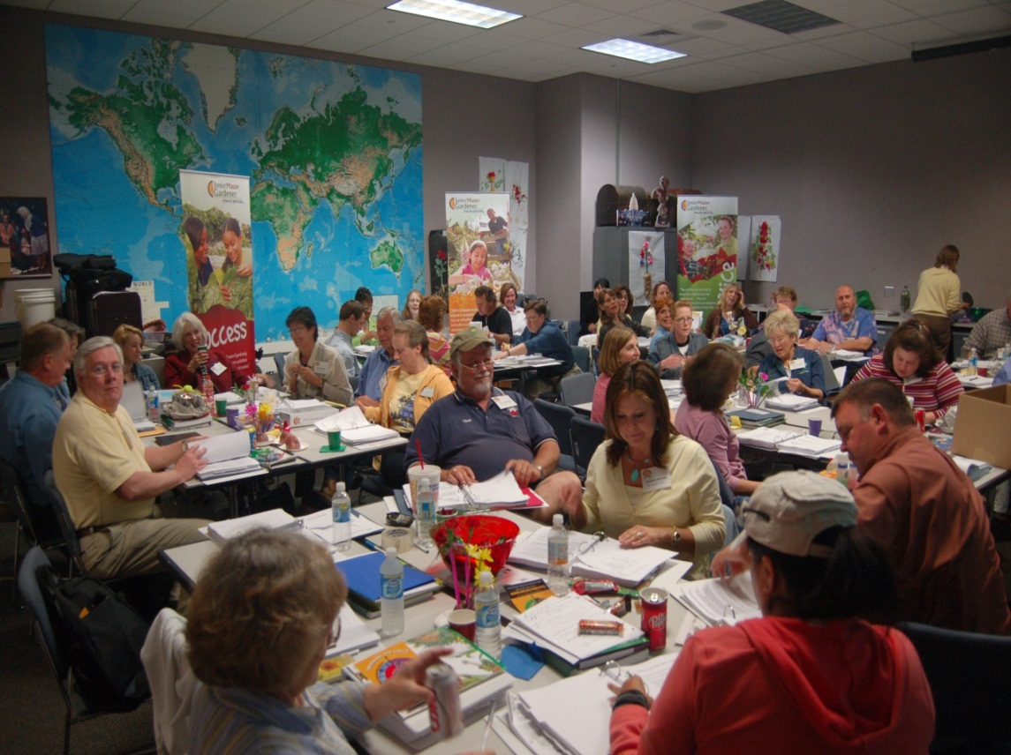
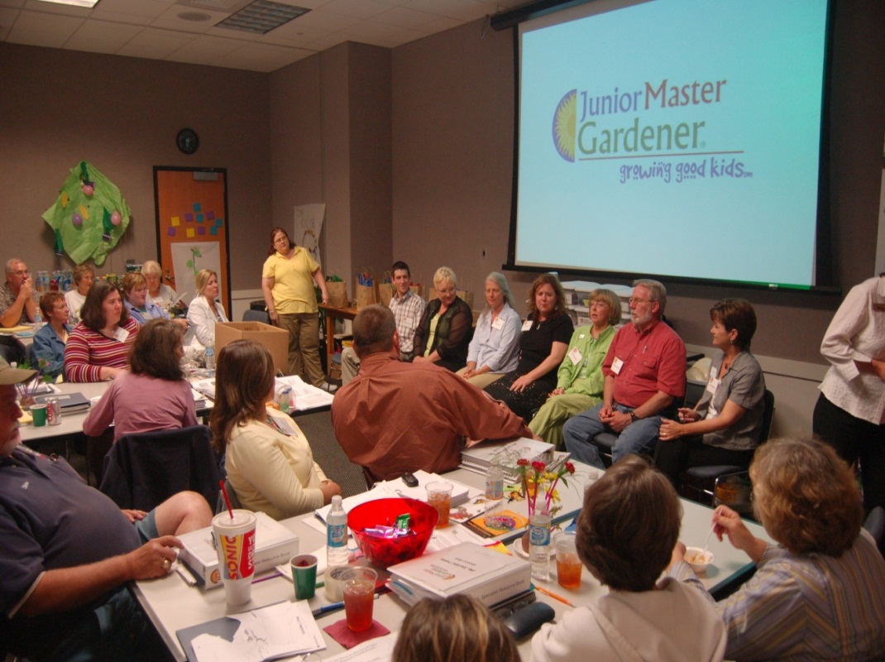
Advantages of Online JMG® Teacher Trainings:
      Less Extension time, resource
      Greater reach, greater flexibility
      More accessible
        delivery/multimedia/comprehensive

Slide 4
modules:
  Plant Growth
  Plant Processes
  Importance /Uses of Plants
  Plant Classification
  Plant Parts
  Plant Needs
  Propagation
each module contains
Sharpening science 2-3:00
(animation/overview to substantiate science background )
Classroom lesson & teacher tip 7-10:00
(visual teaching resource for classroom use)
Bonus learning experience 3-5:00
(classroom lesson video clips of classroom in action)
Resources
(links to resources: pdf printable, recommended resources
at other sites, etc.)

Slide 5
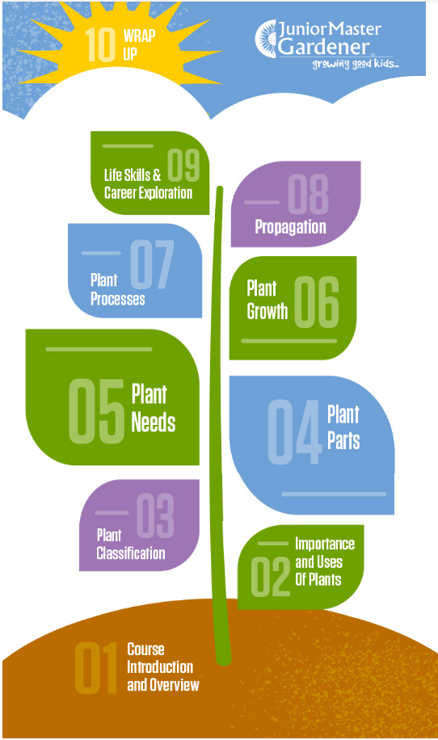


extension.org

Slide 6

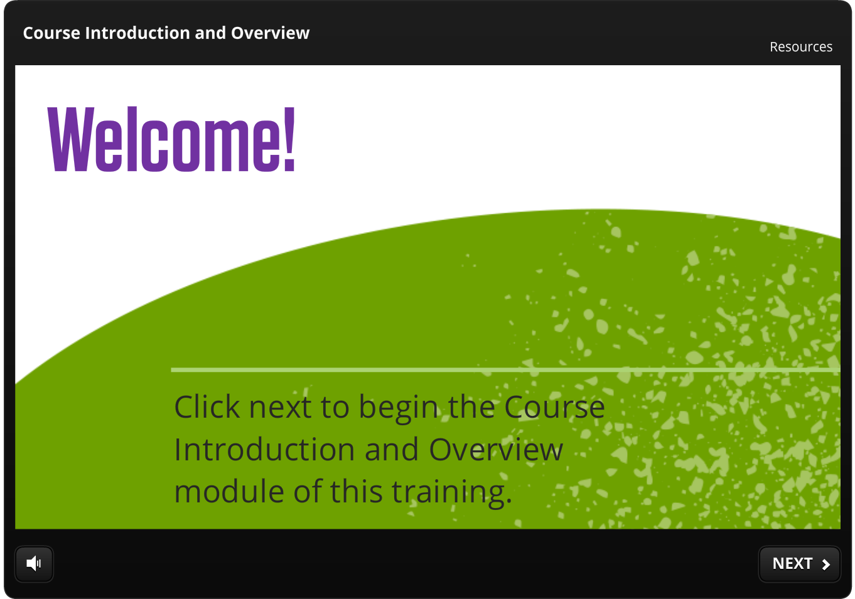

Slide 7
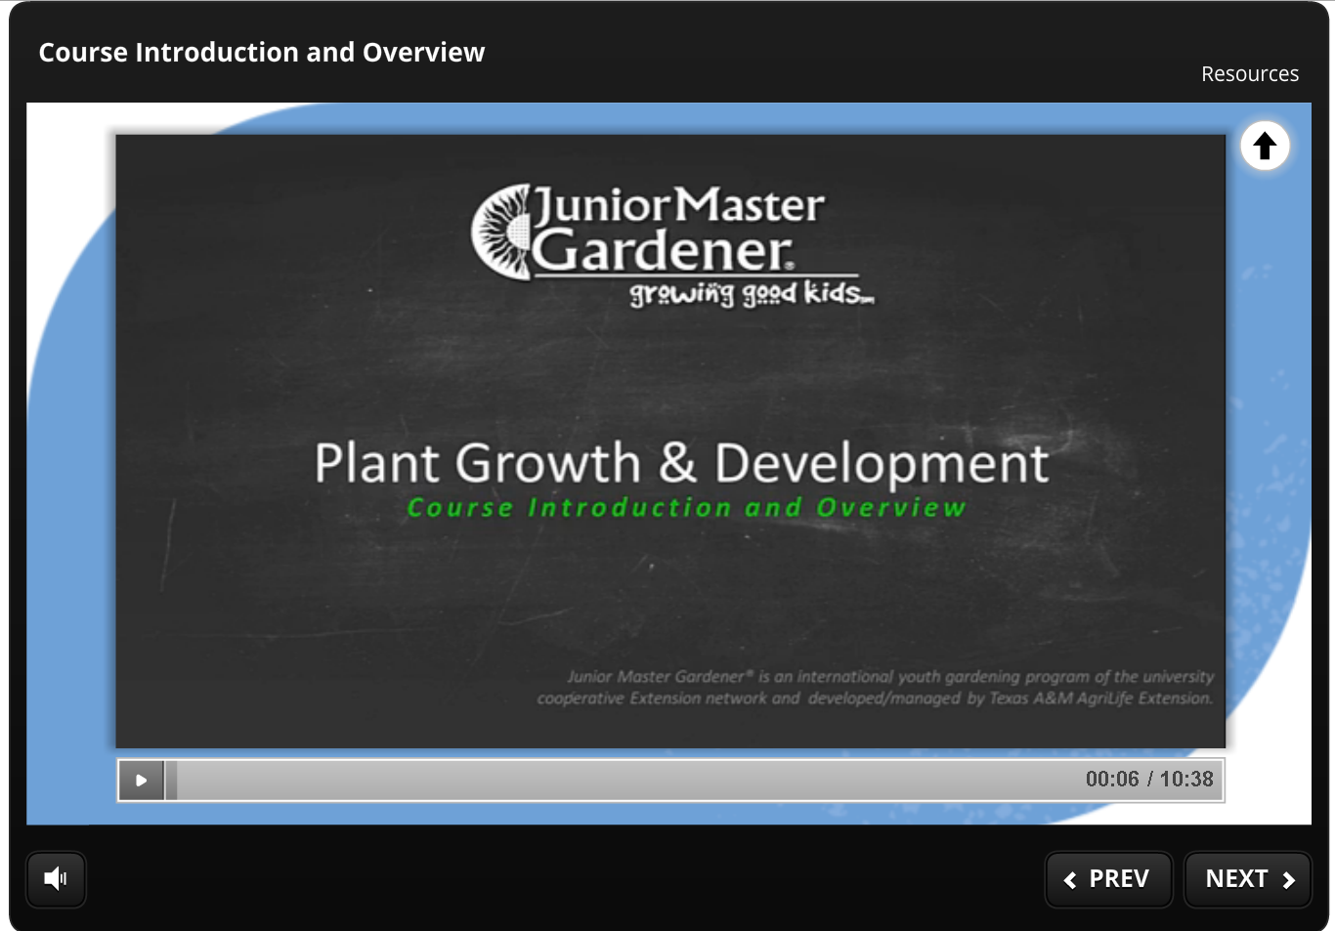
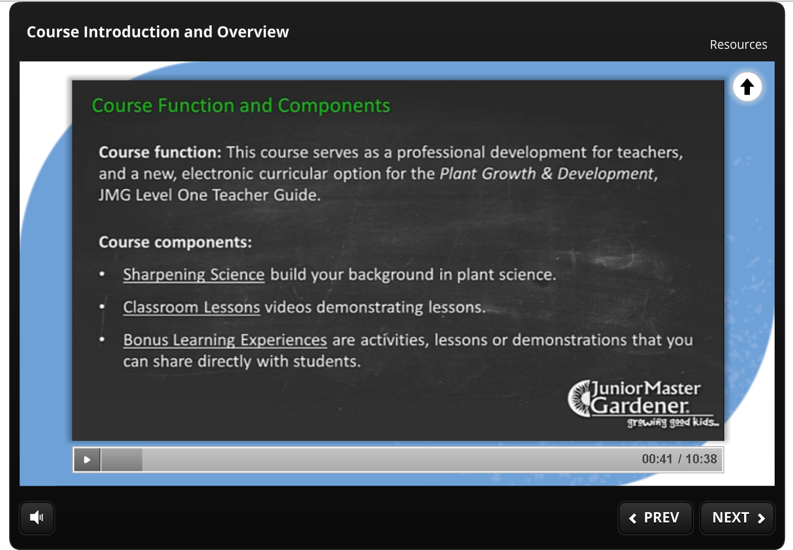
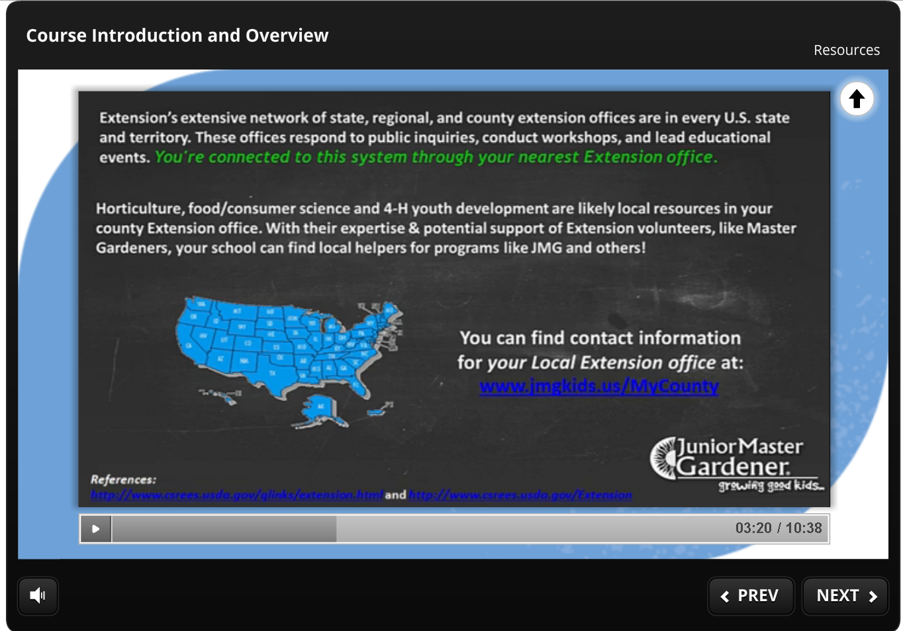

Slide 8
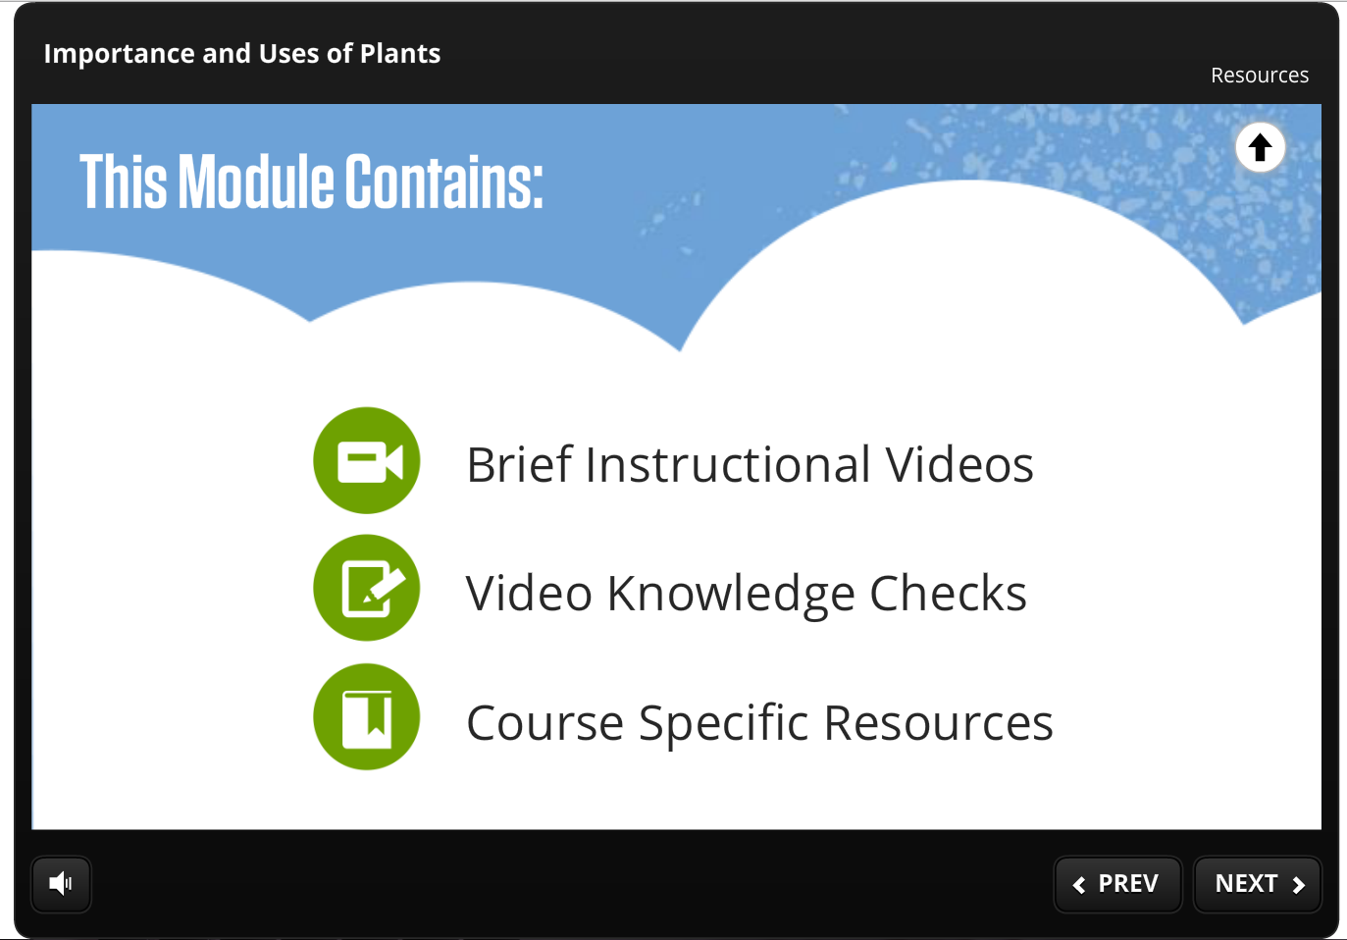
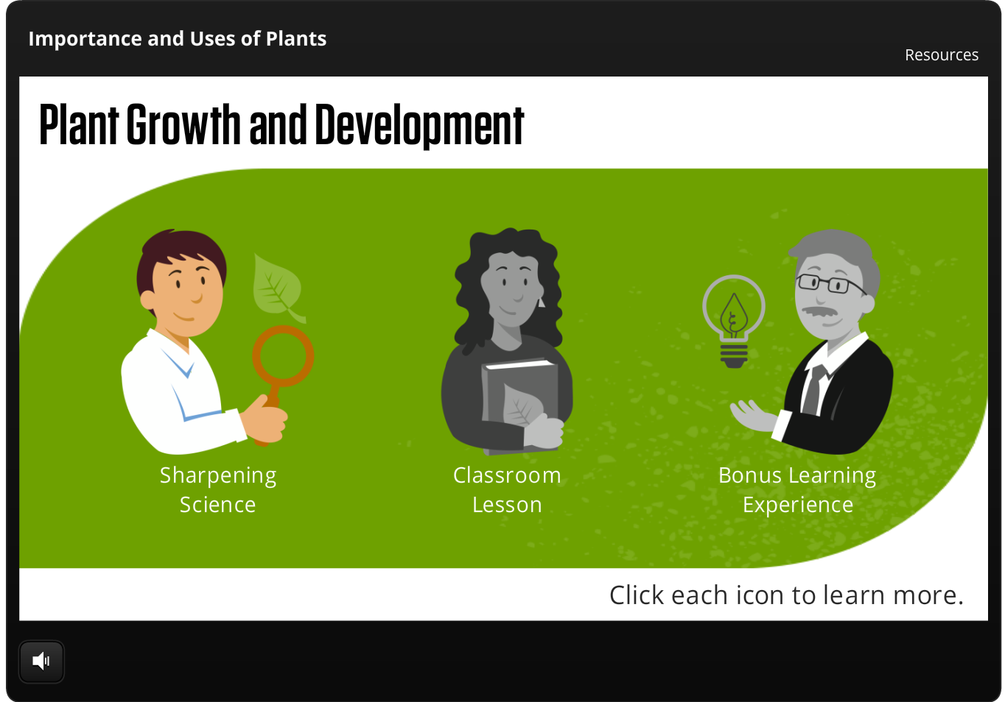

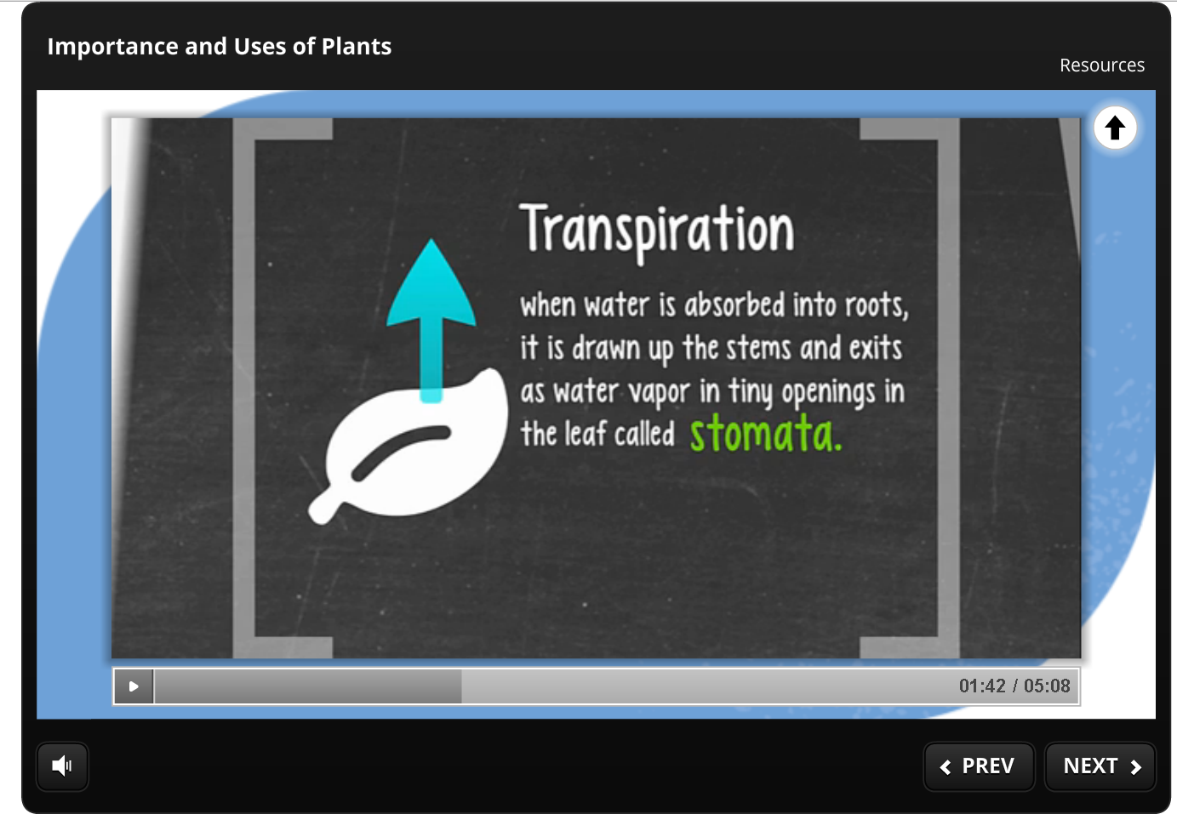
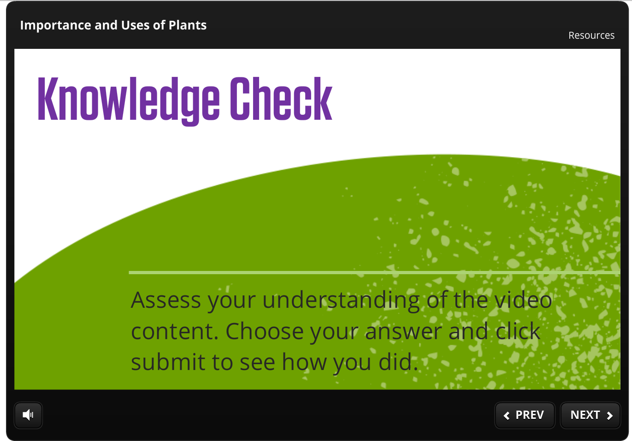
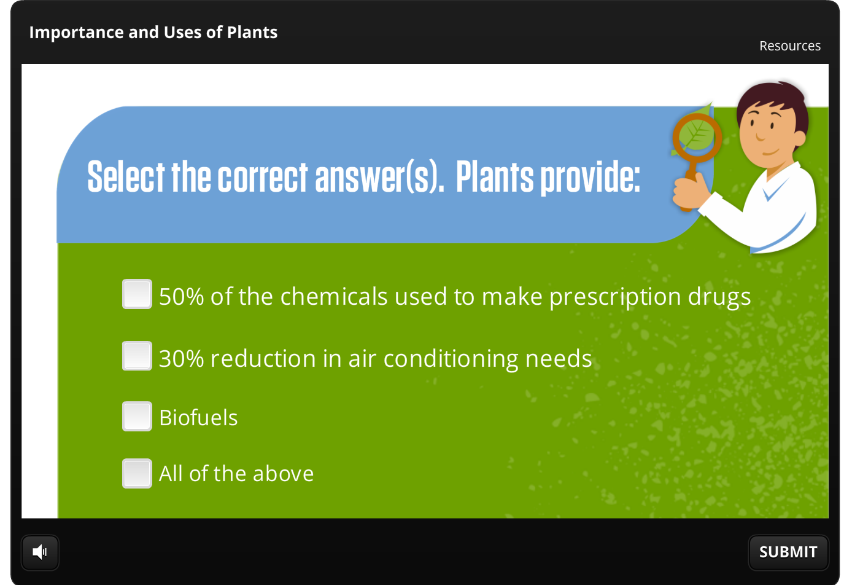

Slide 9
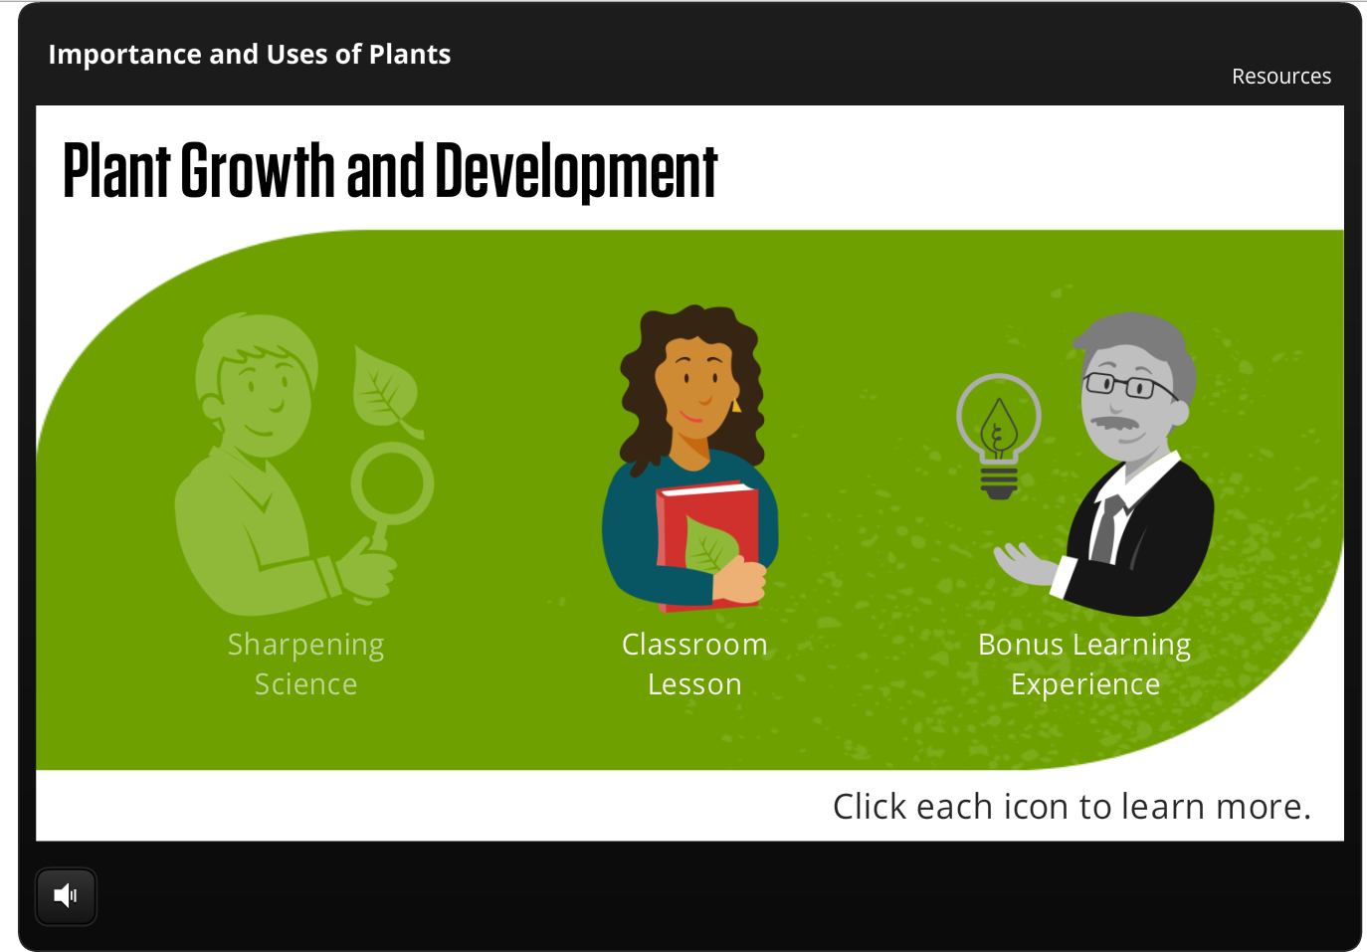
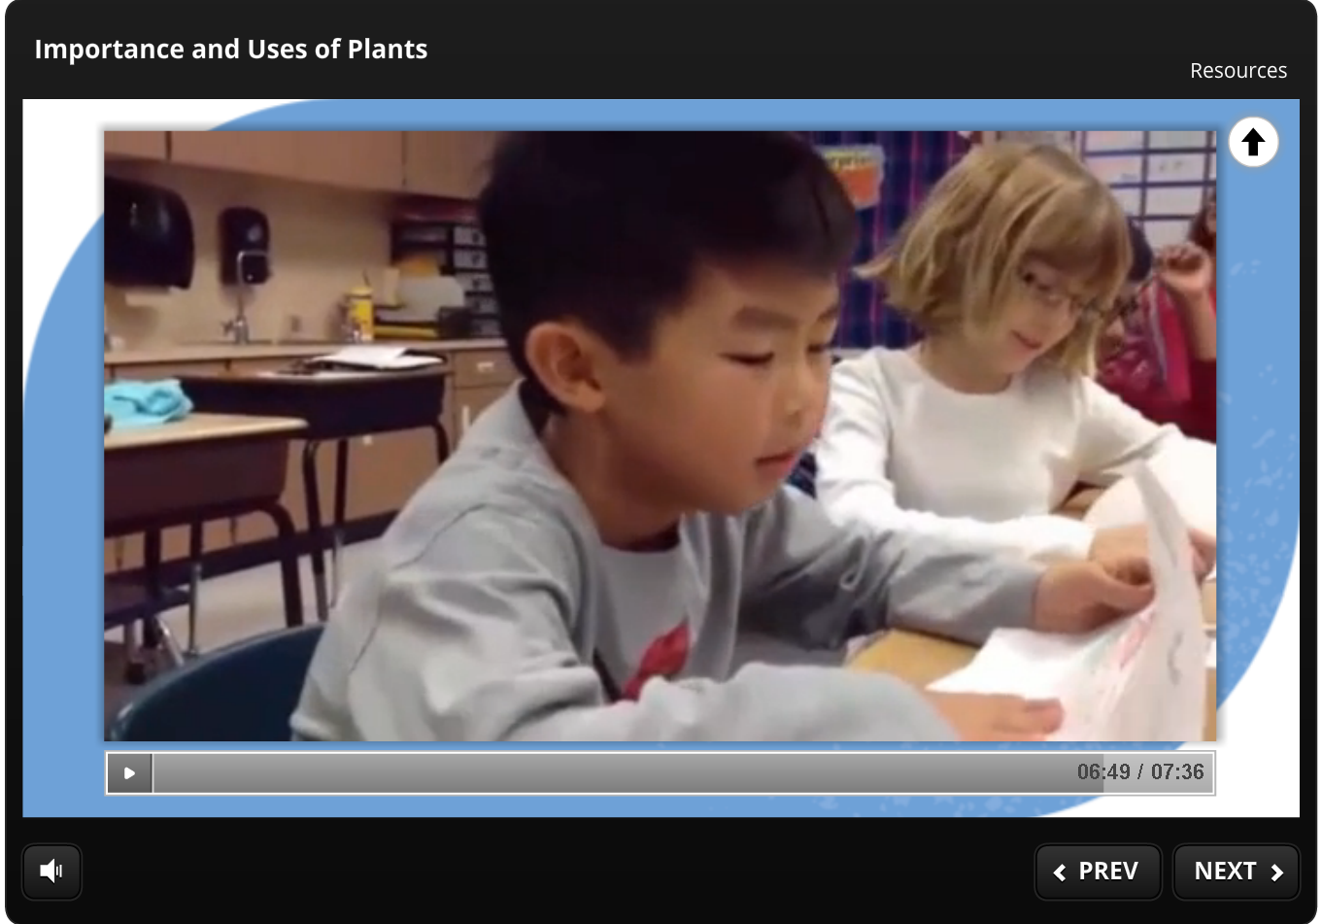

Slide 10
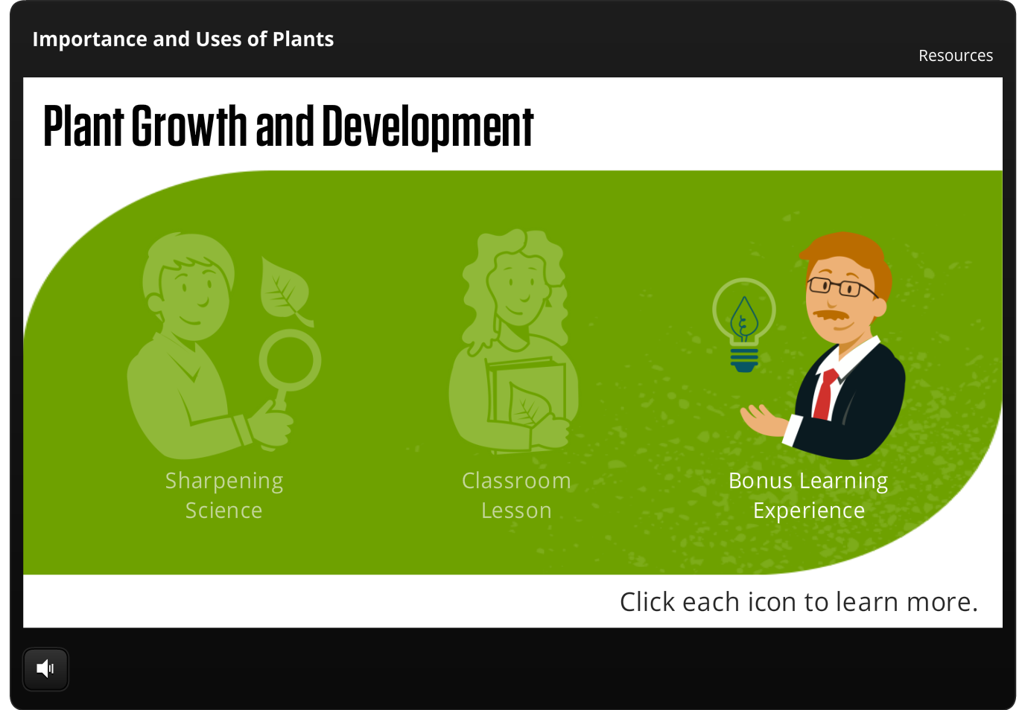
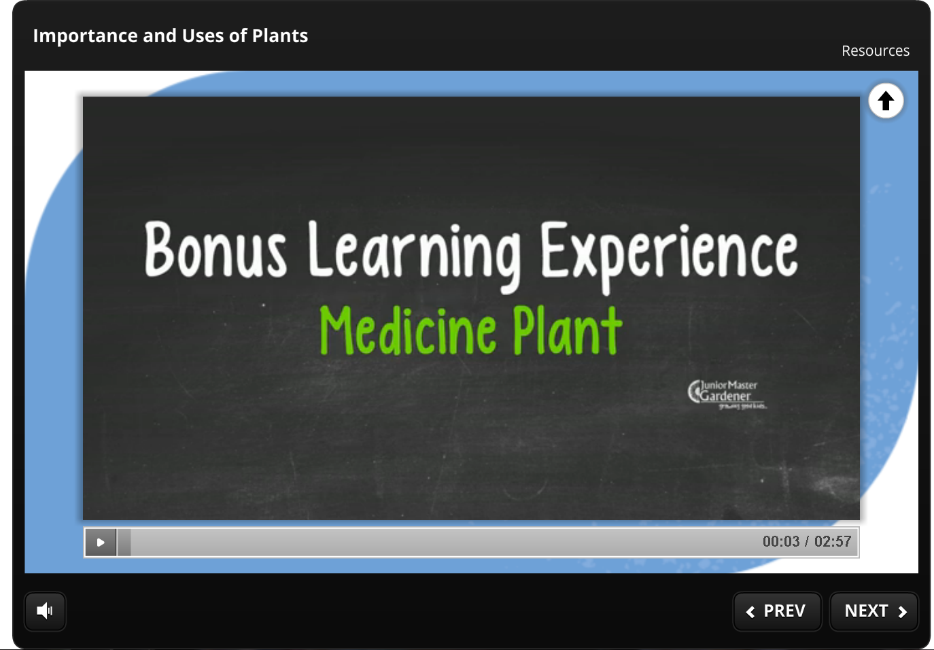
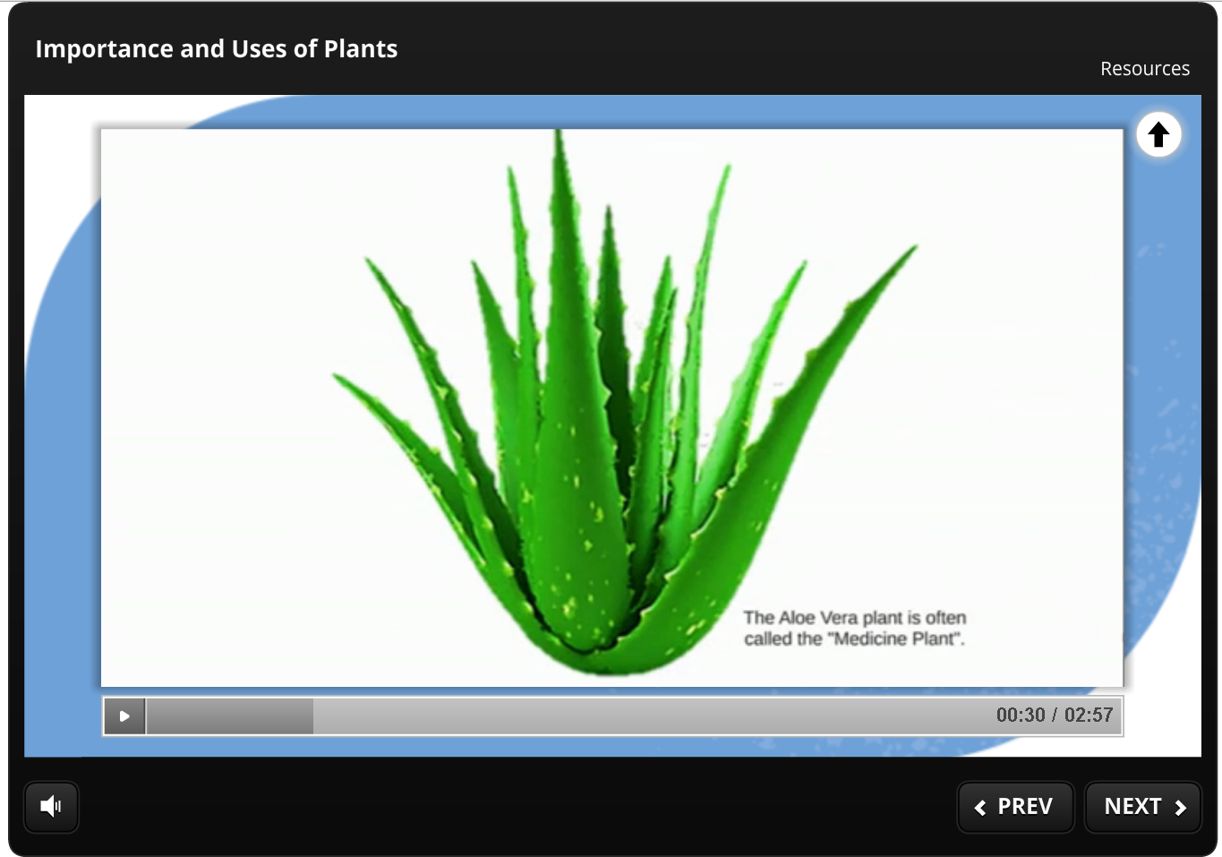
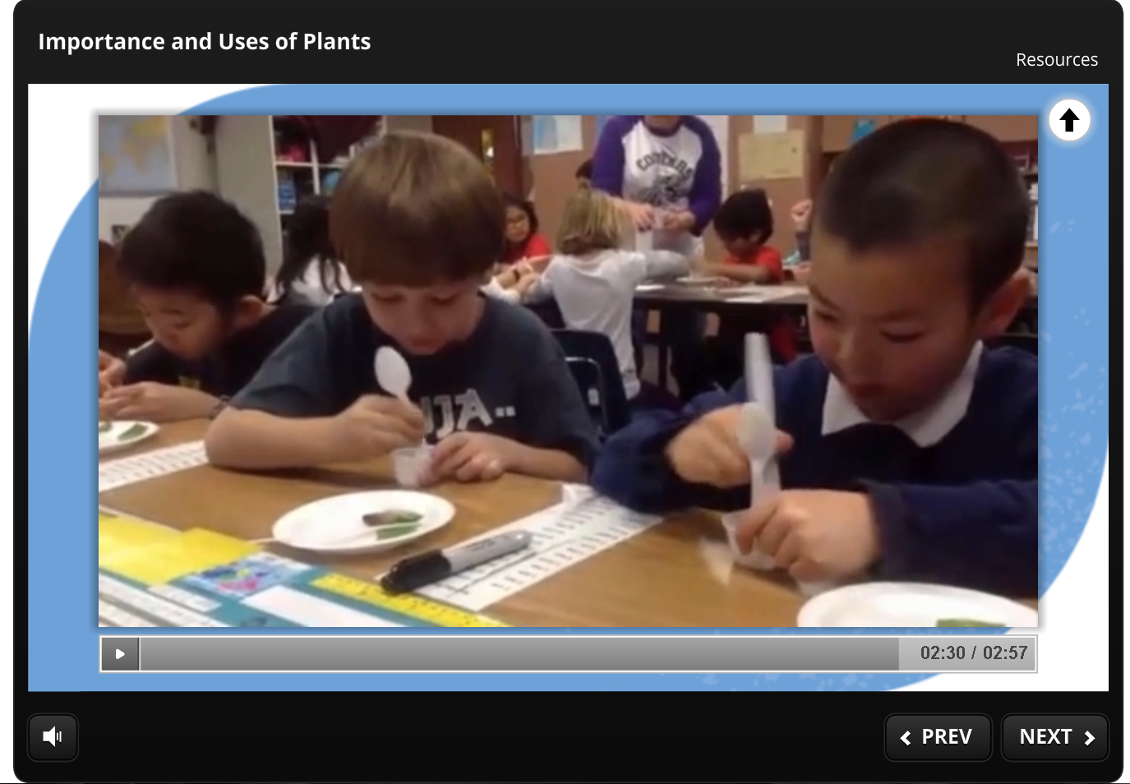
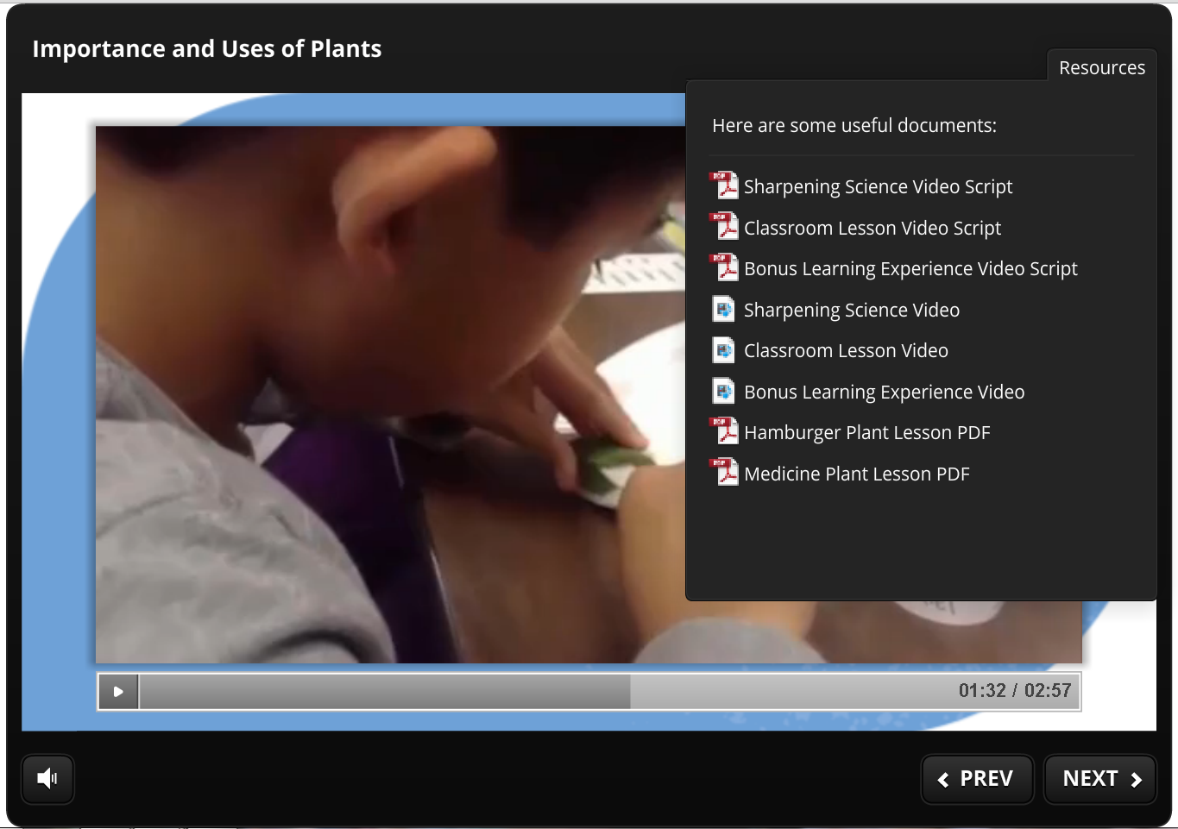
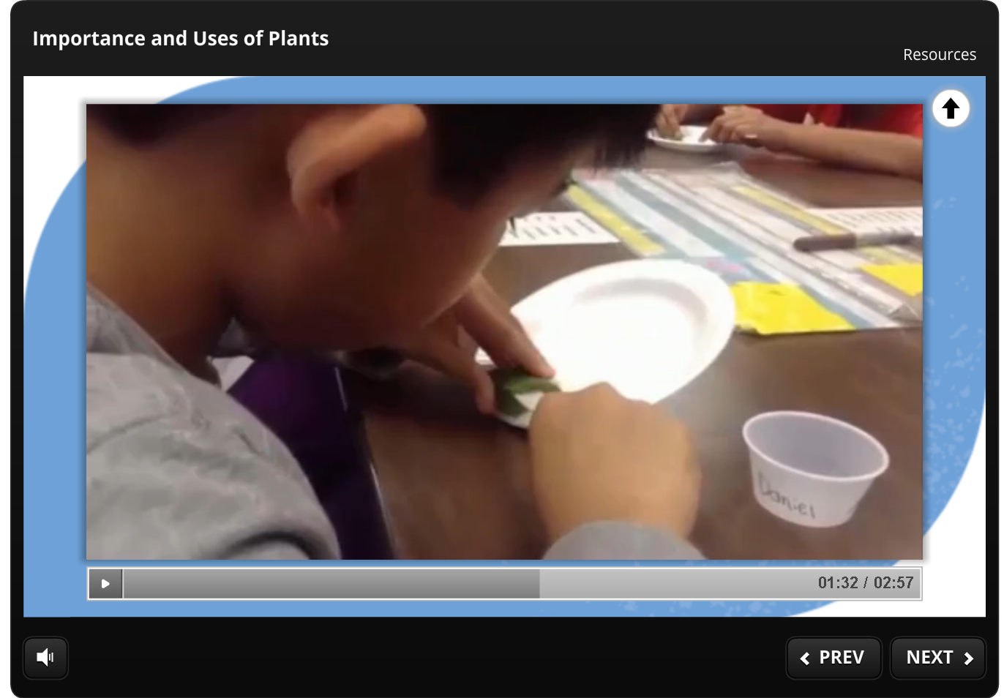

Slide 11
JMG Moodle Course
2 Purposes
As a teacher training course:
Teacher CEUs per module
Continually accessible
As multimedia/web-based curriculum:
Multimedia/multifaceted
Includes printables from hard copy
Allows for certifications
Updateable

Slide 12
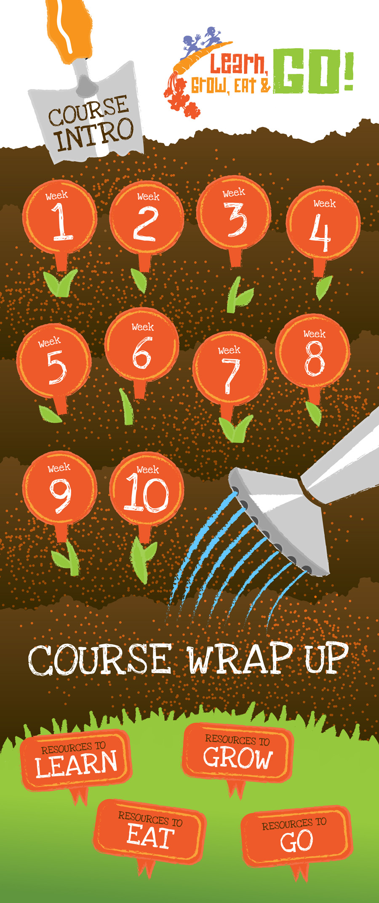
extension.org

Slide 13


4 professional hours
1 full year access
Printable lessons
Easy-to-follow, 10 weekly modules
Sharpening Science components to provide the teacher/leader helpful garden science & food science info
See lessons modeled by teacher in a public school classroom

Slide 14
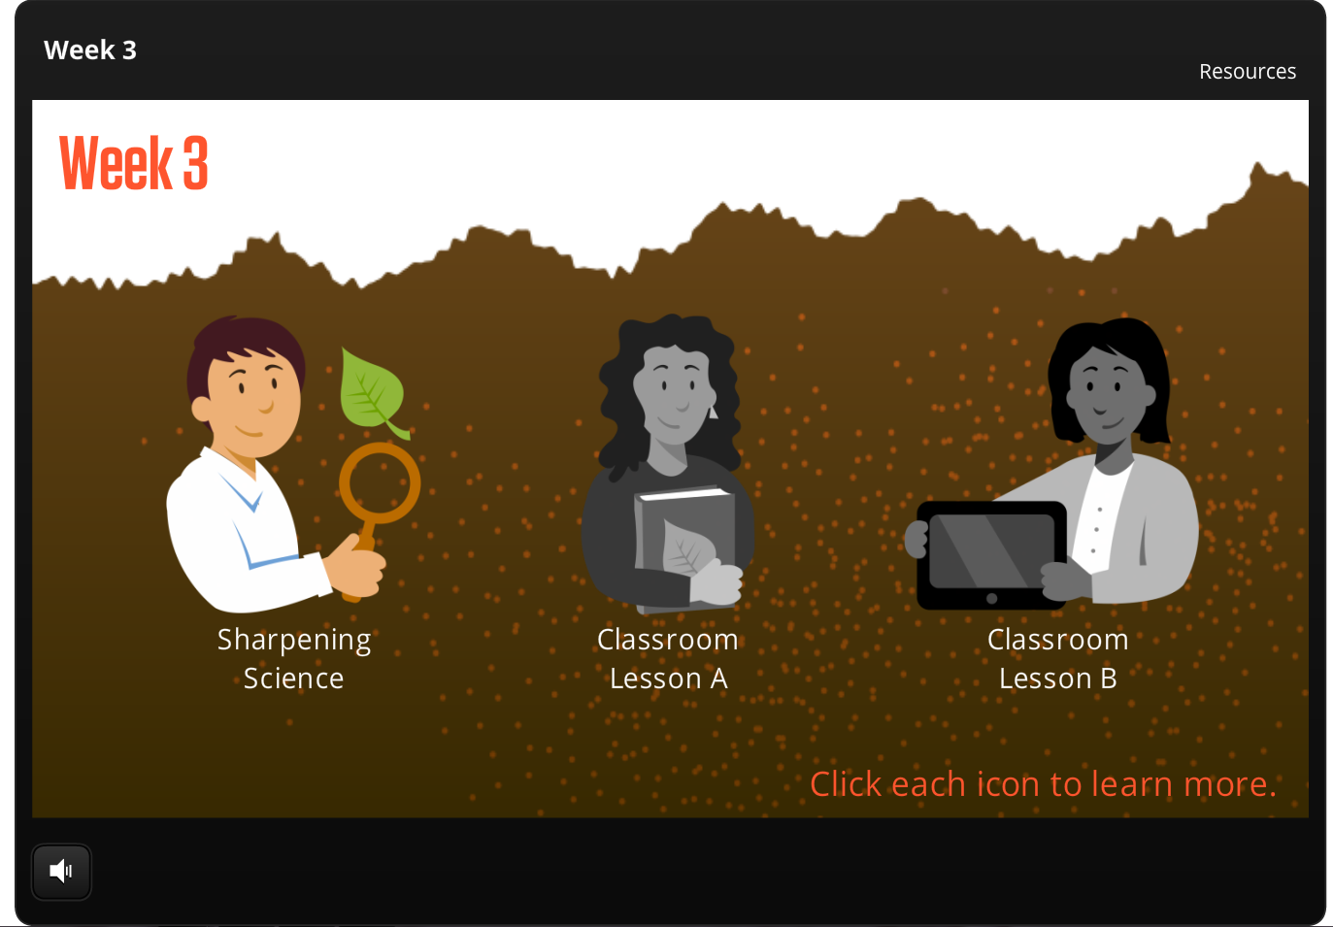

Slide 15
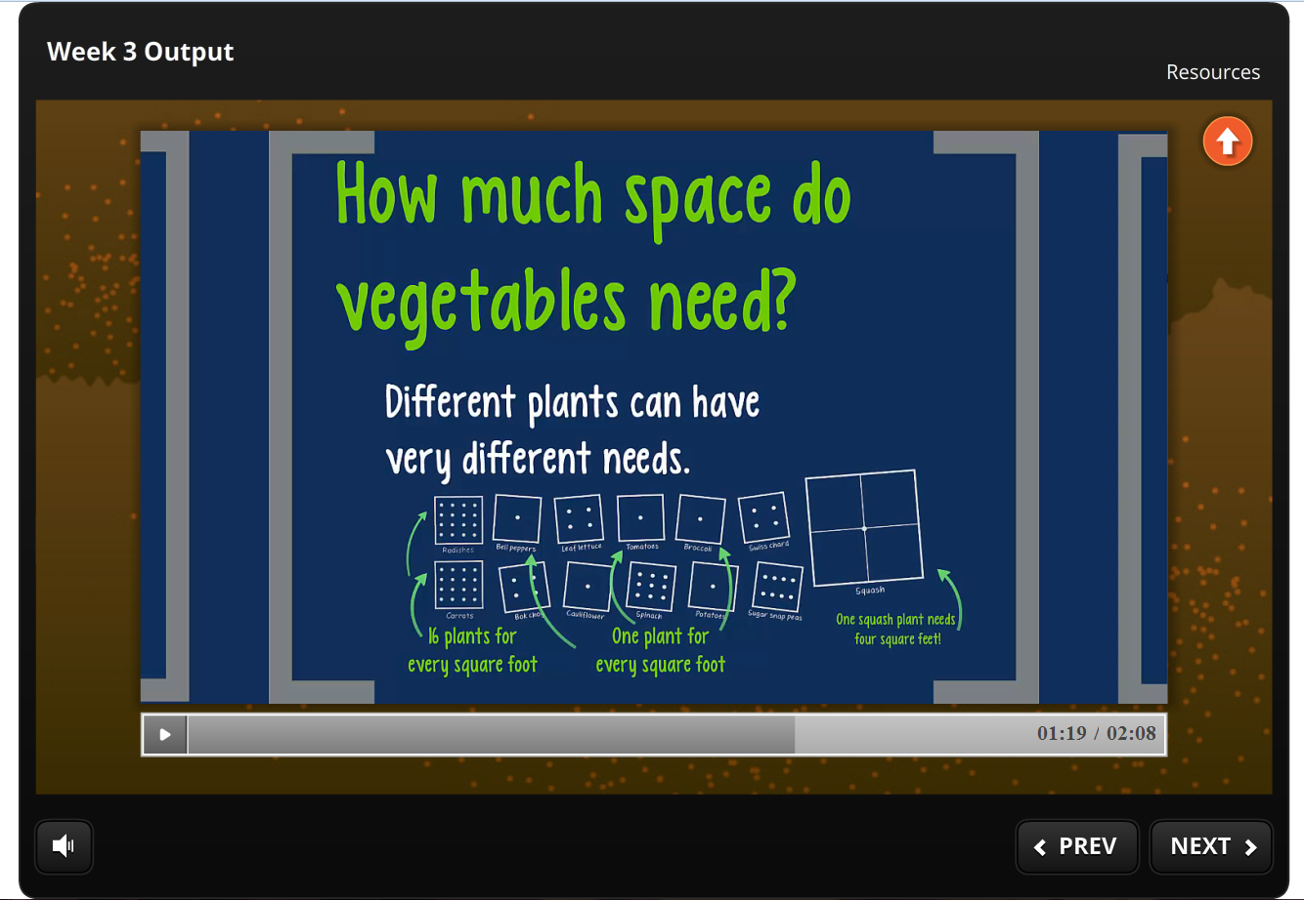

Slide 16
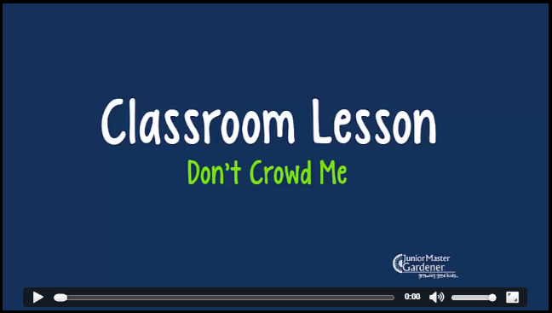
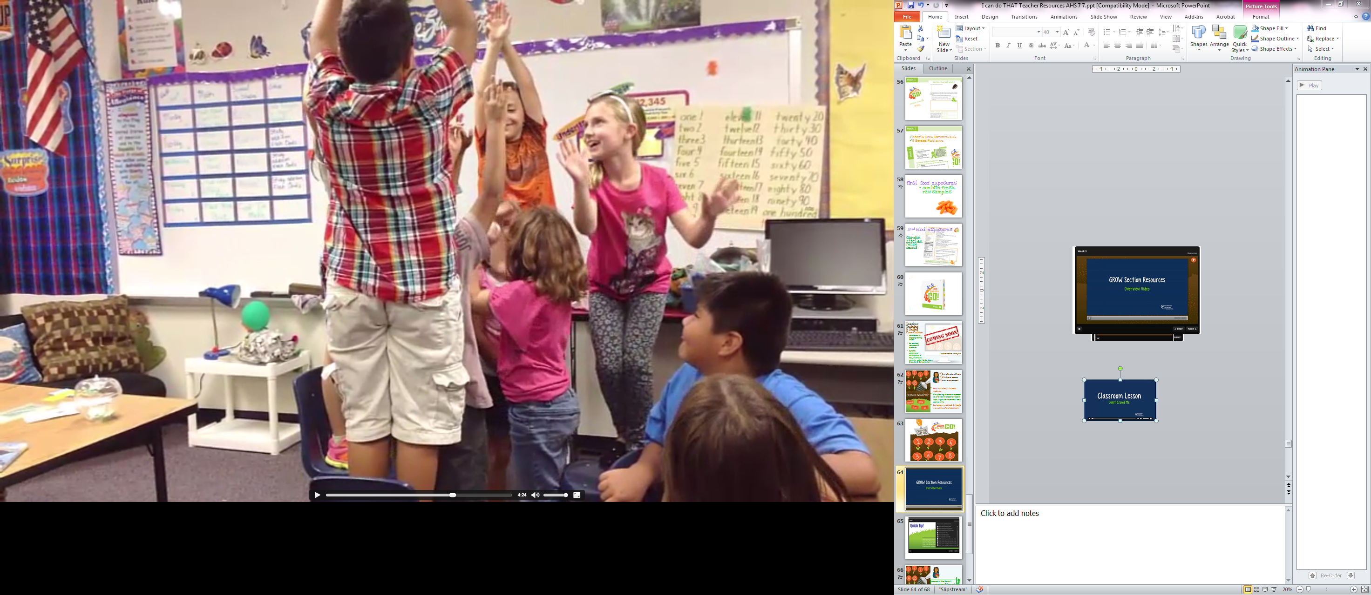

Slide 17
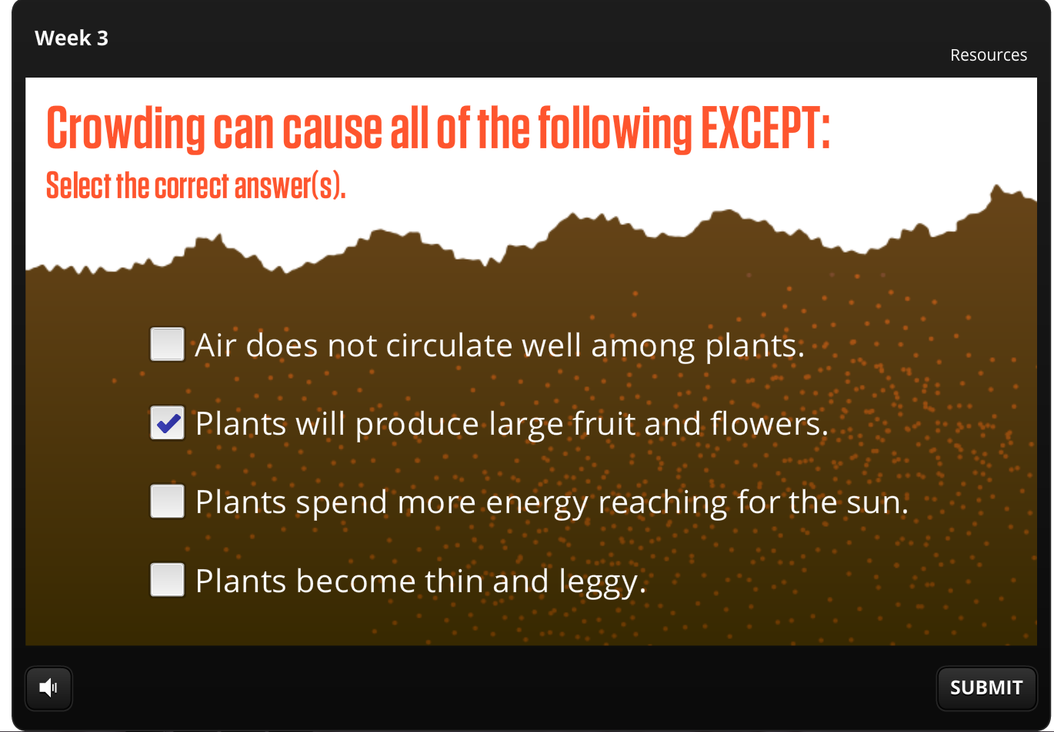

Slide 18
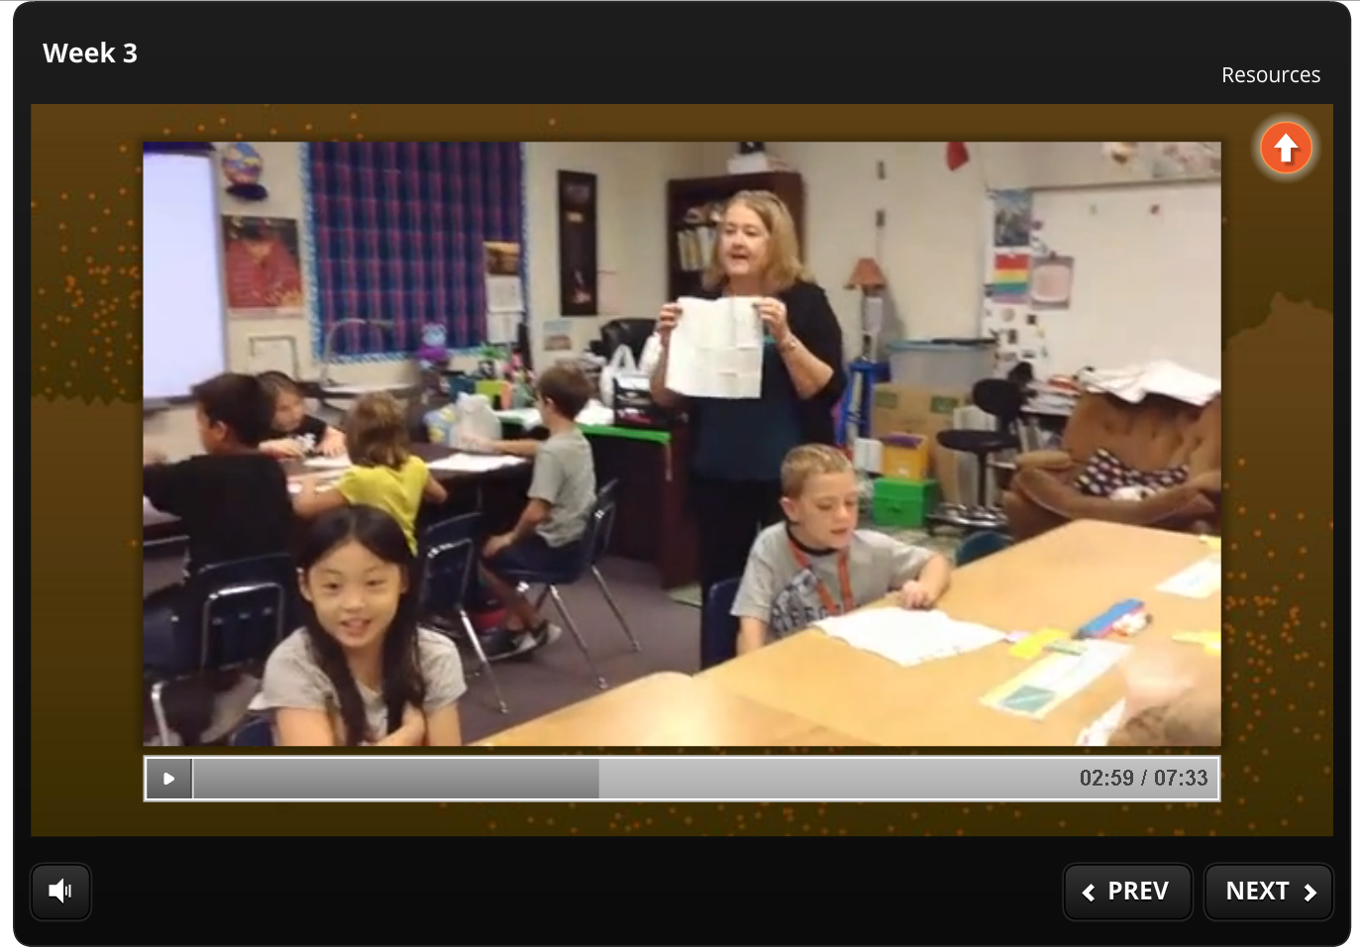
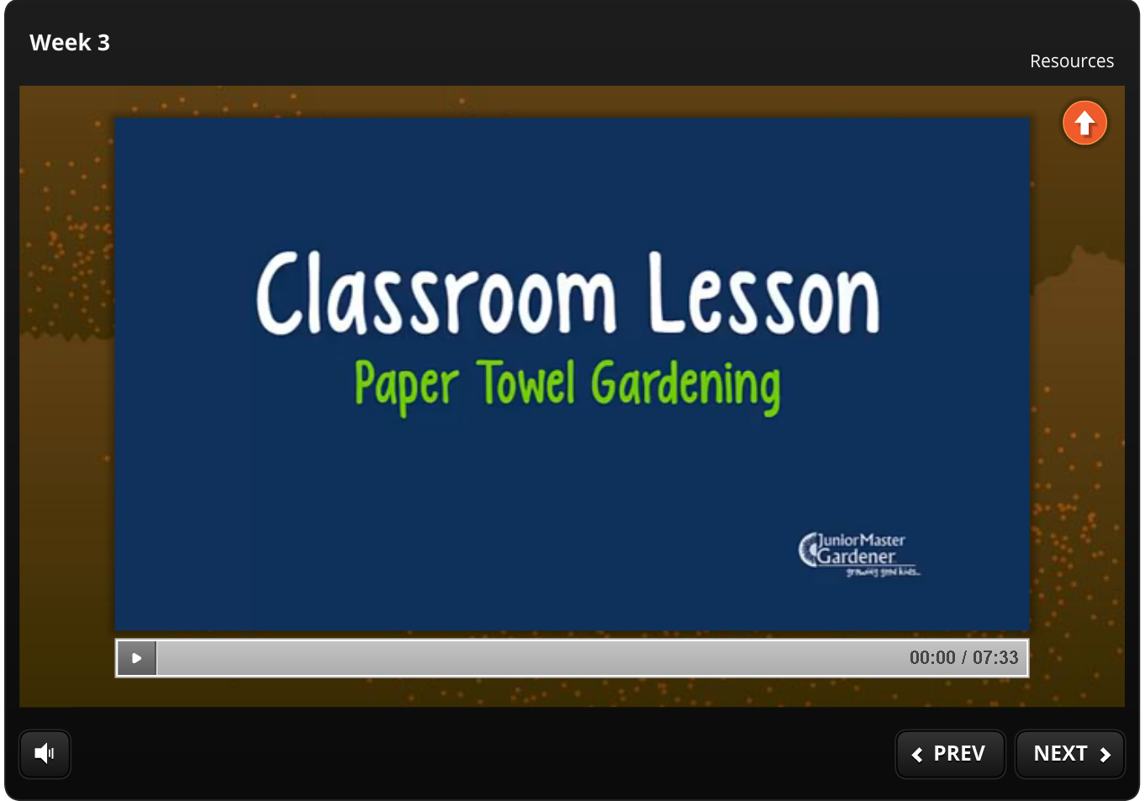

Slide 19
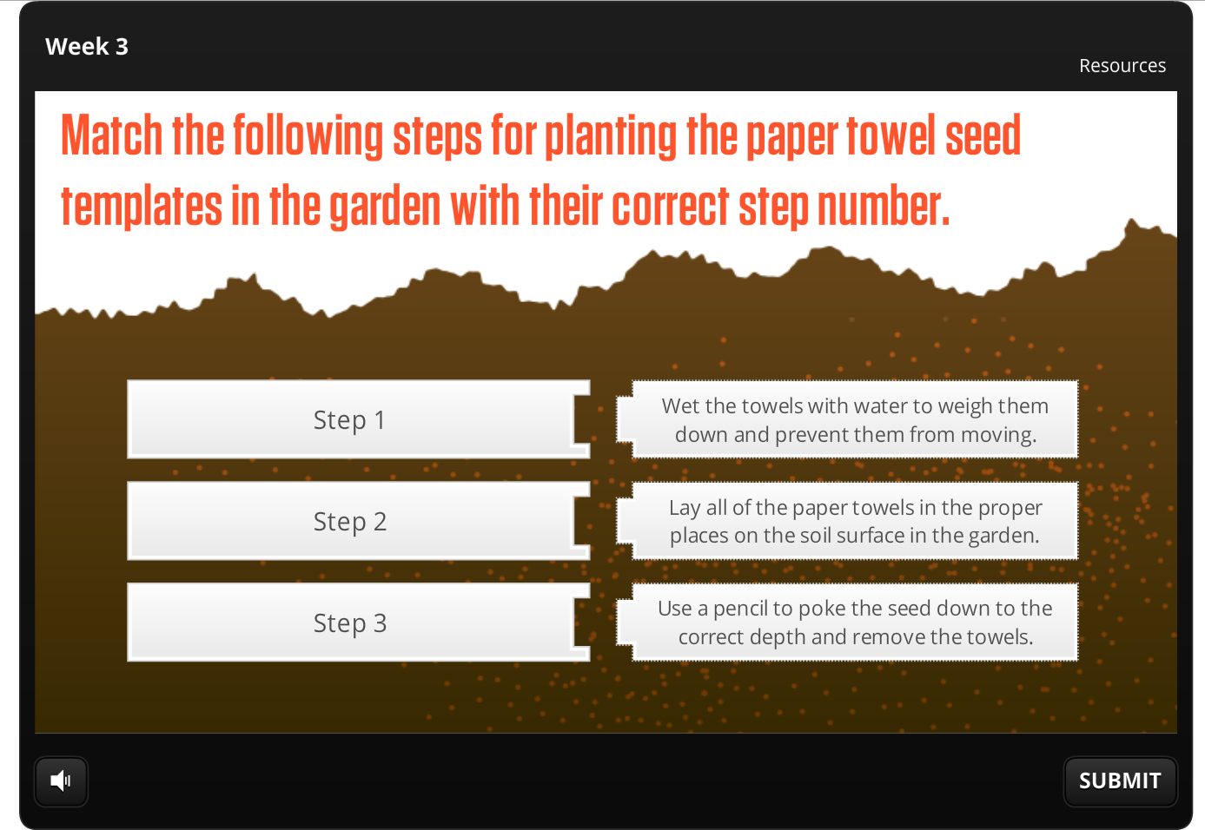

Slide 20
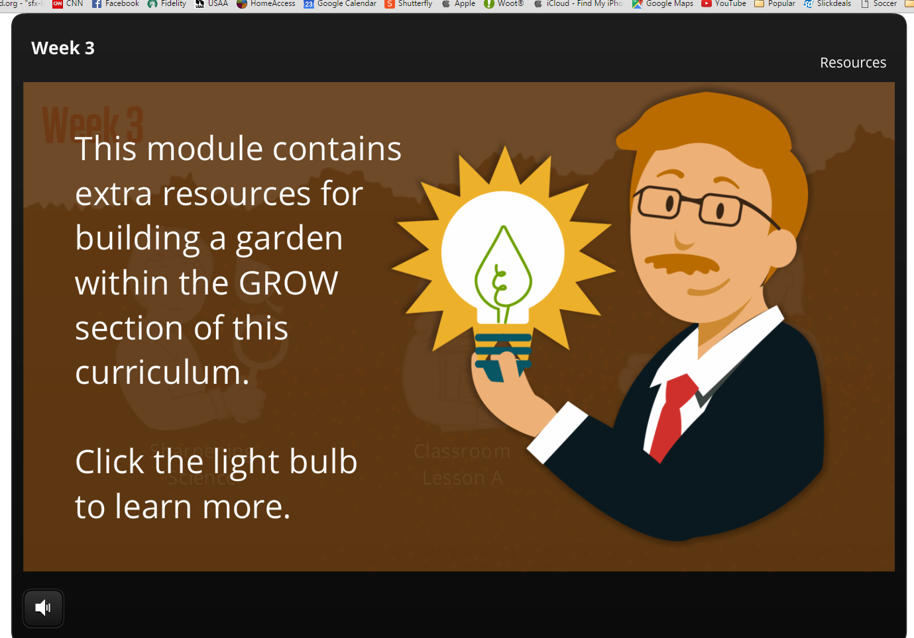

Slide 22
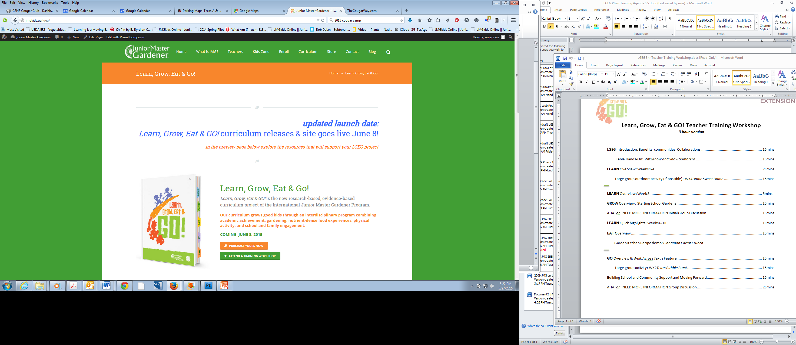
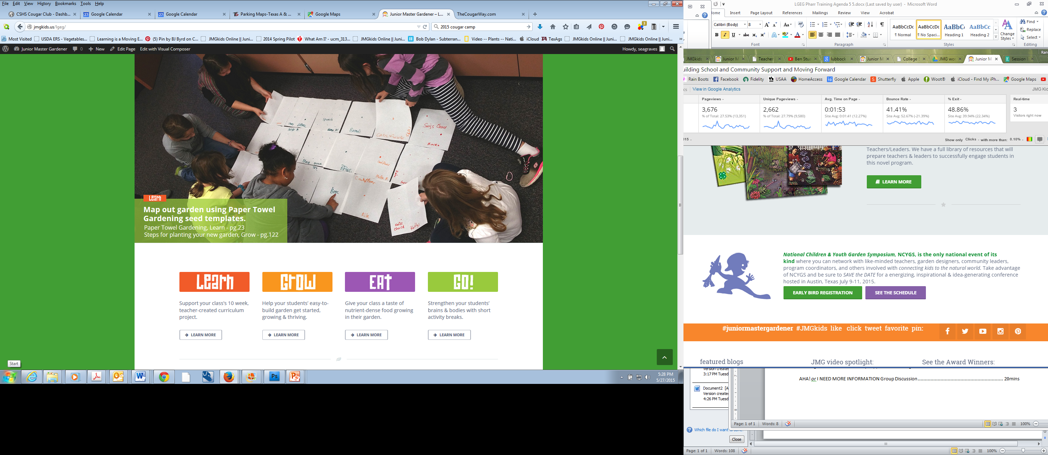
www.JMGkids.us/LGEG
teacher support:
  Make your job easier:
  Curriculum resources
  Videos, resource links
  Free PDFs Copies
  parent letters
  student worksheets
  garden kitchen recipes
  garden journals

Slide 23
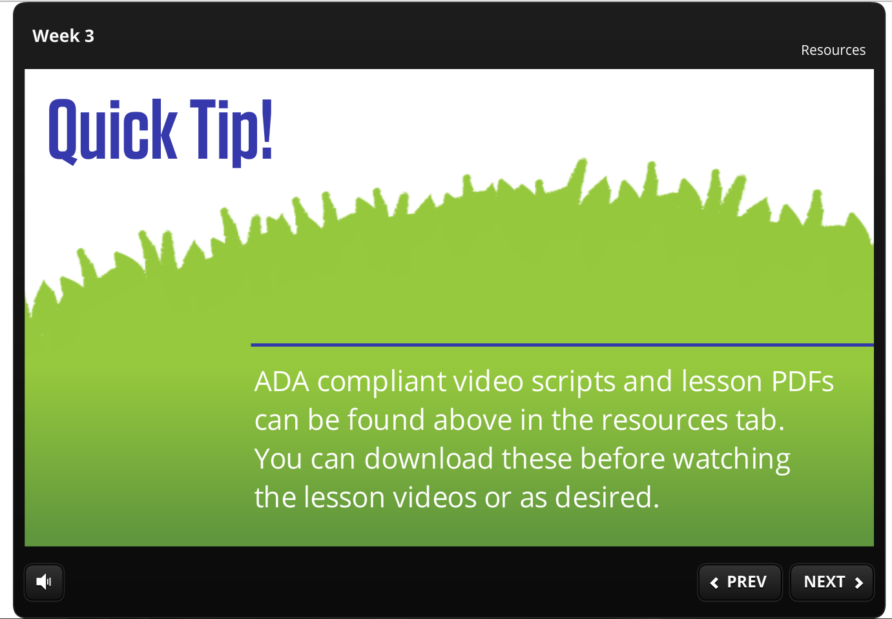
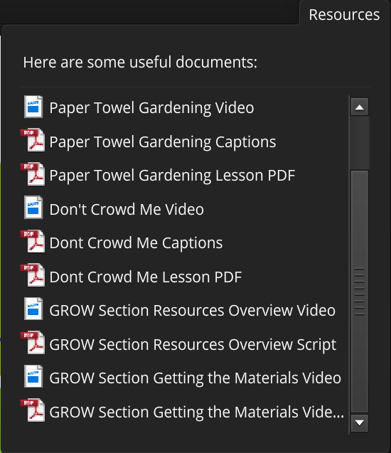

Slide 24

How can I access the course?

Slide 25
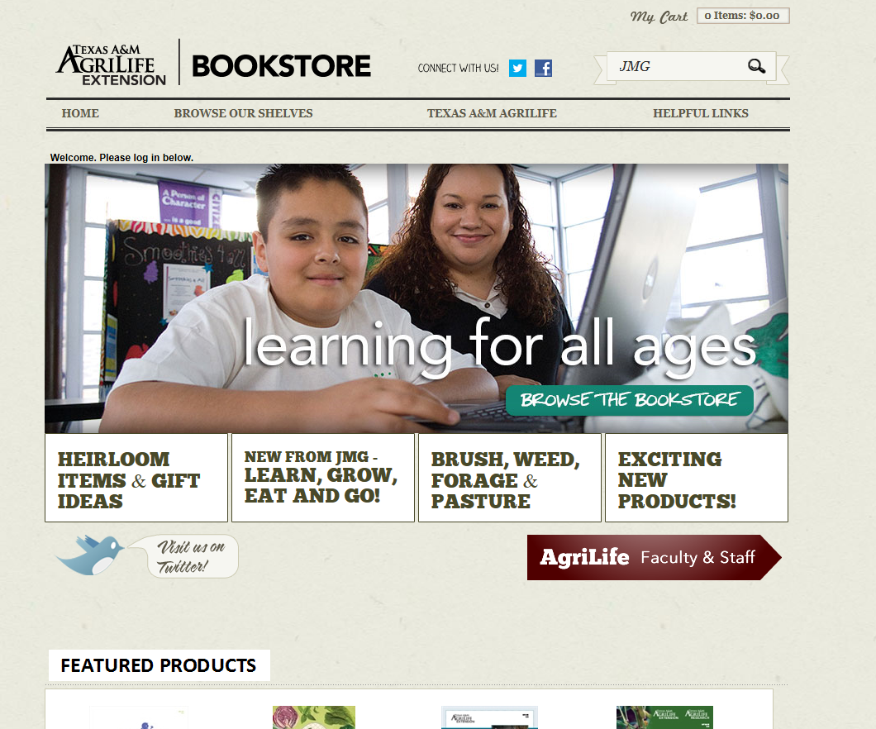
AgriLifeBookstore.org

Slide 26
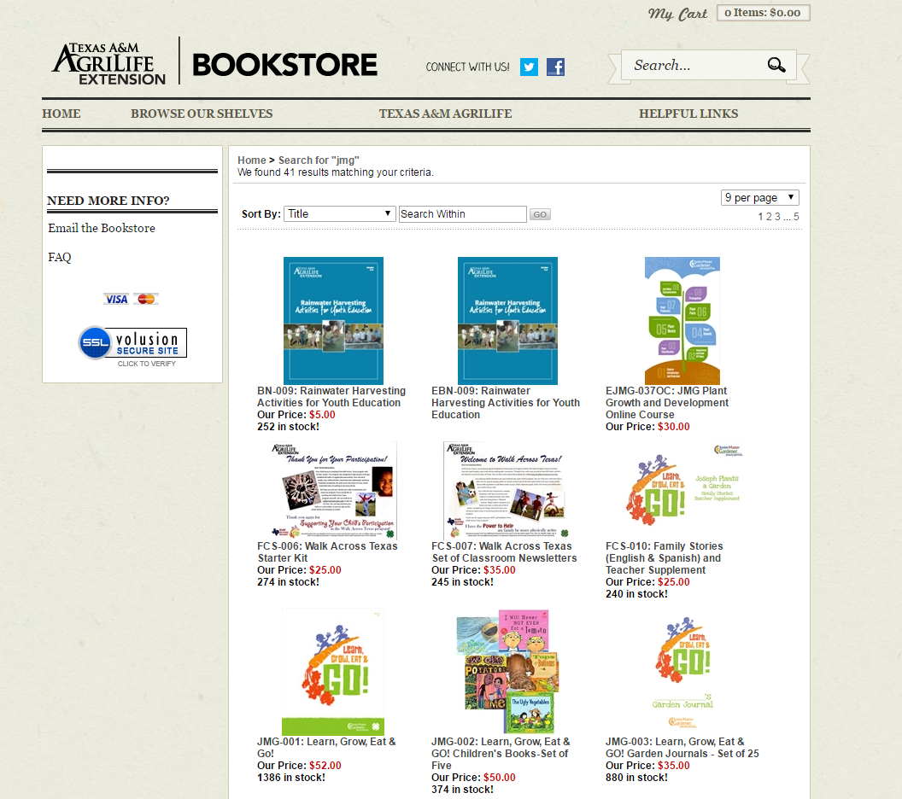

Slide 27
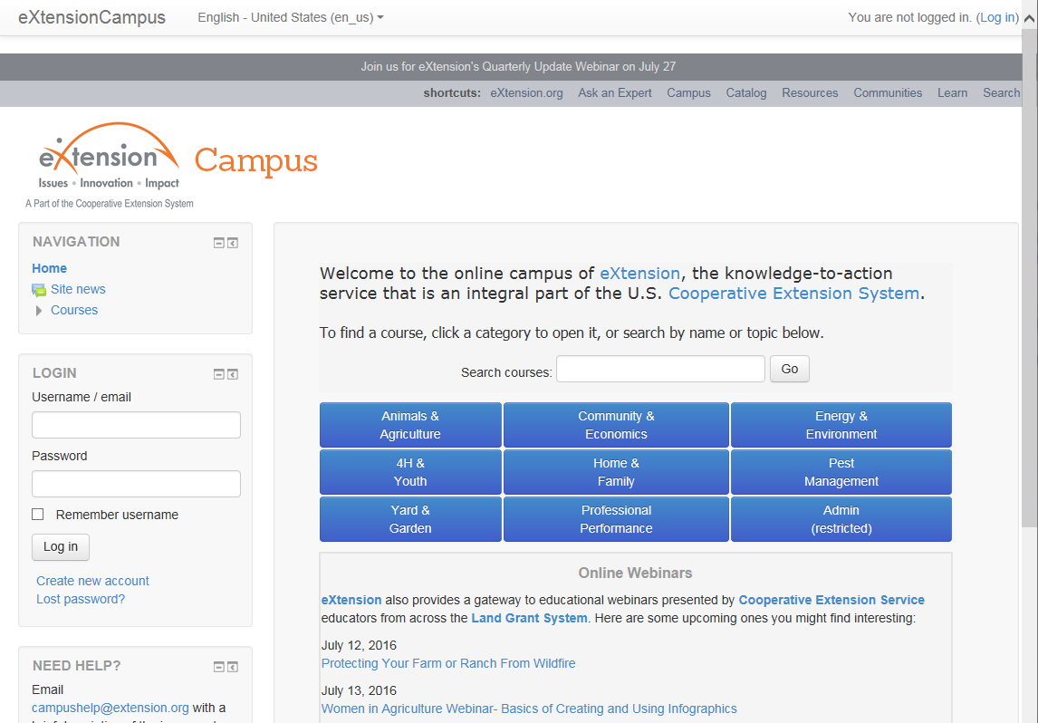

campus.extension.org

Slide 28
2017 National JMG® Leader Training
Finding Resources/Funding

Slide 29
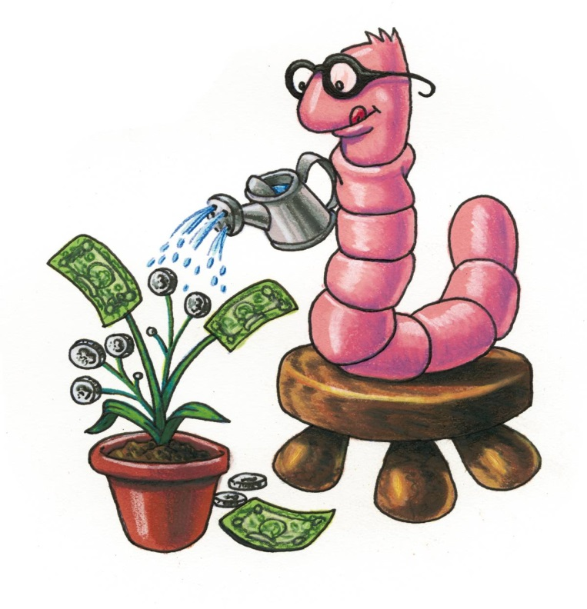
Funding your Programs

Slide 30
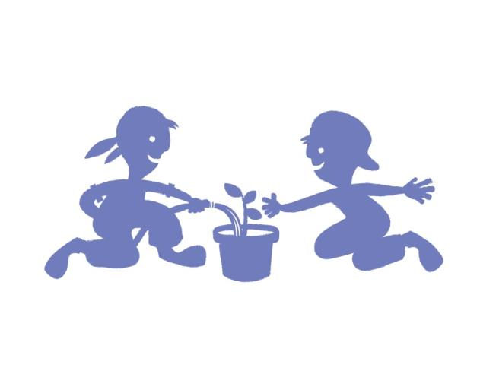
Example:
Scenario: I would like to implement the LGEG curricula in 4 elementary schools in my county. I know that I will need funding for staff to support the program, volunteer/teacher training, curriculum materials, travel and supplies.
HOW do I start??

Slide 31
FUNDING: Steps for Success!
Background on specific program or project
Identify potential community/agency partners
Draft your proposal or idea paper – be specific
Identify potential funding sources

Slide 32
Background of specific program/project
Be specific – people don’t give you money just for grins!
What program are you wanting to fund?
Find out background on this program and any current or relevant research.
How will this program benefit my county/clientele?
How could I show a donor that this program meets a need and their funding dollars will make a positive impact!

Slide 33
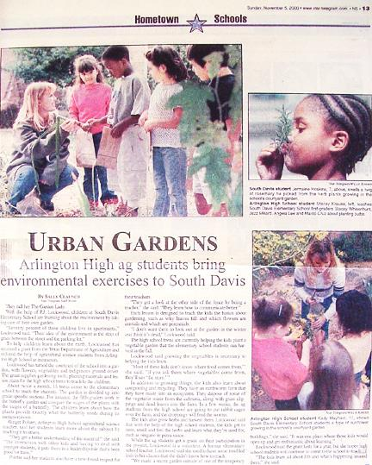
Use the background to BUILD your story!
Buzz words: What is important in the news today???
…nutrition, environment, farm to fork, local foods, academic achievement in schools, youth obesity,
youth “at risk”, special populations, etc.

Slide 34
FUNDING: Steps for Success!
Background on specific program or project
Identify potential community/agency partners
Draft your proposal or idea paper – be specific
Identify potential funding sources

Slide 35
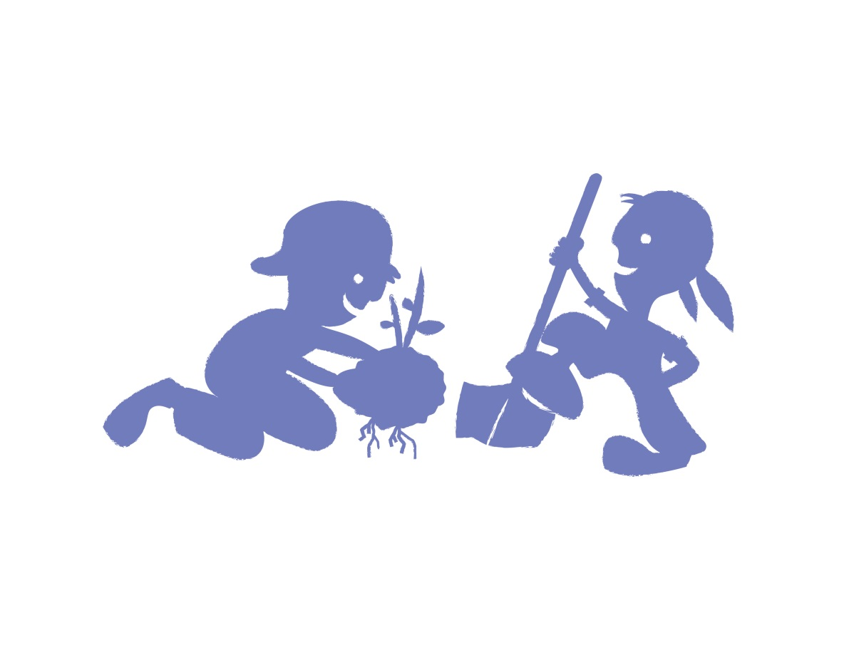
Identify Community/agency partners
Gather 2-3 friends and jot down some notes!
These will vary based on your location, but share ideas!

Slide 36
Donors like Collaborators
Donor might not fund a small project in PODUNK, TX; but, would consider a multi county program that has greater regional impact.
Meet with collaborators early!
Letters of support for County Offices
Letters of support for collaborators/partners
EX: school districts, libraries, human services, regional health organizations, or whomever.

Slide 37
Donors like Collaborators
Call or meet with collaborators to determine interest
Ask for letter of support for the project
If revenue will be split have them be
a part of developing the proposal.
If they are simply stating their interest
and support draft the letter for them!

Slide 38
FUNDING: Steps for Success!
Background on specific program or project
Identify potential community/agency partners
Draft your proposal or idea paper – be specific
Identify potential funding sources

Slide 39

Build a Draft proposal
Format may vary by donor, but develop a basic draft that can be modified and customized for different donors.

Slide 40
Build a Draft proposal
Could vary but donor, but most include:
  Needs Statement
  How your “program” addresses need – Research
  How has your county office risen to meet similar needs in the past
  Specific request – Measurable goals!

Slide 41
Identify Community/agency partners
Gather 2-3 friends and jot down some notes!
These will vary based on your location, but share ideas!

Slide 42

Budget Section
Things to include:
  Money requested and date needed
  Proposed budget – either by goal or by category
  Make sure numbers are realistic
  Tables make budget items easy to read
  Include benefits if required
  Include overhead for management of funds
  Budget narrative – include support after grant!

Slide 43
FUNDING: Steps for Success!
Background on specific program or project
Identify potential community/agency partners
Draft your proposal or idea paper – be specific
Identify potential funding sources

Slide 44
Identify potential donors or funds
Gather 2-3 friends and jot down some notes!
Share any success that you might have had with previous donors.

Slide 45
Identify potential donors or funds
Find out who might be willing to support your project and their funding cycle/previous funding
Internal: BLT – SNAP funds, local MG or 4-H funds
Individuals, Organizations, Local businesses
Utilize 4-H Foundation to identify donor prospects
Learn about regional foundations in your area
Websites like www.foundations.org
Large corporations in your area often have a foundation: IE: Coca Cola, Home Depot, etc.

Slide 46
FUNDING: Steps for Success!
Write a GREAT cover letter that summarizes need and proposal
Finalize Proposal for donor – make it professional and POP
Ask others to review your proposal – Is it clear? Is it realistic in terms of time and money needed?
Do you have collaborators?
Always best if you can get a face
to face meeting!
Happy donors usually give again!

Slide 47
2017 National JMG® Leader Training
Growing Program Sustainability

Slide 48
Empowering
Teachers
&
Growing
sustainability

Slide 49
Partnering with the school community
Captive audience of kids
Reflective population
Professional teachers as leaders

Slide 50
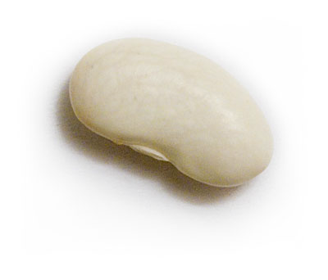
Two sides of Sustainability:
  1. Schools grow sustainable programs
  Teacher/student led, long term support by internal volunteers/partners
  2. Sustainable county office support
  ` Promoter, coach

Slide 51
Supporting partners
Teacher stressors and distractions
  How to motivate?
    Marketing program value & educate about specific benefits
  How they can incorporate something new?
    Piloting, concise program, support of partners/volunteers
  How it meets their needs?
    Foster growth of test scores, healthier student,
    tools for engaging families

Slide 52
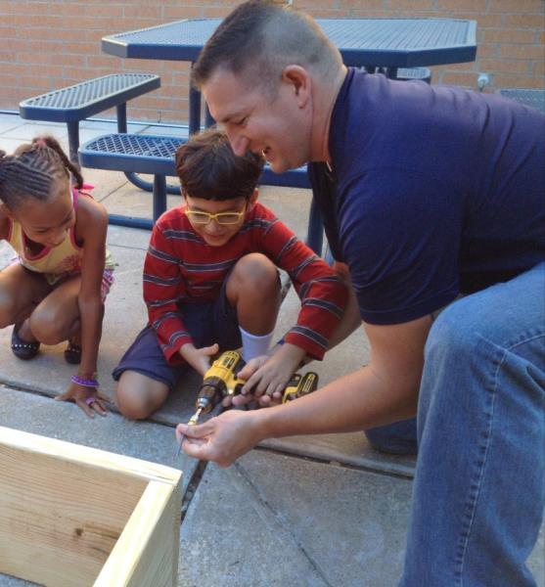
School garden sustainability
Starting Small
Solicit Involvement of Others
  – kid – parent
  – PTA – business
“Our Garden”
Establish a Plan
  – what –site – materials
  – build –plant –maintain
  –off season – next season

Slide 53
Roles in sustainability
  Your Coaching MESSAGE:
  Motivate – you can do it
  Educate – know your program & people
  Show – initially demonstrate/model it
  Solve - its always something
  Appearance – on occasion
  Guide – leading them to…
  Encourage – be purposeful

Slide 54
2017 National JMG® Leader Training
Planning JMG Training Workshop

Slide 55
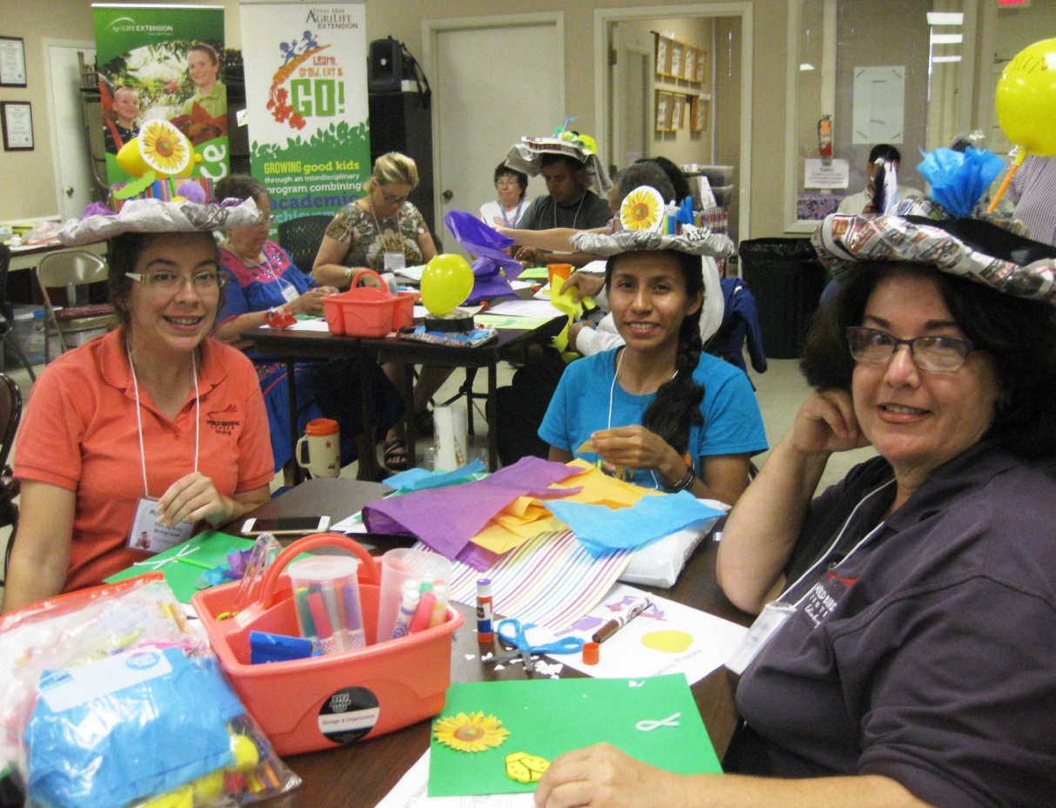
Training Workshop Tools
JMG Workshop Tool Kits
  Presentations/Scripts
  Example Agendas
  Training Handouts
  Evaluation
JMG trainer resources
www.jmgkids.us
Notes:
Training can be to launch JMG in a group, city, county, state…just depends upon your audience.
Go through the program…explain each handout
Leaders do not need to be TRAINED…but it is a plus.

Slide 56
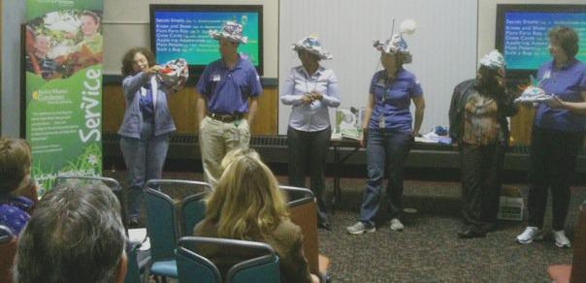
Who needs training?
  Identify your audience
  Who is interested in youth gardening?
    Are there schools with gardens already?
    They teaching environmental units, hands-on science?
    Are there 4-H horticulture projects and leaders?
    After school programs? Youth groups?
    Teachers, Master Gardeners, 4-H, parents, other volunteers
Notes:
Training can be to launch JMG in a group, city, county, state…just depends upon your audience.
Go through the program…explain each handout
Leaders do not need to be TRAINED…but it is a plus.

Slide 57
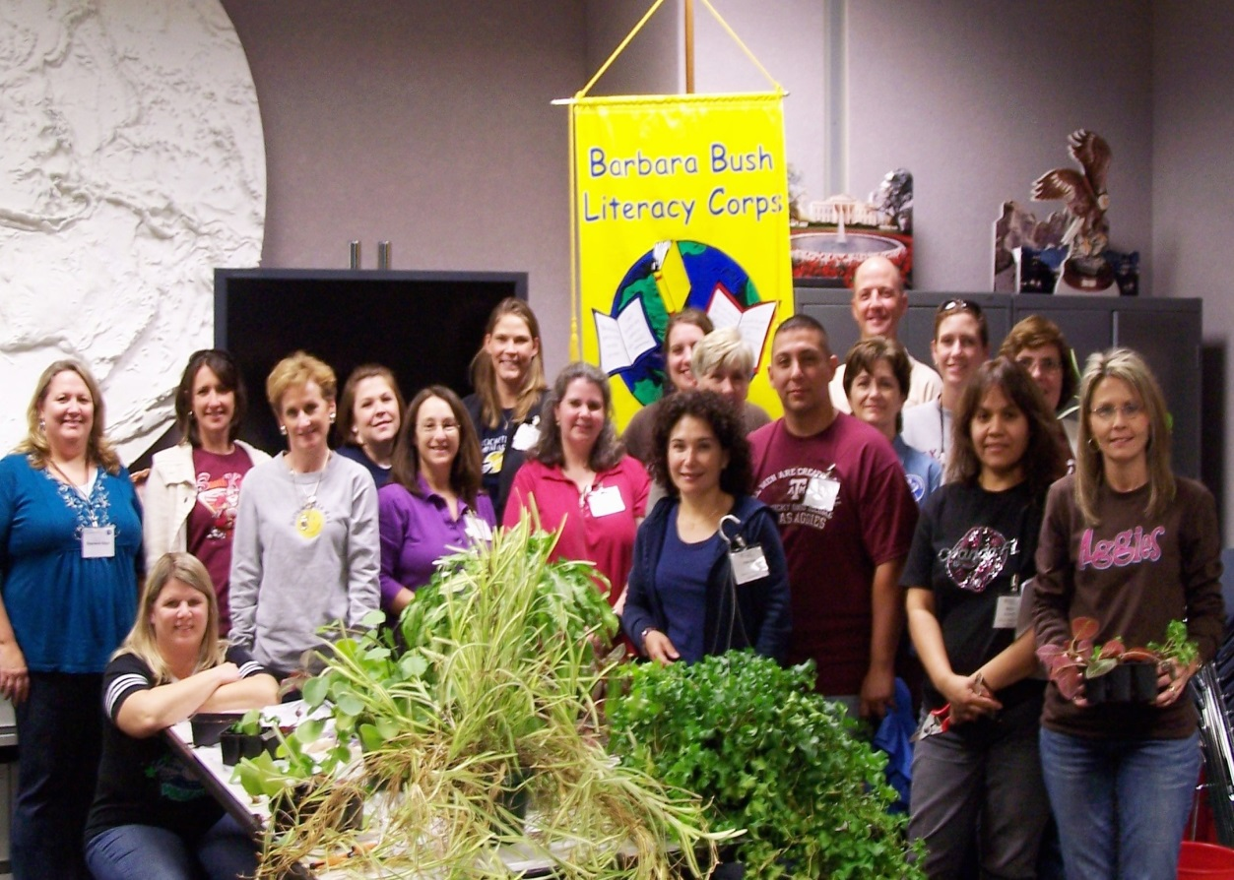
Steps to Setting Up JMG Training
Identify and meet with program partners
  Extension (4-H, MG), School district, Education Agency, etc
Training – workshop or presentation?
  Large, small or one-on-one training
Establish Date, Time, Location
Set Agenda
Invite Audience,
advertise
  Webpage, flyer,
  newspaper,
  Online, Email, TV,
  Radio, 4-H, MGers,
  Newsletters, etc.
Notes:
Training can be to launch JMG in a group, city, county, state…just depends upon your audience.
Go through the program…explain each handout
Leaders do not need to be TRAINED…but it is a plus.

Slide 58

Steps to Setting Up JMG Training
Contact potential sponsors
Gather supplies
Make copies of handouts, etc
Prepare follow-up plan
JUST DO IT!
Notes:
Training can be to launch JMG in a group, city, county, state…just depends upon your audience.
Go through the program…explain each handout
Leaders do not need to be TRAINED…but it is a plus.

Slide 59
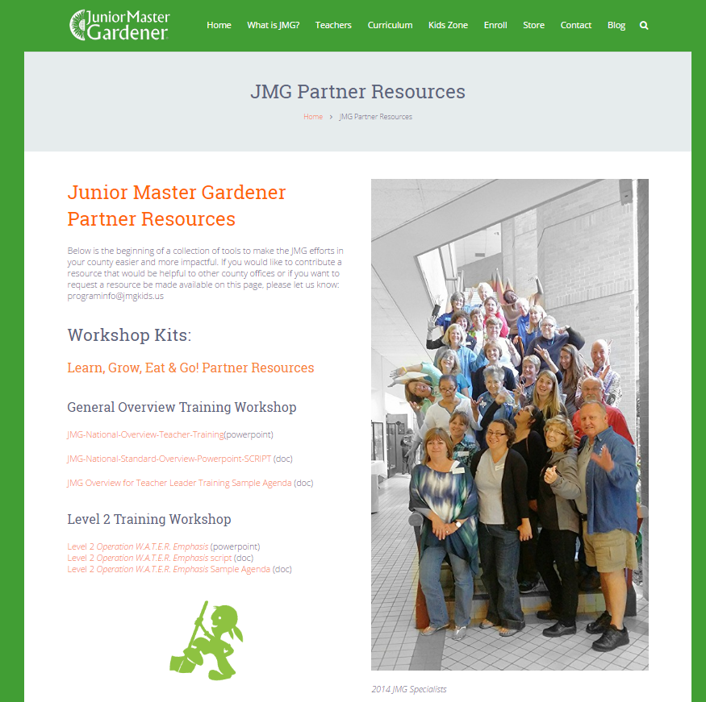
www.JMGkids.us/CountyResources

Slide 60
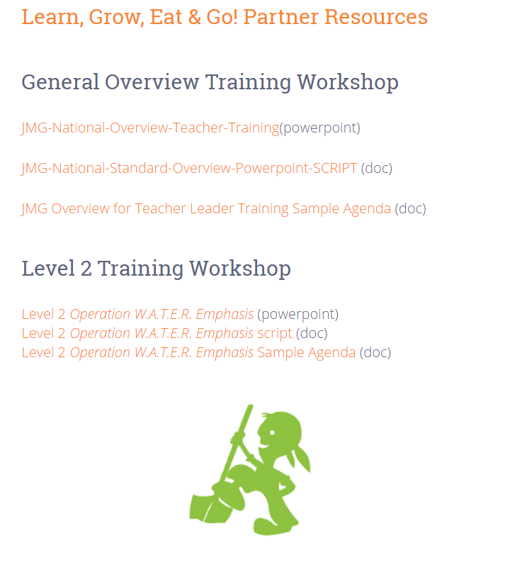
www.JMGkids.us/CountyResources

Slide 61

www.JMGkids.us/CountyResources

Slide 62


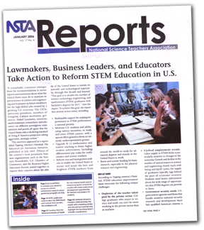
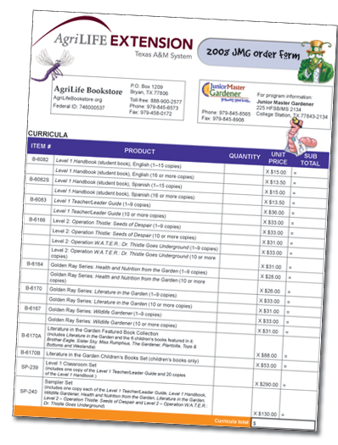


Slide 63



Slide 64

www.JMGkids.us/trainings
helping you
to promote!

Slide 65
2017 National JMG® Leader Training
Creating an Implementation Plan

Slide 66

the Dream

Slide 67

who are the kids?

Slide 68

who are the teachers?

Slide 69

who are the key players?
who are the stakeholders?
collaborators?

Slide 70


Slide 71

JMG groups with gardens taking place at
all 6 elementary campuses in my district
3rd & 4th graders
Grade 3 & 4 Science/math teachers
science teacher, district science coor., academic coord
PTO, MG, Kiwanas, wal-mart

Slide 72







www.twitter.com/jmgkids
www.facebook.com/juniormastergardener
www.pintrest.com/jmgkids
www.instagram.com/jmgkids
www.jmgkids.us

Slide 73

2017 JMG® Specialist Training

