Slide 1

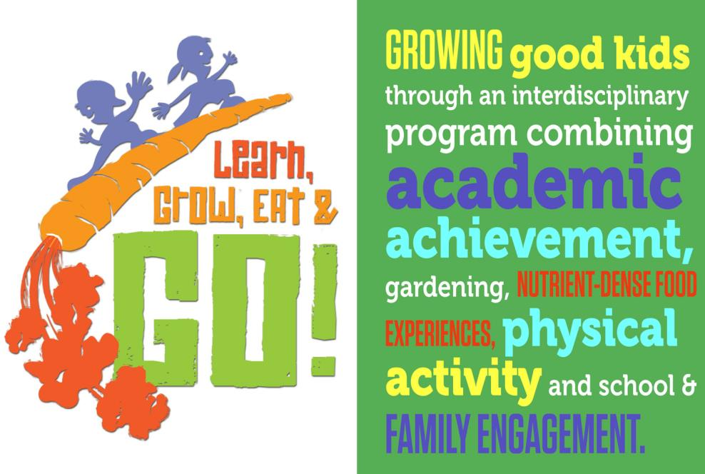
Notes:
There is a significant body of research showing the relationship between improving school performance, attendance, attachment and commitment, and the development of pro-social skills and leadership capacity related to increased physical activity and improved opportunities for project-based, hands-on or real life learning. LGEG is focused on getting children to participate in school activities where they can learn important science, math and language arts concepts and at the same time be more physically active, improve healthy eating habits and have fun. LGEG activities promote leadership and responsibility in children and, according to teacher surveys, have improved classroom participation.

Slide 2
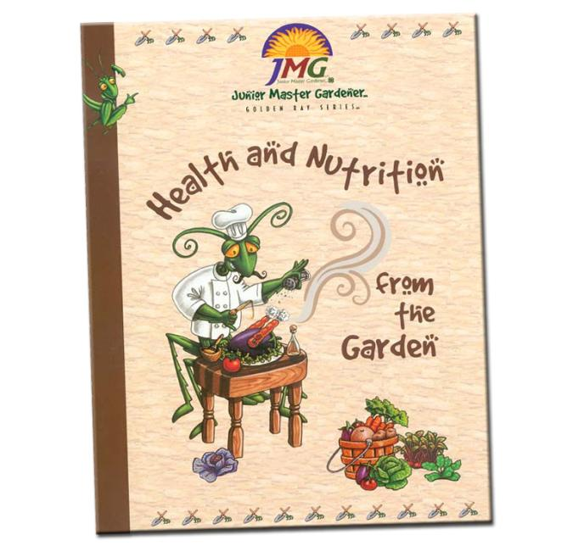
Junior Master Gardener®
^{thematic Level One Curricula}
REVISED!
*early research substantiating real benefits to students/schools

Slide 3



Slide 4
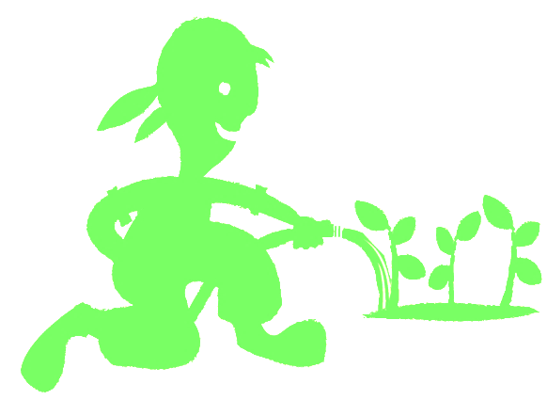
Benefits of JMG to children?
Increased leadership and personal responsibility
Improved academic achievement – particularly science
Increased parent and mentor involvement with youth in schools with JMG
Exposure to career exploration paths
Engagement in community service/service learning projects
Youth certification as Junior Master Gardeners
www.jmgkids.us/research
Notes:
4

Slide 5
Can Gardening Positively impact?
Child Health
Childhood Obesity Rates
Family health
Family mealtimes
Reach into the home
Notes:
5

Slide 6
Why Health Matters
Healthy kids are in school & in class.
Healthy kids are ready to learn.
Healthy teachers are at school with energy.
Healthy administrators and staff are engaged.
Healthy parents are at work or home –involved.
Healthy people have a higher quality of life.
Healthy people need fewer health resources.
Healthy communities are desirable places to live and work.
Notes:
6

Slide 7
Biggest Health Challenges
2017 National JMG® Leader Training

Slide 8
Relevance
High prevalence of childhood obesity is cause for concern because it is linked to negative health consequences for children and their families.
Vegetable exposure plus school gardening has been shown to improve consumption of fruits and vegetables.
Adding more frequent and more vigorous physical activities during school has been shown to improve student fitness and weight.
The greater the frequency of vegetable consumption and physical activity by parents, the greater the consumption of these foods and exercise by their children.
With child obesity rates among low-income children in Texas ranging from 10% to over 20%, engaging schools and families in prevention efforts is critical.
Notes:
8

Slide 9
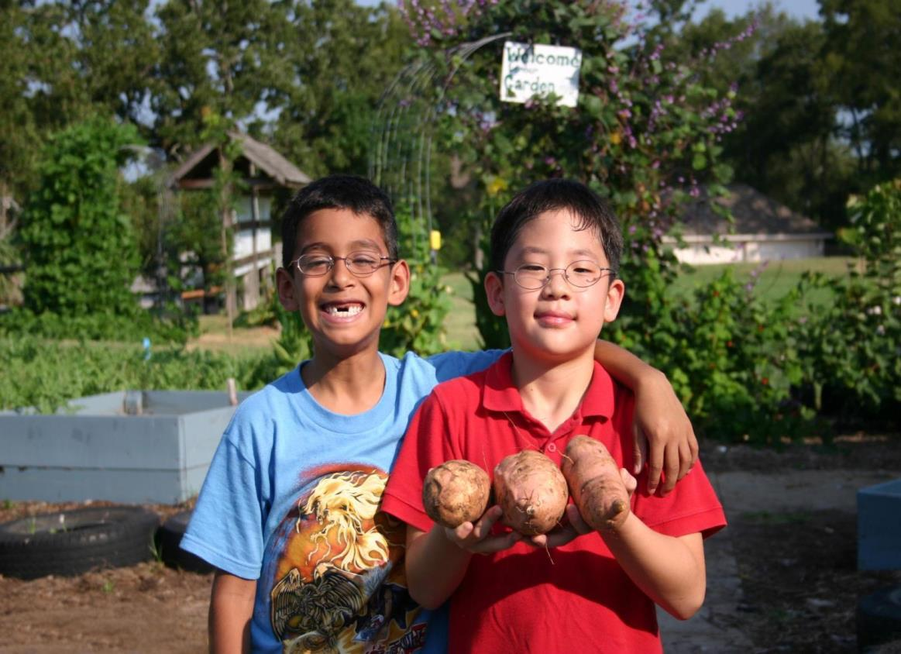









Research Project: Texas Grow! Eat Go!
Expansion/Implementation/Research
Study Project

Slide 10

Who participated in research study
32 Title 1 schools, 5 Texas school districts/5 Texas counties
  Corpus Christi ISD/Nueces County
  Dallas ISD/Dallas County
  Huntsville ISD/Walker County
  Klein ISD/Harris County
  Willis ISD/Montgomery County
8 schools per district (3 to 5 - 3rd grade classes)
3rd and 4th grade students & their families
School personnel at each school
County extension staff and county volunteers
(Master Gardeners; Master Wellness; interns)
Largest research and evaluation study ever done on the
Junior Master Gardener program

Slide 11
Methods
Methods:
Instrumentation:
Pre-post test study with control group
Sample:
  28 schools across 5 cities in Texas
  ~ 1,600 student-parent pairs (C1 + C2 = 1326)
Schools randomized in each school district to receive varying combination of intervention components:
  CATCH only (control)
  CATCH + WAT
  CATCH + JMG
  CATCH + WAT+ JMG
Intervention implemented in 3rd grade classes
  Students measured pre-post intervention in 3rd grade and at the beginning and end of 4th grade
Student Surveys (read by research staff)
Parent Survey
Child BMI (height & weight)
Teacher Surveys and interviews
Extension Project Specialist Interviews
Interviews with school administrative staff
Teacher Program Activity Time Log (SNAP-Ed Match Form)

Slide 12
Parent Demographics: Race/Ethnicity
Language Spoken at Home
English | 72%
Spanish | 27%
Other | 1%
Notes:
This is a nice visual of the ethnic distribution:
Over 25% of the participating parents spoke Spanish as their main language

Slide 13
Behavioral Targets
Twelve Core Behaviors
Child Behaviors | Parent/Adult Behaviors | Child & Parent/Adult Interaction Behaviors
Increasing fruit and vegetable consumption (F&V) | Increasing access and availability of F&V in the home | Gardening together
Decreasing sugar sweetened beverage (SSB) consumption | Limiting availability of SSB | Preparing snacks and meals together
Increasing physical activity (PA) | Providing PA opportunities for children | Engaging in PA together
Decreasing sedentary activity | Limiting children’s sedentary activity | Eating snacks and meals together

Slide 14
Summary of Significant Outcomes by Treatment
 | CATCH | CATCH+ JMG | CATCH+ WAT | CATCH+ JMG+WAT
Student
Vegetables preference | * | * |  | *
Vegetable consumption at school |  | * |  | *
Knowledge | * | * | * | *
Engagement in moderate PA | * |  | * | *
Sedentary Behavior (decrease) |  |  | *
Vegetable consumption at home
SSB consumption (decrease) |  |  |  | *
Parent
Home availability Vegetables
Home availability SSB |  |  | * | *
Parental support for child PA |  | * | *
Parental support for decreasing sedentary behavior
Student/Parent Interaction
Gardening together |  | * | * | *
Preparing food together |  | * |  | *
Eating meals together |  |  |  | *
PA together |  | * | *

Slide 15
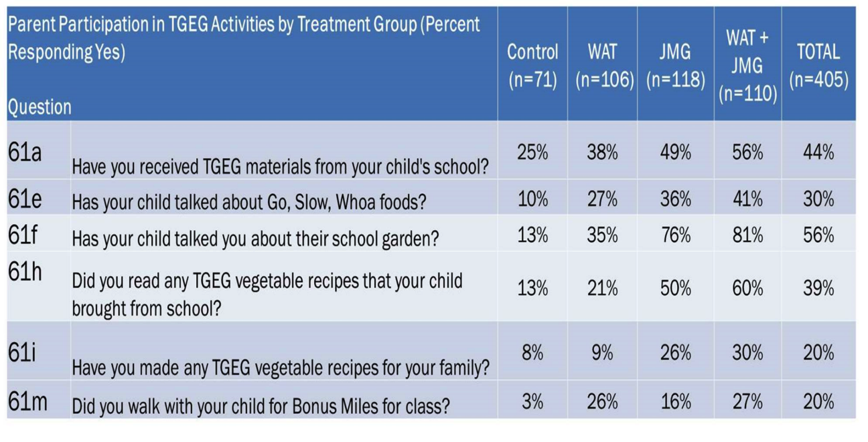
Component Reach into the Family Home

Slide 16
LGEG Evidence Based Outcomes
Significant Improvements in:
MVPA
Total Physical Activity
Vegetables Consumption
Vegetable Preferences
Healthy Beverage Preferences
Self-Efficacy & Knowledge
Parent/child cooking, physical activity and gardening
Reaches into the home to support positive family health practices
BMI Significantly Reduced for use of LGEG
BMI Significantly Reduced for use of LGEG
Preliminary Conclusion: Family-focused garden, nutrition and physical activity
programs significantly improve health behaviors in children.
Notes:
Through the course of this research, we saw
child vegetable preference, and nutrition and plant science knowledge increased significantly
child physical activity with parents increased, while screen time decreased.
Parents encouraged eating vegetables and increased gardening with their children.
Teachers reported that students were more attentive and had high participation in LGEG learning activities.
41% of Parents learned about “Go, slow and whoa” foods
81% of parents learned about the school gardens
60% of parents read the recipes sent home and 30% tried the recipes
27% of parents walked with their child to earn “Bonus Miles” for their child’s class.

Slide 17


LGEG Curriculum
& Program
Notes:
There is a significant body of research showing the relationship between improving school performance, attendance, attachment and commitment, and the development of pro-social skills and leadership capacity related to increased physical activity and improved opportunities for project-based, hands-on or real life learning. LGEG is focused on getting children to participate in school activities where they can learn important science, math and language arts concepts and at the same time be more physically active, improve healthy eating habits and have fun. LGEG activities promote leadership and responsibility in children and, according to teacher surveys, have improved classroom participation.

Slide 18

LGEG Evidence-Based Facts
Encourages daily physical activity
Increase exposure to vegetables
Encourages adoption of healthy beverages
Expands knowledge in plant science and nutrition
Reaches into the home to support positive family health practices
Notes:
Through the course of this research, we saw
child vegetable preference, and nutrition and plant science knowledge increased significantly
child physical activity with parents increased, while screen time decreased.
Sugar sweetened beverage consumption decreased.
Parents encouraged eating vegetables and increased gardening with their children.
Teachers reported that students were more attentive and had high participation in learning activities.
41% of Parents learned about “Go, slow and whoa” foods
81% of parents learned about the school gardens
60% of parents read the recipes sent home and 30% tried the recipes
27% of parents walked with their child to earn “Bonus Miles” for their child’s class.

Slide 19
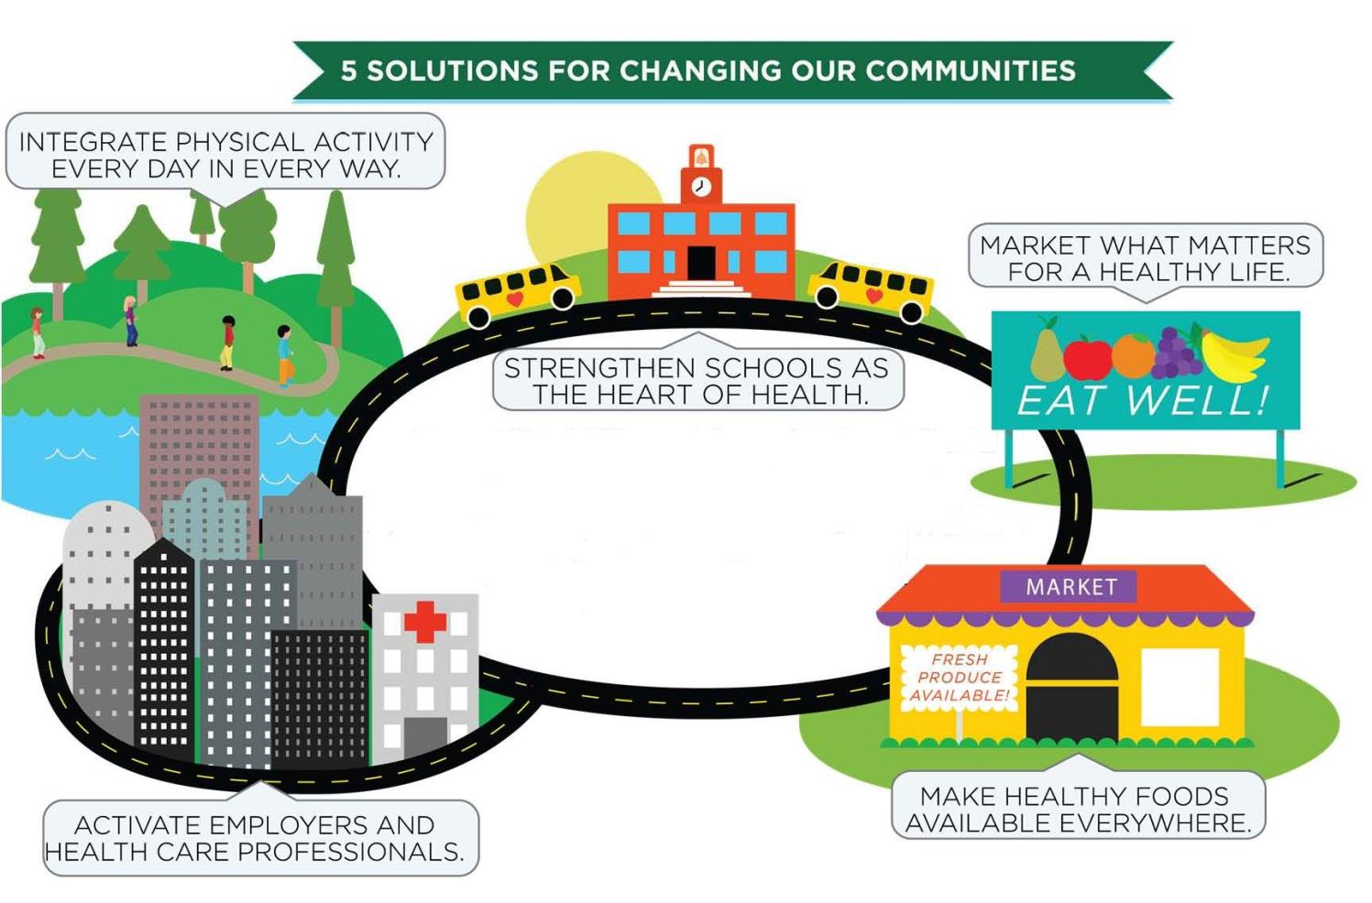
Notes:
Schools have a unique opportunity to connect parents, students, and communities as schools are often the center of a community especially neighborhood schools. But the larger community is also needed to influence other positive changes – safer neighborhoods, safe ways for kids to get to school, open playgrounds, and parents and community members who make space in their lives to volunteer at school.
Coordinated School Health (CSH) programs such as Coordinated Approach to Child Health (CATCH) have clear evidence that school-community collaboration is a successful way to improve child and family health. The Learn, Grow, Eat & Go Program is a natural component of CSH, with high potential for engaging families with school gardens and vegetable exposure and expanding family activity levels through school-community oriented physical activity programs like “Walk Across Texas.”

Slide 20
School District, Community Partners & Extension Collaboration
School/District Nutrition Services
County Extension Staff & Volunteers
District Wellness/SHAC
School/District Facilities and Maintenance
School & Community Organizations
Teachers and PE Coaches
Principal/AP
Notes:
Schools with healthy environments are most successful when they start with a campus team! School Health Advisory Councils or SHAC’s, administrators, nutrition/food service, teachers, parent groups , coaches/PE teachers, and school maintenance crews can all have an impact on a healthy school climate. Support from local organizations, community leaders, and elected officials can then help enhance the school health team’s efforts for a greater impact.

Slide 21
Help Growing Sustainability by
Establishing LGEG Coalition/Advisory Group
Can be site specific or across program sites
  Consider any/all community sectors
    Media
    School & Non-profit organizations
    Parents & community leaders (churches, etc.)
    Representatives from existing groups; SHACs, Wellness teams, FCS committees, etc.
Engage Group in program direction/decisions

Slide 22
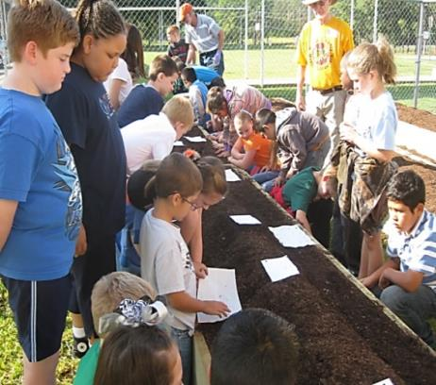
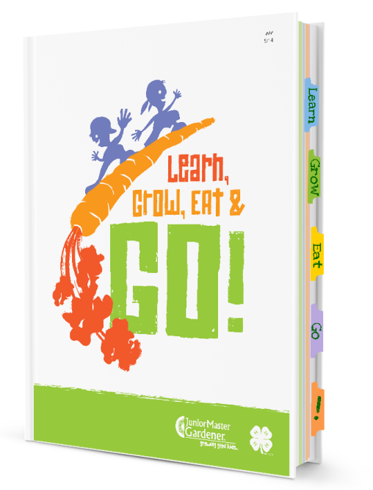
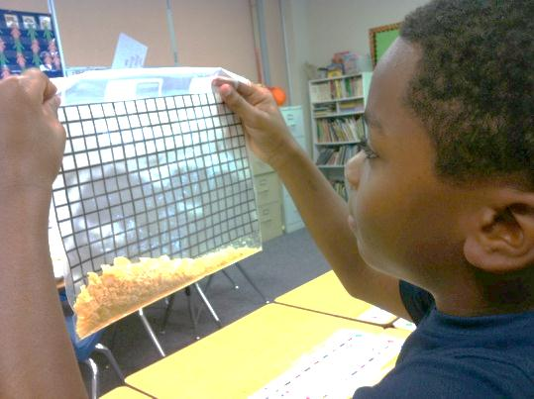
LGEG Components

Slide 23
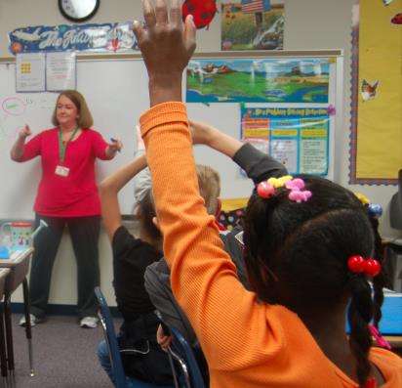

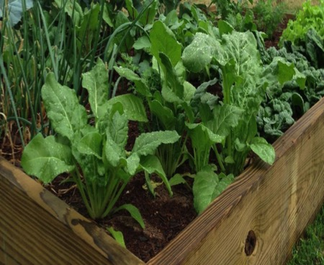

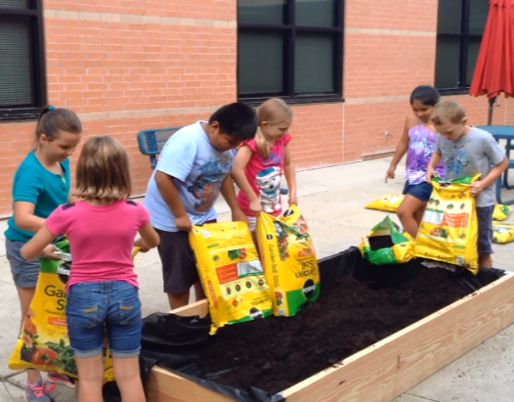


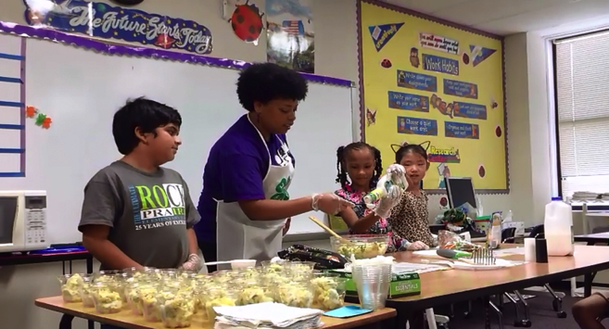
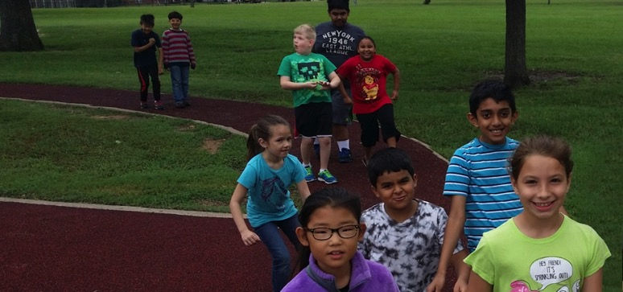


Slide 24
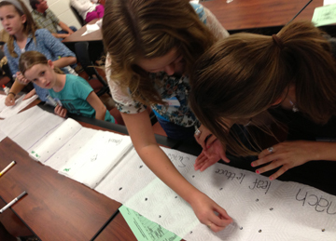



CLASSROOM INSTRUCTION
10 week – lessons aligned to TEKS, STAAR readiness and supporting standards
Student garden journals
Math within Garden Kitchen recipes
Family engagement resources online
Service-learning opportunity
JMG certification opportunity

Slide 25
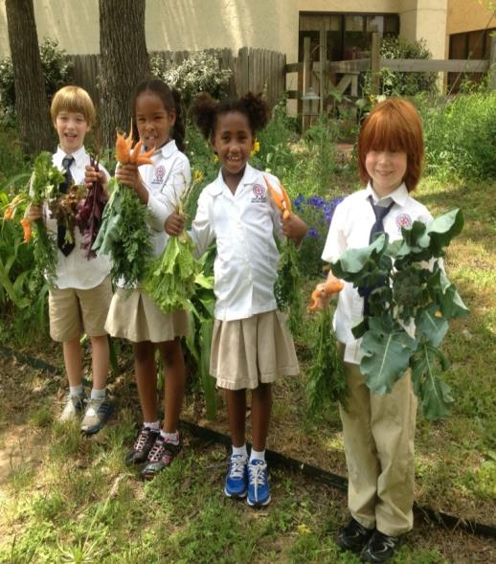
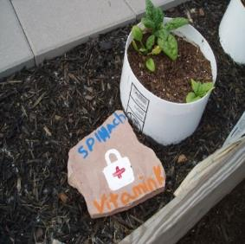
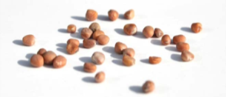
GARDENS - raised beds or container gardens
Grow featured nutrient-dense vegetables
Carrot
Red leaf/loose leaf lettuce
Broccoli
Potatoes
Swiss chard
Bell pepper
Cauliflower
Spinach
Oriental cabbage – Bok Choy
Cherry tomatoes
Sugar snap peas
Squash

Slide 26
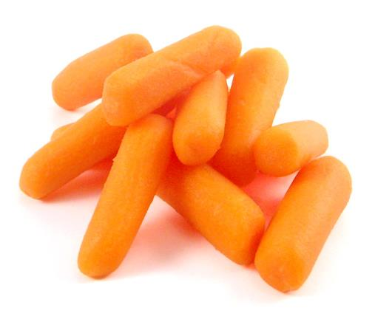
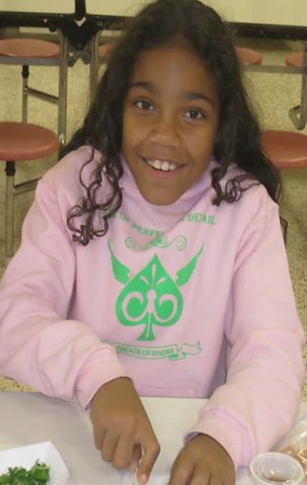
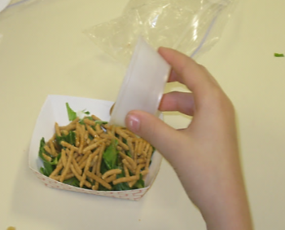
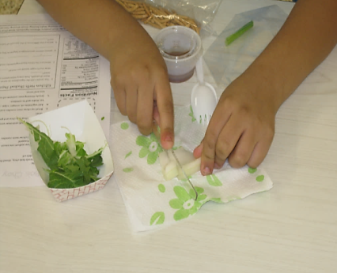
Food Exposure
1st exposure: Evaluation
of fresh vegetable sample in classroom
2nd Exposure: Garden Kitchen recipe demonstrations in classroom with featured vegetables

Slide 27
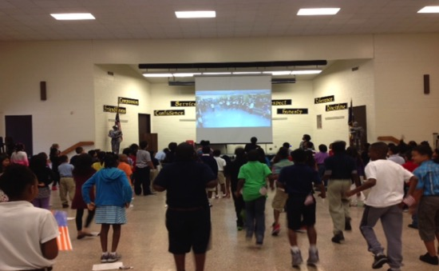
Go Strong - Physical activities at school to use in the classroom
Promotion of gardening physical activity components
Walk Across Texas - enrollment

Slide 28
CURRICULUM DESIGN
10 weeks,
2 lessons/week
Sequence, integration,
pace, & flexibility

Slide 29
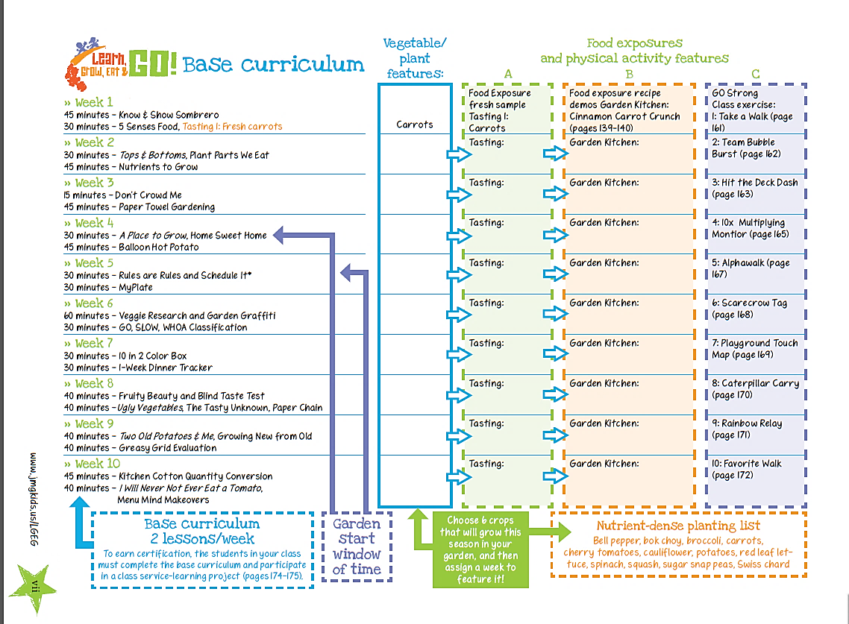
Start WAT!

Slide 30
Weeks 1-5
Lesson
Overview

Slide 31
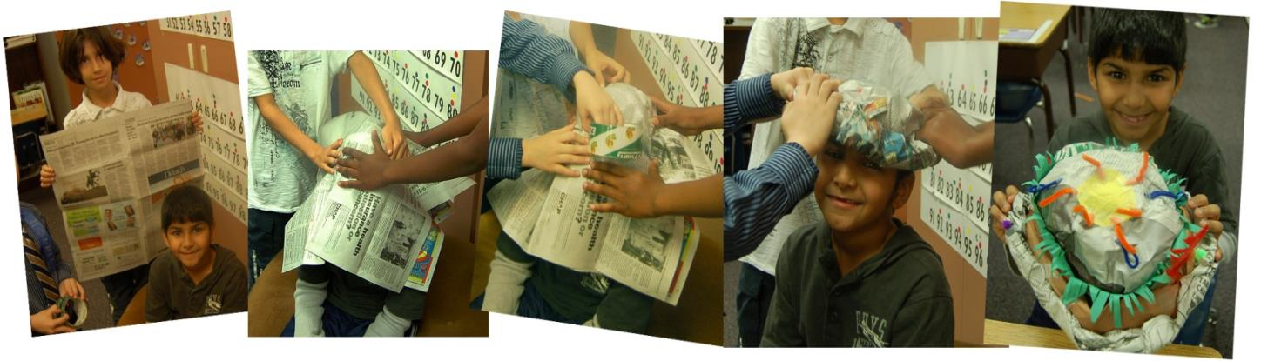
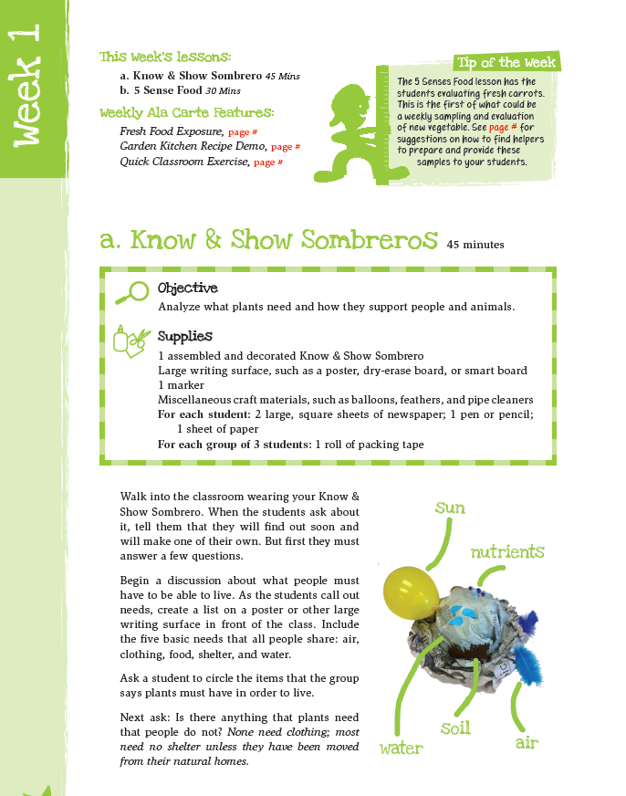
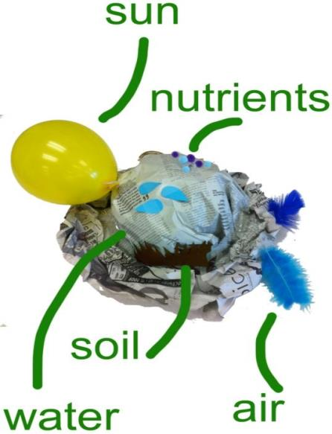
Plants need P.L.A.N.T.S.
P
L
A
N
T
S
lace
ight
ir
utrients
hirsty
oil
Notes:
Do know and show sombrero with participants

Slide 32
Activity Session
Know and Show Sombrero
WHERE TO FIND ME?
LGEG Manual
Week 1, page 2

Slide 33
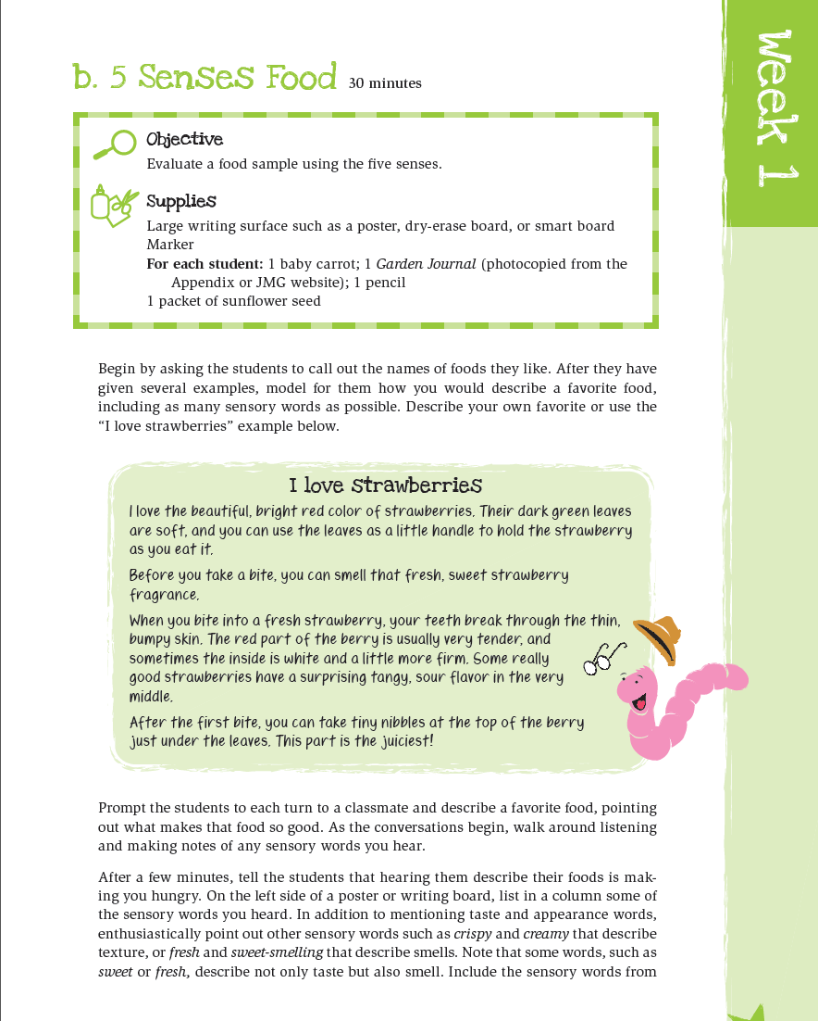


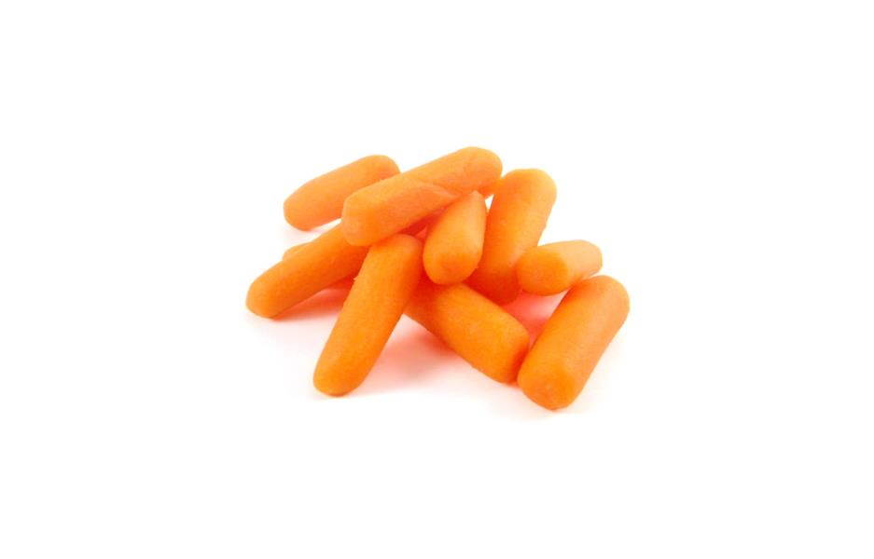

Slide 34

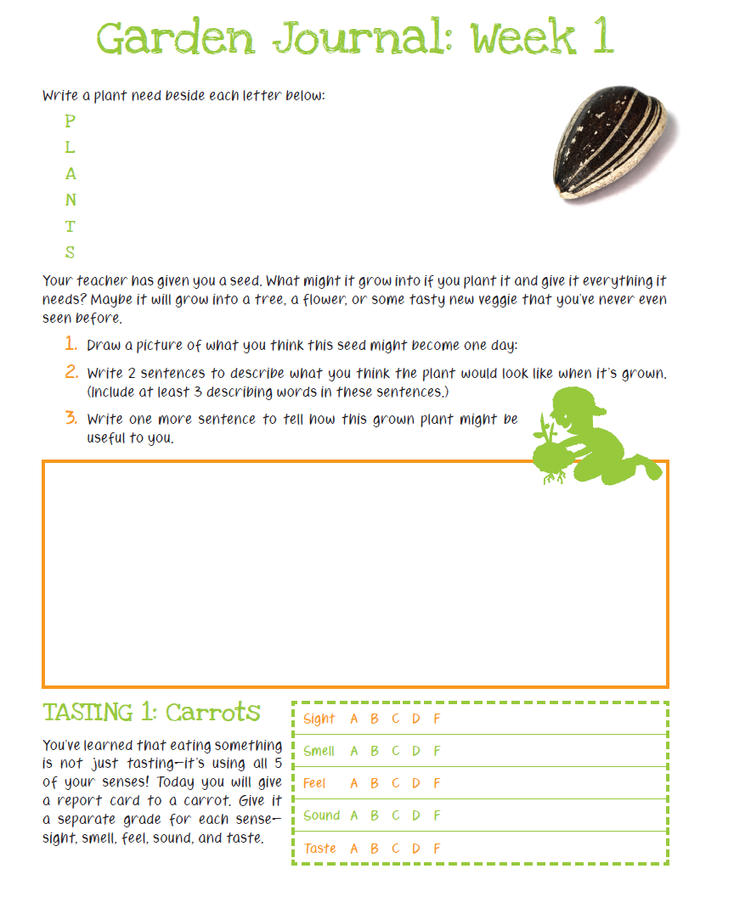
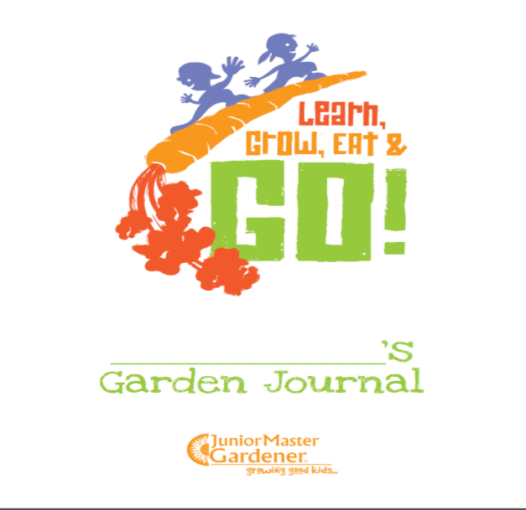

Slide 35

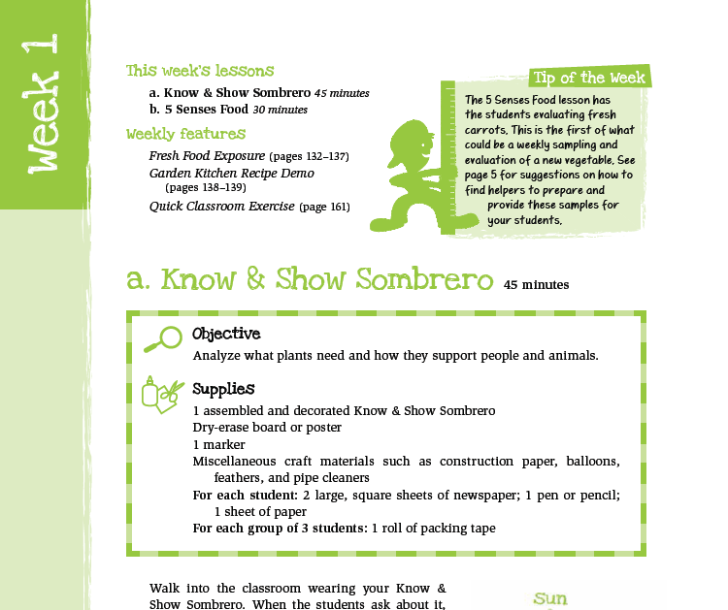

Know & Show Sombrero 45 mins
5 Senses Food 30 mins

Slide 36

first food exposures
- one bite fresh,
raw samples

Slide 37

2nd food exposures
Garden
Kitchen
recipe
demos

Slide 38


Texas Essential Knowledge & Skills
Readiness Standard
Supporting Standard

Slide 39
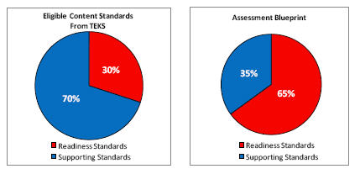

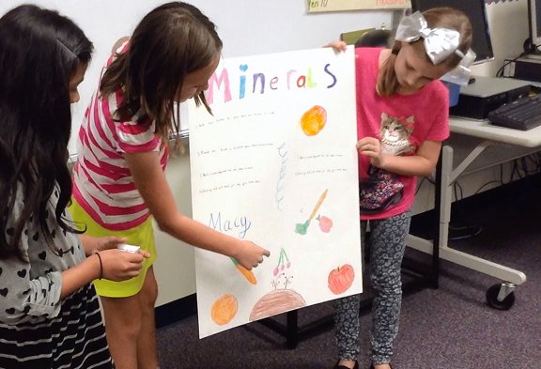

Slide 40
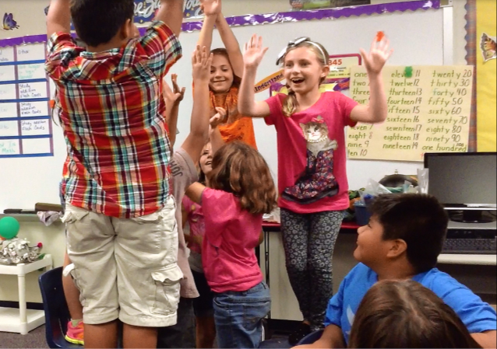
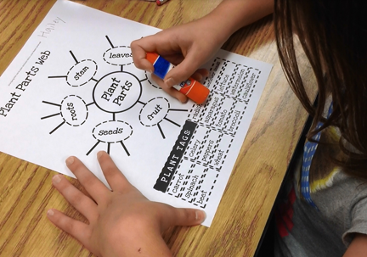
Learn! Grow! Eat! & Go!
Concepts provide:
  10 Week curriculum comprised of hands-on learning activities
      Total number of TEKS addressed: 116
      Total number STAAR test eligible TEKS: 34%
        Readiness Standards: 45%
        Supporting Standards: 55%

Slide 41
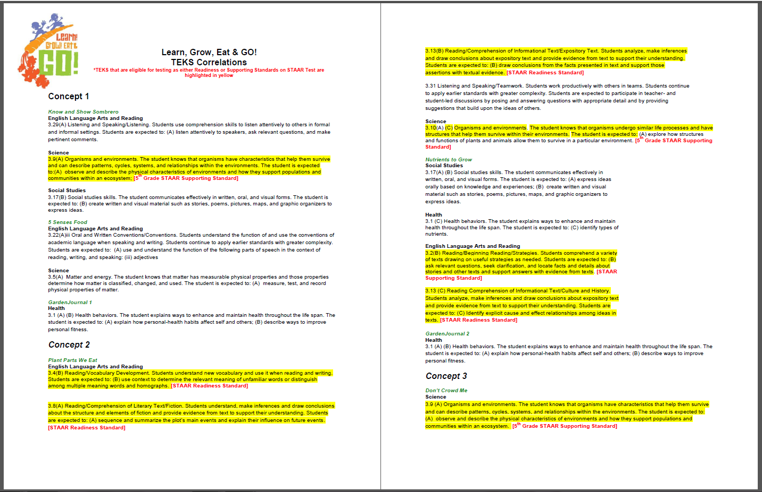

Slide 42




Slide 43
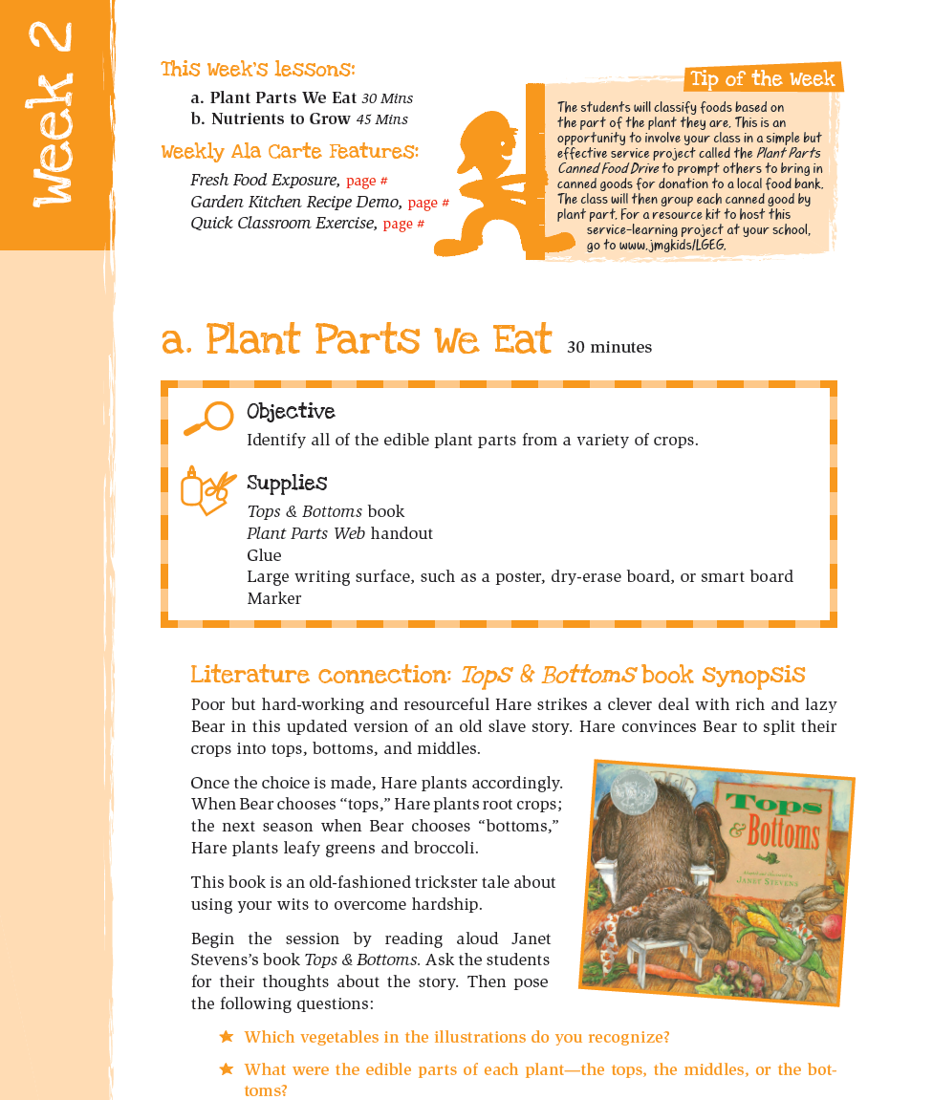
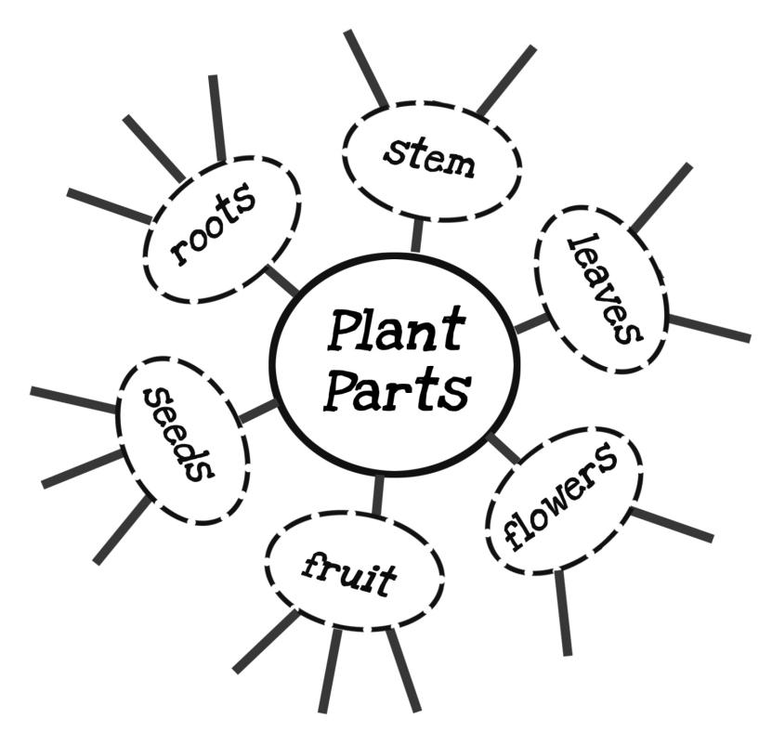



Slide 44
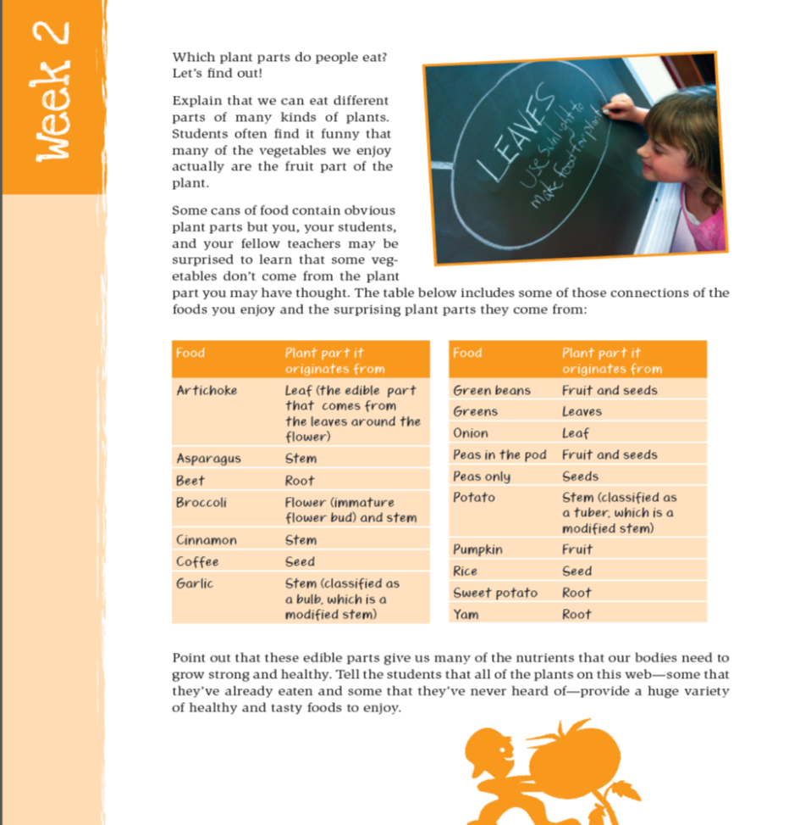

Slide 45
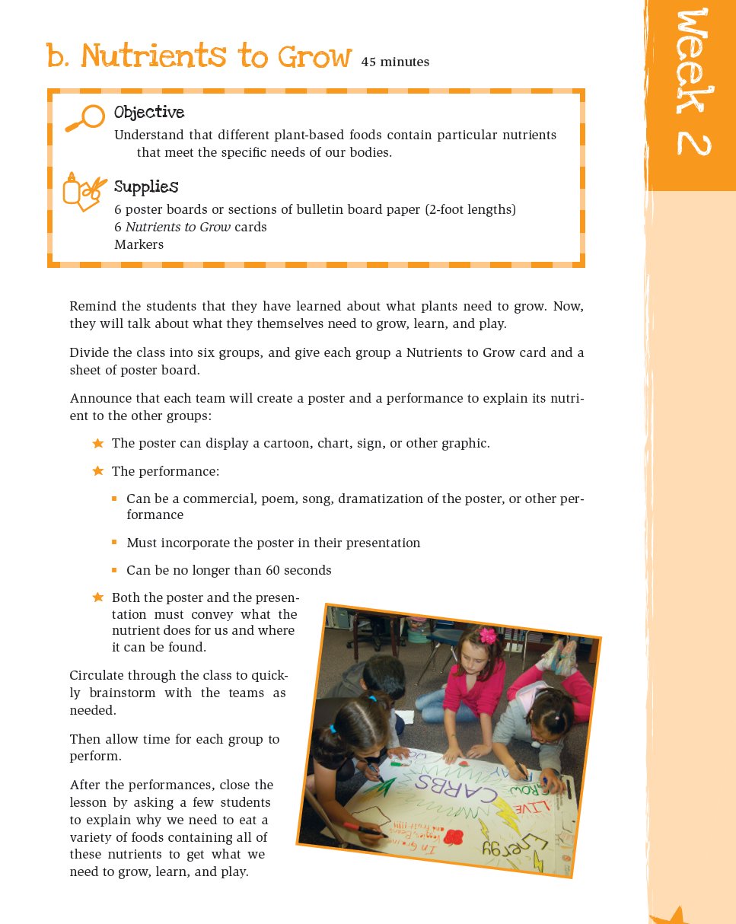
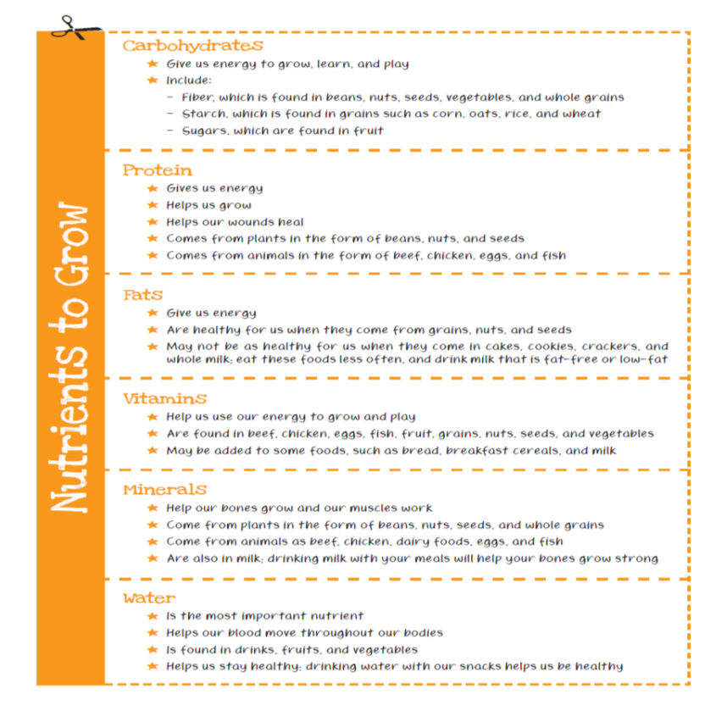

Slide 46
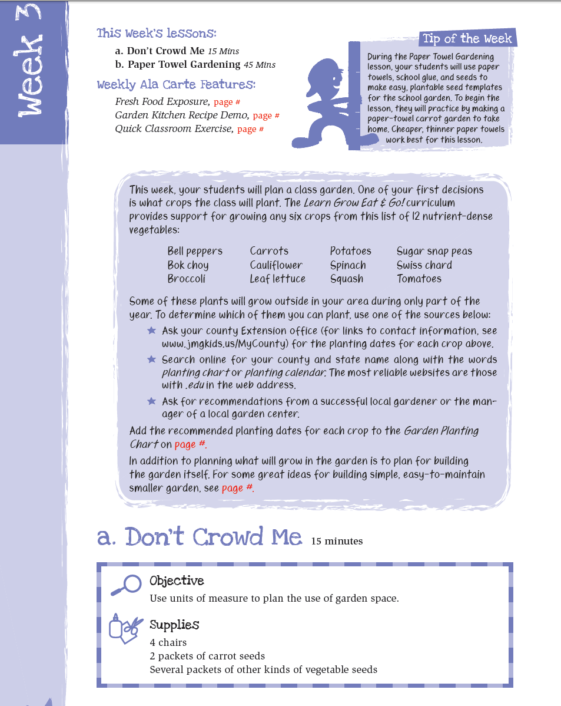

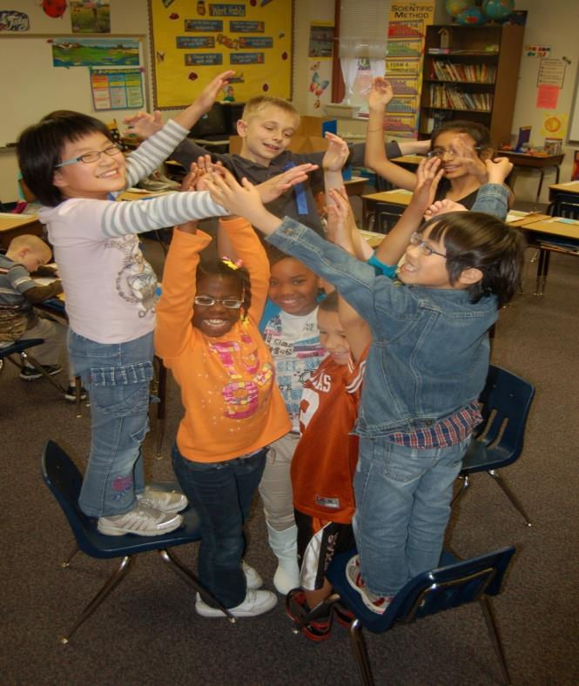

Slide 47
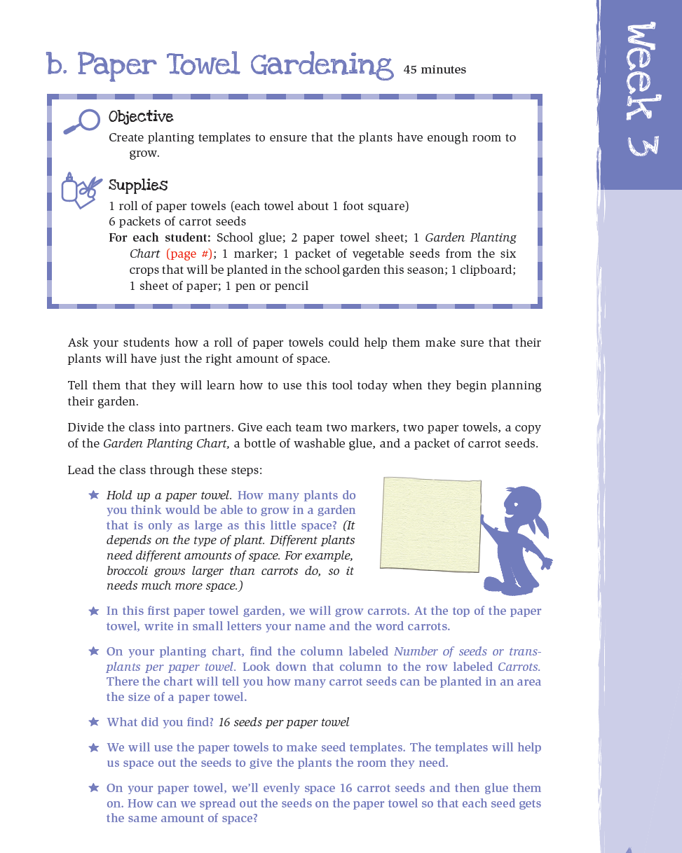
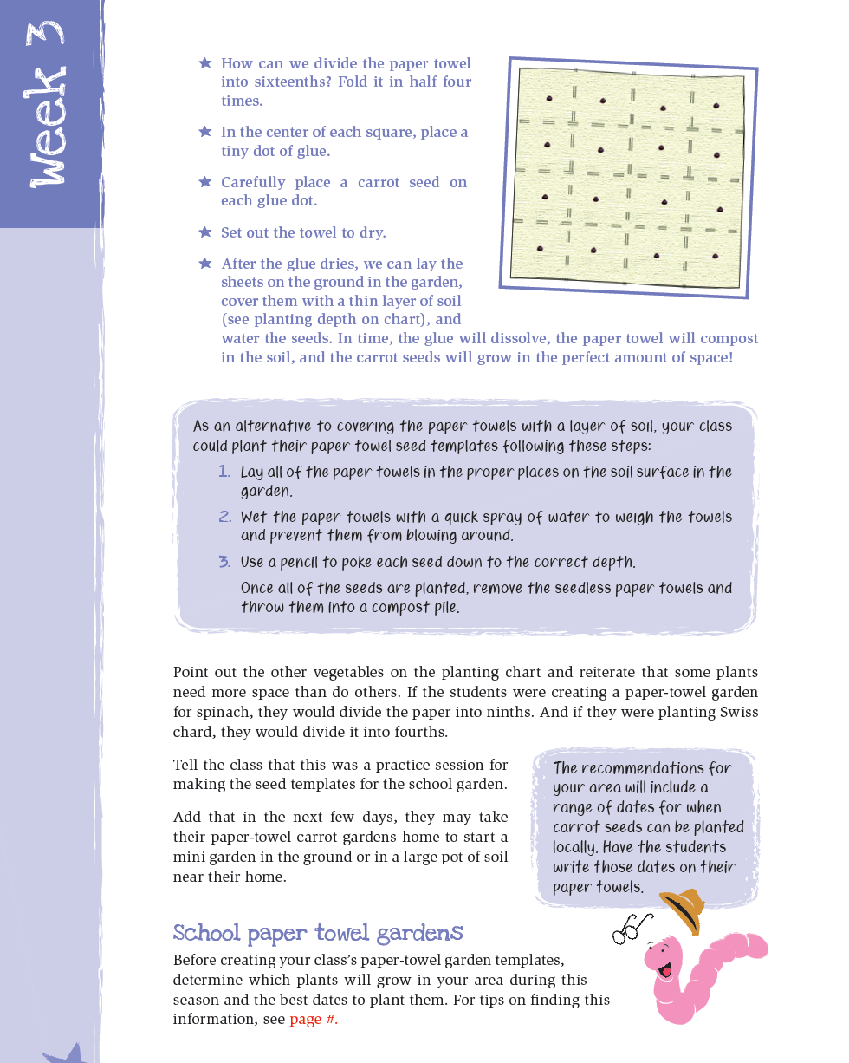

Slide 48


How close together do we
plant seeds?

Slide 49

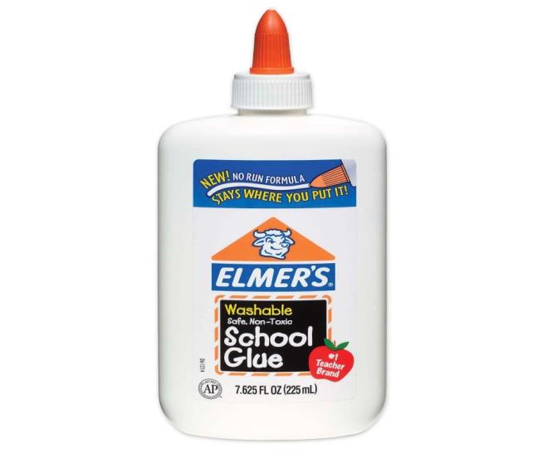
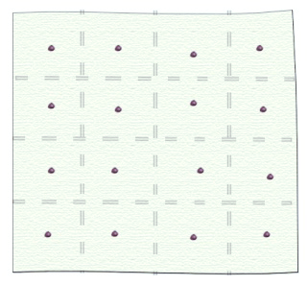

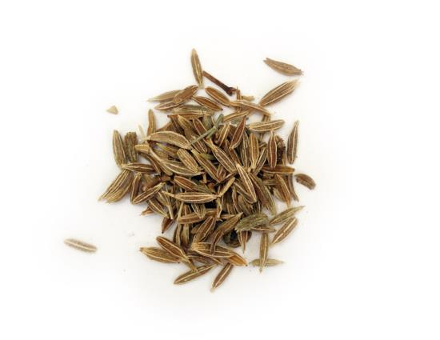

Slide 50







What don’t we just put 16
seeds & plants in every square?

Slide 51
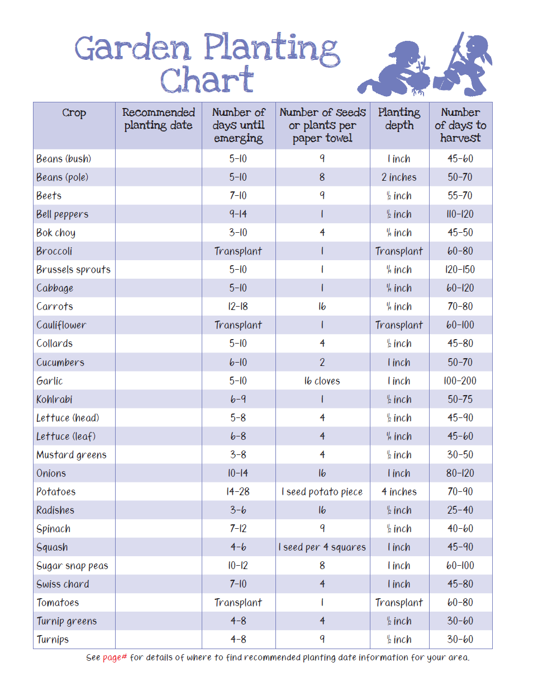

Local
Extension
support
provide
info on
your local
planting
dates

Slide 52



Slide 53



Slide 54
Activity Session
Home Sweet Home
WHERE TO FIND ME?
LGEG Manual
Week 4, page 28

Slide 55

Soon after students evaluate & select the location in the Home Sweet Home lesson, the garden can be built.

Slide 56







Slide 57



Slide 58



Slide 59


Starting
School Gardens

Slide 60

Primary constraints &
stressors of our teachers
Time & testing
Many others… funding, societal/family
issues, training, etc.

Slide 61

EMPOWERING TEACHERS
WHAT?
WHO?
HOW?
WHEN?
WHERE?
GROWING SUSTAINABILITY
&

Slide 62






Lots of Options!

Slide 63

The LGEG school garden project specifically designed to be:
Simple
Easy
Quick
Inexpensive

Slide 64


Quick & Easy Garden Kit
Getting Materials
Building the Garden
Planting It
Provides
teachers
with
steps on:
with the help of one volunteer with a drill!

Slide 65


Quick & Easy Garden Kit
Getting Materials: What are we growing?
- growing 6 seasonal crops
- 3 square ft. plantings of each
- extra space for kids to choice plantings
- simplicity of steps/supplies
Sample cool season 3x7 raised bed:
kids’
choice
kids’
choice
kids’
choice

Slide 66



Quick & Easy Garden Kit
- simplicity of steps/supplies
2
10’ boards
21
cubic
feet soil
Boards can be cut at building store
12
4” Screws

Slide 67





Quick & Easy Garden Kit
How to get materials to school?
- can be loaded for you at building store
- whole garden fits in back of van or small truck
(borrowed vehicle, potential volunteer task?)

Slide 68



Grow:
Quick & Easy Garden Kit Pages include in curriculum

Slide 69

Tips for Starting a Children’s Garden
Funding & Starting Small
Solicit Involvement of Others
  – kid – parent
  – PTA – business
“Our Garden”
Establish a Plan
  – what –site – materials
  – build –plant –maintain
  –off season – next season

Slide 70


Garden success!

Slide 71
Push Pause!!!
AHA! I think this is great and I can really see this working!
I think I need more information?
OR

Slide 72



Slide 73



nutrient stone:
Class makes 3 different stones for each crop growing:
label stone:
benefit stone:

Slide 74

nutrient stone:
a Quick & Easy
option to stones/paint:
Use stir sticks and
permanent markers
Class makes 3 different stones for each crop growing:
label stone:
benefit stone:

Slide 75

Evaluate foods and classify based on amounts of:
unhealthy fats, added sugars, and salt
Whoa foods – contain the most
Go foods – contain the least

Slide 76


Be critical of advertising:
Are all 5 food groups really represented?
It could be argued that they are BUT students come to consensus
To classify each food as Go
Slow
or Whoa

Slide 77

Classification charts included to illustrate
how foods are classified

Slide 78




Slide 79




Slide 80



GO = 0

Slide 81





Slide 82






Slide 83





Slide 84




Slide 85






meat/protein =3 ounces
grains = ½ cup
vegetables = ½ cup
fruits ½ cup
dairy = 1 cup

Slide 86







Slide 87

Food Exposure

Slide 88


Goals
  Exposure to new foods preparations thru food demonstrations will engage and excite children.
  Children will share those food experiences in the
  home environment by encouraging care
  providers to prepare
  foods from the garden.

Slide 89

Selecting Recipes for
In-School Food Demonstrations
Identify viable recipes
  Limited set-up space, cooking equipment, and time
  Cost and availability
  Cooking skills
  Kid friendly
  Model healthful food choices
  & safe kitchen practices

Slide 91
Garden
Kitchen
recipe
demos
http://jmgkids.us/garden-kitchen-recipe-demos/
Notes:
Show video

Slide 93




Slide 94




Slide 95




Grow Strong and
Walk Across Texas

Slide 96



Walk Across Texas
Program Goal: “Helping people of all ages establish
the habit of regular physical activity since 1996”
Fun, motivating way to become active and get moving!
All it takes is people willing to get physically active!
Goal: Each team, individual, or classroom will walk(log miles) across Texas= 833 MILES!
3 WAYS TO PARTICIPATE

Slide 97

http://walkacrosstexas.tamu.edu

Slide 98





School & Community Gardens = Activity??

Slide 99



What counts as a mile?
Generally, any exercise that makes you breath hard and sweat!
Also
  20 min. of activity = 1 mile
  A measured mile i.e. track, treadmill, etc.
  2000 steps on a pedometer

Slide 100

GETTING STARTED…
Coalition and/or Advisory Team
Set program planning goals for the year
Identify partners/existing relationships & committees
  Has anyone asked for a physical activity program?
  Identify existing local campaigns/events to enhance implementation
Review program components and resources

Slide 101

Set Program Planning Goal
Consider planning program components at least 3-6 months before WAT implementation
Review State & School resources/guidelines

Slide 102

PARTNERING FOR GREATER IMPACT
Schools
Coordinated School Health Advisory Councils (SHACs)
  Campus Improvement Plans
  Employee Wellness Initiatives
School Parent Teacher Associations/Organizations
  Healthy Fundraisers- Fun runs/walks
Utilize programs to fullest
  Fuel Up to Play 60
  Marathon Kids
  American Heart/Cancer Events

Slide 103

PARTNERING FOR GREATER IMPACT
Communities
Community organizations like United Way, HEB, or American Heart Association
Media outlets
Civic organizations like Parks & Recreation Departments and Chambers of Commerce
Local businesses and organizations aimed at supporting healthy lifestyles

Slide 104

Review Your Schools Resources
Training & Participation Materials
  Teacher Guides
  School Video & PowerPoint
  Classroom Packet
Publicity & Marketing
  Media resources
WAT Activities
  Teacher Lesson Plans (TEKS)
  Parent Newsletters / Bonus Miles / Bingo
  Guide to creating an Active School Environment
Wrap Up & Awards
  Certificates and celebration

Slide 105


Go!
Notes:
Have groups participate in an activity

Slide 106
WAT Activity Session
Tic Tac Toe

Slide 107


included
Teacher
Resources
Notes:
You can start with short term actions in your plan to improve the school health environment in each of these areas: classroom, grade level, cafeteria, gym/playground and engaging families. In some schools, we have seen communities and families connecting through:
PTA/PTO support of school gardens
ESL classes helping with the vegetable demonstrations
Parent and family members volunteering with vegetable tastings/demonstrations, garden building/planting/maintenance, and Walk Across Texas support
Local community volunteer groups providing assistance with garden and nutrition demonstrations, and physical activities
Community service organizations (ex. Junior League) providing financial assistance for building school gardens and improving out door recreation spaces
High School Career Tech and Agriculture teachers partnering high school students with elementary classrooms for mentoring
Local vegetable producers and farmers

Slide 108





Intro letter to parents
weekly update letters
appendix:

Slide 109

If you have access to volunteers, this page lays out specific tasks you can assign them to help:
Intro letter to parents
weekly update letters
appendix:

Slide 110

Building School & Community Support
Notes:
You can start with short term actions in your plan to improve the school health environment in each of these areas: classroom, grade level, cafeteria, gym/playground and engaging families. In some schools, we have seen communities and families connecting through:
PTA/PTO support of school gardens
ESL classes helping with the vegetable demonstrations
Parent and family members volunteering with vegetable tastings/demonstrations, garden building/planting/maintenance, and Walk Across Texas support
Local community volunteer groups providing assistance with garden and nutrition demonstrations, and physical activities
Community service organizations (ex. Junior League) providing financial assistance for building school gardens and improving out door recreation spaces
High School Career Tech and Agriculture teachers partnering high school students with elementary classrooms for mentoring
Local vegetable producers and farmers

Slide 111
Volunteer Coordination
Master Gardeners
Master Wellness
Community Partners
Local Universities (interns)
School PTO
Targeted Parent Groups (ESL)
TEEA

Slide 112


Utilizing Volunteers
Volunteer descriptions and roles/responsibilities available
ANY volunteer can be trained and utilized for assisting with school gardens, food demonstrations, physical activity events and curriculum activities.
Volunteer training should “model” how you want them to implement!

Slide 113


LGEG Activities
Training Teachers and School Staff
Coordination with teacher(s) and/or Parent Liaison
Recruiting and Training Volunteers
Coordination of garden bed building
Garden Planting Days
Garden Markers
Garden Related Demonstrations
WAT! Kick-off
Food Demonstrations
Harvesting Day
End of Year Celebration
WAT! Celebration

Slide 114
Program Costs
Estimated costs for 1 classroom with 25 students
Garden for 1 Fall or Spring Season | $150
Supplies for 6 food demonstrations and tastings | $100
Cost for providing a kit of supplies for LGEG and WAT | $200
These costs can vary based on available resources in each county
There are a variety of options for funding the program

Slide 115
Identify potential donors or funds
School budget
PTA
School fundraising or donations
Find out who might be willing to support your project and their funding cycle/previous funding
Individuals, Organizations, Local businesses
Learn about regional foundations in your area
Websites like www.foundations.org
Large corporations in your area often have a foundation: IE: Lowes, Home Depot, etc.

Slide 116
Website Support
  Videos:
  Vegetable harvest and lifecycle
  Shopping for and preparing vegetables
  How to build raised beds and container gardens
  What’s For Snack
  Recipe demonstrations (linked to Dinner Tonight)
  Publications:
  Easy Gardening Series
  Vegetable Varieties and Planting Timelines
  Recipes
  Nutrient Information
  Child Activities
http://jmgkids.us/LGEG

Slide 117
How to Jump Start LGEG and Build Excitement with Students, Parents and the Community?
A STRONG KICK OFF EVENT
Kick-off is the opportunity to recruit additional parent and community volunteers to participate in LGEG program to assist the county staff and teachers
Coordinate with an existing school event, if possible
  Open House; Health and Wellness Night; etc.
Utilize booths and exhibits you already have…make it fun and interactive
Have a designated location set up to recruit volunteers and ask them what area of volunteering they are interested in
Kick Off Event helps to excite the school about LGEG!

Slide 118

FAMILY ENGAGEMENT!!
Take home pieces:
  Walk Across Texas (WAT) Newsletters & LGEG family stories
  WAT Bonus Miles & Bingo Forms
Website: Vegetable harvest, preparation videos of recipes, English and Spanish
Take home Garden Kitchen recipes for families to make together at home
Recruitment and training of parents as volunteers
Videos on how to build raised beds and container gardens on website
Videos on how to register and participate in Walk Across Texas(WAT) program
Local varieties and sources of vegetable seeds/transplants
Opportunities for “how to” garden workshops for parents and families
Dinner Tonight videos and recipes to make a complete meal
Encourage food service to promote featured veggies
Collaborate with PTO, SHAC, and other groups
Celebration events

Slide 119

Want to know the benefits to your kids?
Have them complete online survey!
Notes:
Pre-test

Slide 120


Slide 121

Next Steps

Slide 122
Register your class for free!

Slide 123


Slide 124


Slide 125

Why Should a Class Register?
Local Extension/JMG office can better support
Get a class registration certificate
It’s free, doesn’t obligate youth to
complete program
Allows youth in your group to earn certification and recognition

Slide 126







www.twitter.com/jmgkids
www.facebook.com/juniormastergardener
www.pintrest.com/jmgkids
www.instagram.com/jmgkids
www.jmgkids.us

Slide 127
Push Pause!!!
AHA! I think this is great and I can really see this working!
I think I need more information?
OR

Slide 128

Questions?

