Slide 1
United ISD
LGEG through Gifted and Talented Program
Presented by: Lisa M. Dunn, GT/AA Coordinator
6A School District (29 elementary schools, ten middle schools, and four high schools) in south Texas/ 43,154 students/ 5,836 identified gifted and talented students

Slide 2
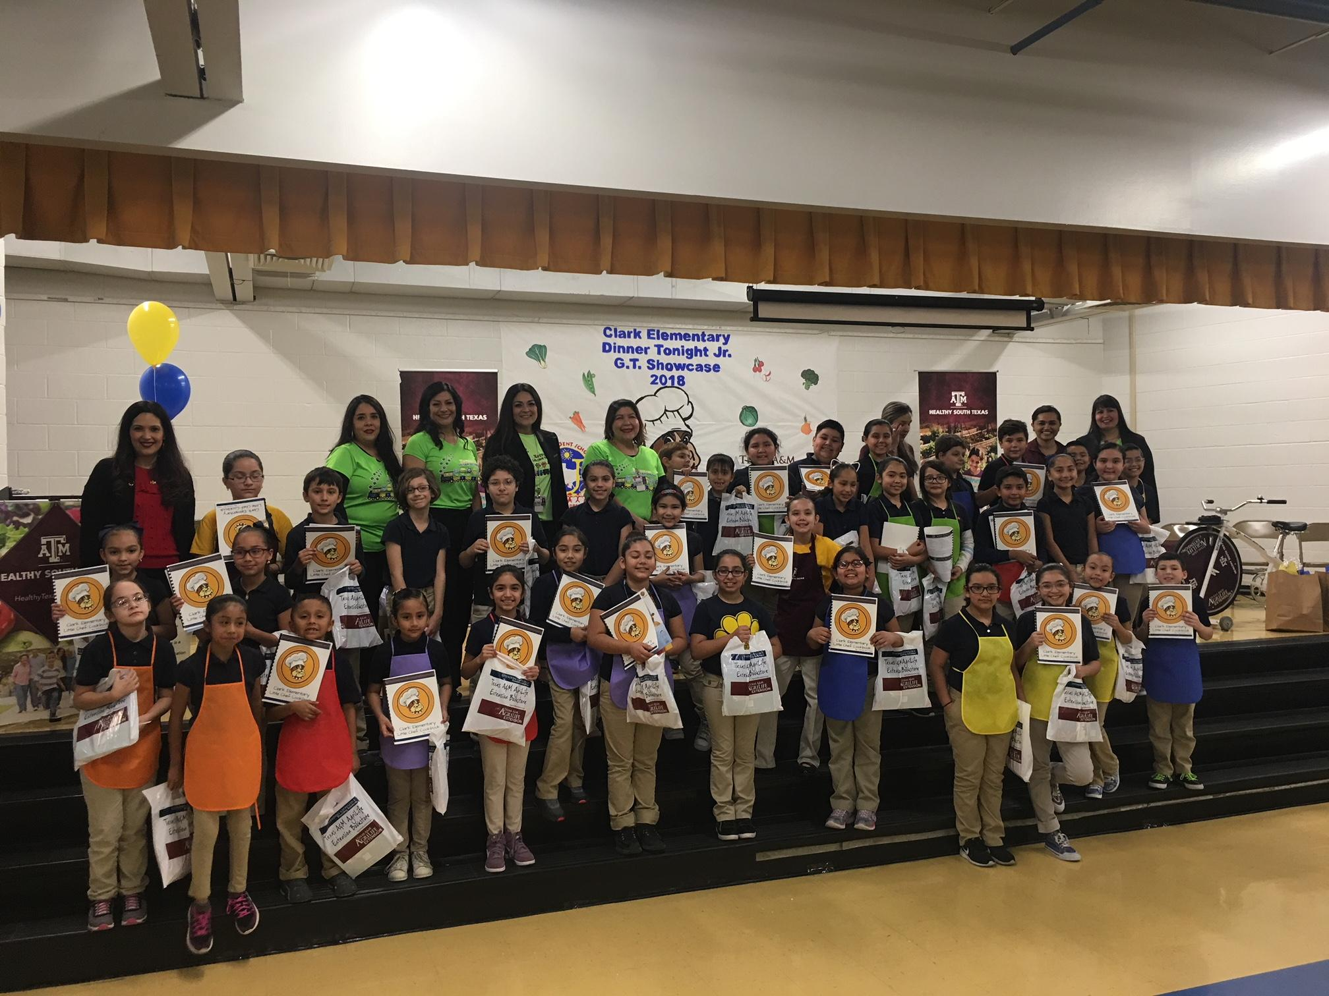
What? LGEG through Gifted & Talented Program
LGEG Pilot Program last
year (2017-18) at Clark ES
Conversation with principal
Small team of teachers and administrators
LGEG lessons (including tastings) implemented by music teacher (lead GT teacher) in three hour (multi-age, grades 1-5) pull-out program on Fridays
GT campus funds in support of program
First Dinner Tonight, Jr. in the state of Texas
Healthy South Texas distinction (hosted Walk Across Texas Rally and Maintain, No Gain)
Experience from CES shared at leadership meeting
Several principals interested in implementation

Slide 3
When and Where? 2018-19 School Year
Teachers received training in the summer on LGEG curriculum
LGEG Curriculum used in GT services (pull-out programs on Fridays or other designated schedule) in conjunction with Kaplan depth and complexity model
Nine elementary schools using LGEG Curriculum and building garden beds through Gifted and Talented Program
LGEG Lessons-springboard to research and community involvement.
Nine middle schools utilizing LGEG and/or JMG Units through advanced science classes (majority through 7th grade)
Clark Elementary hosted an instructor organic gardening session led by Berman Rivera, City of Laredo Construction Superintendent.

Slide 4
How?
Campus meetings with principals and designated GT teachers to plan and coordinate dates with local Agrilife agents (Angelica Sifuentes and Martha Ramirez) for building garden beds, planting, and other events (including Walk Across Texas rallies, Dinner Tonight, Jr., Mobile Cooking School, and Path to the Plate)
Agrilife agents and UISD teachers instrumental in implementation and success of programs
Coordination with City of Laredo for garden instructor sessions on garden maintenance, organic gardening, and irrigation

Slide 5
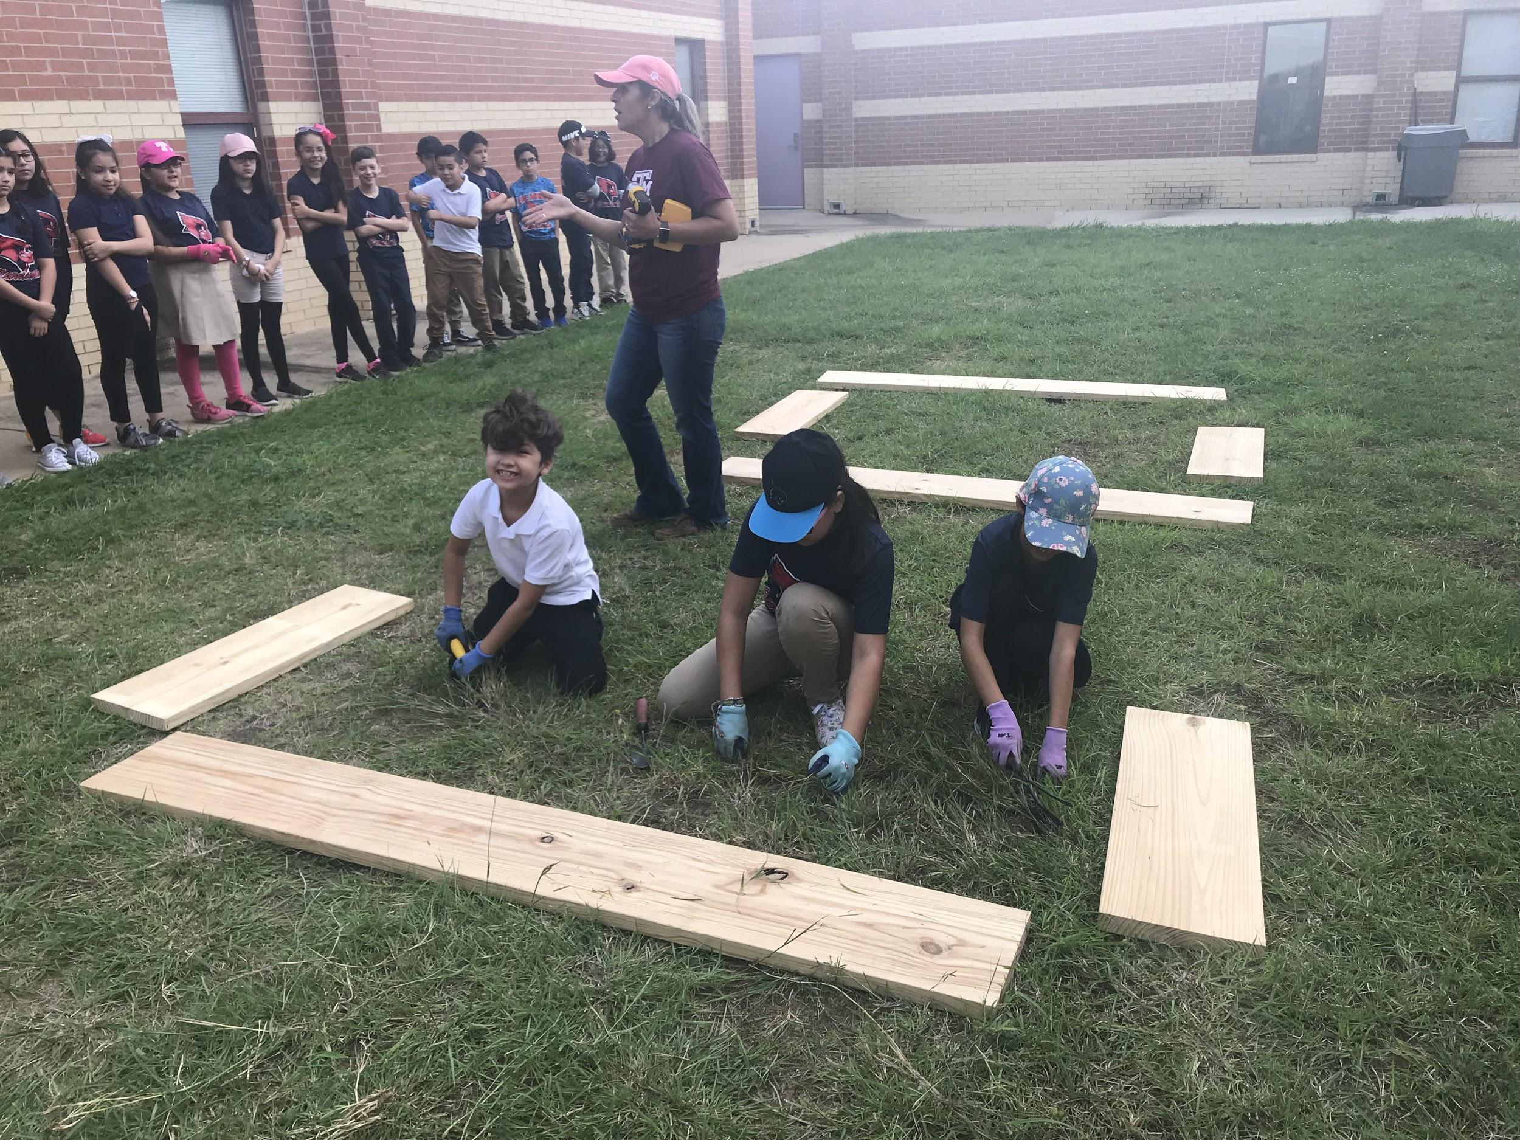
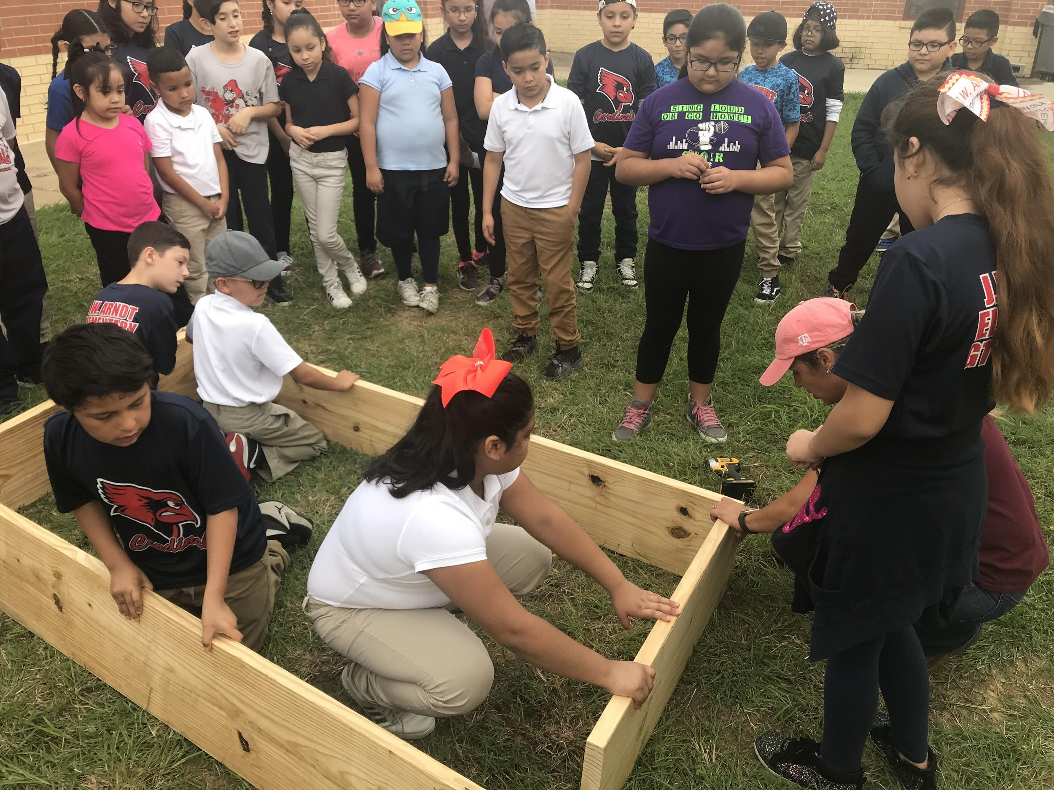
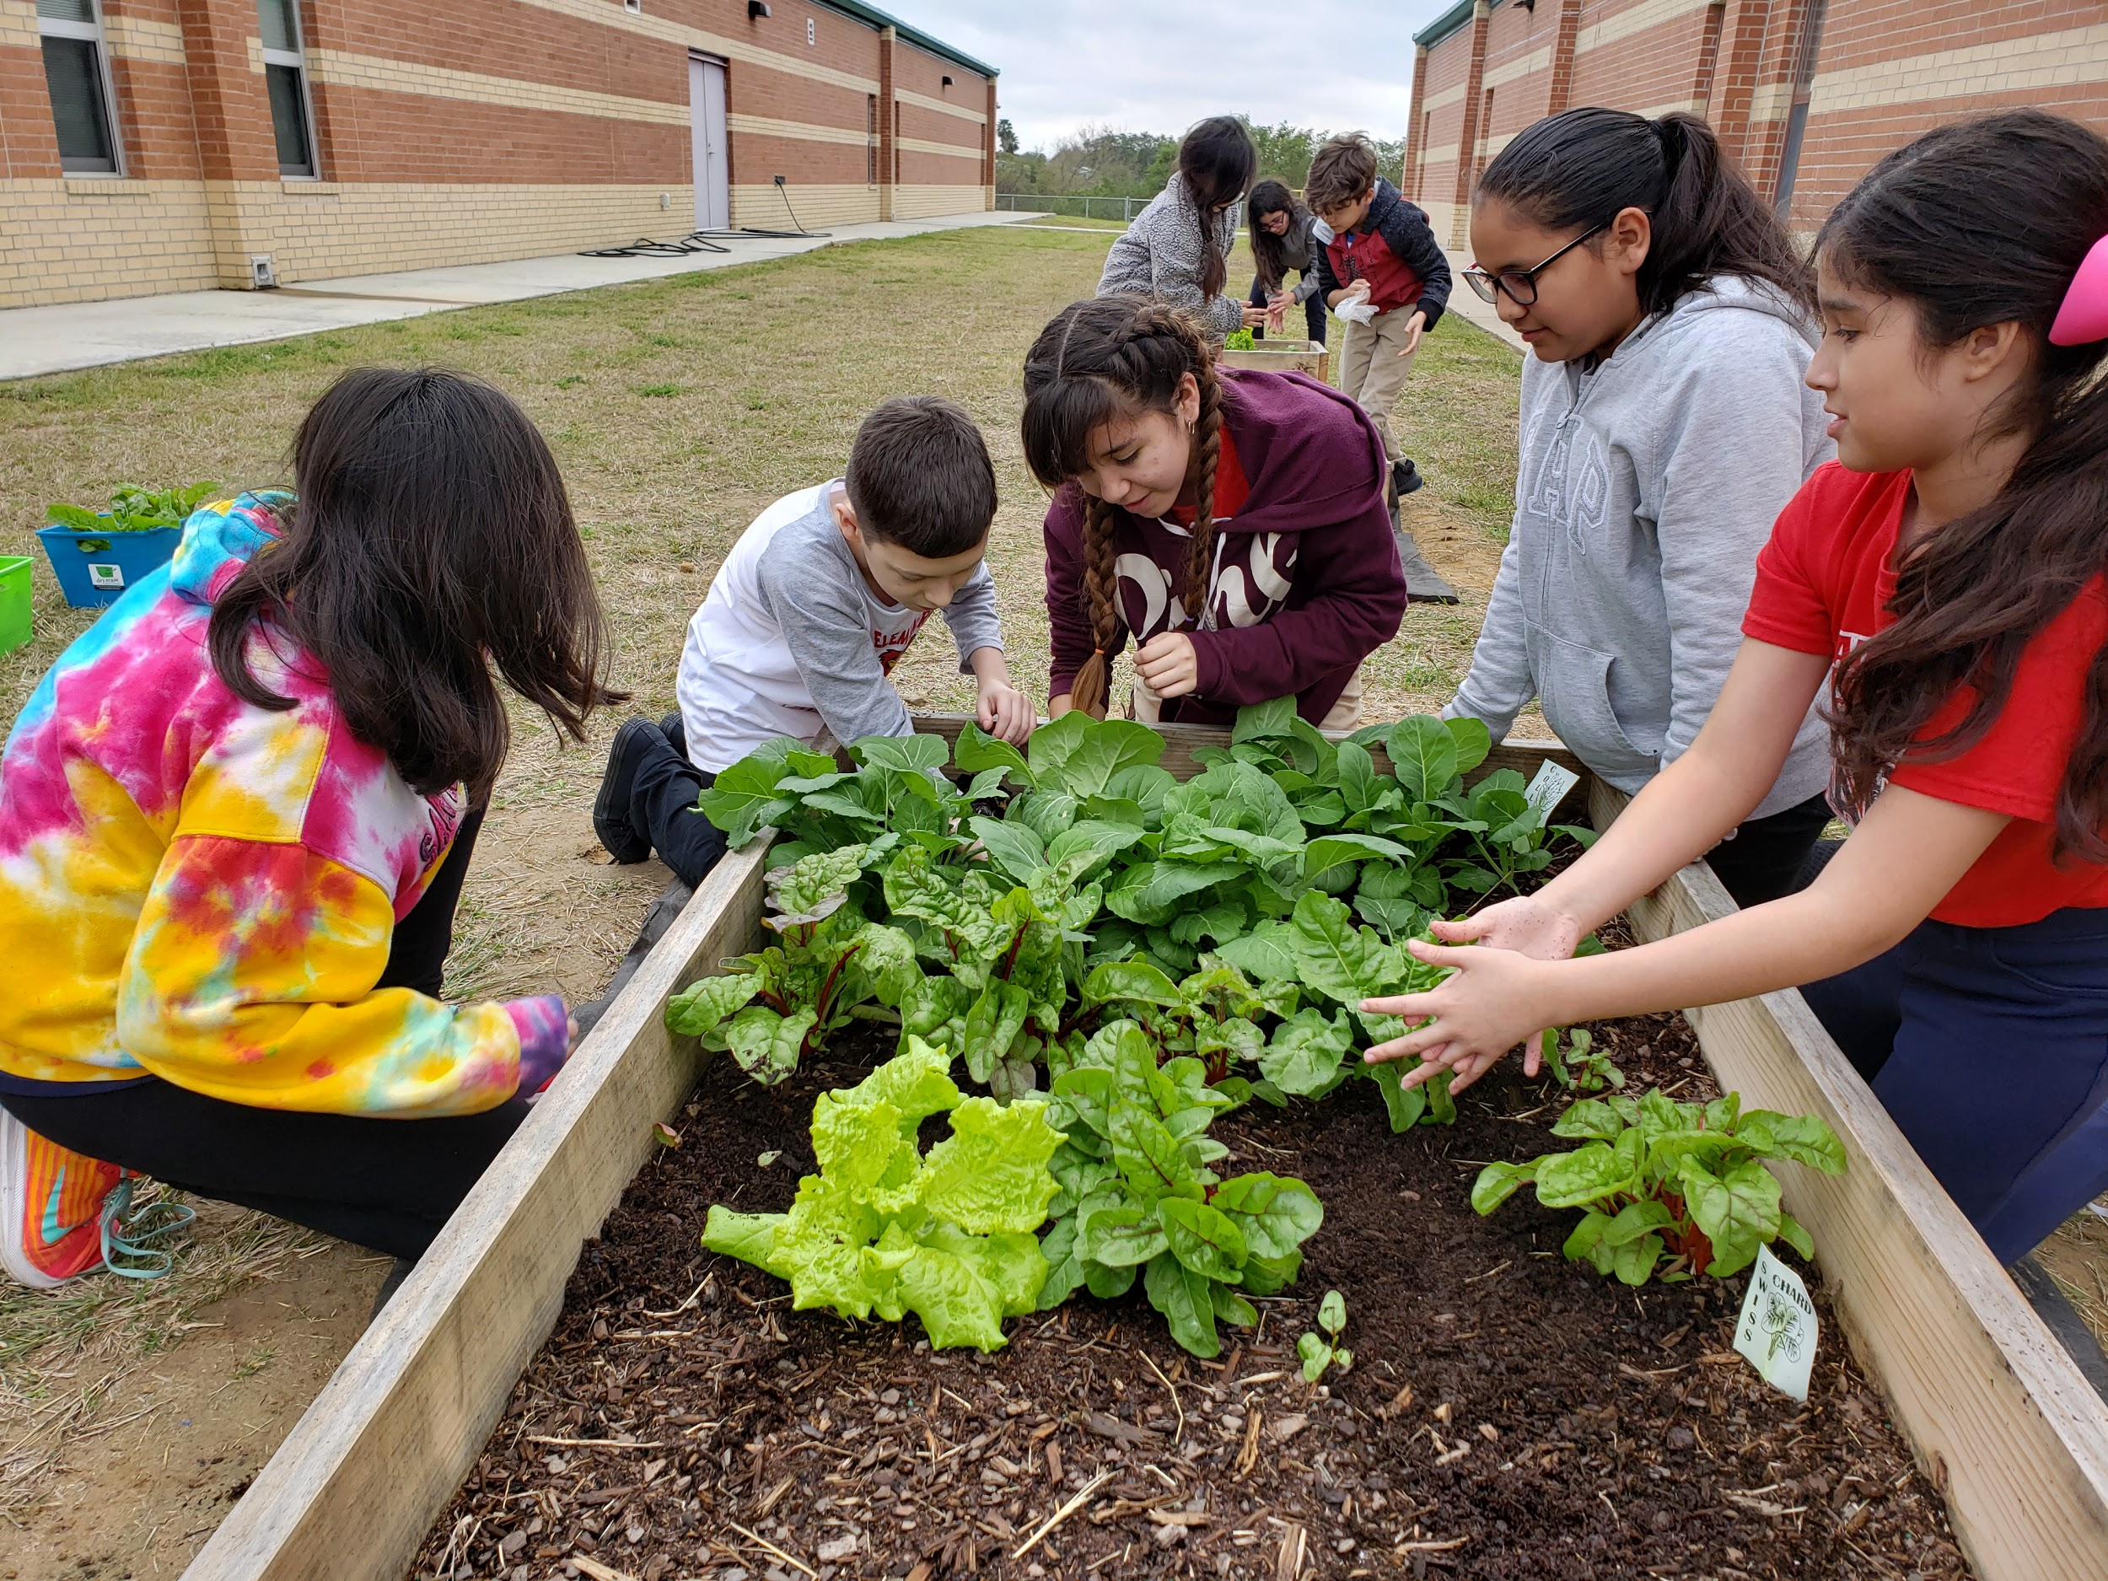
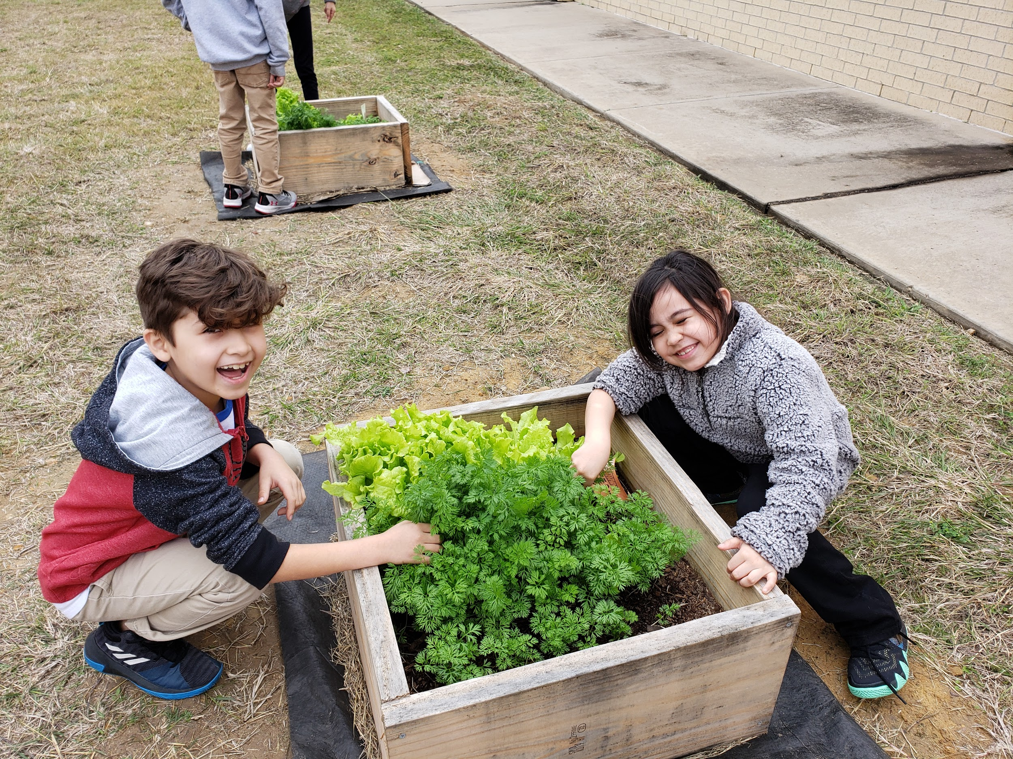
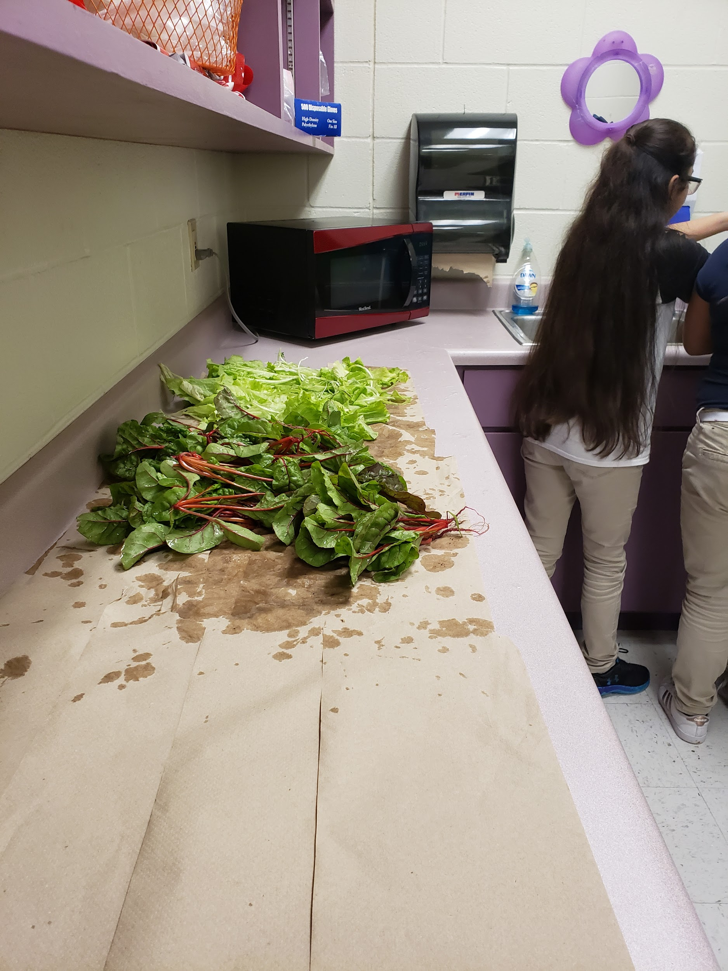
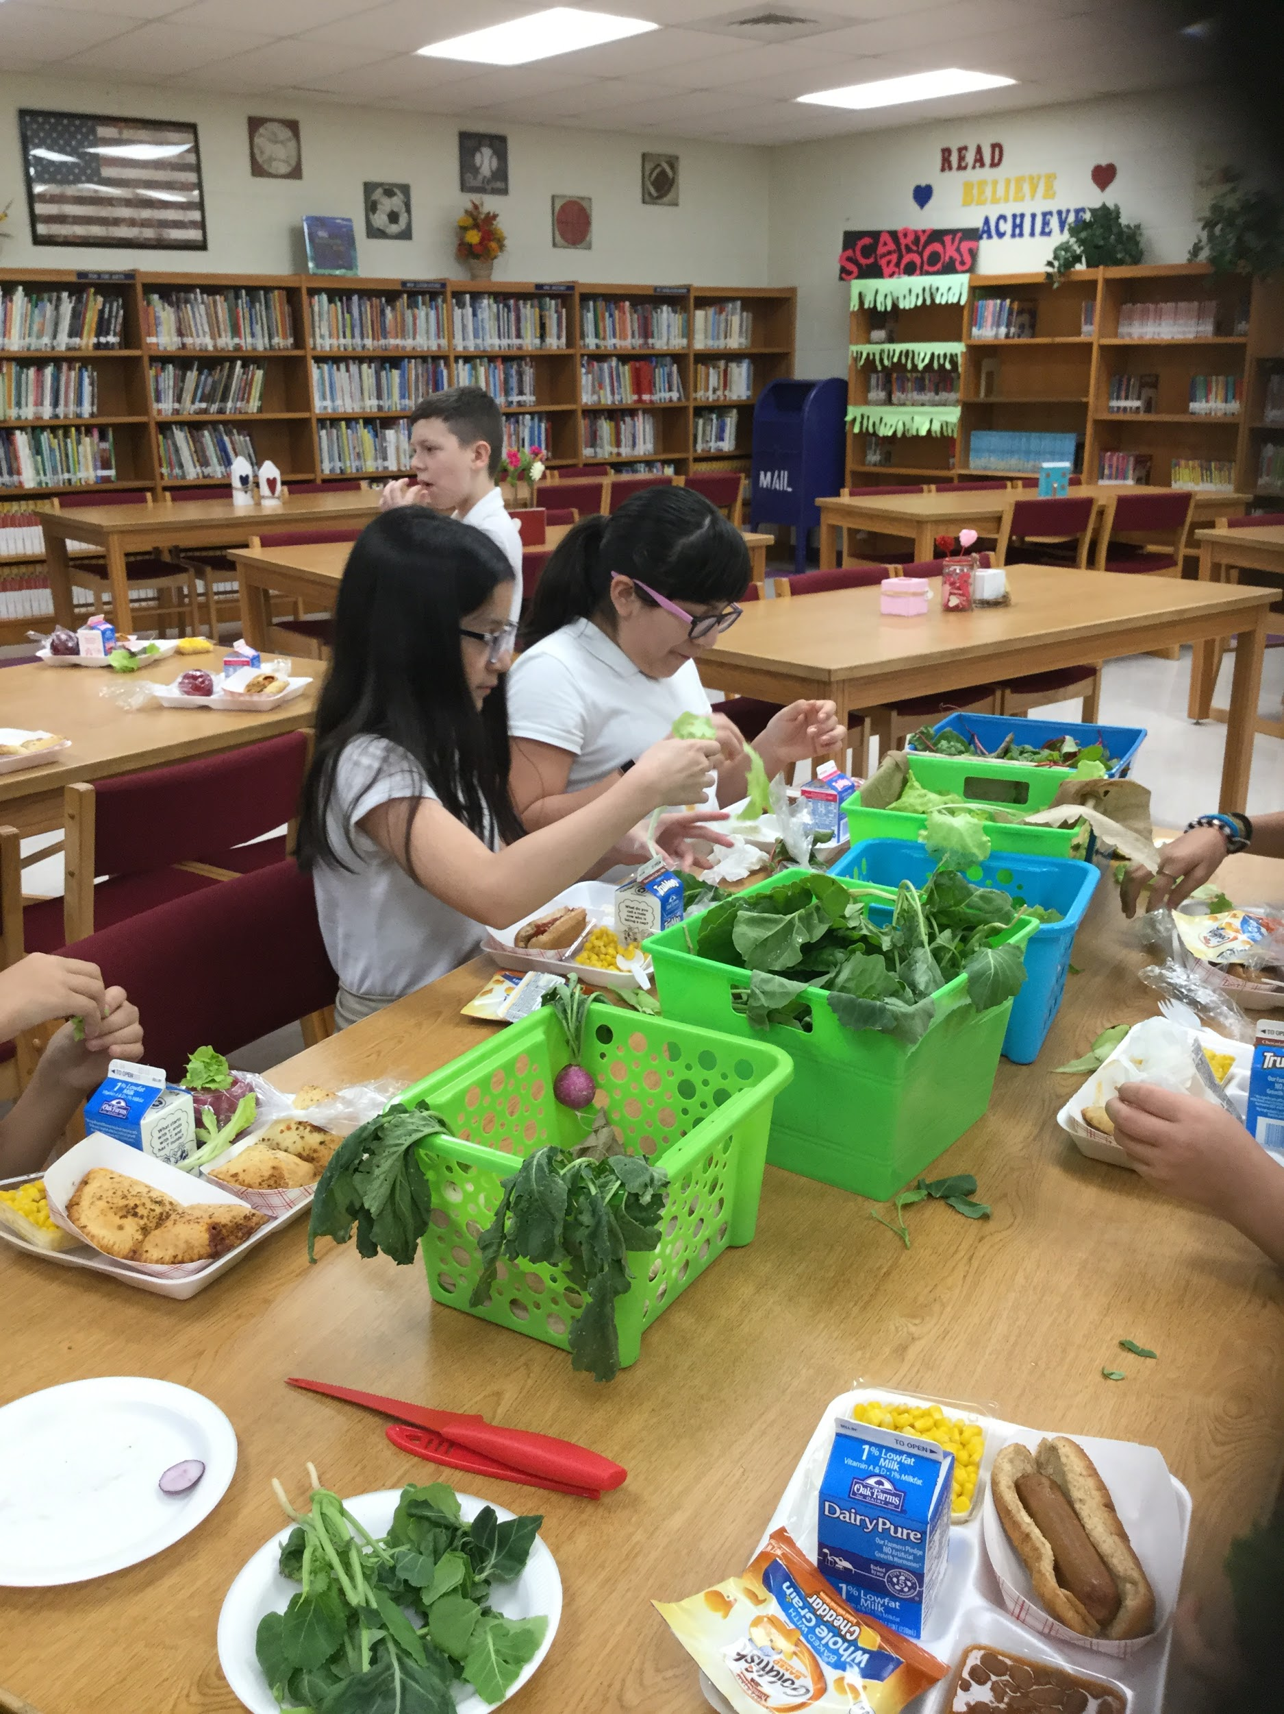
Where?
Arndt Elementary School, Martha Ramirez, Local Agrilife Agent

Slide 6
Bonnie Garcia ES Food Tasting and Recipe Demos 1st grade

Slide 7
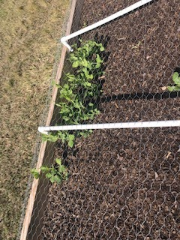
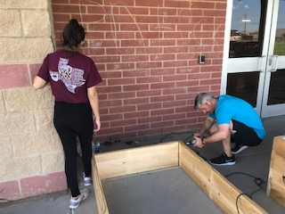
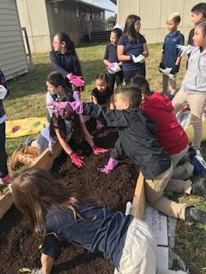
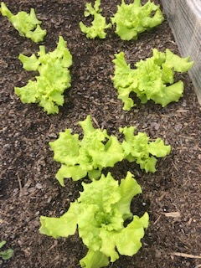
LGEG and Garden at Borchers Elementary School

Slide 8
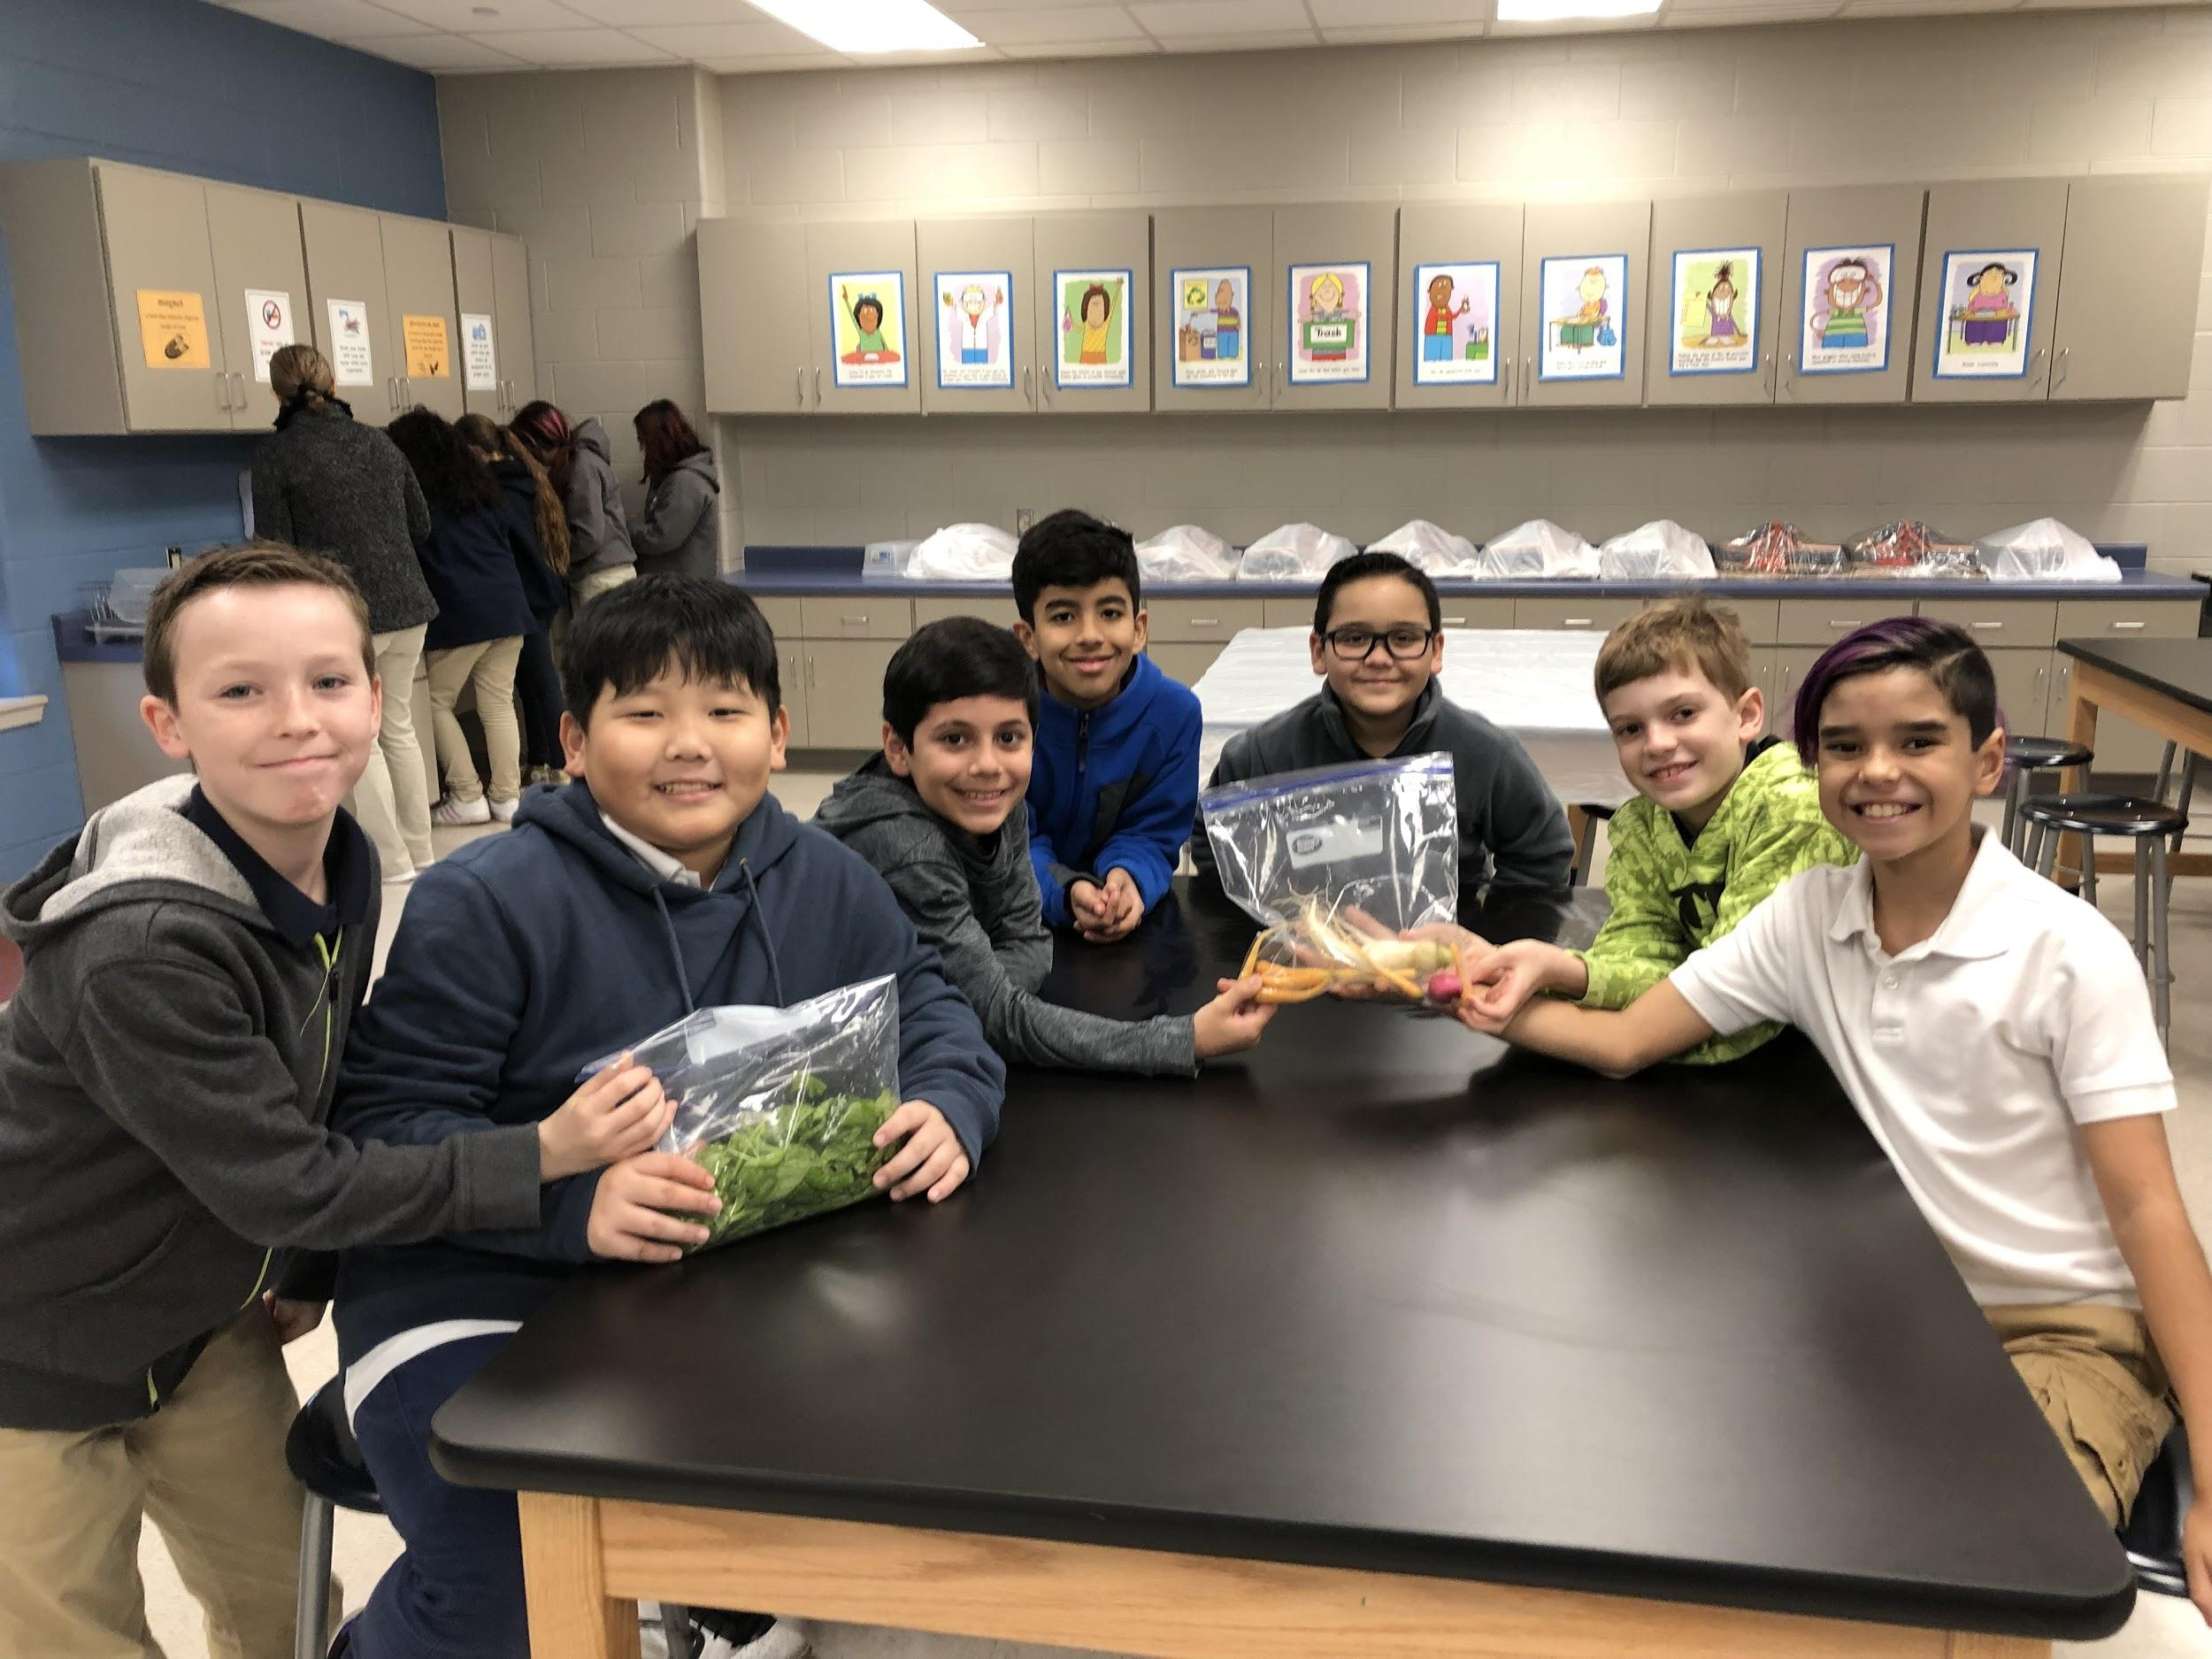
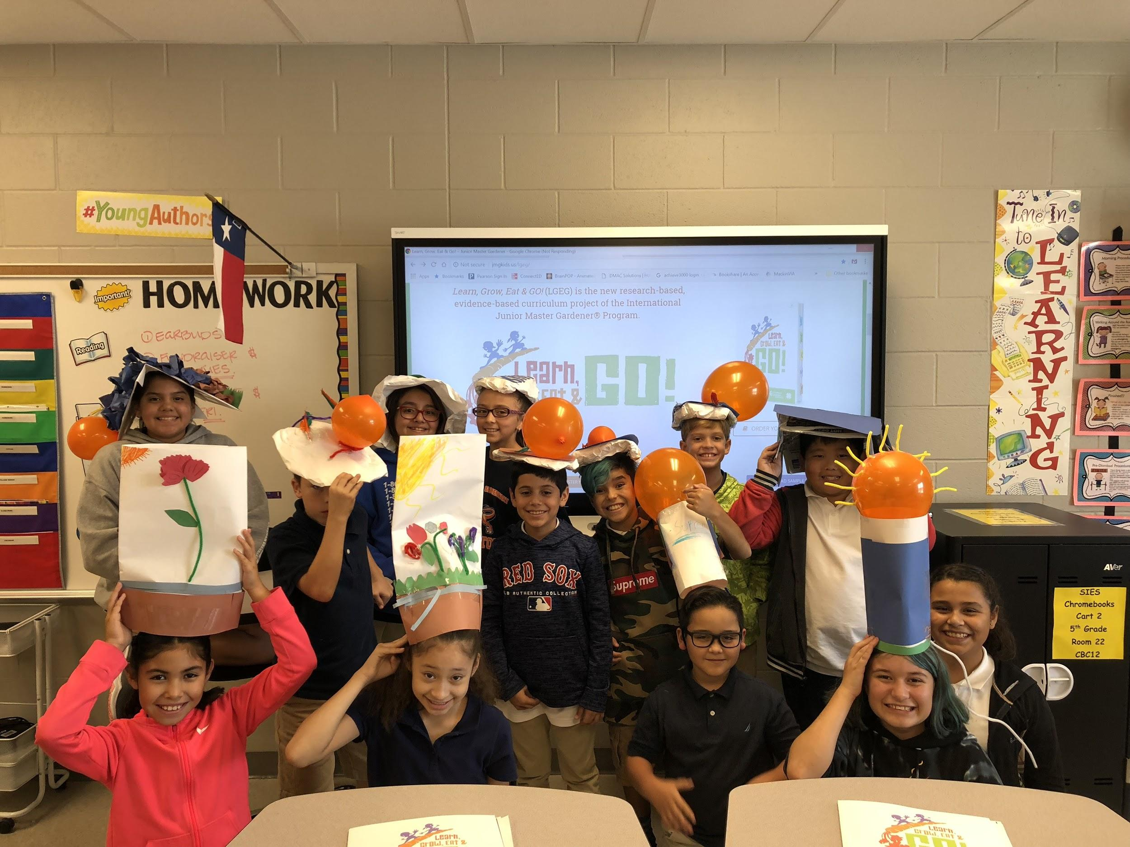
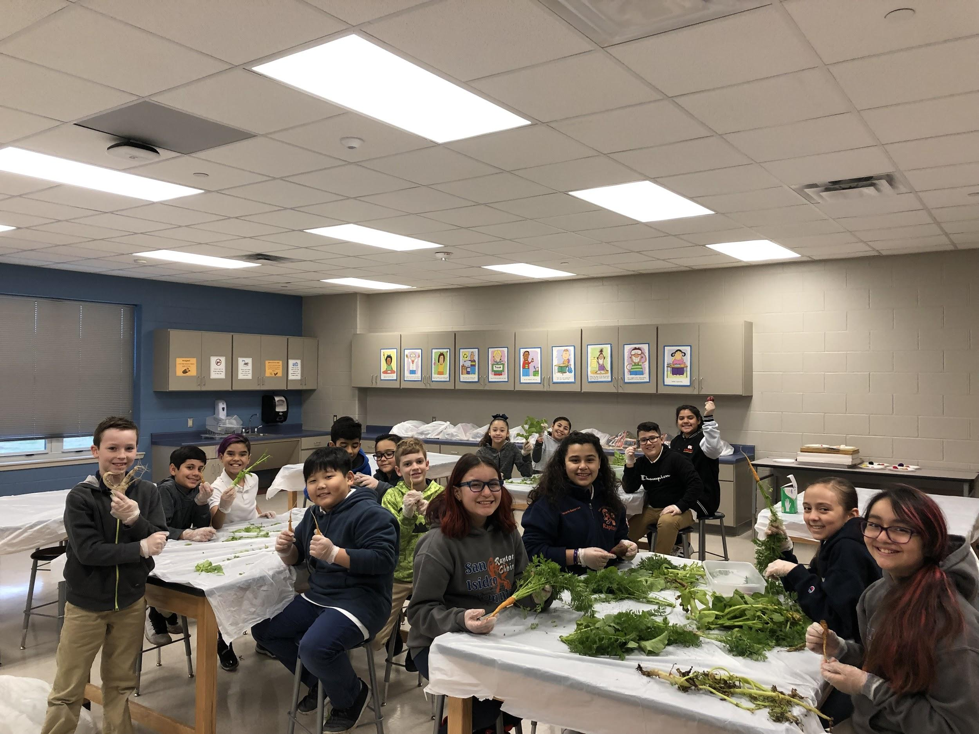
LGEG and Garden at San Isidro Elementary
Know and Show Sombrero
Harvest

Slide 9
Adding Depth and Complexity to Lessons
Literature Connection

Slide 10
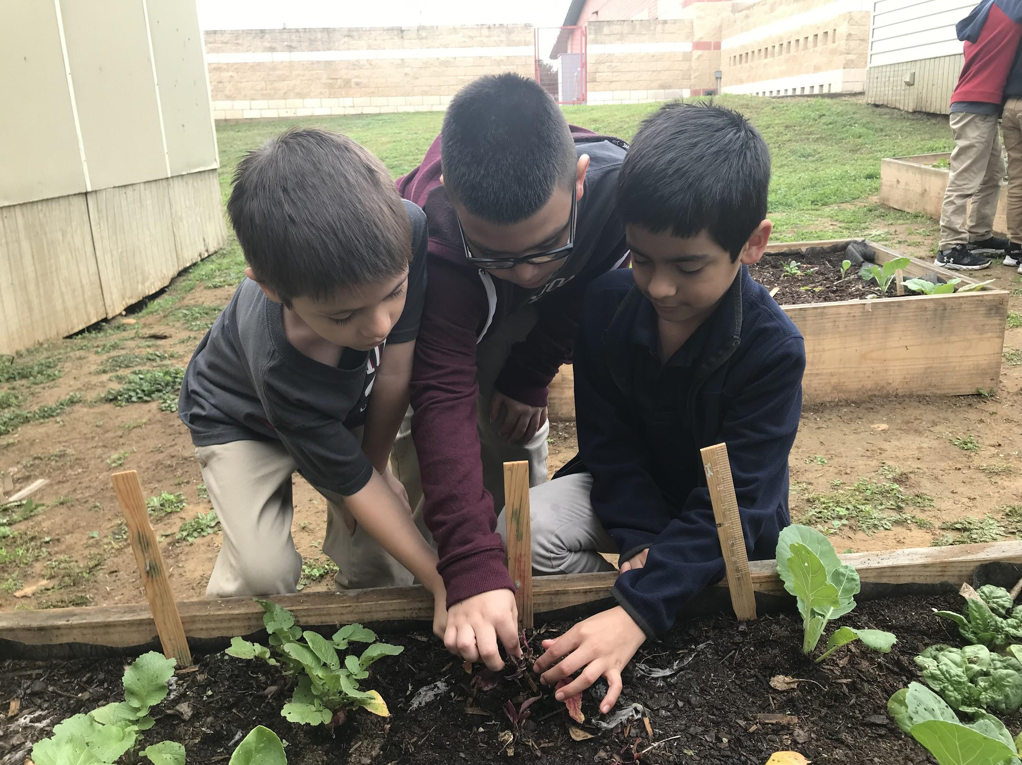
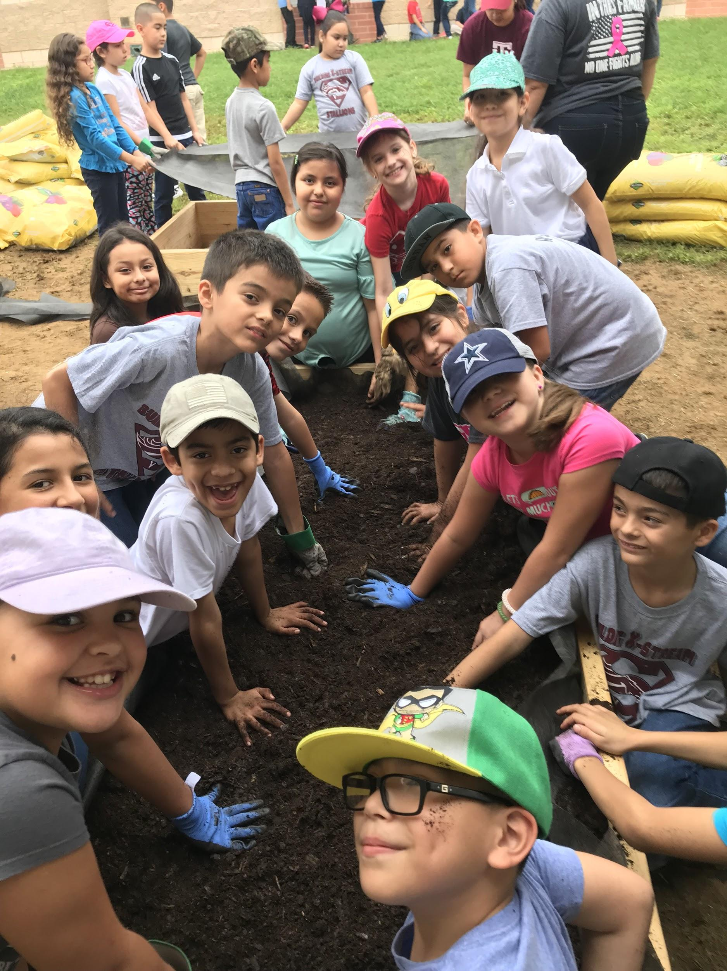
Why?
Spread health and wellness
Inspire our gifted and talented students by fostering leadership opportunities
Cultivate great minds through creativity and collaboration
Key element for success:
Intention followed by inspired action
“Let us cultivate our garden.” Voltaire

