Slide 1

Learn, Grow, Eat & Go!

Slide 2


Overview & Research

Slide 3
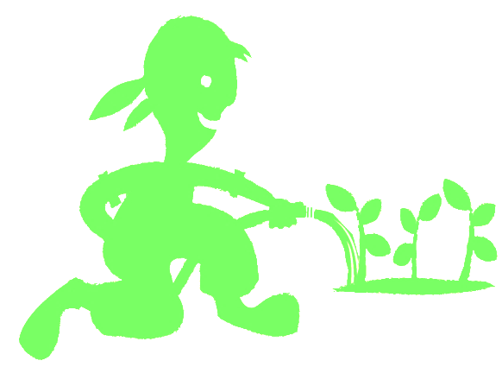
Benefits of JMG to children?
Increased leadership and personal responsibility
Improved academic achievement – particularly science
Increased parent and mentor involvement with youth in schools with JMG
Exposure to career exploration paths
Engagement in community service/service learning projects
Youth certification as Junior Master Gardeners
www.jmgkids.us/research
Notes:
3

Slide 4
Can Gardening Positively impact?
Child Health
Childhood Obesity Rates
Family health
Family mealtimes
Reach into the home
Notes:
4

Slide 5
Why Health Matters
Healthy kids are in school & in class.
Healthy kids are ready to learn.
Healthy teachers are at school with energy.
Healthy administrators and staff are engaged.
Healthy parents are at work or home –involved.
Healthy people have a higher quality of life.
Healthy people need fewer health resources.
Healthy communities are desirable places to live and work.
Notes:
5

Slide 6
Biggest Health Challenges
2018 National JMG® Leader Training

Slide 7
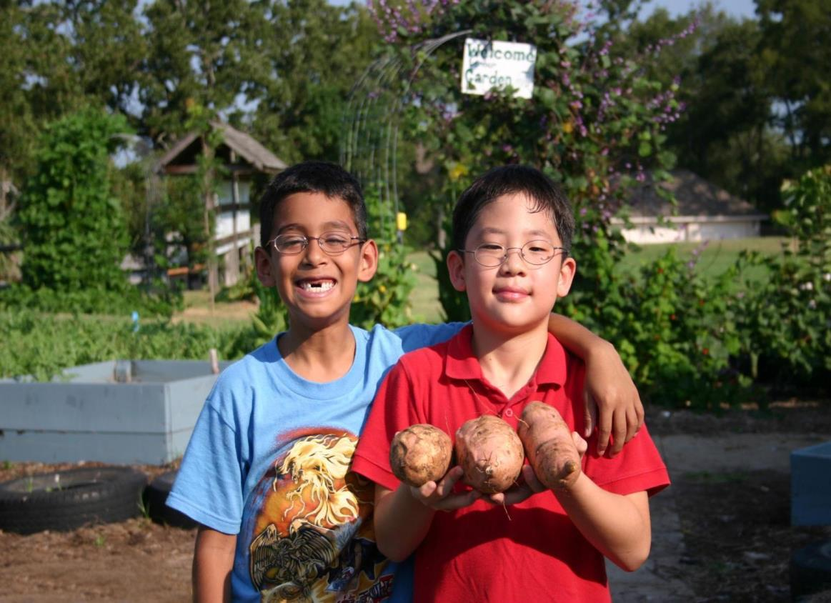









Research Project: Texas Grow! Eat! Go!
Expansion/Implementation/Research
Study Project

Slide 8

Who participated in research study
32 Title 1 schools, 5 Texas school districts/5 Texas counties
  Corpus Christi ISD/Nueces County
  Dallas ISD/Dallas County
  Huntsville ISD/Walker County
  Klein ISD/Harris County
  Willis ISD/Montgomery County
8 schools per district (3 to 5 - 3rd grade classes)
3rd and 4th grade students & their families
School personnel at each school
County extension staff and county volunteers
(Master Gardeners; Master Wellness; interns)
Largest research and evaluation study ever done on the
Junior Master Gardener program

Slide 9
Parent Demographics: Race/Ethnicity
Language Spoken at Home
English | 72%
Spanish | 27%
Other | 1%
Notes:
This is a nice visual of the ethnic distribution:
Over 25% of the participating parents spoke Spanish as their main language

Slide 10

Parent Demographics:
Percent of Parents Reported to Receive:
48.6%
reported receiving
NO benefits
12.0%
42.3%
6.2%
WIC
SNAP
Other

Slide 11
LGEG Evidence Based Outcomes
Significant Improvements in:
MVPA
Total Physical Activity
Vegetables Consumption
Vegetable Preferences
Healthy Beverage Preferences
Self-Efficacy & Knowledge
Parent/child cooking, physical activity and gardening
Reaches into the home to support positive family health practices
BMI Significantly Reduced for use of LGEG
BMI Significantly Reduced for use of LGEG
Preliminary Conclusion: Family-focused garden, nutrition and physical activity
programs significantly improve health behaviors in children.
Notes:
Through the course of this research, we saw
child vegetable preference, and nutrition and plant science knowledge increased significantly
child physical activity with parents increased, while screen time decreased.
Parents encouraged eating vegetables and increased gardening with their children.
Teachers reported that students were more attentive and had high participation in LGEG learning activities.
41% of Parents learned about “Go, slow and whoa” foods
81% of parents learned about the school gardens
60% of parents read the recipes sent home and 30% tried the recipes
27% of parents walked with their child to earn “Bonus Miles” for their child’s class.

Slide 12
Featured lessons: Weeks 1-4

Slide 13
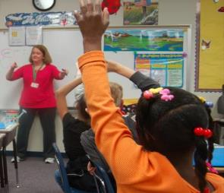


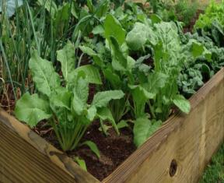

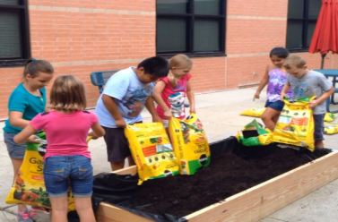

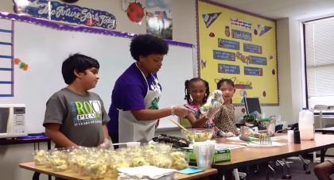

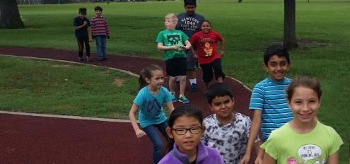


Slide 14


CURRICULUM DESIGN
10 weeks,
2 lessons/week
Sequence, integration,
pace, & flexibility

Slide 15
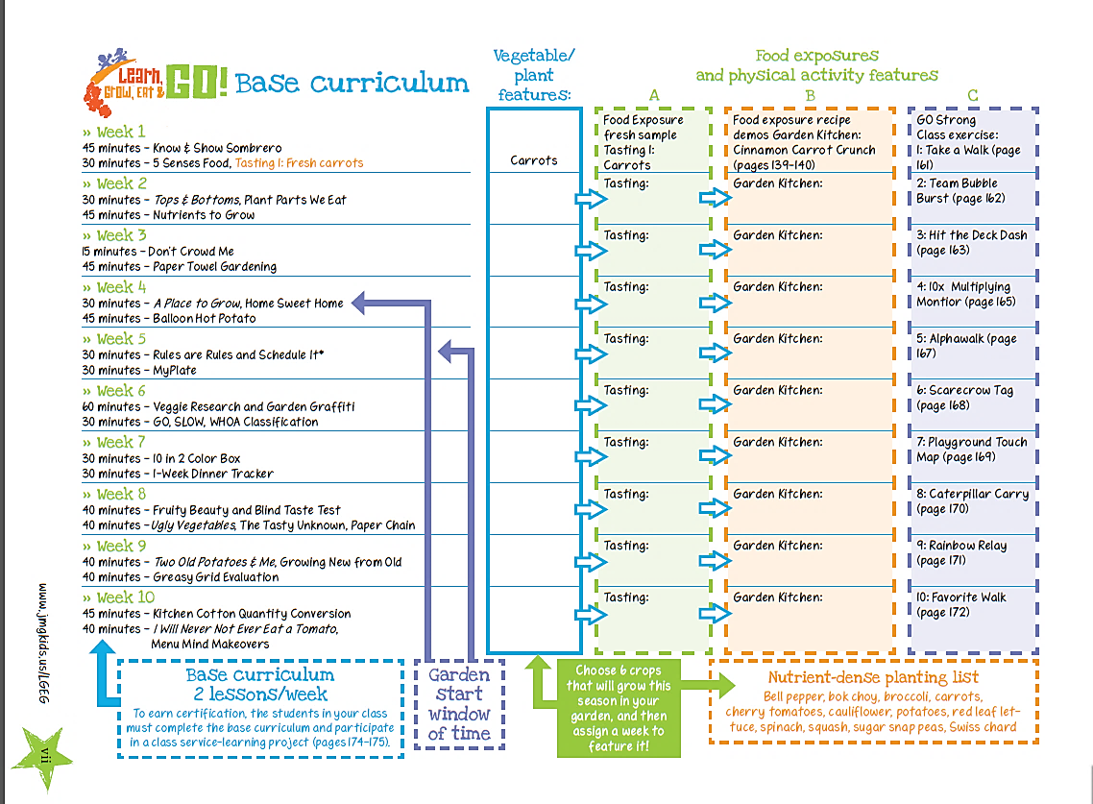

Slide 16


Lesson
Overview

Slide 17
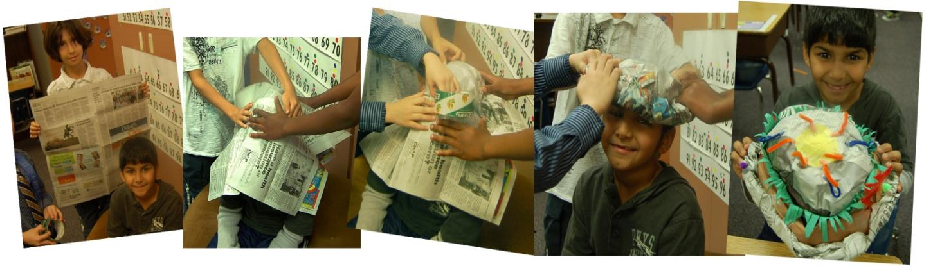
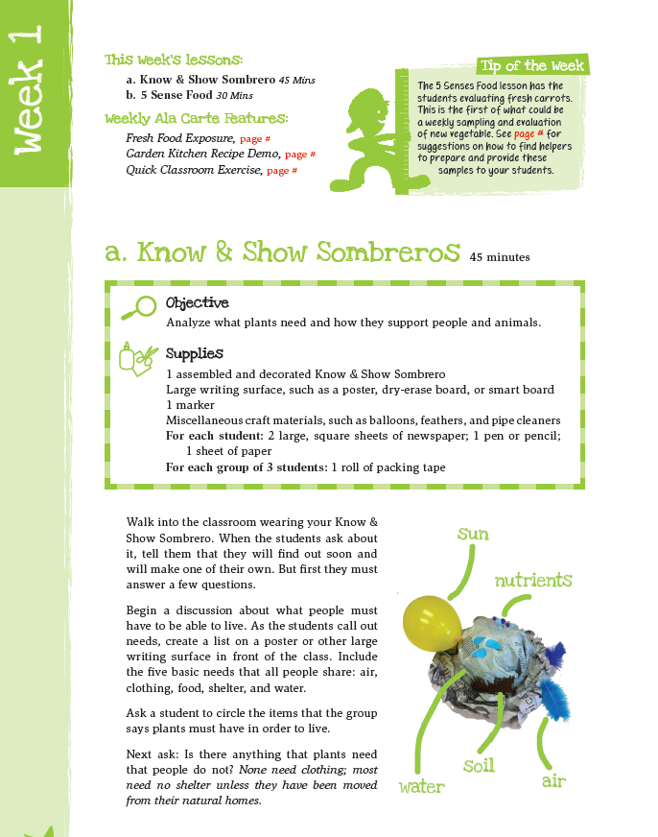

Plants need P.L.A.N.T.S.
P
L
A
N
T
S
lace
ight
ir
utrients
hirsty
oil
Notes:
Do know and show sombrero with participants

Slide 18
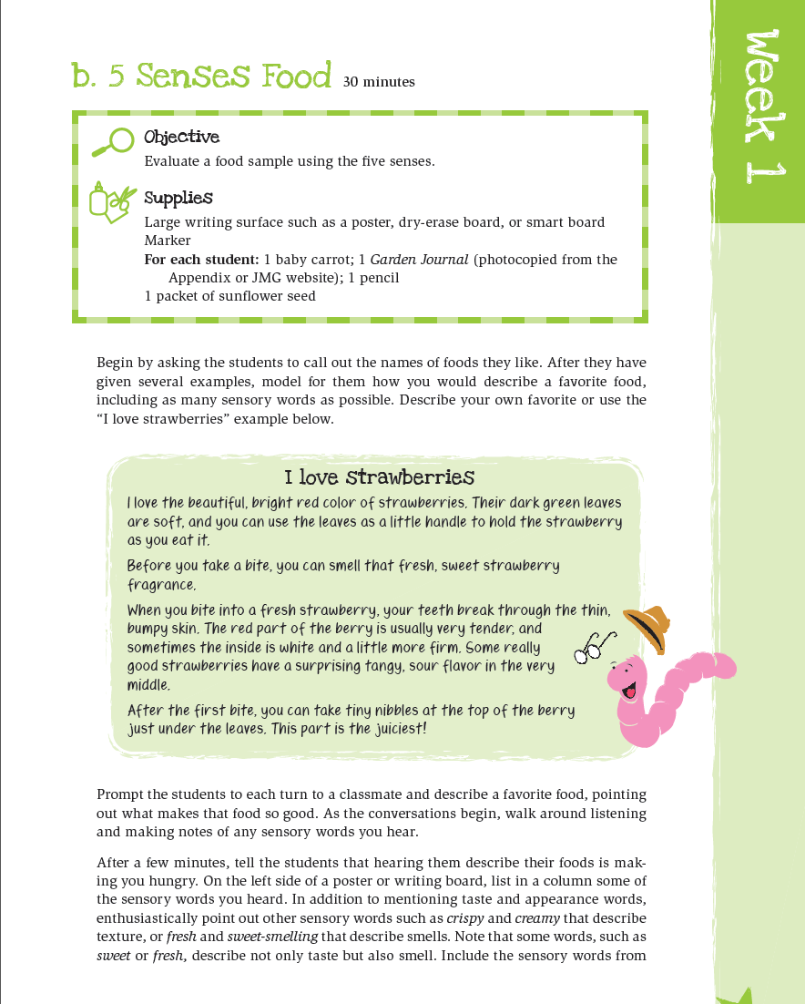


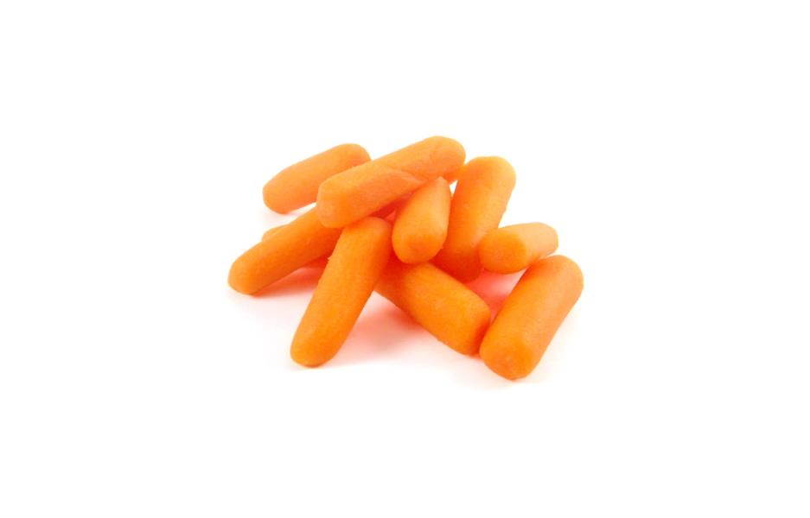

Slide 19

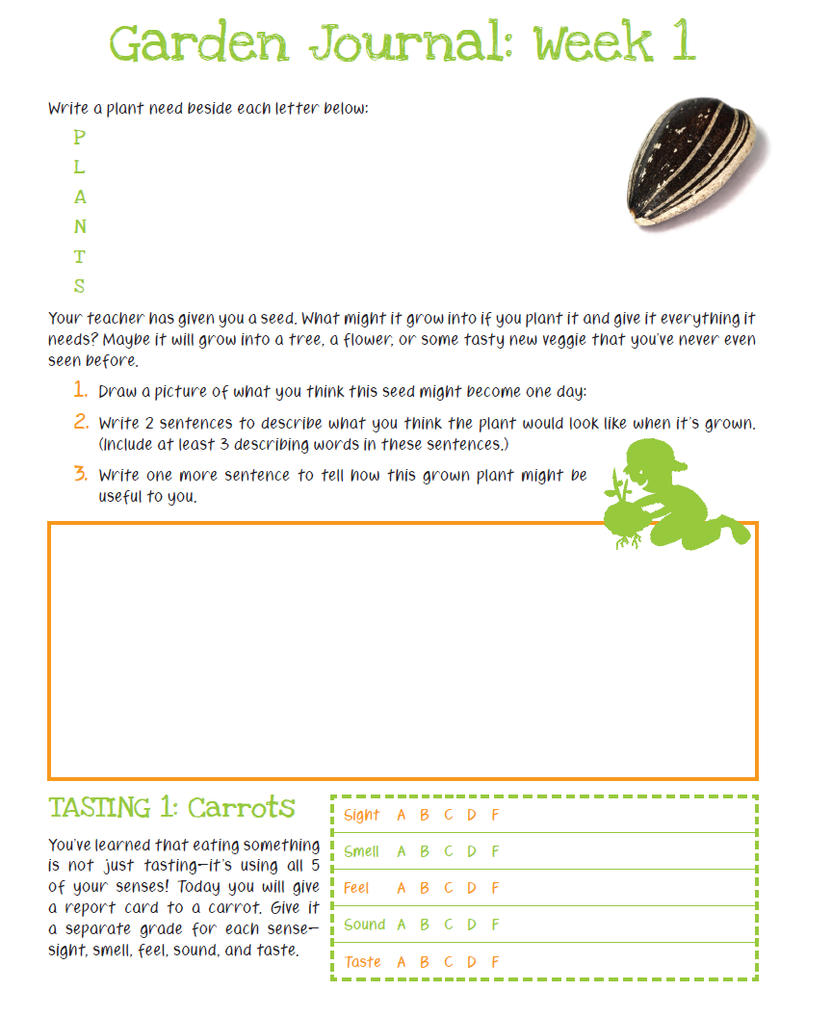
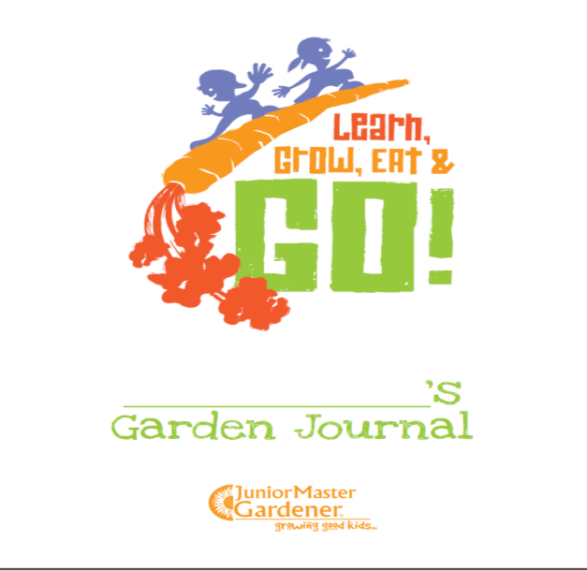

Slide 20

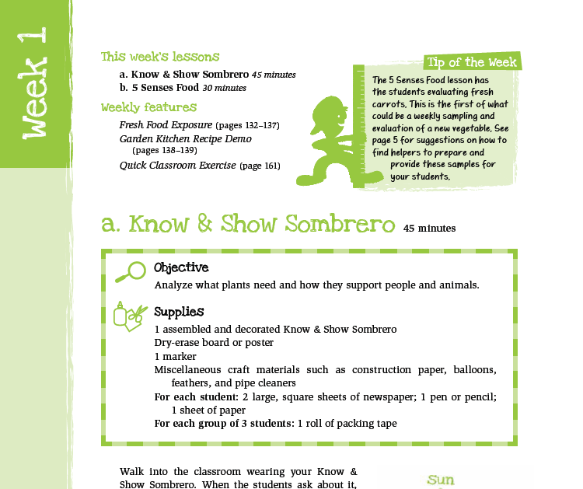
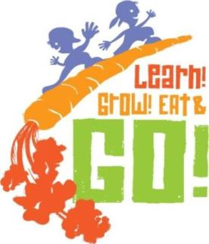
Know & Show Sombrero 45 mins
5 Senses Food 30 mins

Slide 21

first food exposures
- one bite fresh,
raw samples

Slide 22
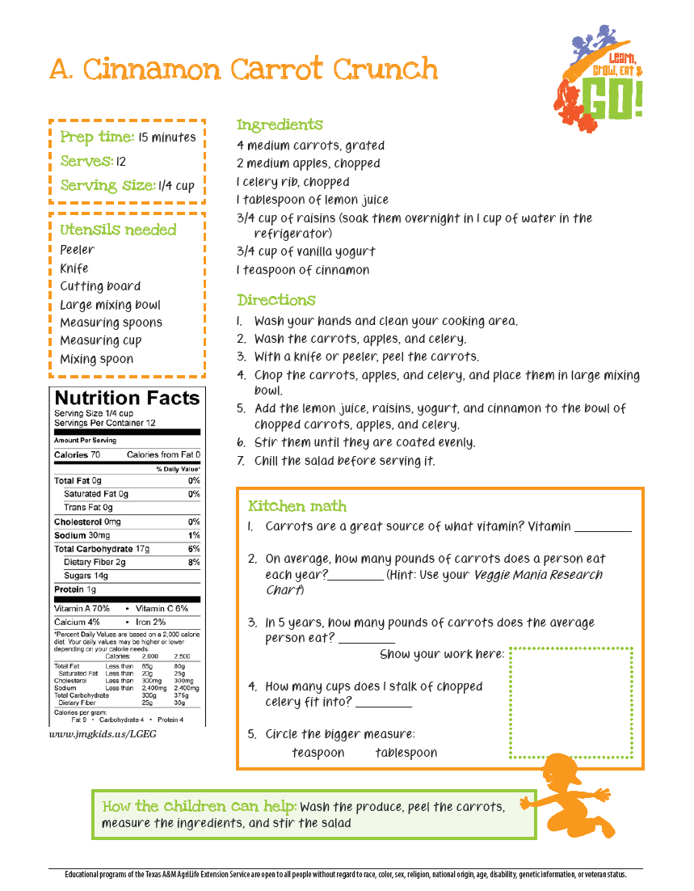
2nd food exposures
Garden
Kitchen
recipe
demos

Slide 23


Slide 24
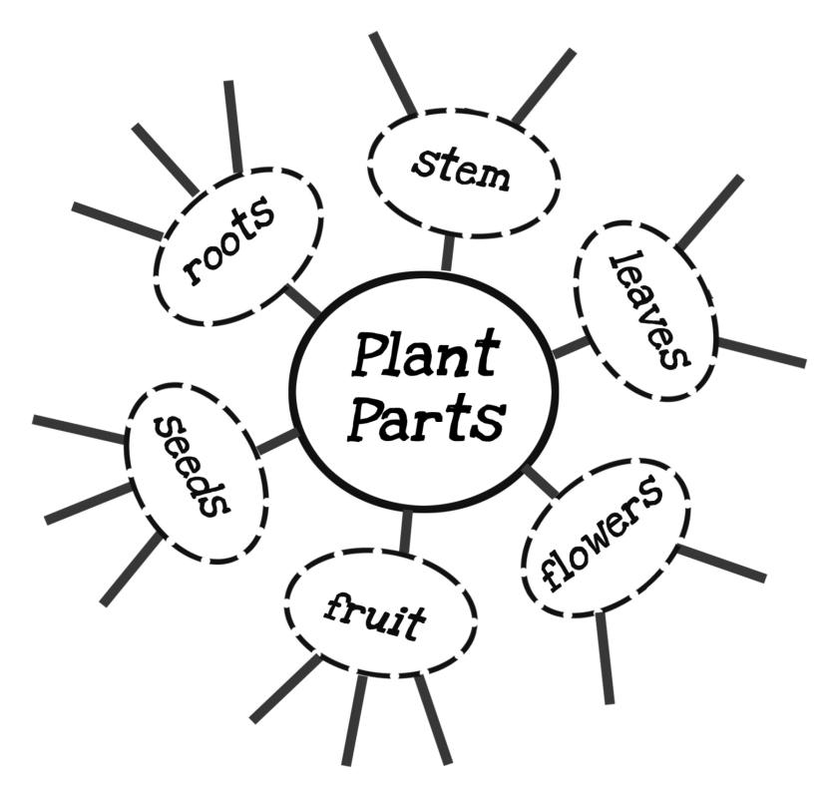
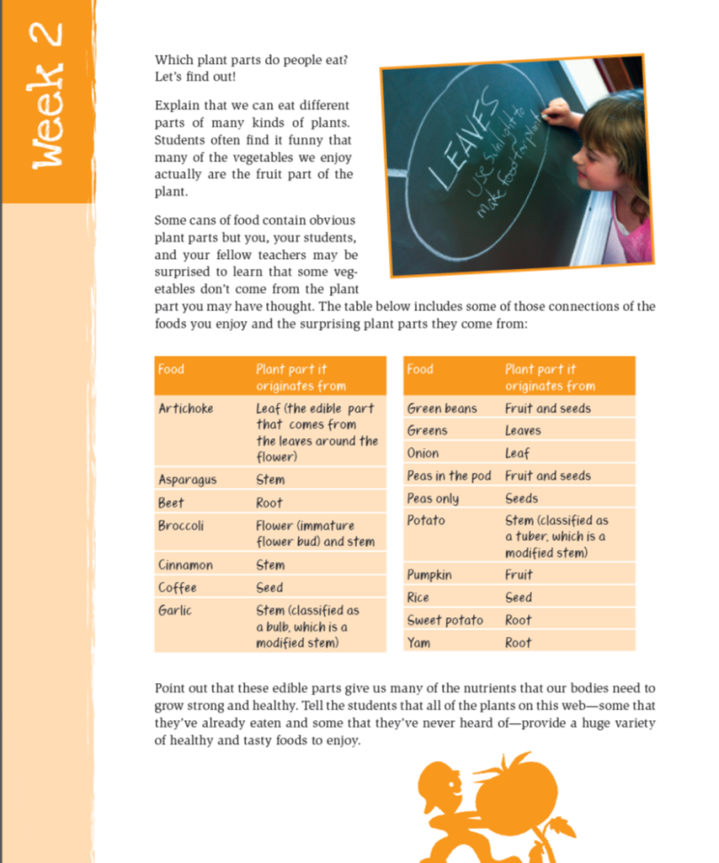


Slide 25
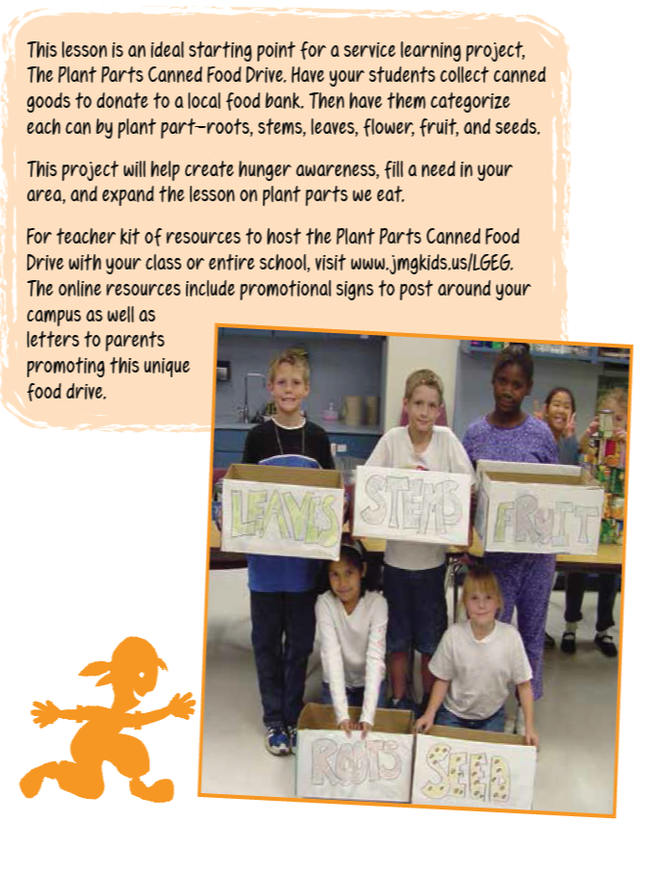

Slide 26
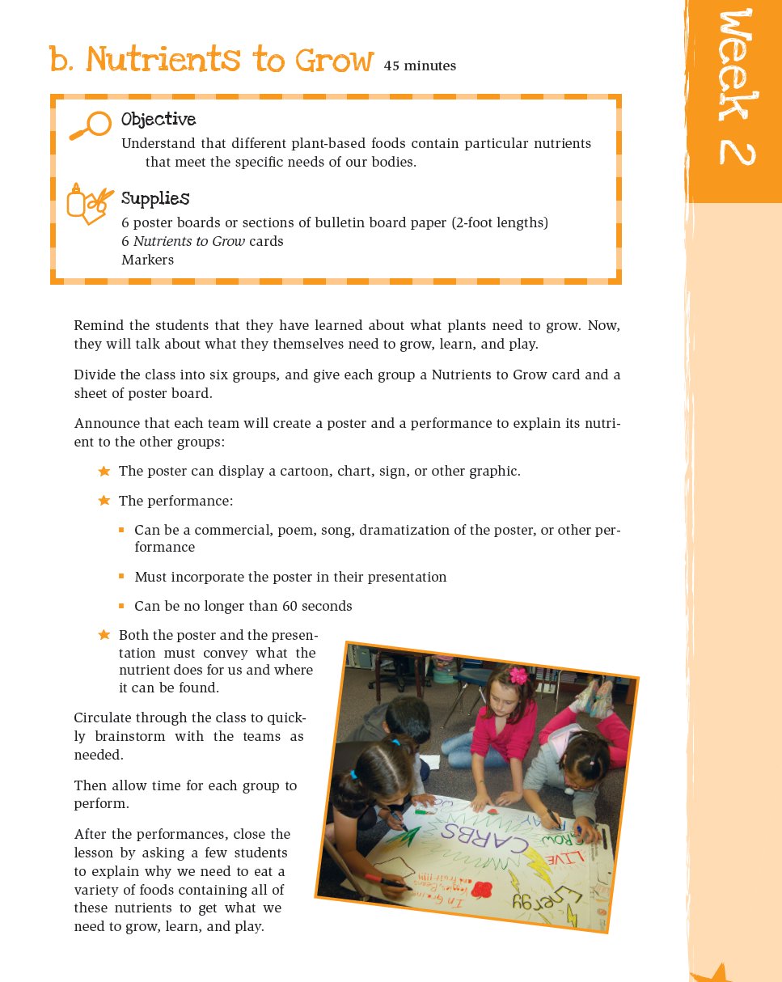
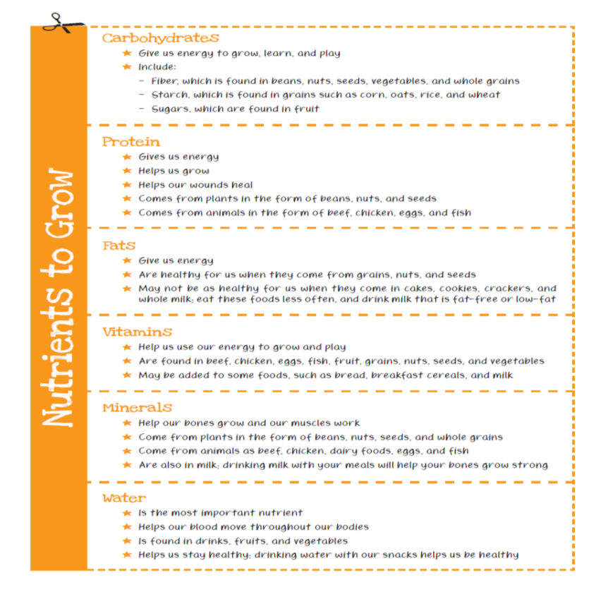

Slide 27
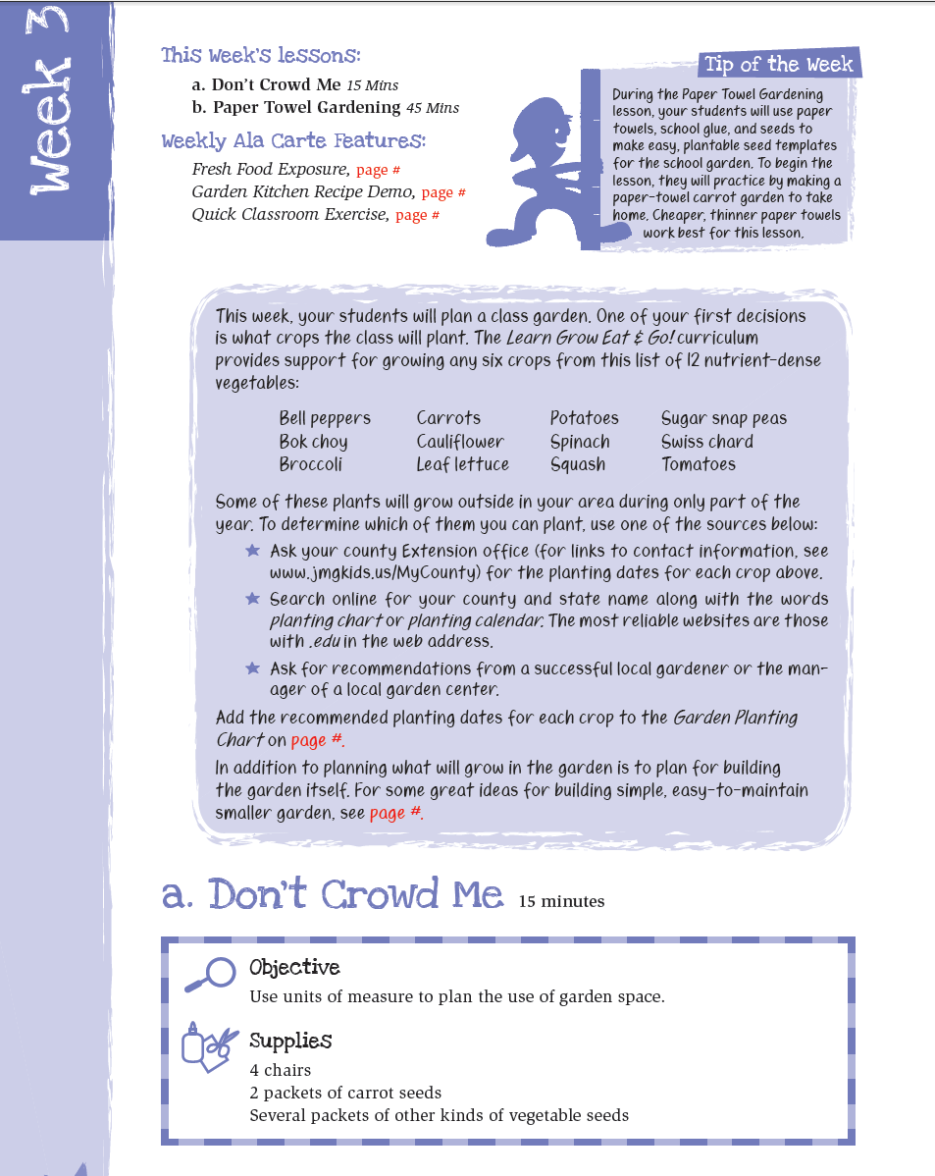

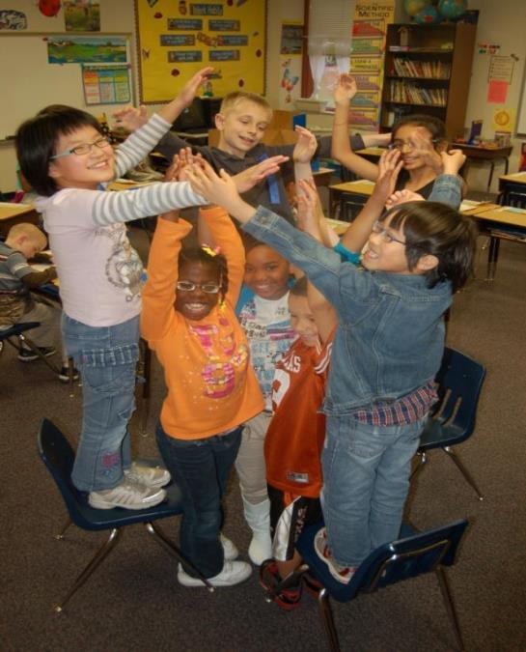

Slide 28

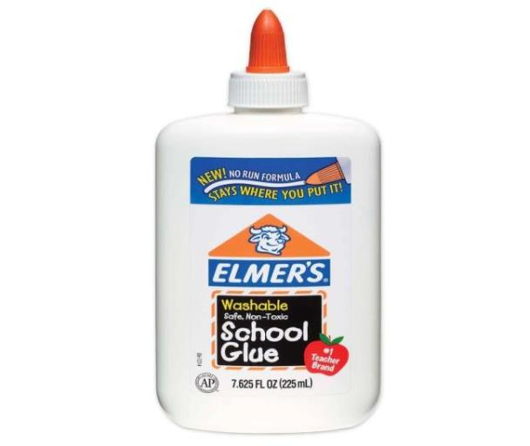
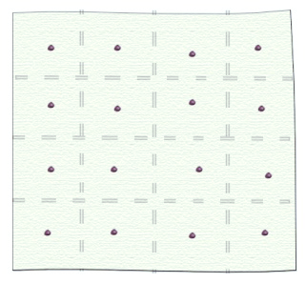

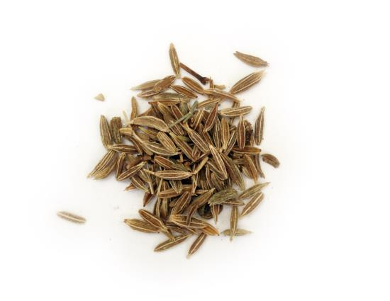

Slide 29
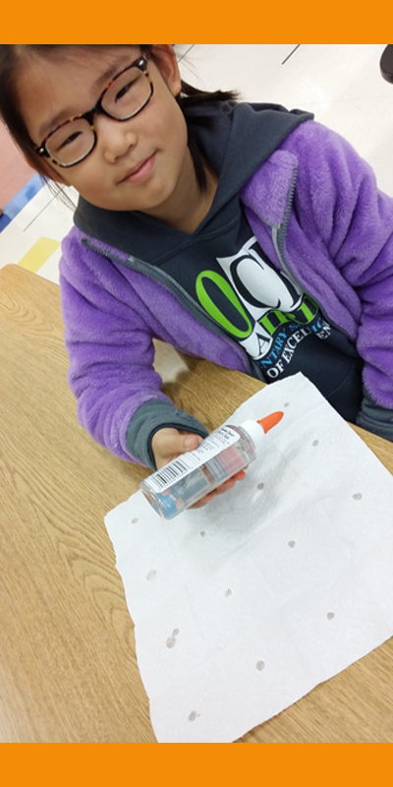

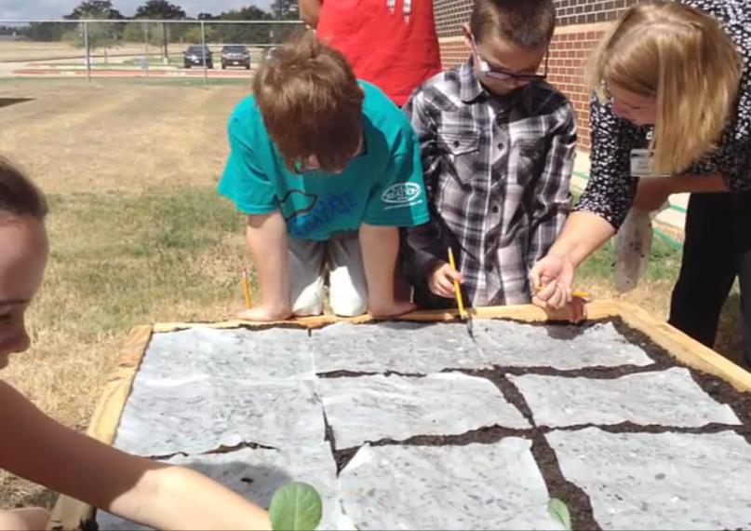



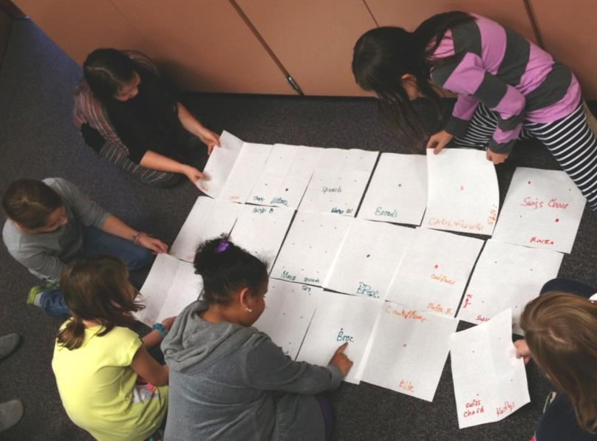

Slide 30
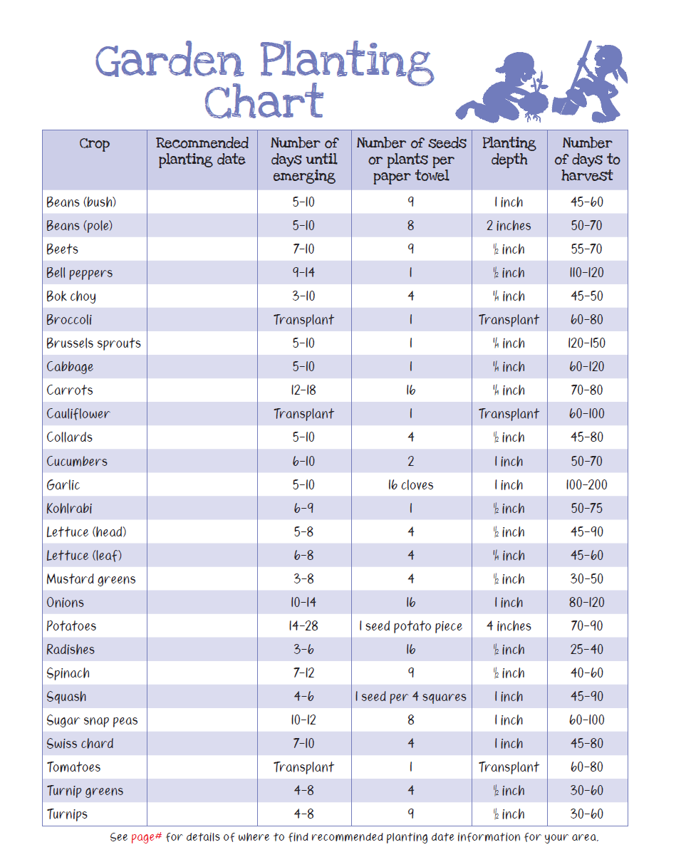
Local
Extension
support
provide
info on
your local
planting
dates

Slide 31
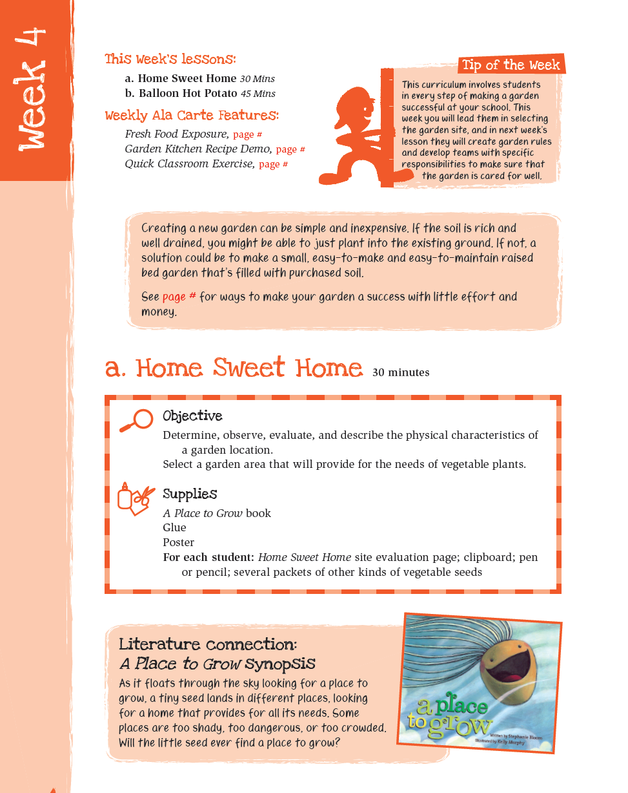


Slide 32
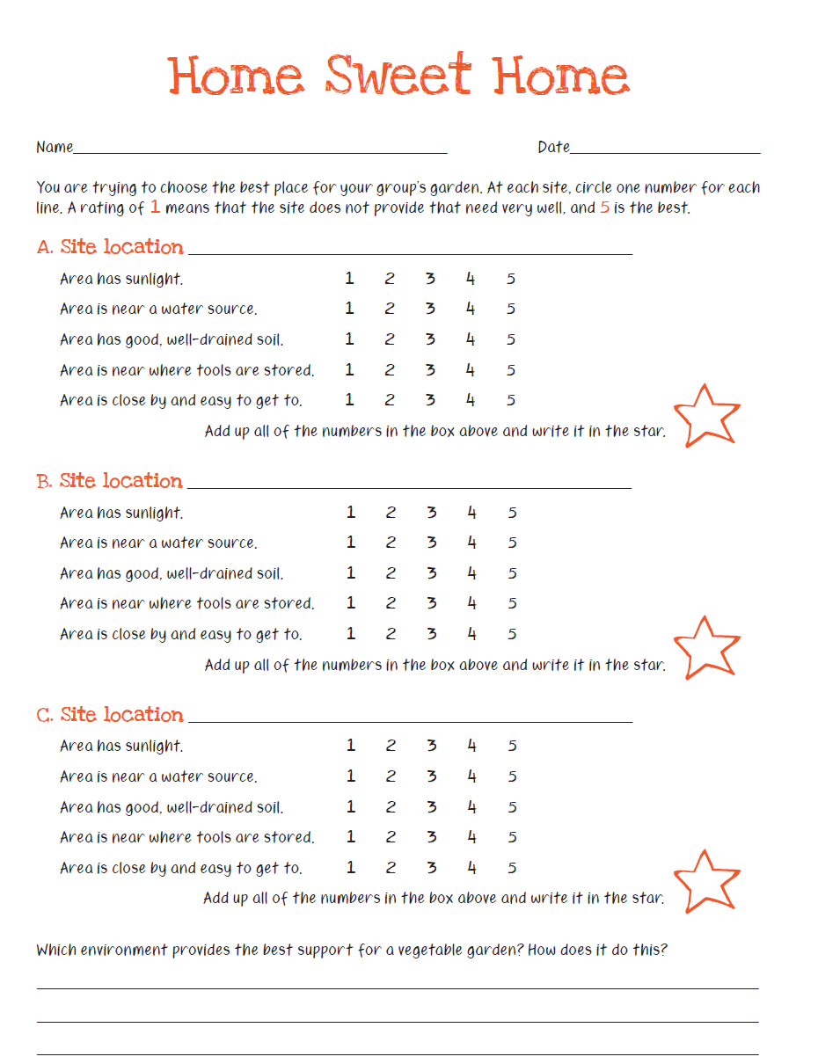


Slide 33
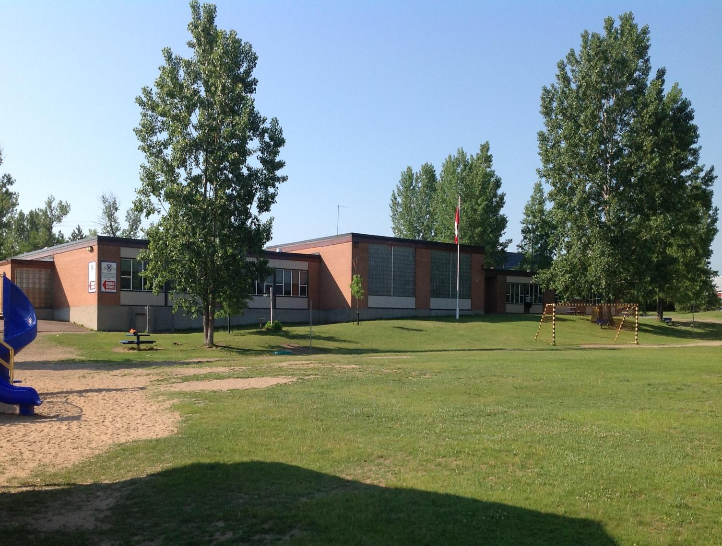
C.
B.
A.

Slide 34
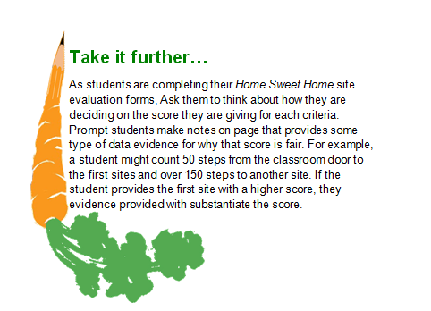

Slide 35
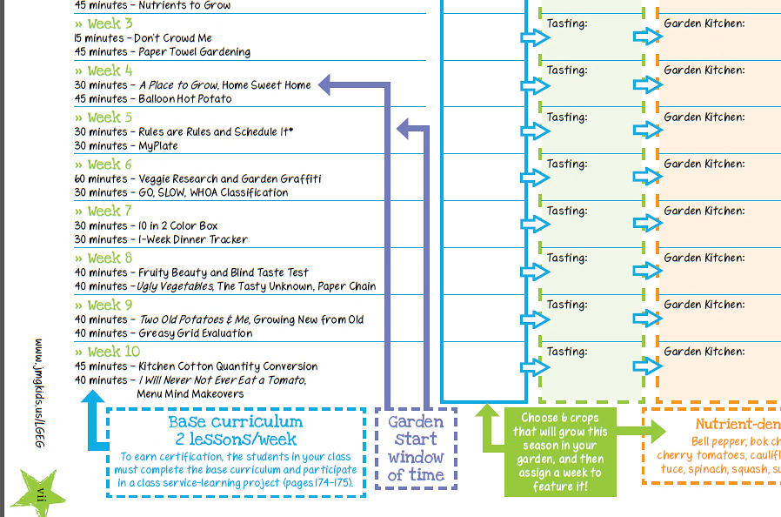
Soon after students evaluate & select the location in the Home Sweet Home lesson, the garden can be built.

Slide 36



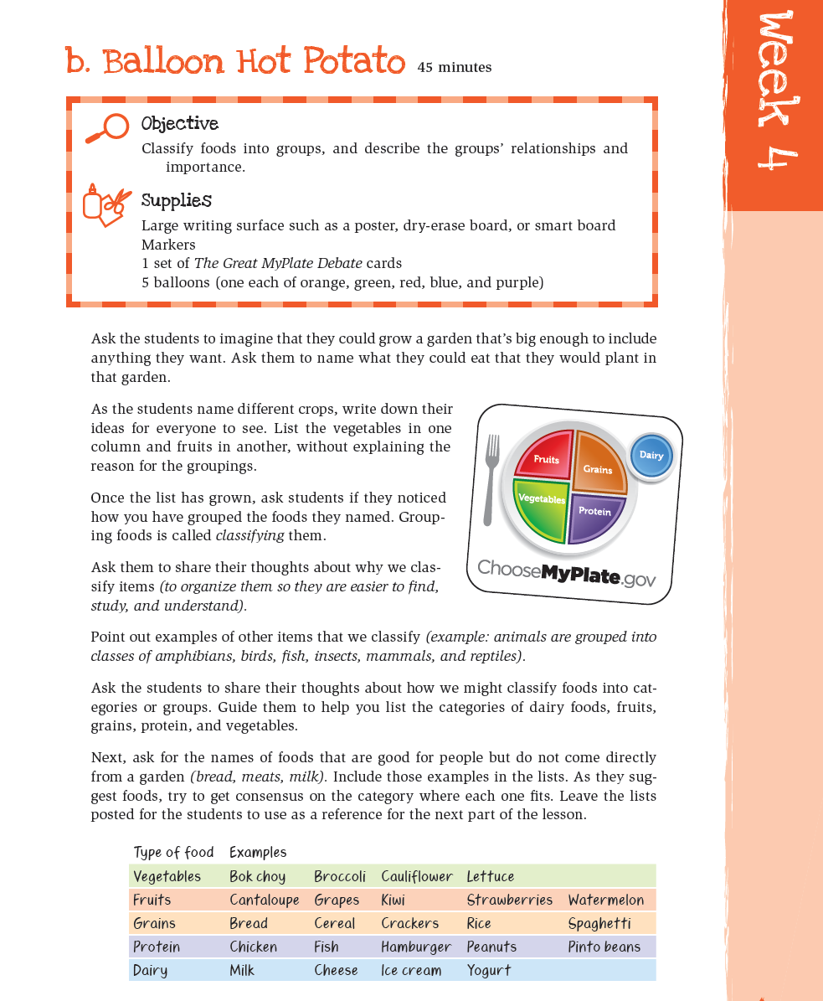
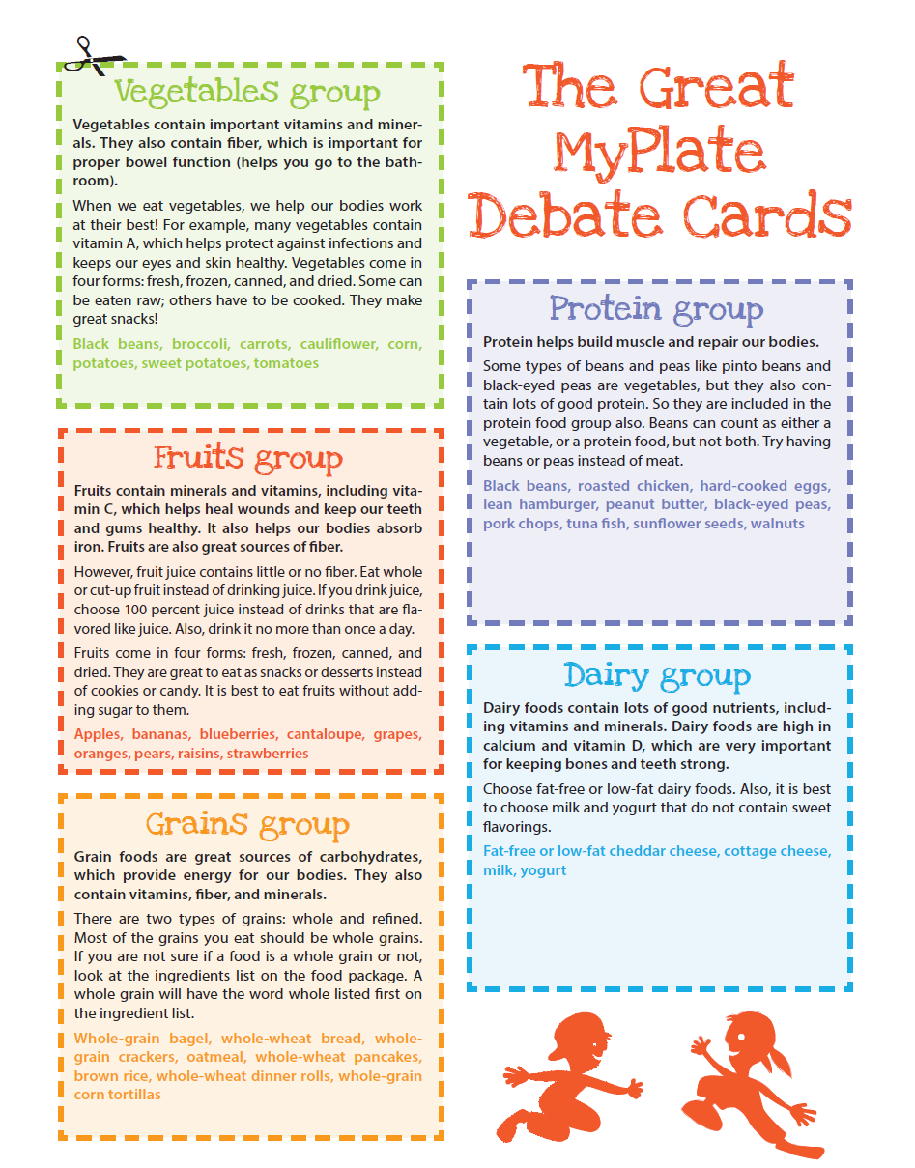
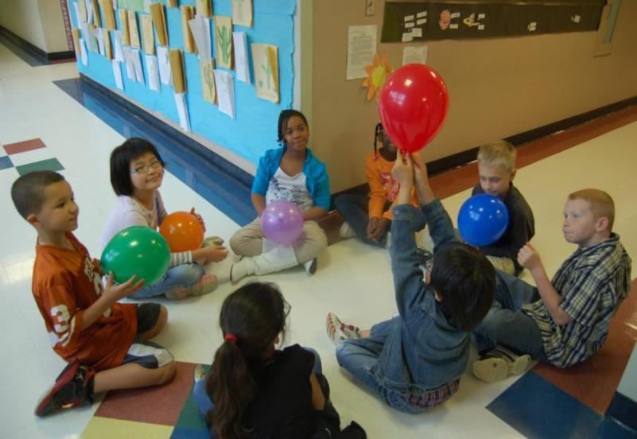


Slide 37
Overview: GROW Section

Slide 38

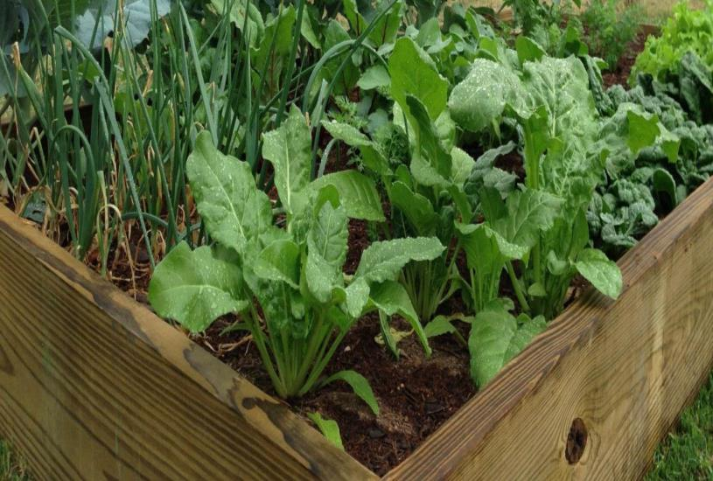
The LGEG school garden project specifically designed to be:
Simple
Easy
Quick
Inexpensive

Slide 39
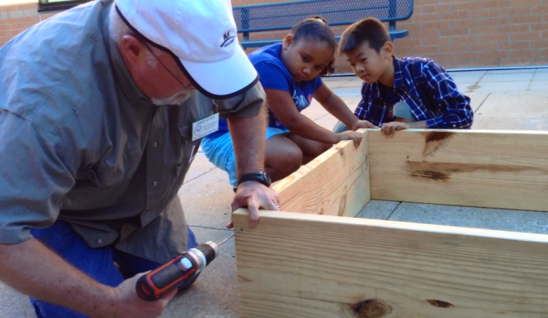
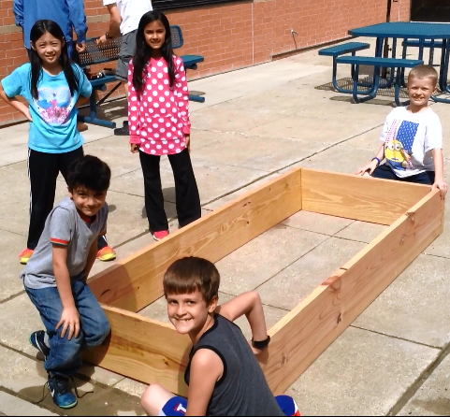

Quick & Easy Garden Kit
Getting Materials
Building the Garden
Planting It
Provides
teachers
with
steps on:
with the help of one volunteer with a drill!

Slide 40
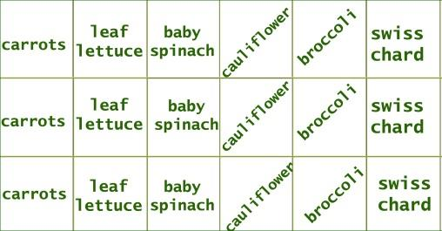
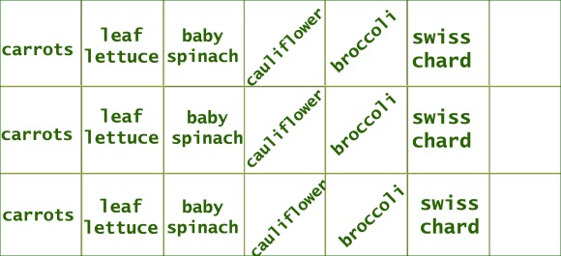
Quick & Easy Garden Kit
Getting Materials: What are we growing?
- growing 6 seasonal crops
- 3 square ft. plantings of each
- extra space for kids to choice plantings
- simplicity of steps/supplies
Sample cool season 3x7 raised bed:
kids’
choice
kids’
choice
kids’
choice

Slide 41
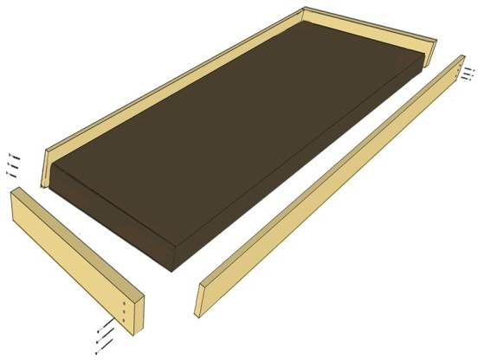
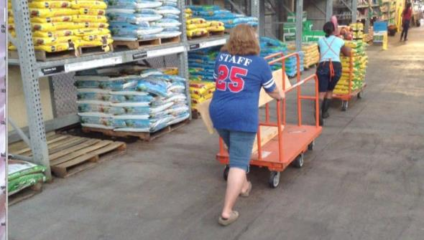
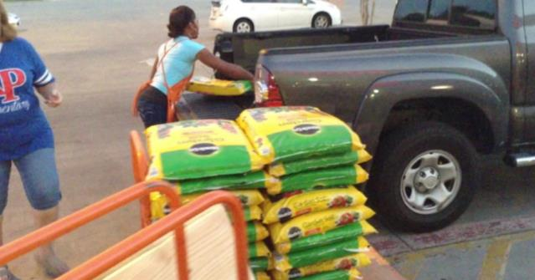
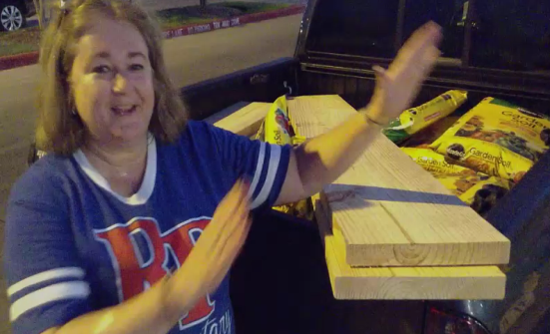
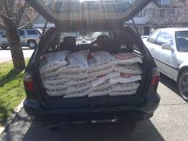
Quick & Easy Garden Kit
How to get materials to school?
- can be loaded for you at building store
- whole garden fits in back of van or small truck
(borrowed vehicle, potential volunteer task?)

Slide 42


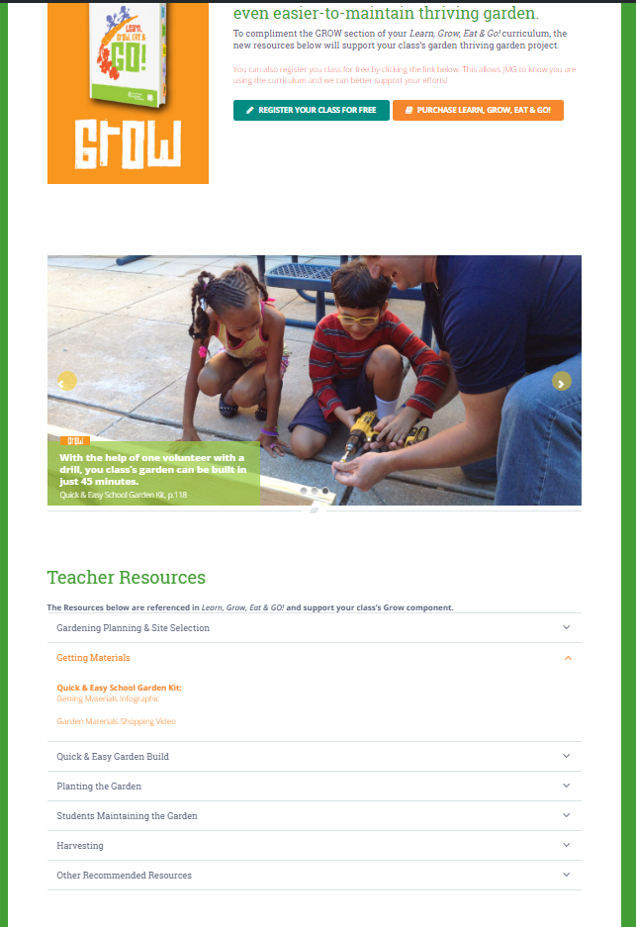



/LGEG
www.JMGkids.us

Slide 43



Grow:
Quick & Easy Garden Kit Pages include in curriculum

Slide 44
Featured lessons: Weeks 5-6

Slide 45



Slide 46





Food Guide Pyramid

Slide 47


Slide 48



Slide 49



nutrient stone:
Class makes 3 different stones for each crop growing:
label stone:
benefit stone:

Slide 50

nutrient stone:
Class makes 3 different stones for each crop growing:
label stone:
benefit stone:

Slide 51
nutrient stone:
a Quick & Easy
option to stones/paint:
Use stir sticks and
permanent markers
Class makes 3 different stones for each crop growing:
label stone:
benefit stone:

Slide 52
Overview: EAT Section

Slide 53


Food Exposure

Slide 54


nutrient-dense planting list
carrots
leaf lettuce
broccoli
potatoes
swiss chard
bell pepper
Cauliflower
spinach
bok choy
cherry tomatoes
sugar snap peas
squash
(choose 6 to plant in your
school garden)

Slide 55



  Exposure to new foods:
    evaluation of ray, fresh samples
    Garden Kitchen recipe demos
    engage kids & encourage willingness to include new foods.
  Research shows children share those food experiences at home.
  Classroom & kid-friendly recipes
    Limited set-up space, cooking
    equipment, and time
    Cooking skills
    Model healthful food choices
    & safe kitchen practices

Slide 56

first food exposures
- raw sample
during Journal
time

Slide 57
Garden
Kitchen
recipe
demos
http://jmgkids.us/garden-kitchen-recipe-demos/
Notes:
Show video

Slide 59



Fresh sample prep & Garden
Kitchen Recipe Demos
have been led by many different partners including:
Cafeteria staff
Room moms
PTO Parent Committee
Volunteer organizations
(like Junior League, Lions Club)
Coaching by local Extension agents/volunteers.
Under supervision of
certified food handler.

Slide 60




Slide 61





Slide 62




Research shows physical activity breaks can improve academic performance.

Slide 63


Weekly featured
brain &
body boosting
activities
Notes:
Have groups participate in an activity

Slide 64






Intro letter to parents
weekly update letters
appendix:

Slide 65

If you have access to volunteers, this page lays out specific tasks you can assign them to help:
Intro letter to parents
weekly update letters
appendix:

Slide 66


Slide 67



Slide 68

Add your group & print
group registration
certificate
Notes:
Walk through the registration packet

Slide 69


Why Should Classes Register?
Be eligible for give-aways
It’s free, doesn’t obligate youth to complete program.
Allows youths in your group to earn recognition certifications.

Slide 70


Register
even if…
Notes:
Ask them to give examples by naming the groups that they have led
Even if… they are only doing a few activities, a summer camp, not working towards certification, etc

Slide 71


JMGkids.us/map
Notes:
Ask them to give examples by naming the groups that they have led
Even if… they are only doing a few activities, a summer camp, not working towards certification, etc

Slide 72







www.twitter.com/jmgkids
www.facebook.com/juniormastergardener
www.pintrest.com/jmgkids
www.instagram.com/jmgkids
www.JMGkids.us

