Slide 1
Landscapes and Landmines: Working with community partners
Dr. Kathryn S. Orvis, Purdue University
Dept. Agricultural Sciences Education & Communication
and
Dept. Horticulture & Landscape Architecture

Slide 2
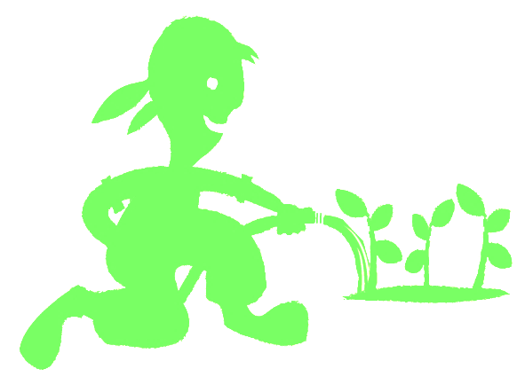
A beautiful landscape of community engagement…
By working alongside people in your community, and building partnerships, you can grow your program, cultivate your presence, and propagate your reach.

Slide 3
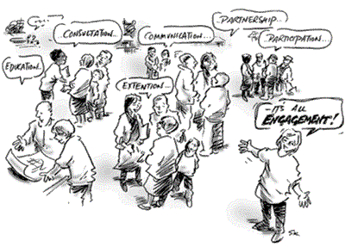
What is Community Engagement?
Community Engagement is…the process of working collaboratively with and through groups of people affiliated by geographic proximity, special interest, or similar situations to address issues affecting the well-being of those people (CDC, 1997)
https://aese.psu.edu/research/centers/cecd/engagement-toolbox/engagement/what-is-community-engagement

Slide 4
Landscape or Landmine?
The sometimes tricky business of building partnerships
Foundationally draws upon fields of Theory of Change and Community Development and Engagement
What do I mean by Landmine?
  All is not rosy in your landscape!
Examples of good partnerships, okay partnerships and partnership fails

Slide 5

JMG Implementation Guide
(jmgkids.us/lgeg/cooperative-extension)
Gather your team
Build community partnerships
Involve Families (5 Simple Principles by, Constantino, 2015)
  A culture that engages every family
  Communicate effectively and build relationships
  Empower every family
  Engage every family in decision making
  Engage the greater community

Slide 6
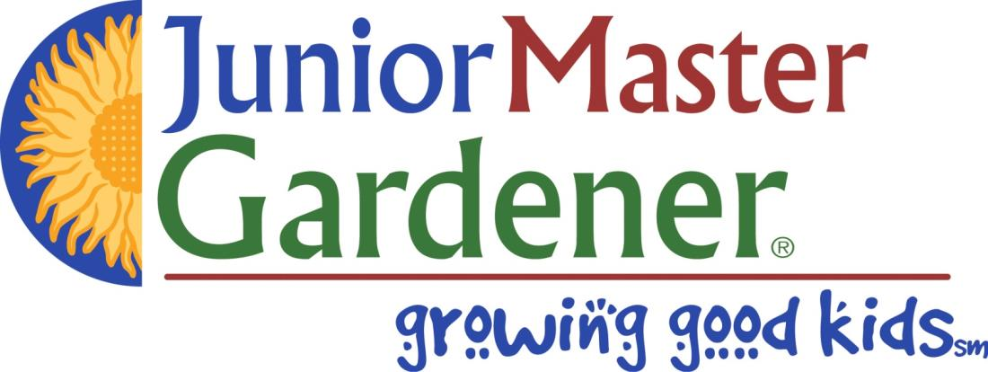
Core Values of Engagement
Engaging with Your Community
Careful Planning and Preparation
Inclusion and Demographic Diversity
Collaboration and Shared Purpose
Openness and Learning
Transparency and Trust
Impact and Action
Sustained Engagement and Participatory Culture
JMG Implementation Guidelines:
Gather your team
Build community partnerships
Involve Families (5 Simple Principles by, Constantino, 2015)
    A culture that engages every family
    Communicate effectively and build relationships
    Empower every family
    Engage every family in decision making
    Engage the greater community

Slide 7
The Art of Building Community Partnerships
Reality… art of building ‘relationships’
Relationships are the foundation on which you build your partnership
Build ahead of time to establish relationships and develop trust
Important to sustain a relationship
Building and sustaining relationships are at the heart of organizing communities
Organizing communities = successful JMG programs

Slide 8


FUNDAMENTAL REASONS TO BUILD RELATIONSHIPS:
Community building occurs one-to-one.
  You need to build relationships if you want people to become involved in your group or organization.
We need relationships in order to win supporters to our cause.
  To garner support from people outside our organizations, you will need to build relationships and trust.
Our relationships give meaning and richness to our work and to our lives.
Hey Friend!
Notes:
Some people become involved in organizations because they believe in the cause. However, many people become involved in a community group or organization, just because they have a relationship with another person who is already involved.

Slide 9
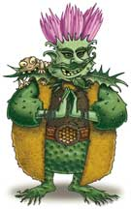
Barriers to community engagement
Major barriers to the achievement of community empowerment engagement:
community capacity
institutional capacity
organizational cultures
regulatory/policy

Slide 10
Engaging with your Community
It is not a straight line from start to finish!
Finish
And players and locations are constantly changing
So what are some methods for engagement or participation in your community?
Start

Slide 11
IAP2 Public Participation Spectrum
 | Inform | Consult | Involve | Collaborate | Empower
Public Participation Goal | To provide the public with balanced and objective information to assist them in understanding the problem, alternatives and/or solutions. | To obtain public feedback on analysis, alternatives and/or decision. | To work directly with the public throughout the process to ensure that public concerns and aspirations are consistently understood and considered. | To partner with the public in each aspect of the decision including the development of alternatives and the preferred solution. | To place final decision-making in the hands of the public.
Promise to the Public | We will keep you informed. | We will keep you informed, listen to and acknowledge concerns and aspirations, and Provide feedback on how public input influenced the decision. | We will work with you to ensure that your concerns and aspirations are directly reflected in the alternatives developed and provide feedback on how public input influenced the decision. | We will look to you for advice and innovation in formulating solutions and incorporate your advice and recommenda-tions into the decisions to the maximum extent possible. | We will implement what you decide.
developed by the international association for public participation https://iap2usa.org/cvs

Slide 12
Practice
What form of community engagement is it?
- Assemble into groups of 4-6

Slide 13
HOW DO YOU BUILD RELATIONSHIPS WITH PEOPLE OF DIFFERENT CULTURAL BACKGROUNDS THAN YOUR OWN?
A few guidelines:
Learn about the person's culture.
Put yourself at the center of another person's culture.
Take a stand against the person's oppression.
It's okay to make mistakes.
https://ctb.ku.edu/en/table-of-contents/leadership/leadership-functions/build-sustain-relationships/main
Notes:
Learn about the person's culture. Any effort will go a long way in showing that you care enough to find out about the reality of another person's life.
Put yourself at the center of another person's culture. Especially if you are getting to know someone who is not a part of majority culture, try going to their cultural events where you are the minority. If you are willing to take risks and put yourself in a situation in which you might feel uncomfortable, people will be more inclined to want to get to know you.
Take a stand against the person's oppression. Actions speak louder than words. People who experience oppression need allies to speak out against injustice. Strong relationships are forged when people act courageously on behalf of each other.
It's okay to make mistakes. You may have to make mistakes as you build relationships with people who have different cultural backgrounds than your own, but people are generally forgiving, especially if your intentions are good. Remember, hang in there even if you feel rejected.

Slide 14
Sustainability of Methods of Engagement -
When Working in Diverse and At-Risk Communities
Do your homework first.
  Needs assessment of the partner, who is already working in the space, what norms and values exist?
Building trust is crucial
  Listen, listen, listen
  Put people first, programming after
Share tasks
  Helps guard against imbalance of power
Work through existing networks
  Identify leaders
  Awareness of existing power dynamics
Build reciprocal capacity
  Helps give wide breadth of community members voice
Monitor and Evaluate and Reflect

Slide 15
Landmines in the Landscape of Your Community
What to do when you step on one by accident?
Put on your best listening ears – and really use them
Take the emotion out of the equation
Take a step back and evaluate what is the objective you are trying to achieve
What is the most important next step in your project and how can that one thing get accomplished
Don’t give up!
And….
  Don’t do the same thing expecting
  different results!

Slide 16
Engaging with your Community
It is not a straight line from start to finish!
Finish
And players and locations are constantly changing
Think about how “YOU” can engage in your community and build your program….
Start

Slide 17
A beautiful landscape of community engagement…
By working alongside people in your community, and building partnerships, you can grow your program, cultivate your presence, and propagate your reach.

Slide 18
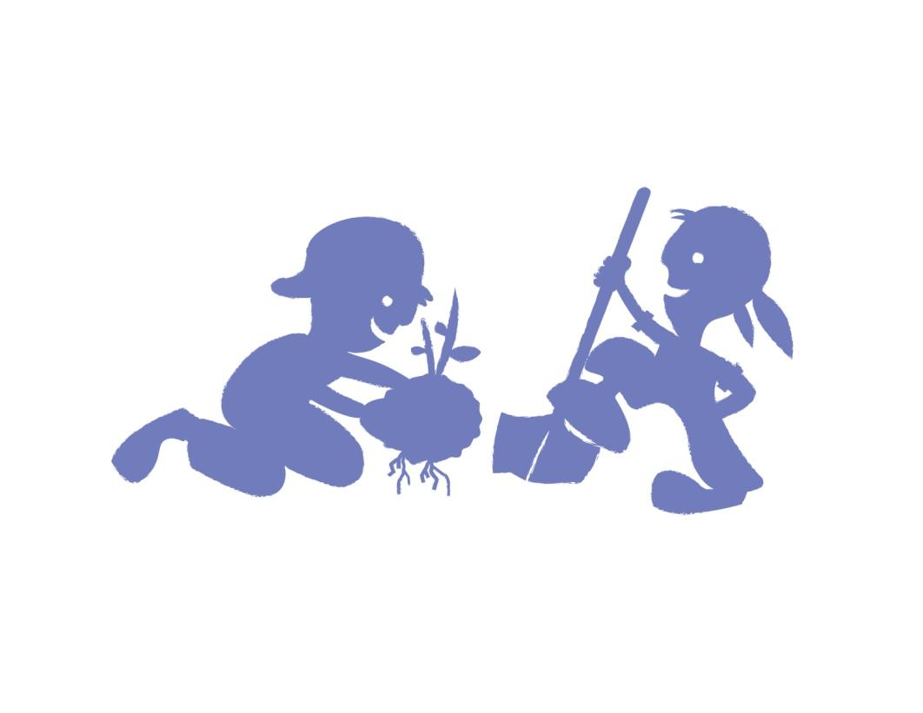
Questions?
Contact: orvis@purdue.edu

