Slide 1
Young Gardeners Program
Building to Last
Nan Wilson & Denise Walker
Notes:
Introduction by Nan and then Denise

Slide 2
Move your butt!!
Notes:
move your butt jmg 2020
Move your butt if you’ve gardened before?
Move your butt if you’ve built a garden?
Move your butt if you’ve a garden at their school
Move your butt if you eat vegetables everyday
Move your butt if you know someone who has diabetes
Move your butt if you know someone who has high blood pressure
Move your butt if you know someone who struggles with obesity
What is the relationship between food and health?

Slide 3
Family-focused garden and nutrition programs can reduce childhood obesity.
A Texas A & M study found:
Pre-program: Kids were 57% obese, 10% overweight, 31% normal weight.
Post-program: Kids were 38% obese, 16% overweight, 45% normal weight.
Notes:
Why we do what we do,

Slide 4
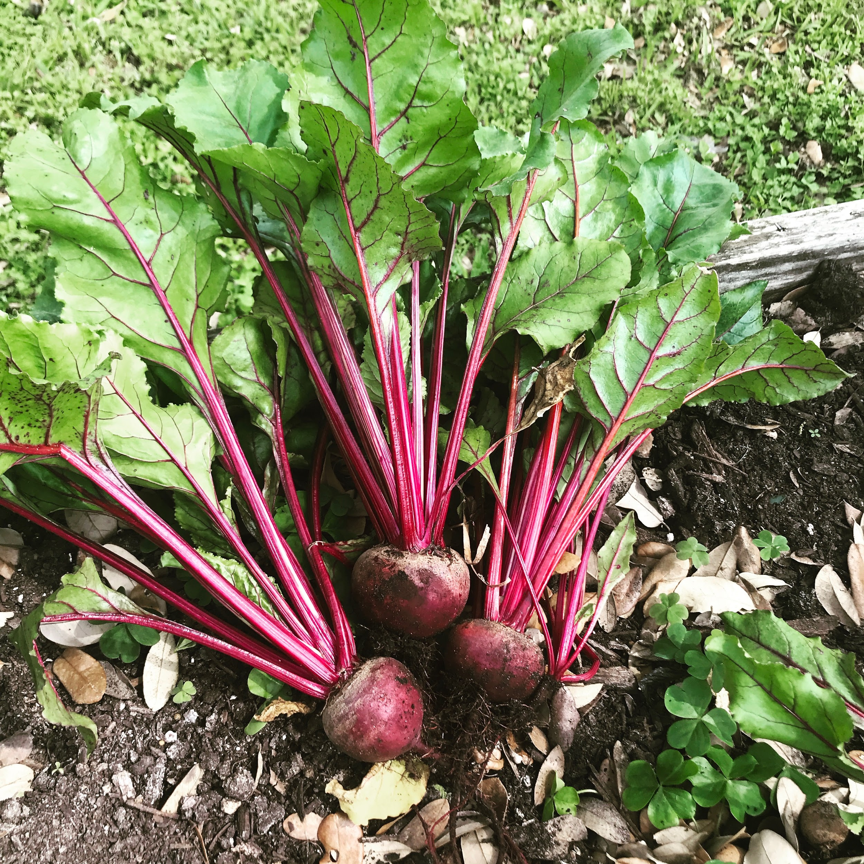

Slide 5
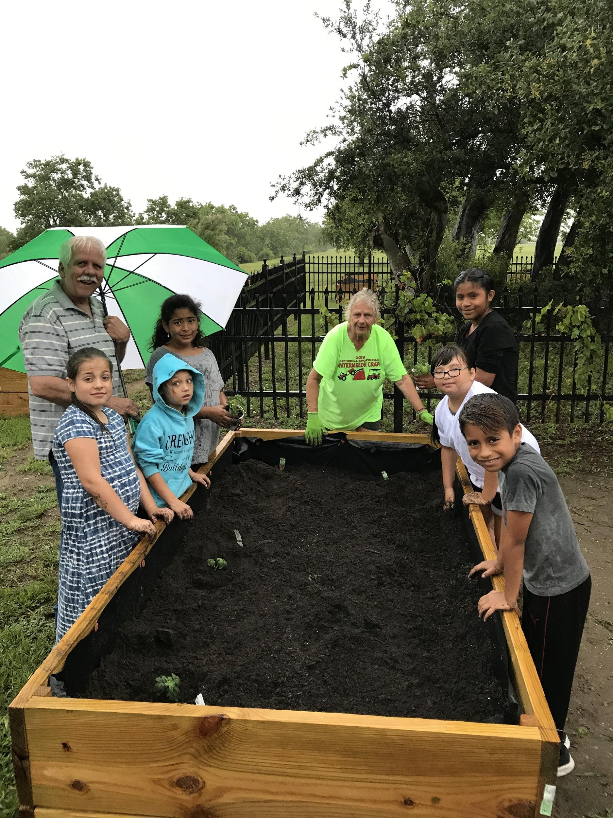

Slide 6
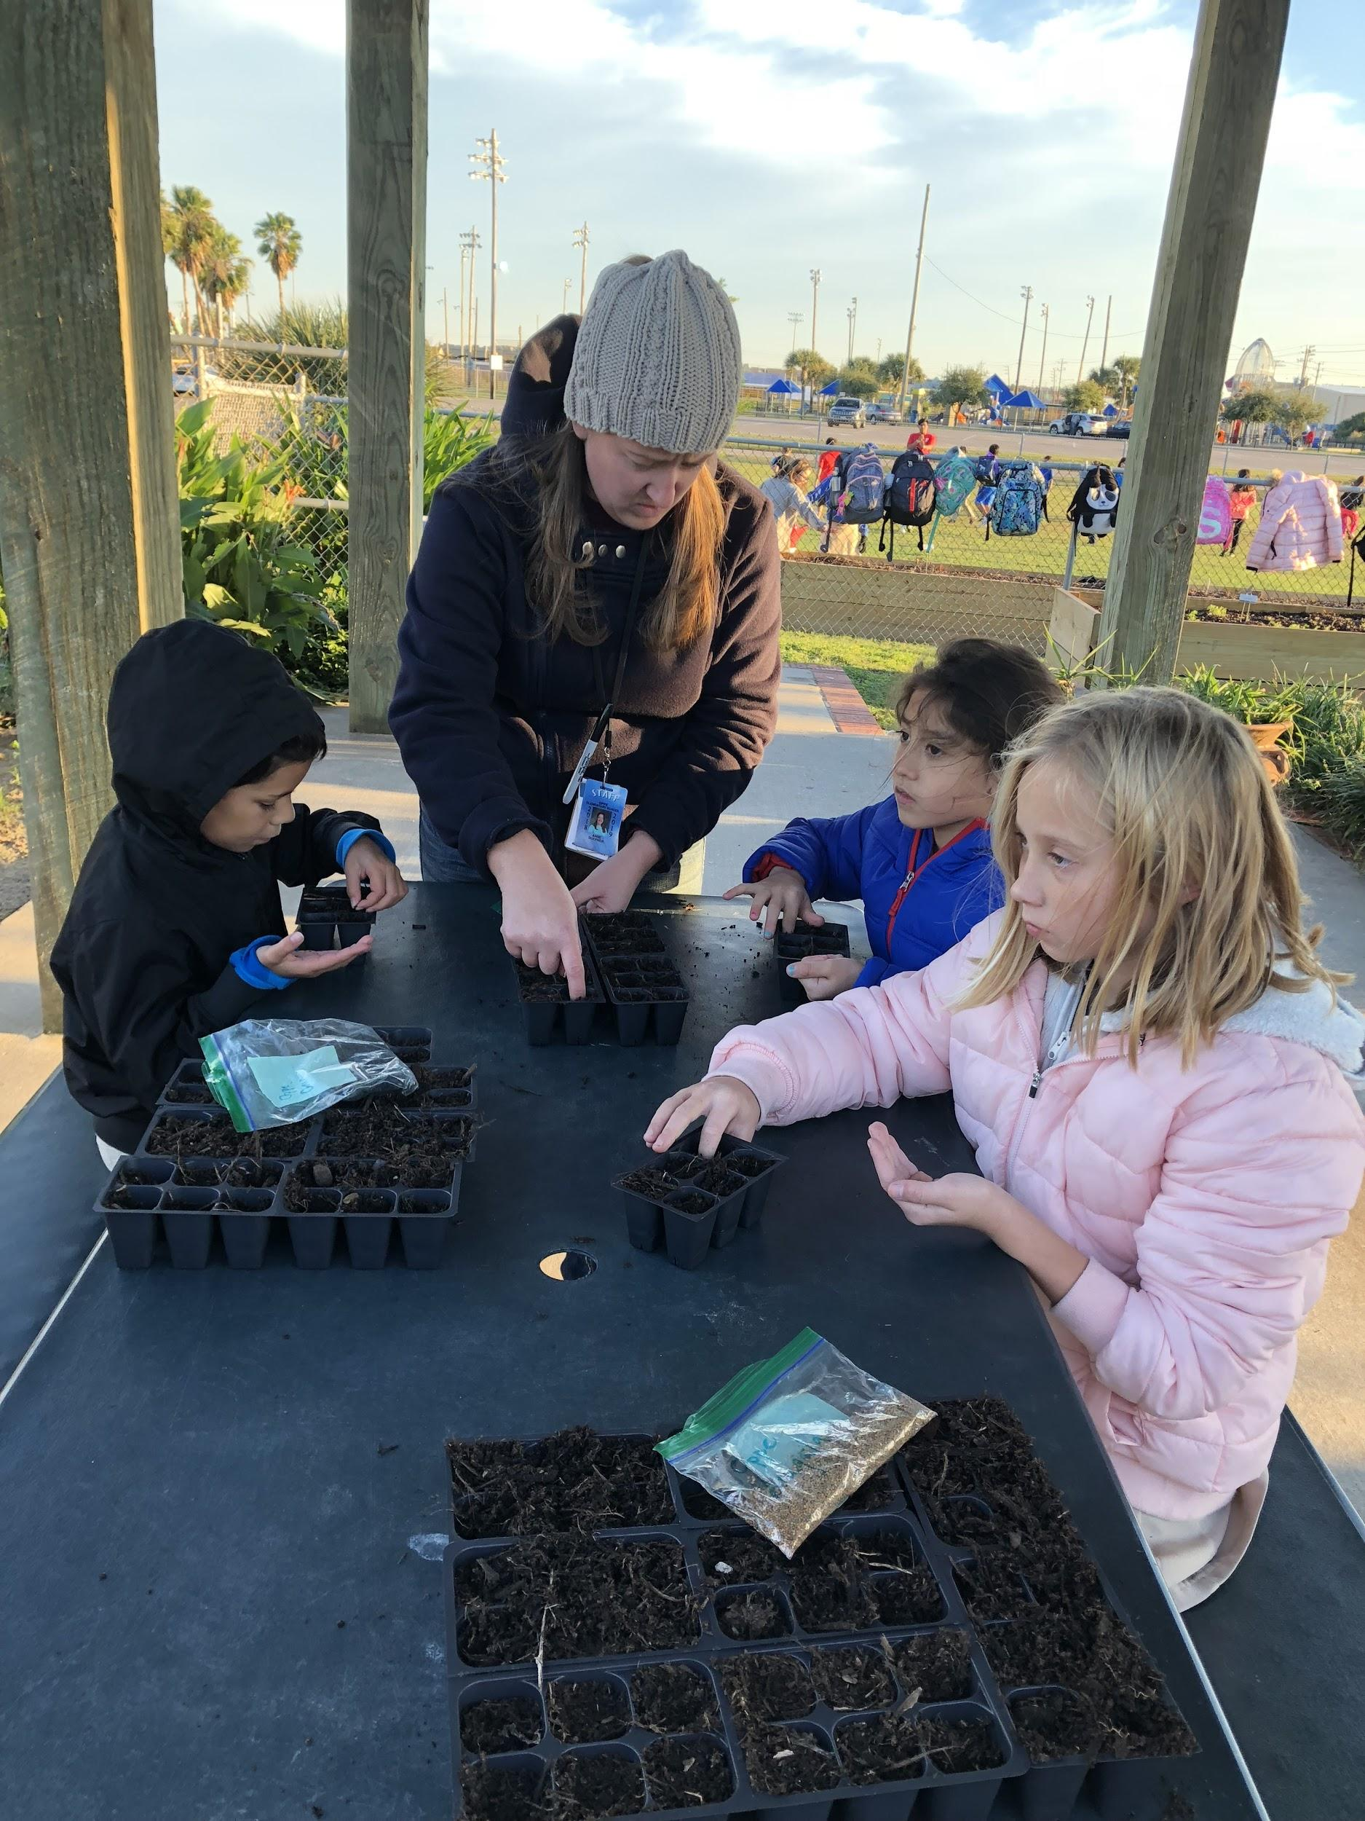

Slide 7
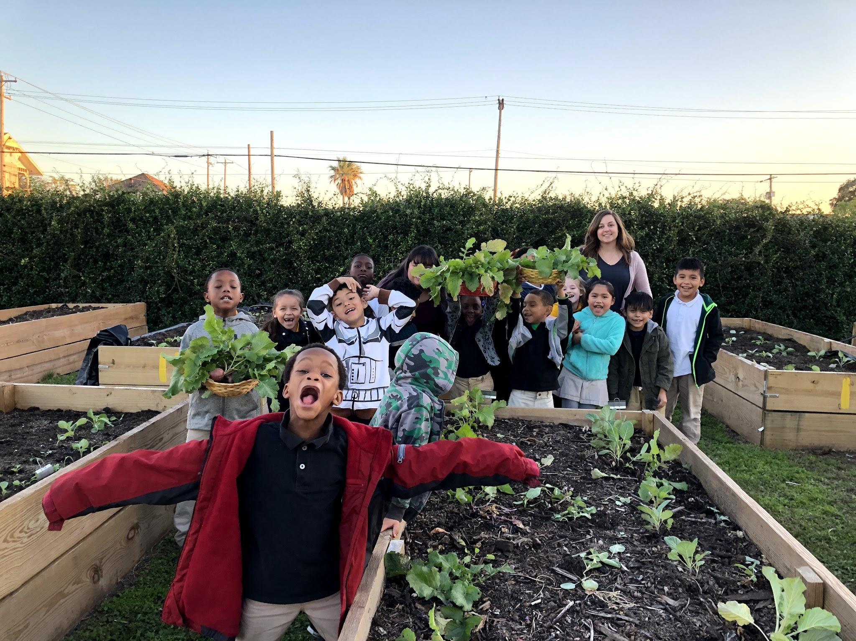

Slide 8
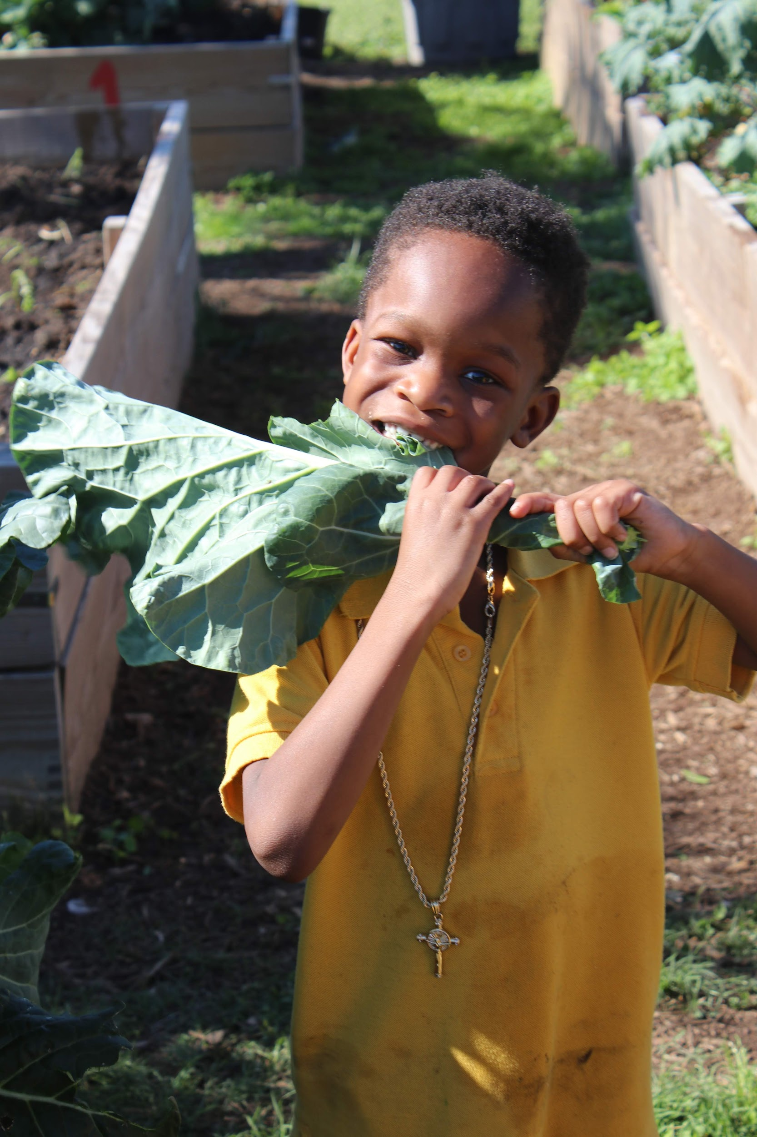

Slide 9
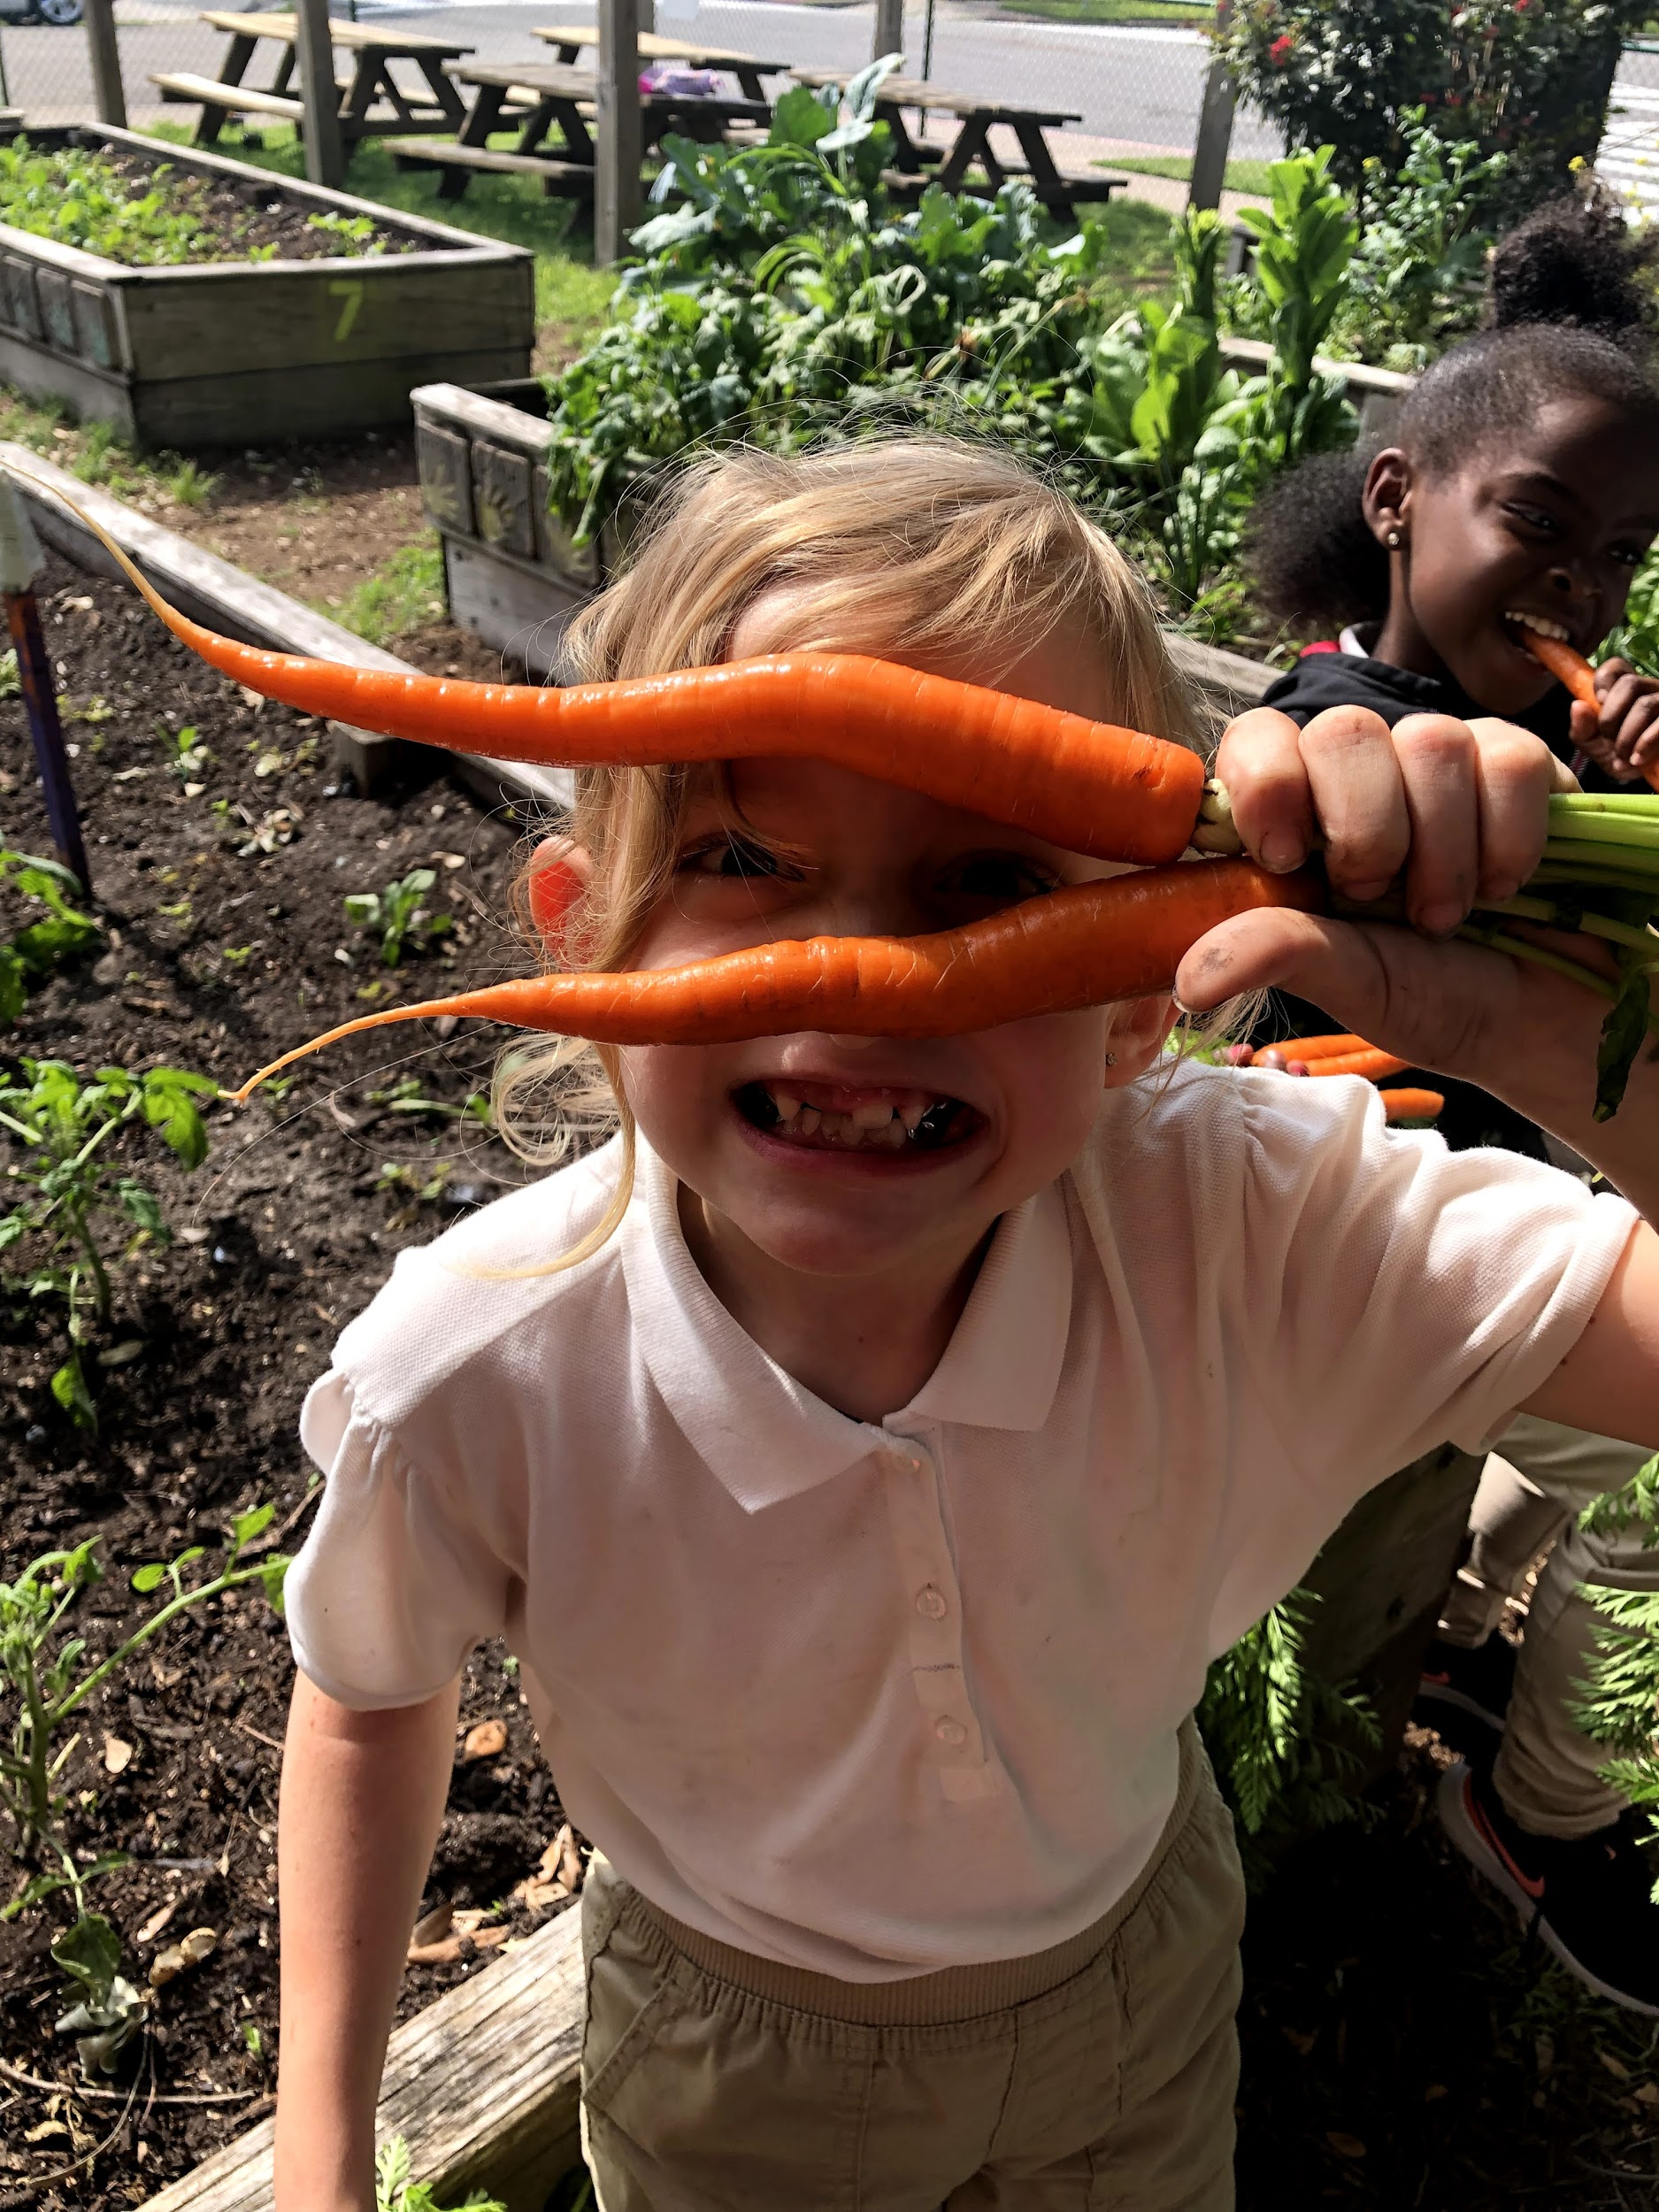

Slide 10
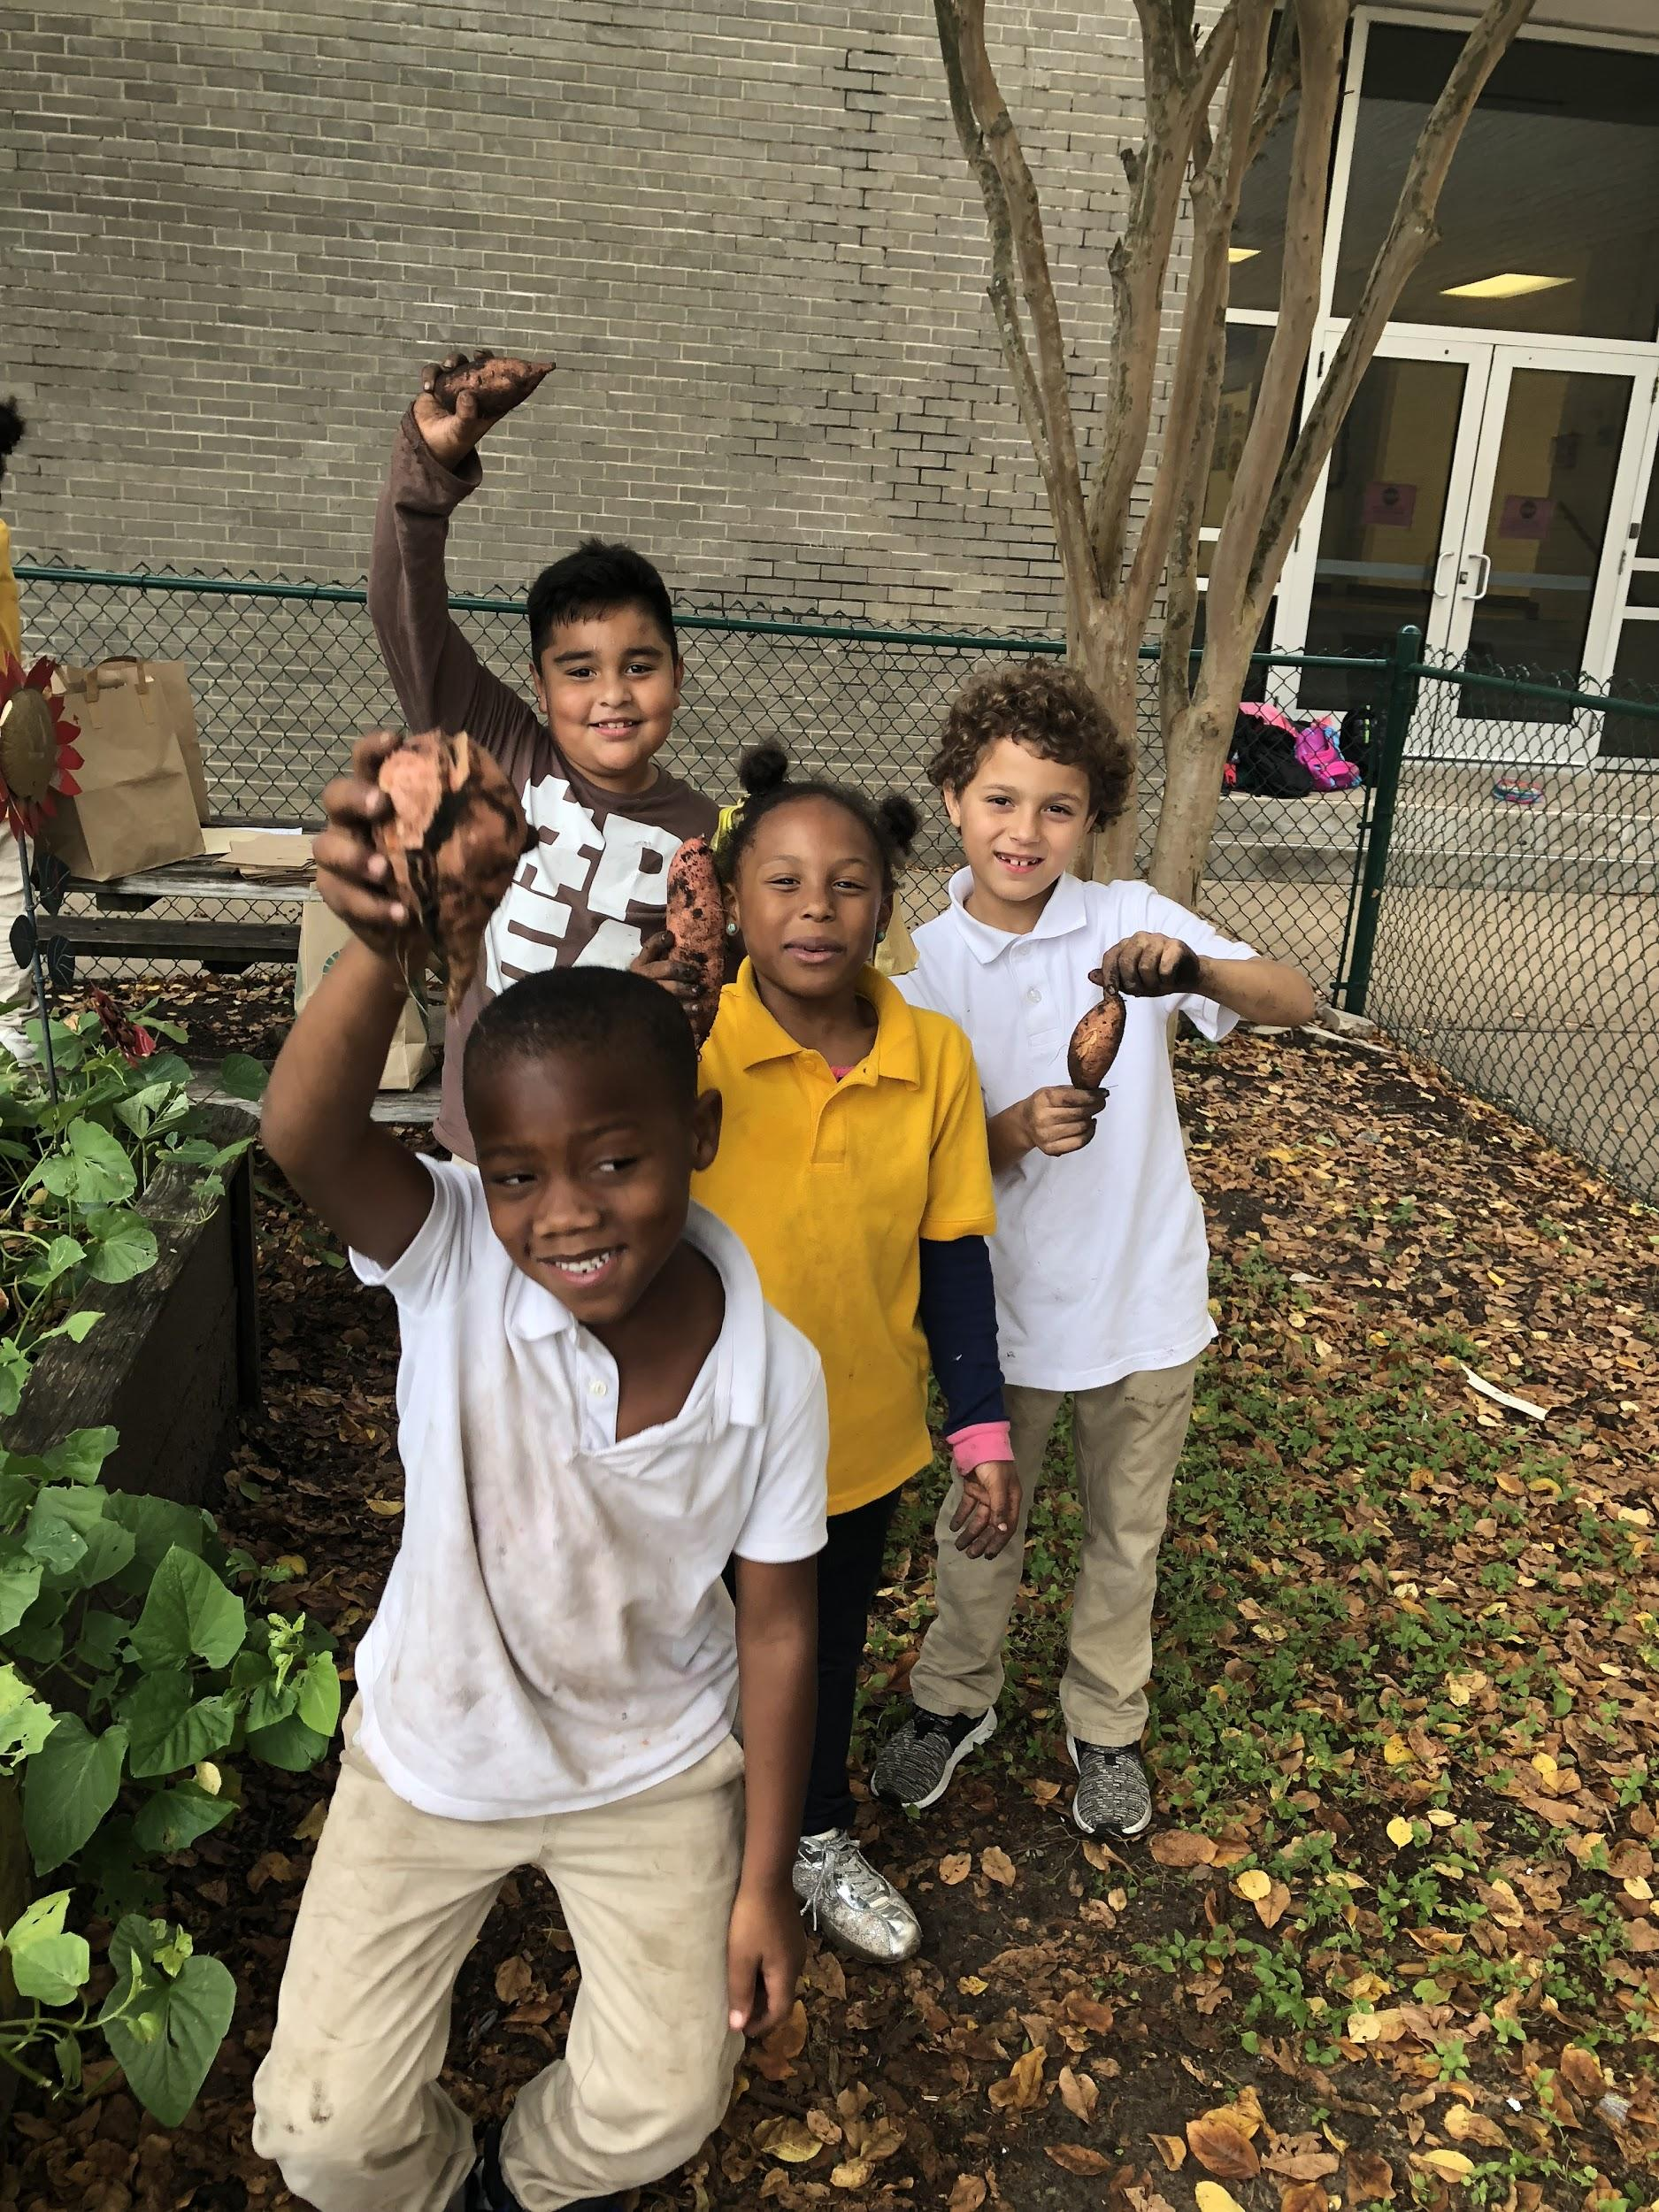

Slide 11
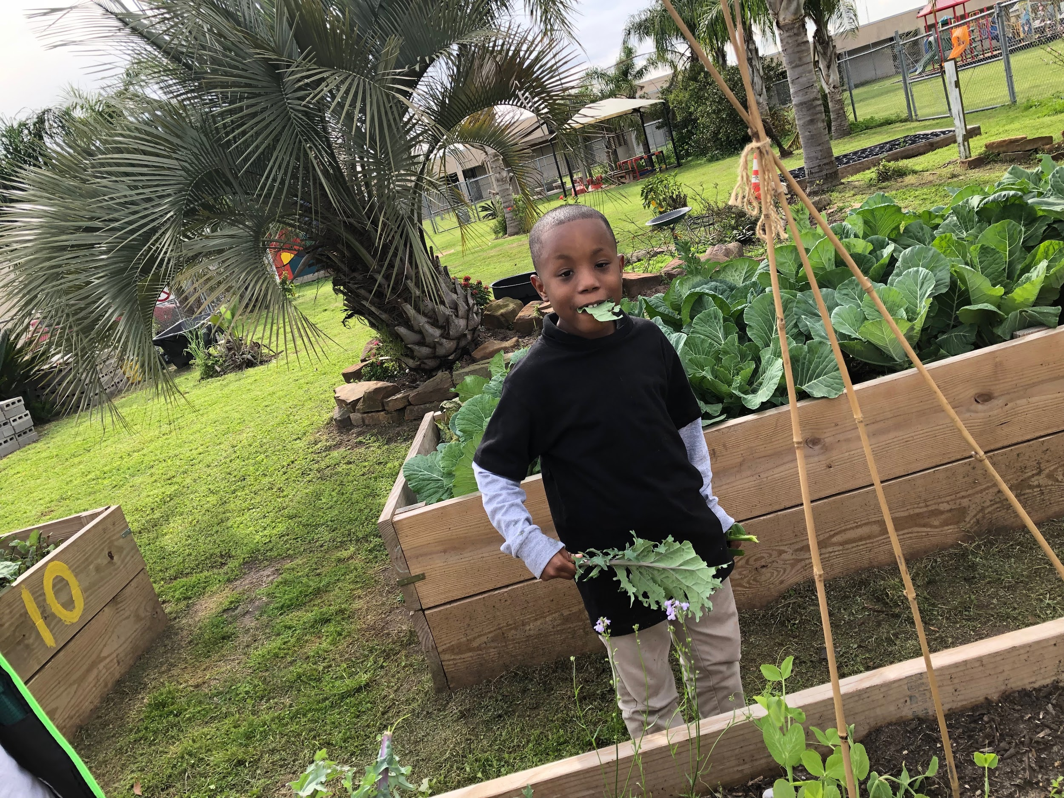

Slide 12
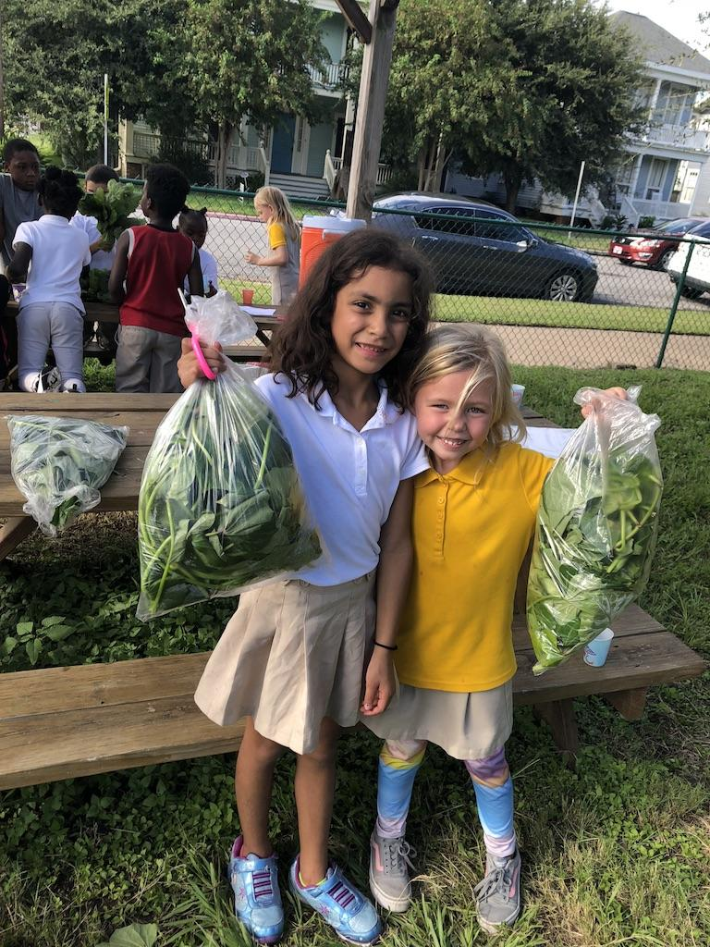

Slide 13
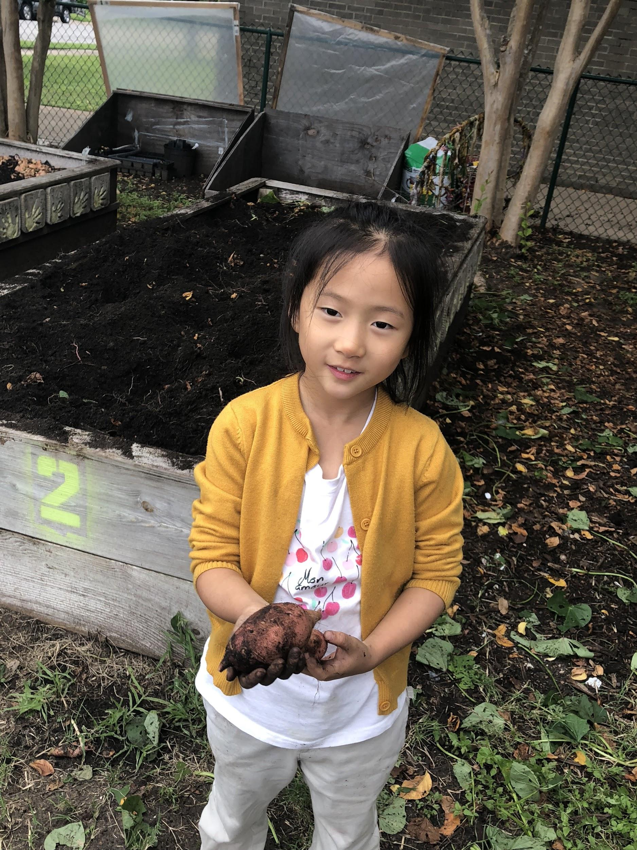

Slide 14
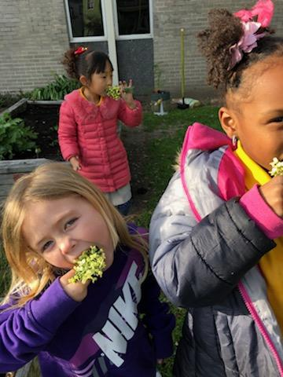

Slide 15
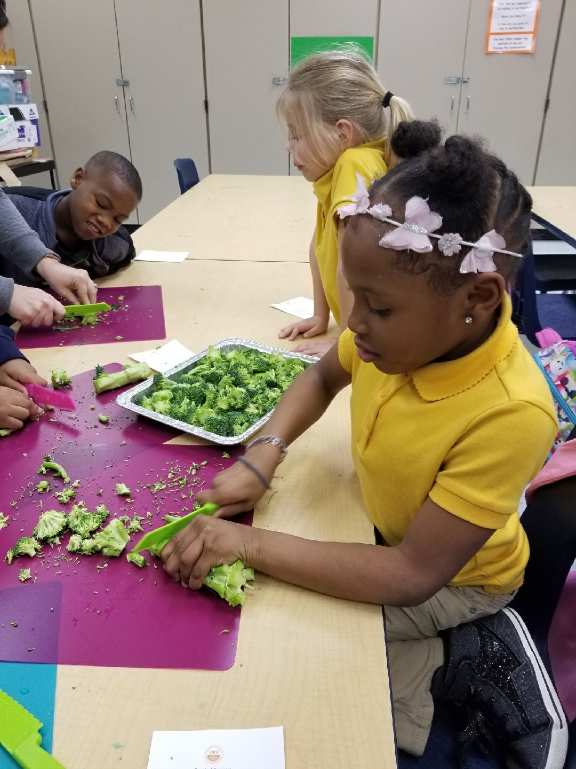

Slide 16
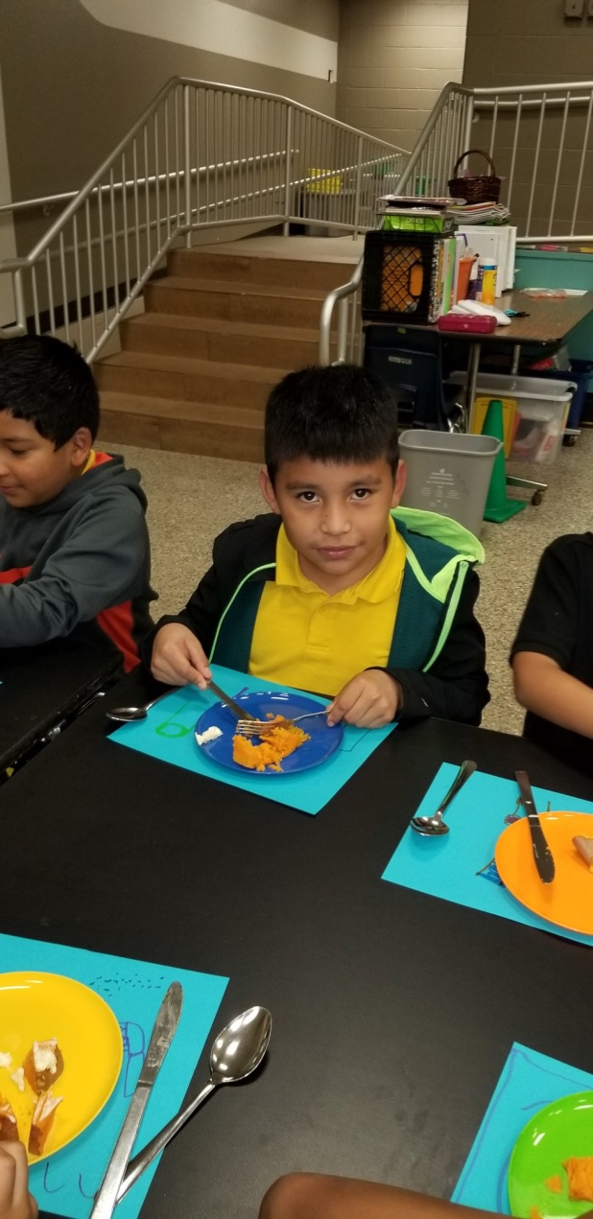

Slide 17
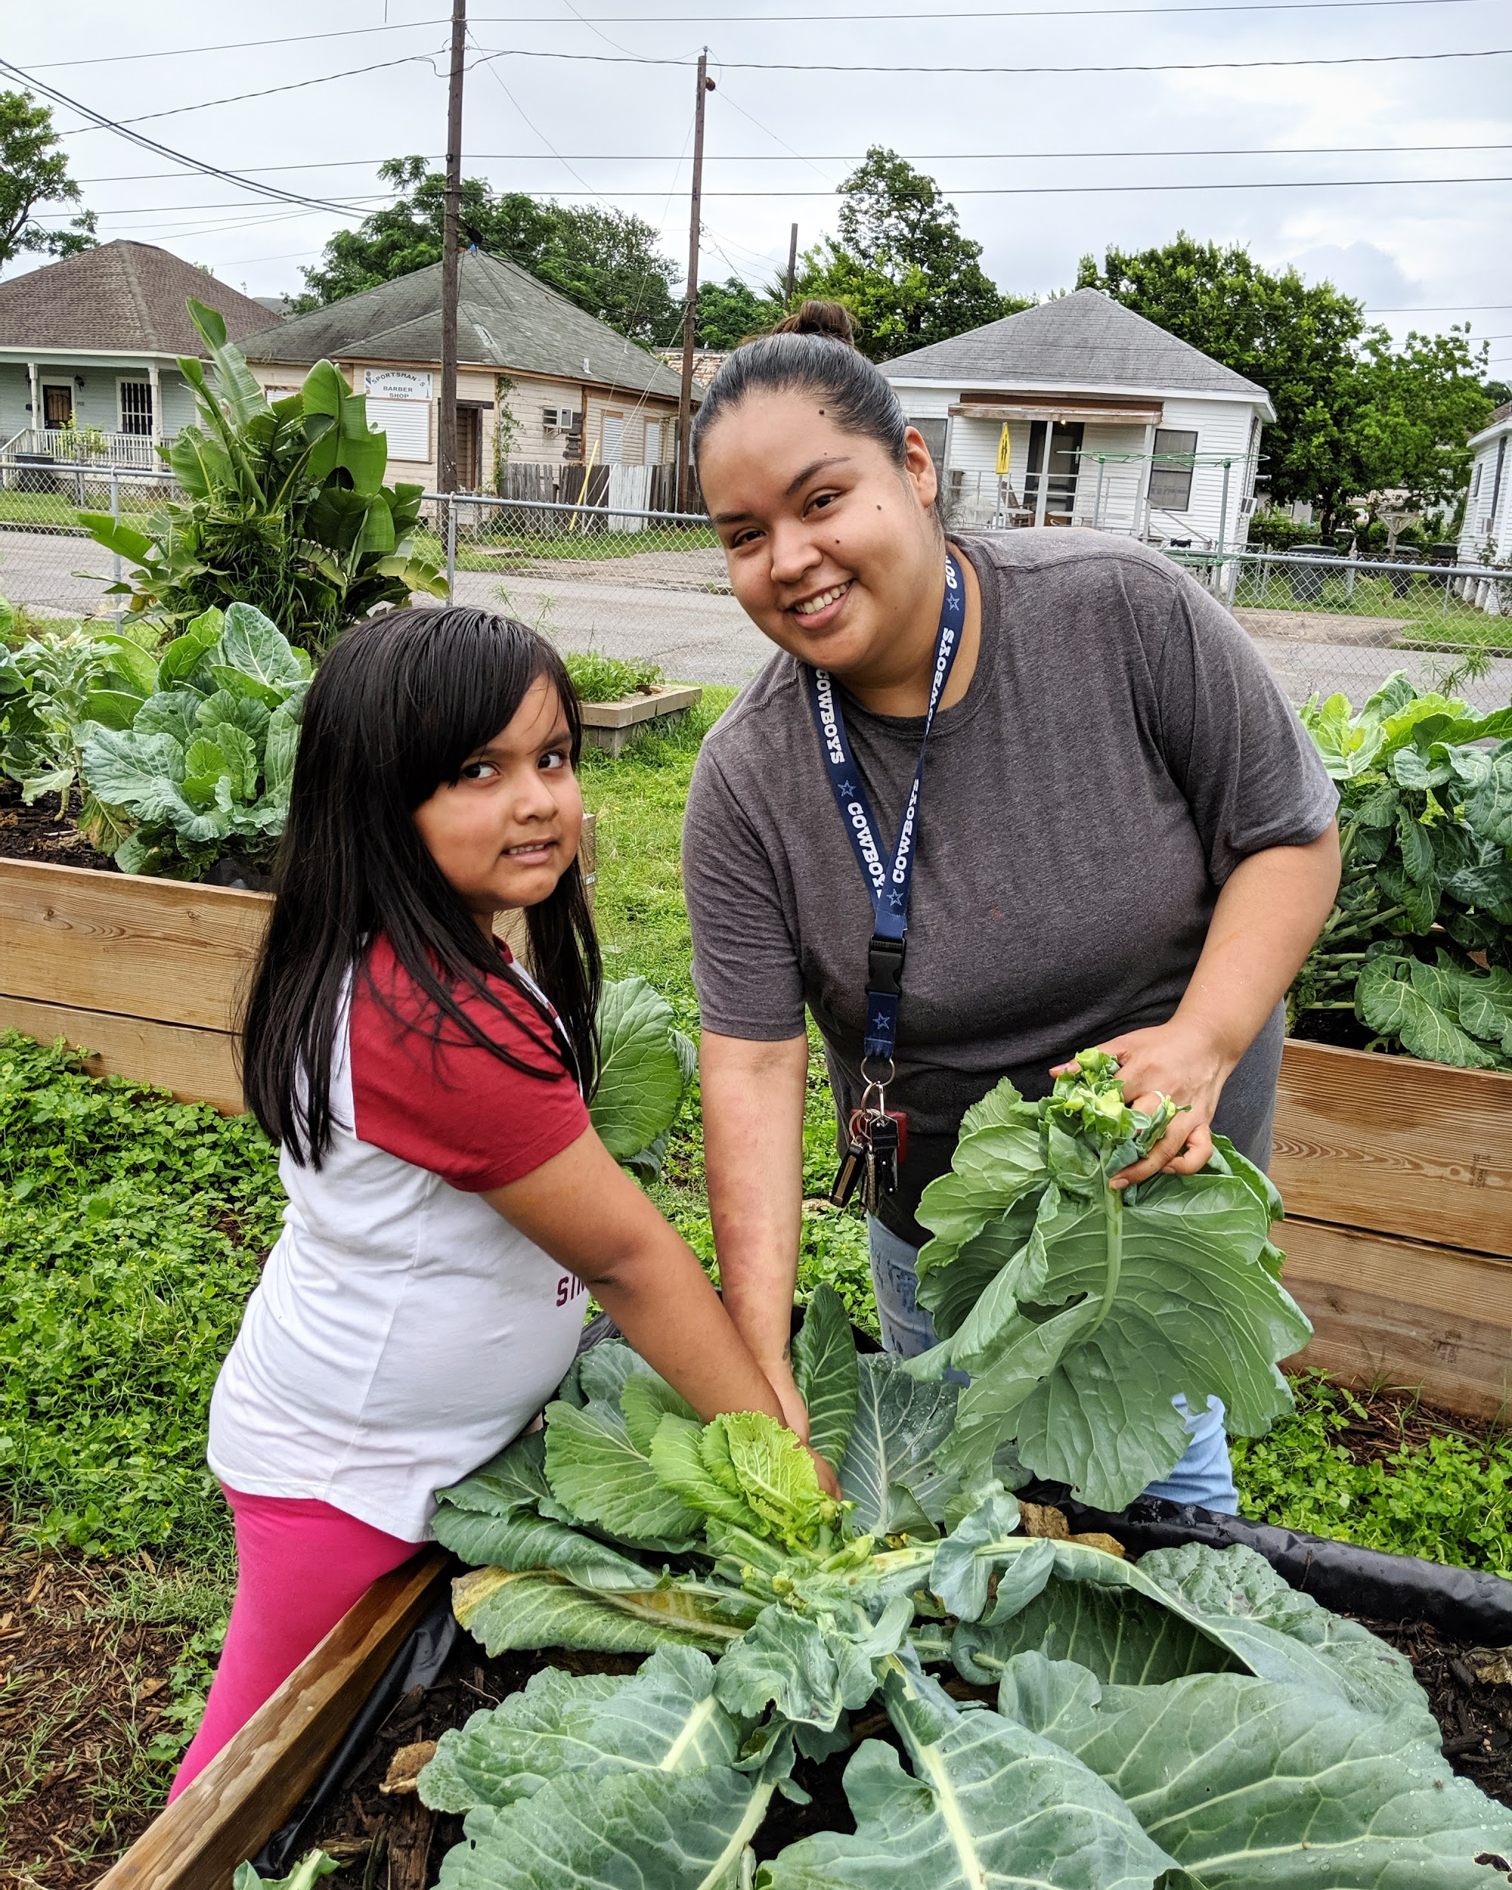

Slide 18
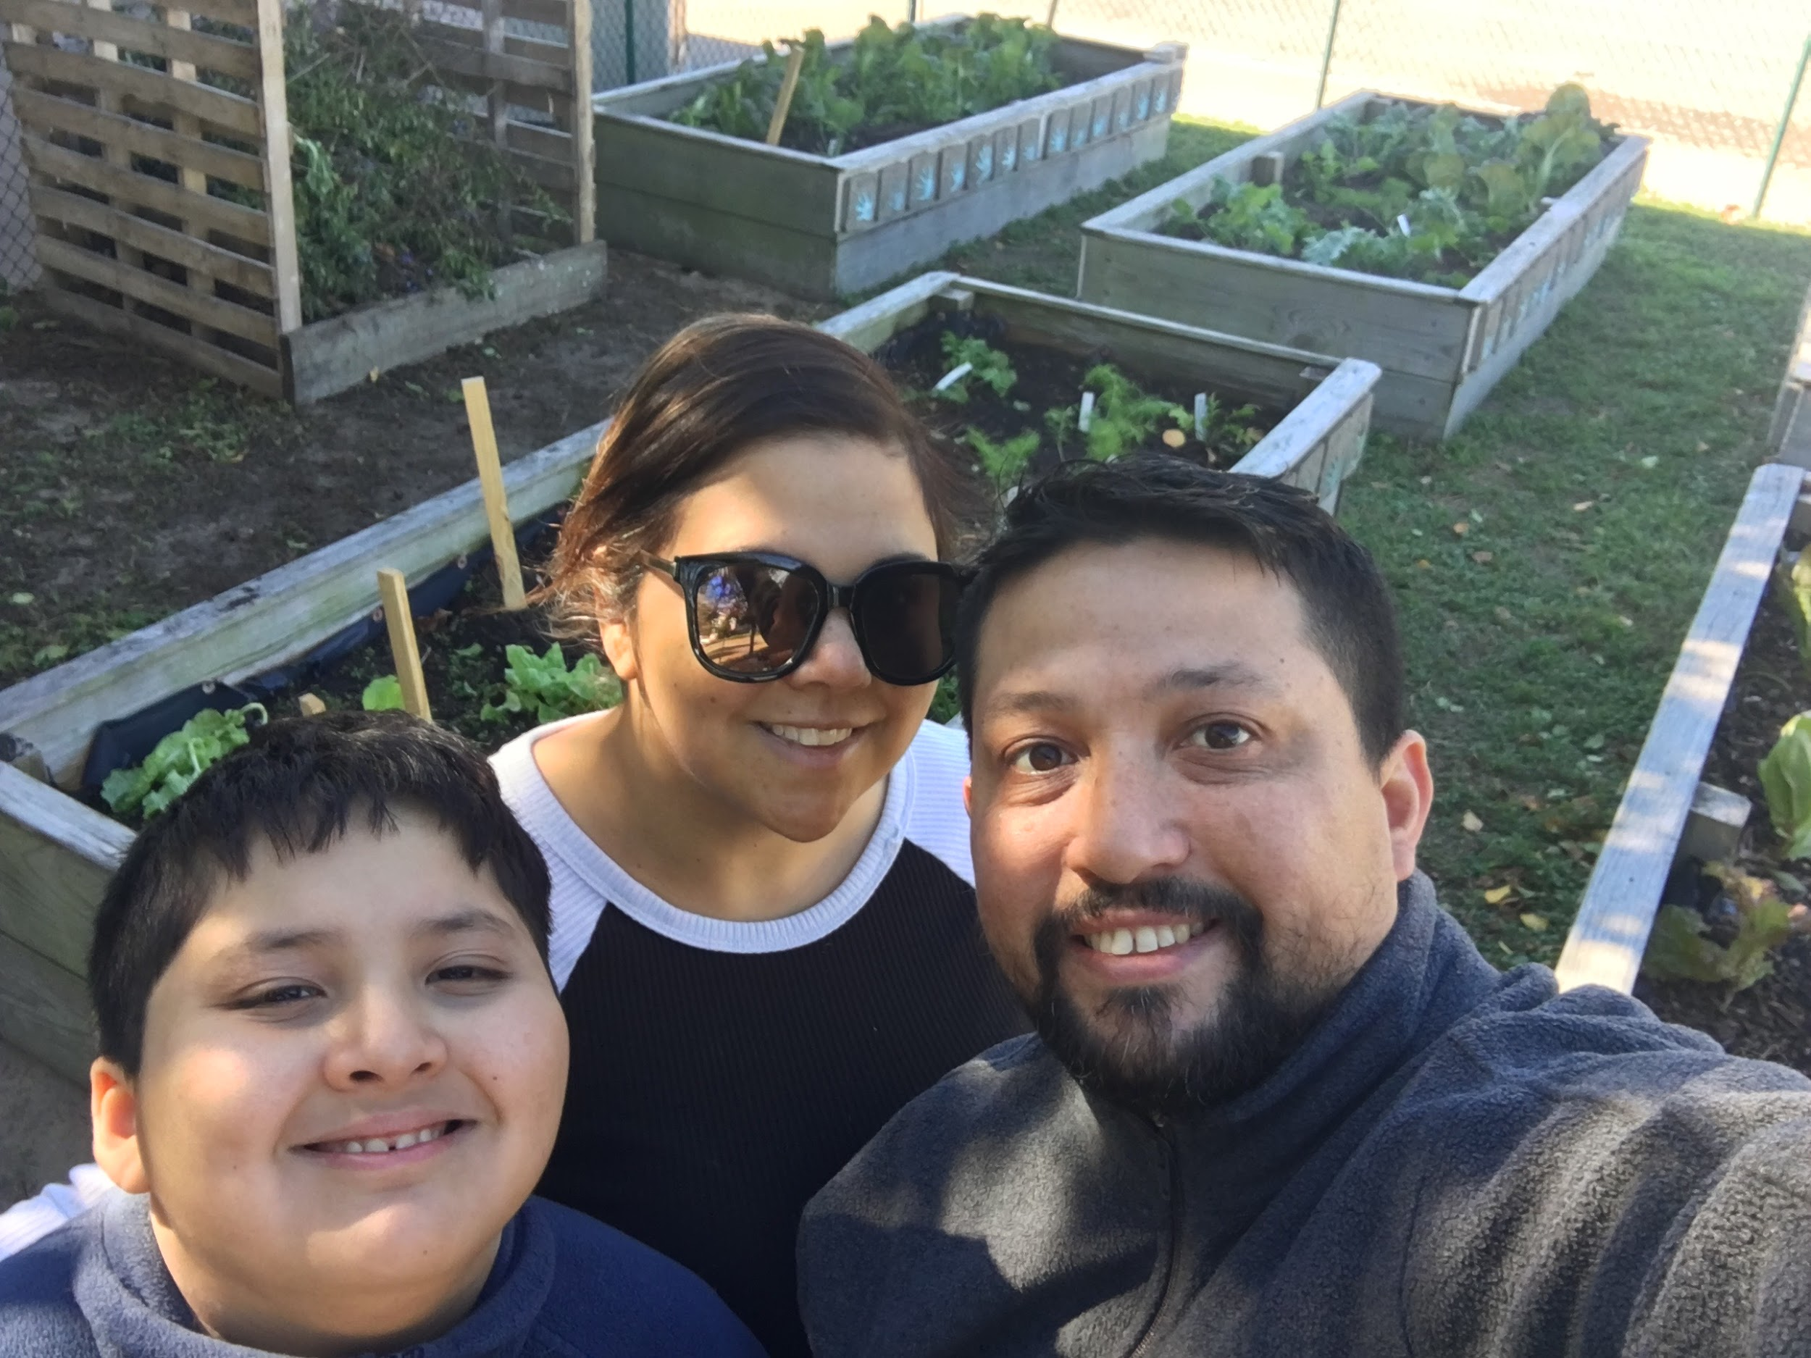

Slide 19
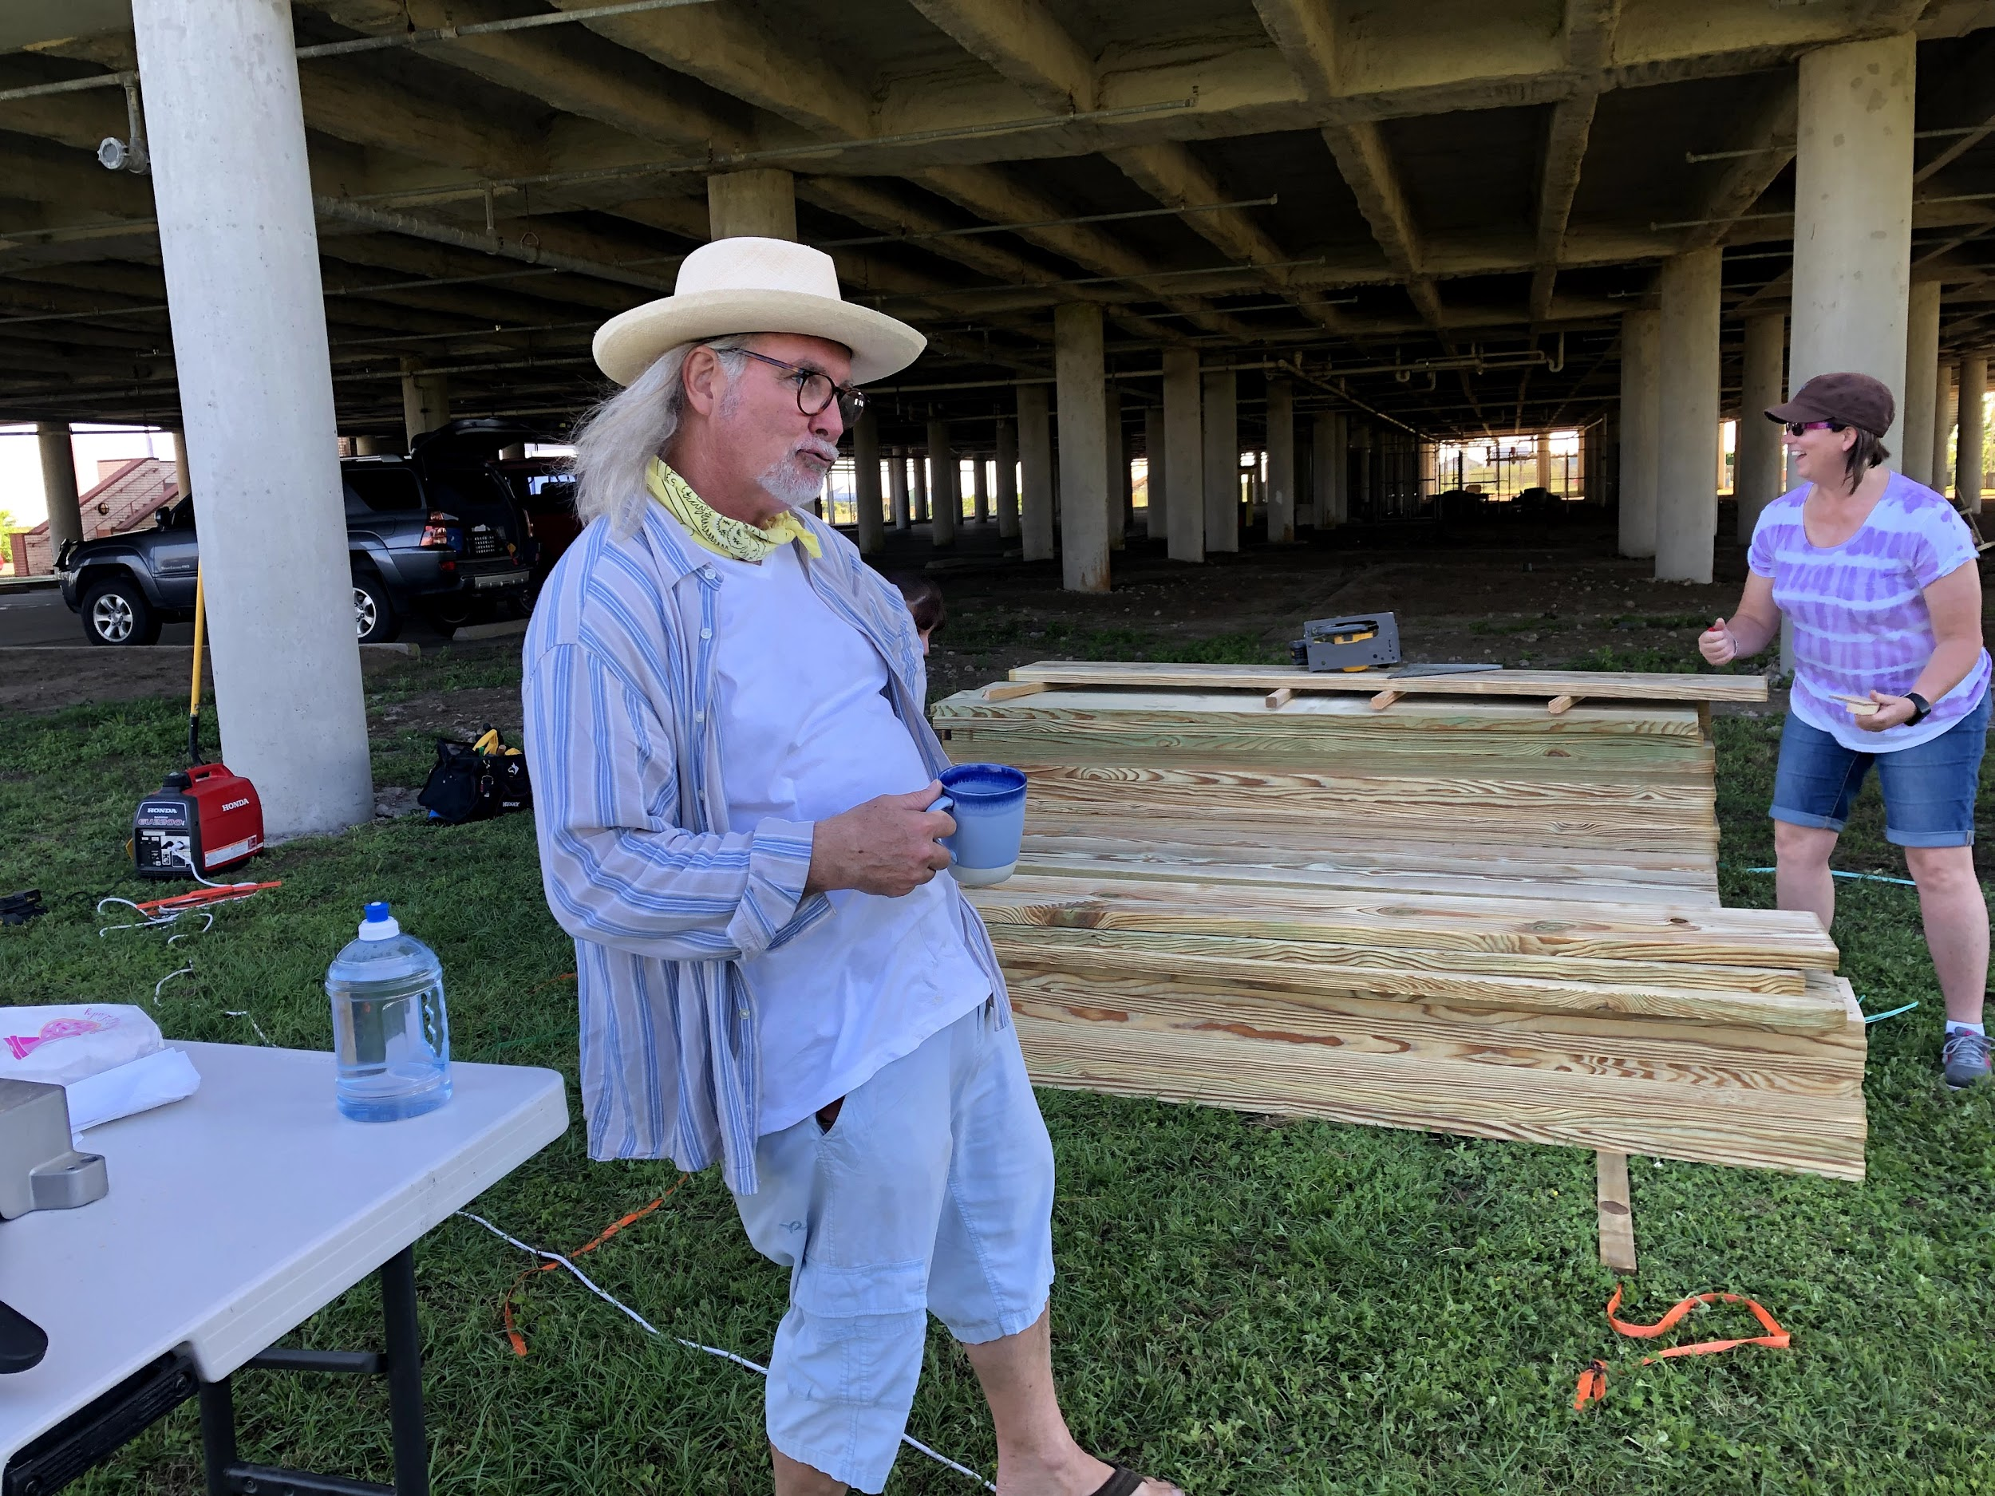
Notes:
Wayne the Coffee Guy

Slide 20
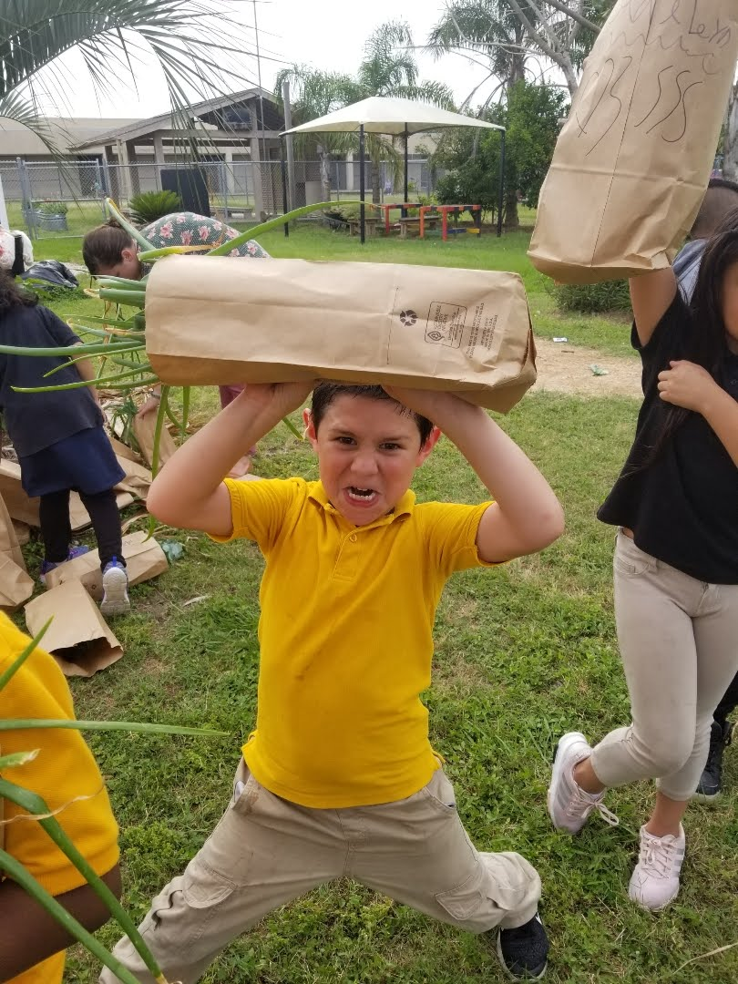

Slide 21
How to Build a Sustainable Garden
Notes:
Denise - Talk about what it means to have a sustainable garden. 1) A garden that is not just the project of one teacher for one year 2) a garden that remains in action for years to come 3) programming that remains in tact for many years

Slide 22
Find a leader who is passionate, excited, and committed!
Notes:
Nan’s story. Nan discusses communicating not just with a teacher but others in the school/district who have decision making capability. It is very important to have a good relationship with the facilities people.

Slide 23
Put together a team that is made up of your leader, parents, and community members and someone with vegetable gardening experience.
Notes:
Denise talks about the importance of support of all stakeholders and the importance of having a regular person in charge of garden plans and garden tasks.

Slide 24
Make a plan for getting Volunteers

Slide 25
Schedule a a future one on one session with us.

