Slide 1

Youth Horticulture Education Program:
Promoting Plant Science Education in Southern Nevada

Slide 2
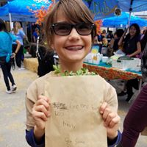
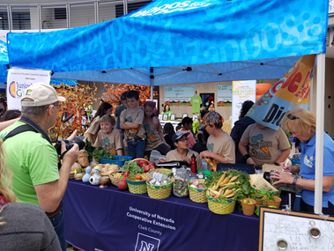
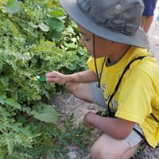
Agenda
Introduction
GBL of Time Passed
YHEP’s New Strategy for Success Today
Put strategy into action!
The Blackberries- Junior Master Gardener Group at the Student Farmers Market at Zappos.
TBP Spring 2020
Notes:
Who will speak?

Slide 3
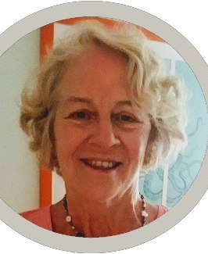
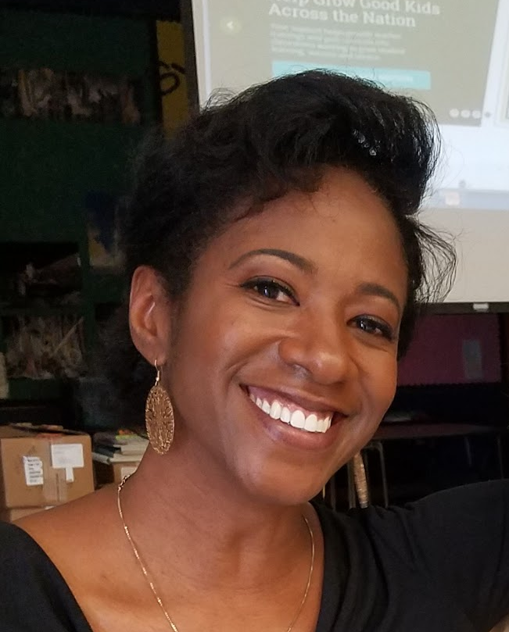
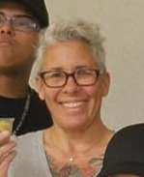
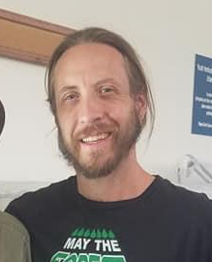
Meet YHEP Faculty & Staff
Angela O’Callaghan, Ph.D.
Social Horticulture Specialist, Associate Professor
Tricia Braxton Perry, M.A.
Youth Horticulture Education
Program Manager
Nicole Hansen Community-based Instructor III
Focus Area: JMG
Ian Ford-Terry
Community-based Instructor III
Focus Area: Career Readiness

Slide 4
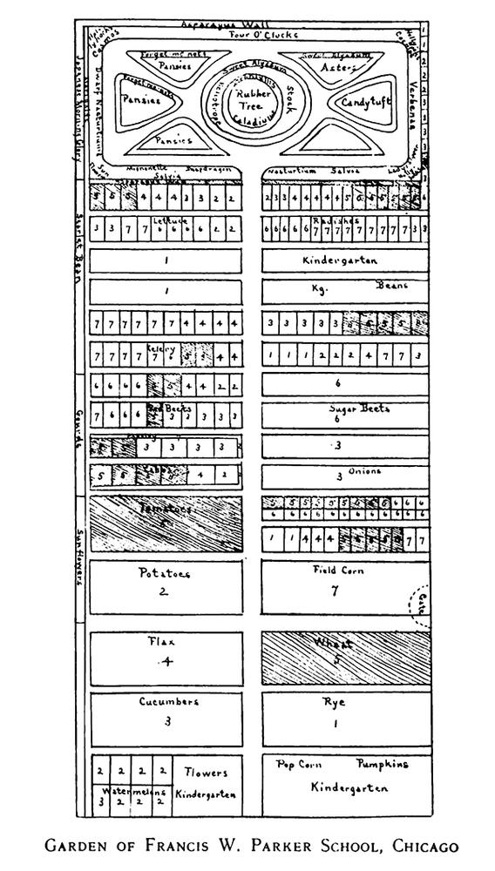
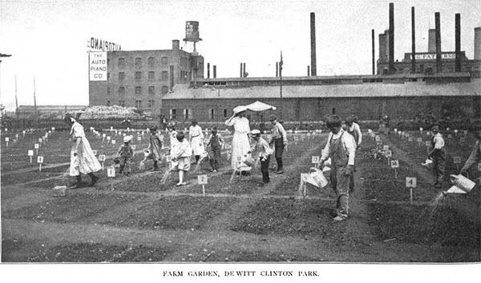
School Gardens of Time Passed
With smokestacks in the background, children water their plots at DeWitt Clinton Park in New York City, c. 1906
https://communityofgardens.si.edu/exhibits/show/historycommunitygardens/schoolgardens
Plans for a school garden in Chicago, c. 1911. The orderly design of children’s gardens was intended to promote efficiency and individual responsibility. From Among School Gardens, 1911.
Notes:
One of the earliest school garden programs in the United States was developed in 1891, at the George Putnam School in Roxbury, Massachusetts. (Today, the nationally recognized Food Project also teaches youth about gardening and urban agriculture in the Roxbury neighborhood of Boston) http://ucfoodobserver.com/2015/05/06/a-history-of-school-gardens-and-how-the-model-is-getting-a-boost-today-from-food-corps/

Slide 5
UNR- Extension School Gardens Program 1998 to mid 2017
1998 The Junior Master Gardener Curriculum (JMG), created by Texas A&M University brought to Cooperative Extension. One JMG chapter per semester is delivered.
2000 Angela O’Callaghan, Ph.D. surveys CCSD schools to garden activity and begins a formal School Gardens program for Cooperative Extension.
2005 Peer Reviewed Journal Article is published! Creating A School Gardens Program In The Challenging Environment Of Las Vegas, Nevada, O’Callaghan, A.M. HortTechnology, 2005, Vol.15(3), pp.429-433
2003- 2017 JMG curriculum is taught in cycles of one JMG club per two year period.

Slide 6

Photo:SethChernoff.com

Slide 7
Build from past achievement
Develop new ideas!
&

Slide 8
Activity Time!
Your programs past performance!
      Using bullet points, write a list of three to five past accomplishments of your program

Slide 9
Move forward!
2017 Dr. O’Callaghan brings Tricia Braxton Perry, Program Manager III onboard to enhance garden-based learning efforts for larger youth audience.
Youth Horticulture Education Program becomes the formal name of youth efforts. Youth projects are formally identified and logic model is created
Roger Olsen, Nicole Hansen & Ian Ford- Terry join Tricia to form TEAM YHEP!
Team YHEP expands when a handful of Master Gardeners join Team YHEP and are referred to as Volunteer Champions

Slide 10
Create a STRATEGIC PLAN
A six step approach:
Clarify vision
Formulate strategy
Team Diversity
Implement
Evaluate
Modify and amplify

Slide 11
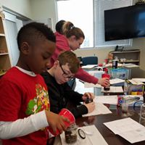
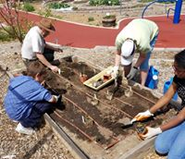
Clarify Vision
To empower youth and their families to embrace the science of plant cultivation and management!
JMG curricula in action!!
The Mojave Kids- Junior Master Gardener group learn about micronutrients before planting.
Notes:
Roger-

Slide 12
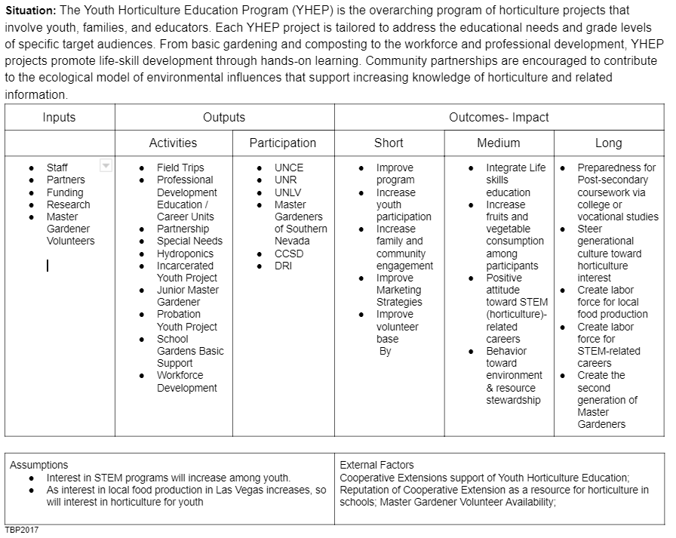
Formulate Strategy

Slide 13
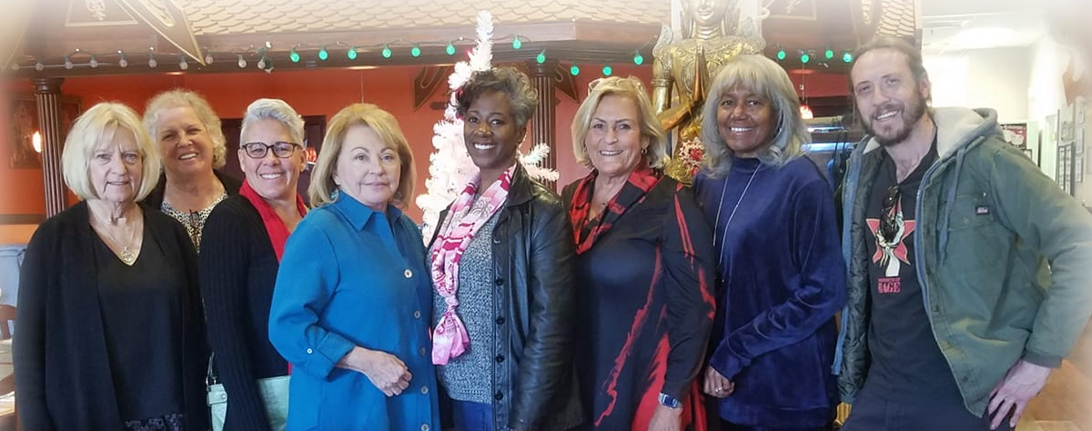
Team Diversity
Team YHEP

Slide 14
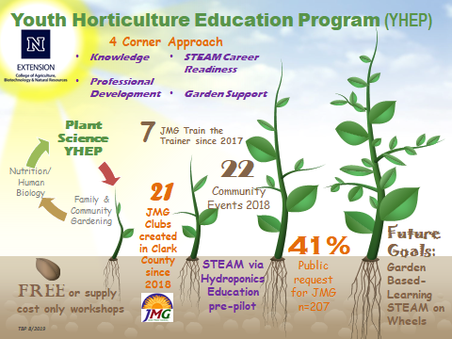
Implement

Slide 15
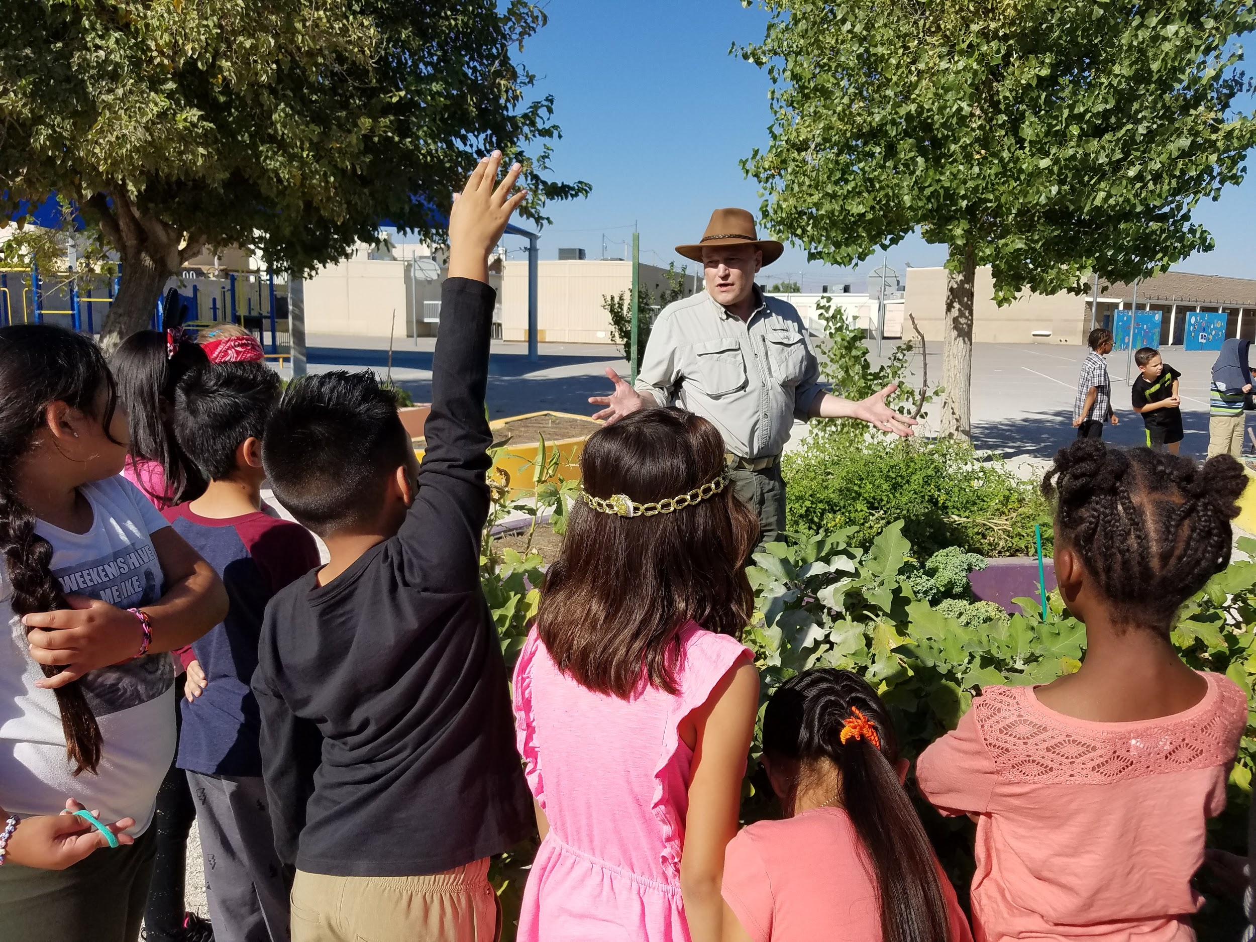
YHEP 4 Corner Approach!
Knowledge Development
Professional Development
STEAM Career Readiness
Garden Support
MG Roger Olson teaching about vegetables at Long Elementary.
http://www.rasmussen.edu/degrees/education/blog/gardening-for-kids-benefits/

Slide 16

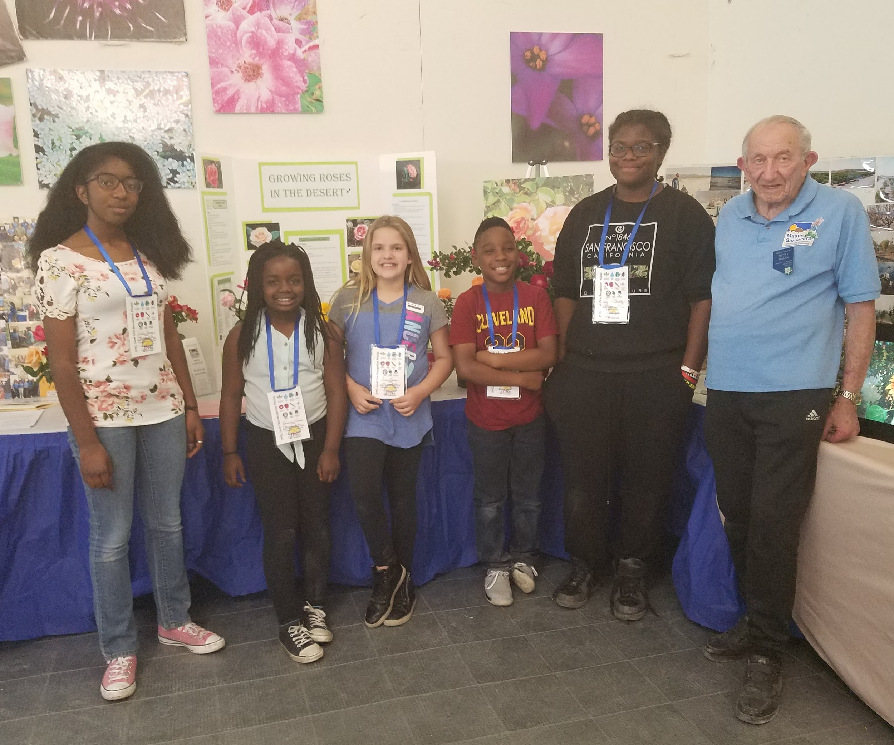
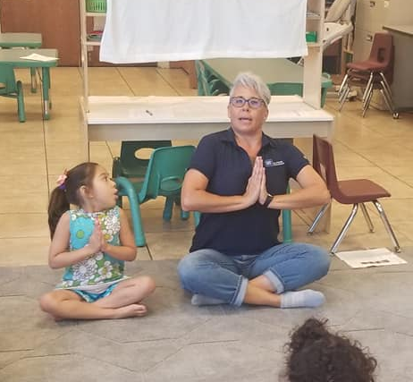
YHEP Knowledge Development
http://jmgkids.us/

Slide 17
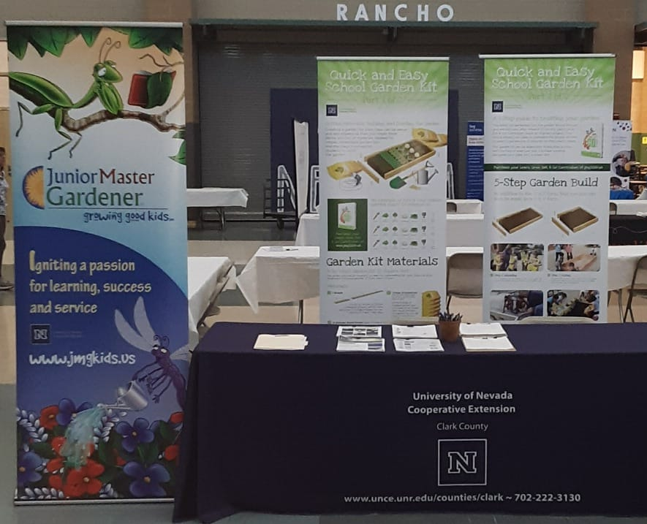
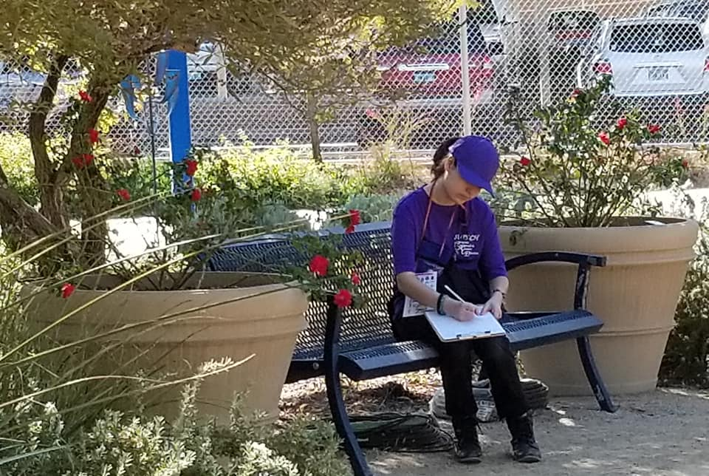
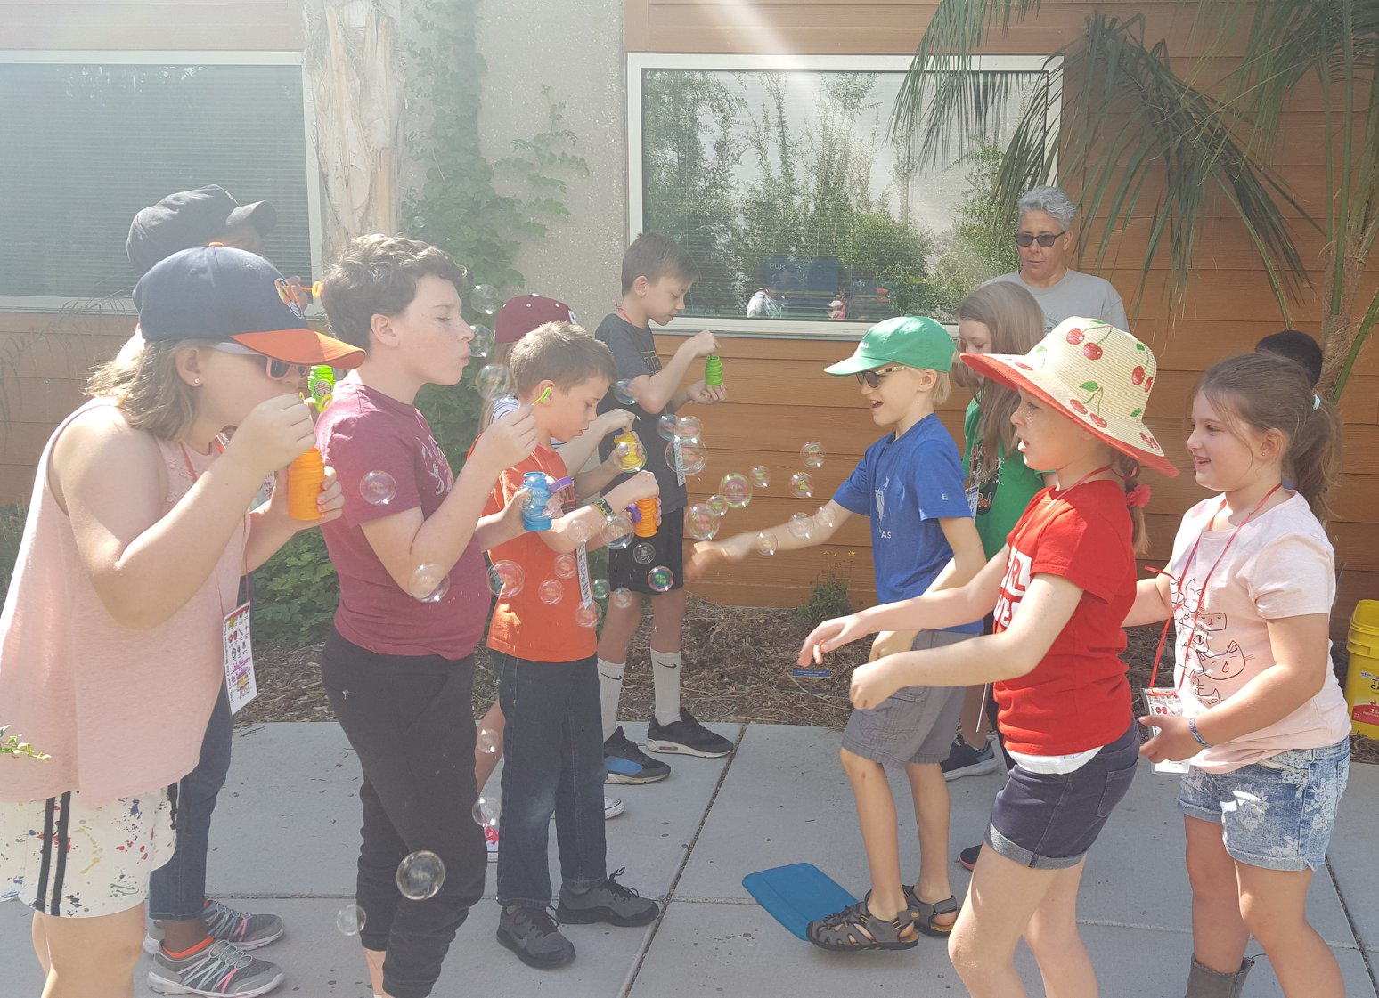
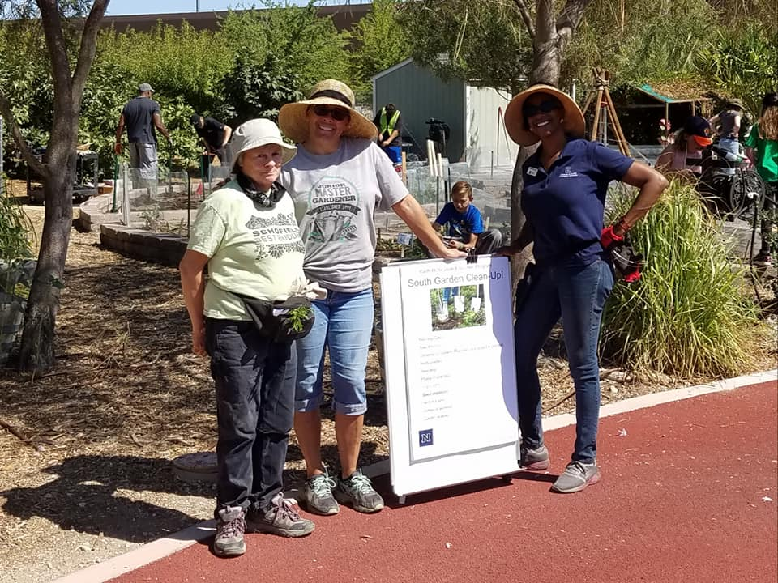
Can you name the JMG activity/lesson in three of the photos?
Notes:
Roger-

Slide 18
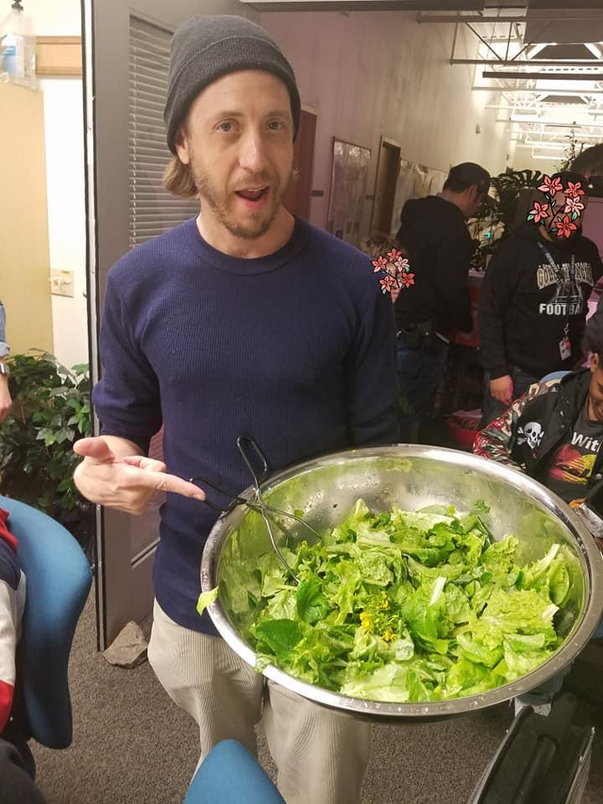
YHEP STEAM Career Readiness
Using Hydroponics to address science, technology, engineering, arts and math!
Training for Jobs of the Future- Global Impact!
Audience: DJJS, High School, Special Needs
Notes:
Tricia and Karyn- One or two sentences

Slide 19
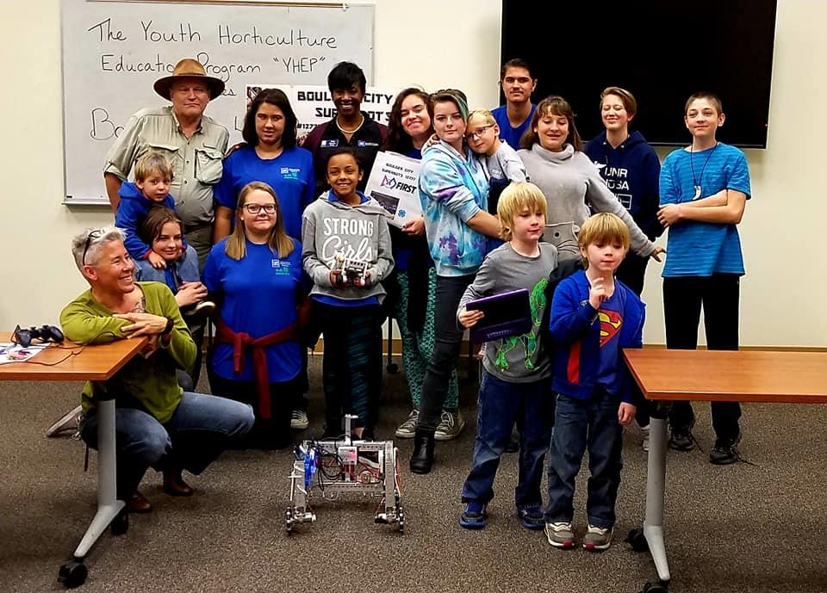
YHEP Professional Development
TBP Fall 2019

Slide 20
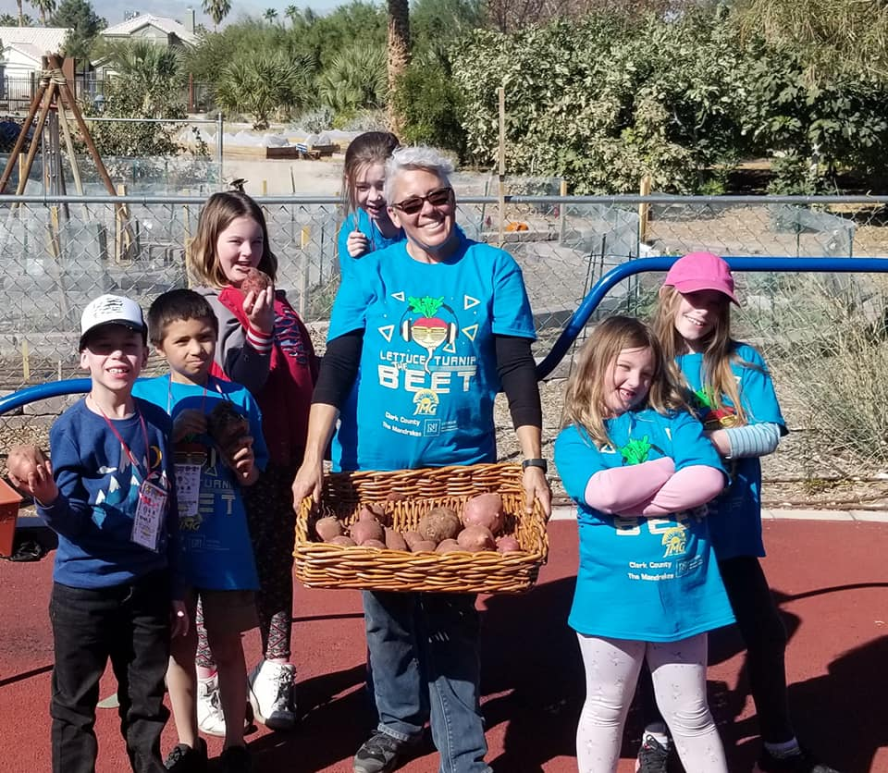
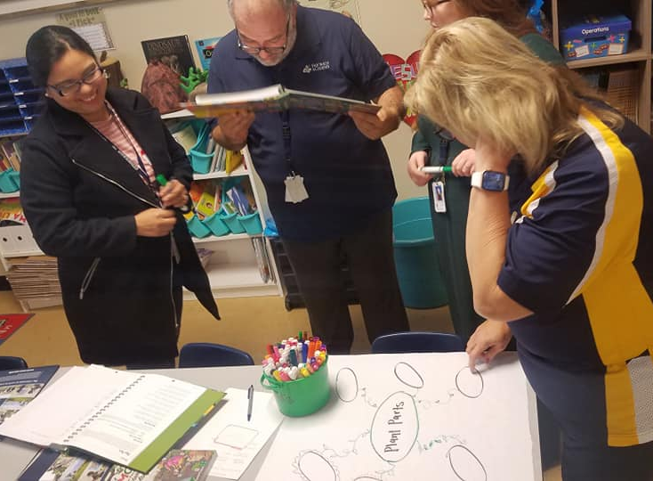
JMG Train-the-trainer teacher workshops are recognized by the Clark County School District. Teachers earn contact units for the 3hr. sessions
Wearing JMG apparel is a great way to show support for garden-based learning.

Slide 21
YHEP Garden Support
Guidance offered for planter bed placement, literature about gardening in the Mojave
Planting and harvesting guidance, seeds (if available)
Garden-based learning organizational methods and best practices
JMG administrative support
Field trips to the Botanical Garden at the University of Nevada Cooperative Extension
Support tailored to each learning environment

Slide 22
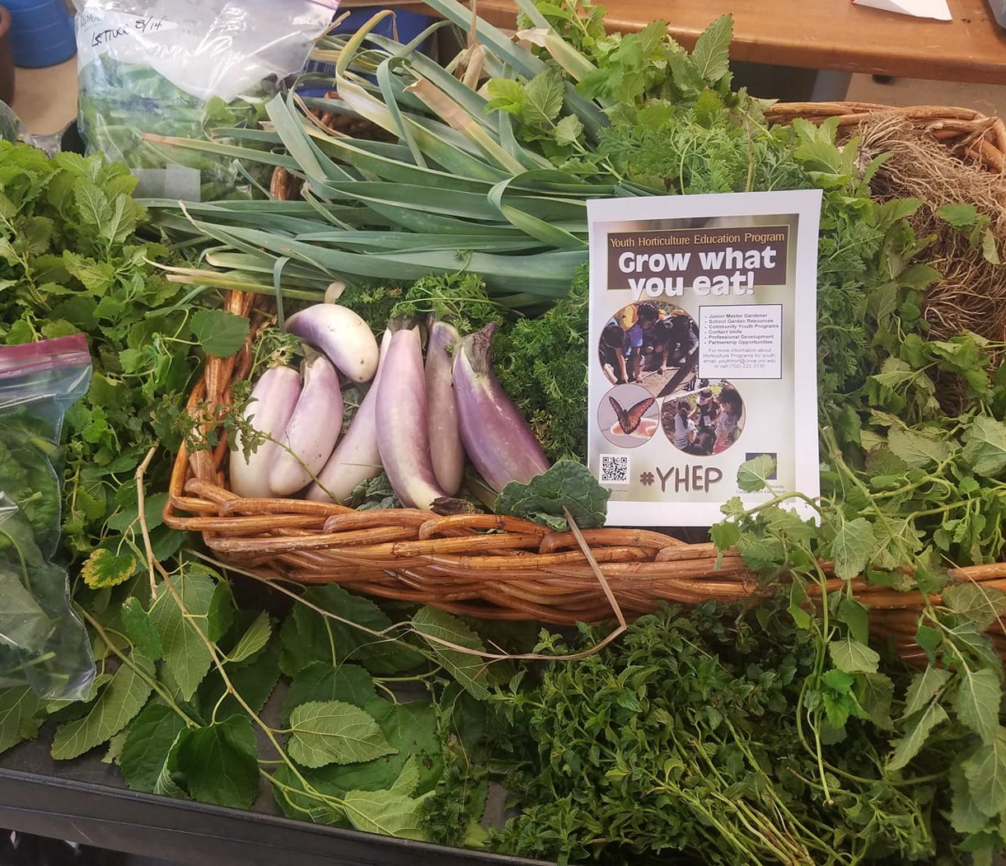
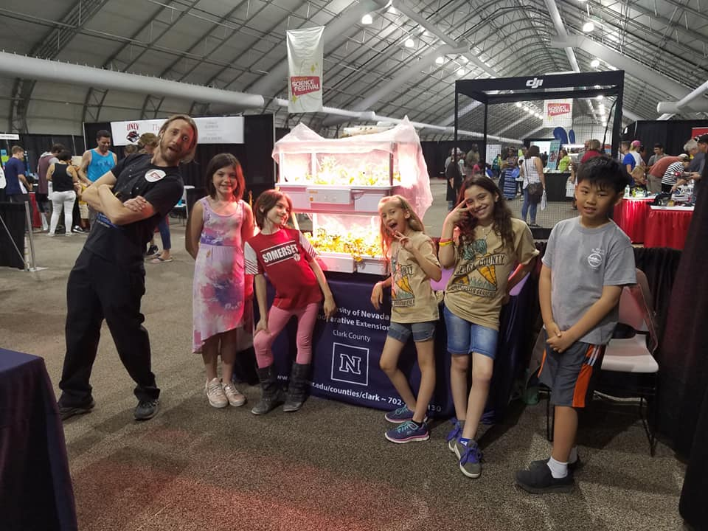
YHEP participants proudly donate a large portion of their garden harvest to food banks in Clark County!

Slide 23
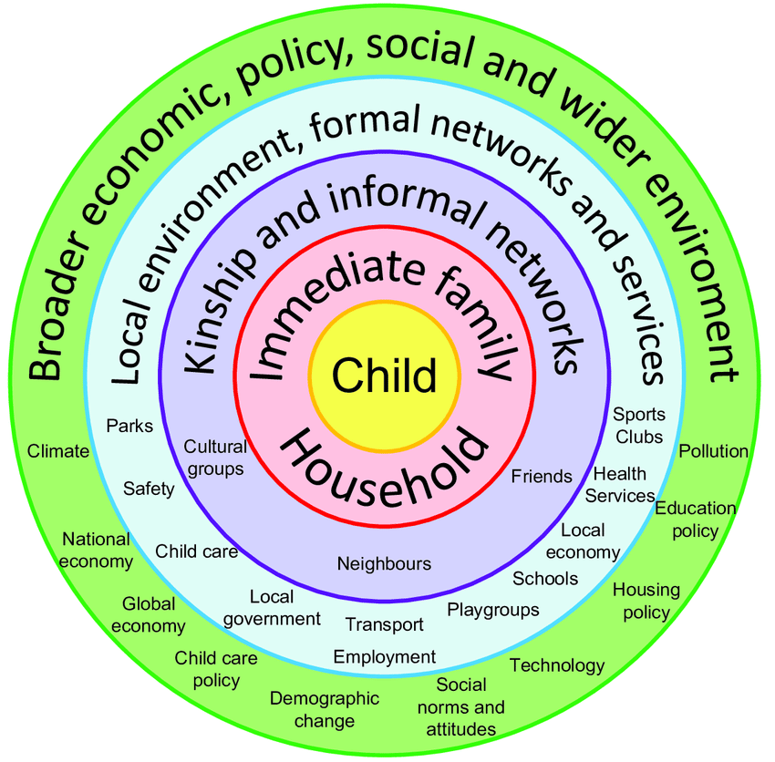


YHEP Ecological Model of Choice!
Every aspect of the ecological model can by actualized intentionally!
Bronfenbrenner's ecological model. Diagram by Joel Gibbs based on Bronfenbrenner's (1979) ecological model. Source: Researchgate.net Uploaded by Kathryn Scott

Slide 24
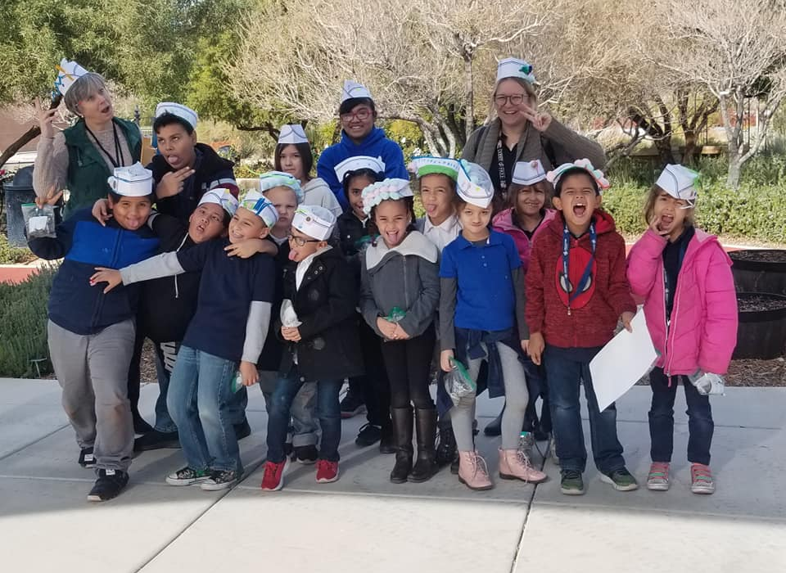
Evaluate
“I am thrilled to be able to work with the staff at YHEP in Las Vegas. They are the hardest working, most devoted, and knowledgeable leaders I could ever imagine. They spend so much time planning and preparing for every event and it always is a success. The only criticism is that there are not enough of them. The demand is there. We have a tremendous need in Southern Nevada for horticulture education for our kids. We need to grow this department. There is tremendous demand and it is essential that these young people have the kind of instruction that they get from our YHEP group at UNR of Southern Nevada.”
“The JMG program has been a wonderful learning experience for my Kindergarten students. They have learned so much about plants and water and soils. They have gone from "never dirty divas" to " dirt lovers!" It has been a great transition for them and it has worked cross curricular as well.”
“Always enjoy our visits to the garden. The staff is always kind and professional. I like that they take the time to ensure all of our students get to participate in the lesson and give them ample opportunities to learn and work hands on in the garden.”

Slide 25
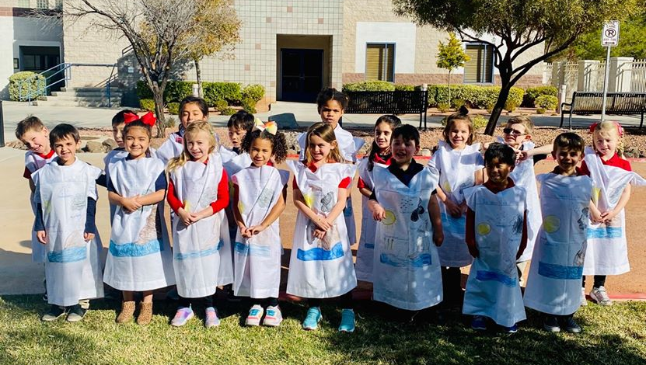
Facebook Post by the Henderson International School-
“The JMGP or Junior Master Gardening Program is an international youth gardening program created and managed by Texas A&M Cooperative extension. Here in NV it was introduced by our own land grant university, University of NV Reno Cooperative Extension. Through their local Youth Horticulture Education Program, they reach out to schools and share the curriculum which not only aligns with our science standards but also encourages a love of gardening and appreciation for the environment.”
Unsolicited social media comments can serve as a type of informal evaluation!!

Slide 26
Activity Time!
Create a logic model
      Identify your program
      Define your purpose
      Inputs- I.D. stakeholders
      Outputs- Activities and participation
      Outcomes-Short, medium, long term goals
      Assumptions- What must be in place for goals to be accomplished?
      External Factors- Potential or real barriers to overcome

Slide 27




Social Media
https://www.facebook.com/YHEPClarkCounty/
https://www.instagram.com/YHEPClarkCounty/
https://twitter.com/YHEPClarkCounty
Notes:
Ronnie

Slide 28
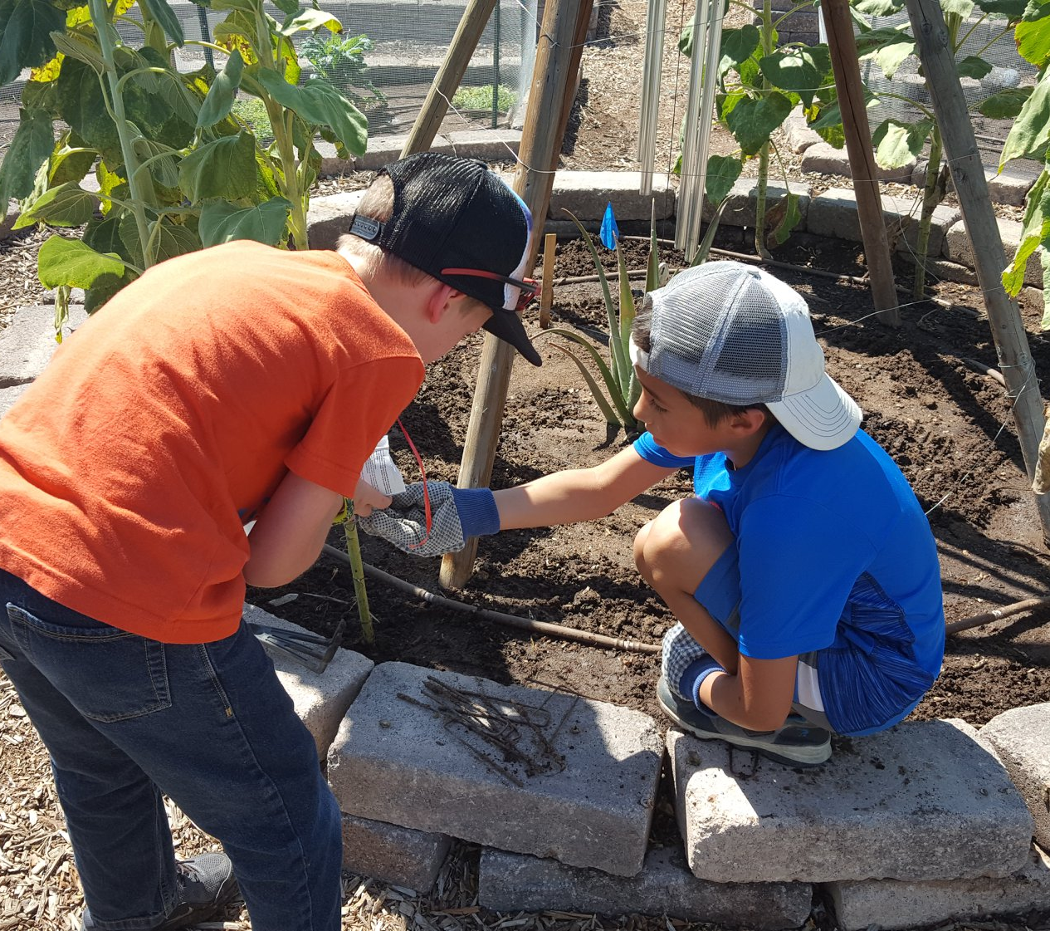
Questions?
TBP Fall 2019

